Slide 1
Logistic Binary CE and Cross Entropy Losses
Pablo Ruiz

Slide 2
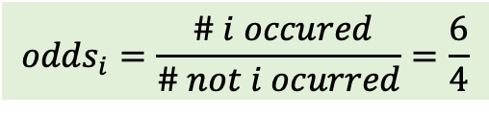
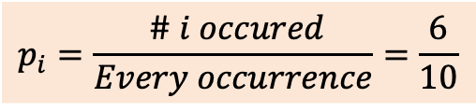
Log-odds and Logistic Regression
$$p_{i}=\frac{ \# i occured}{Every occurrence}=\frac{6}{10}$$
$${odds}_{i}=\frac{ \# i occured}{\# not i ocurred}=\frac{6}{4}$$

Slide 3








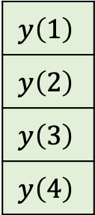

Dataset
X
W¹
z²
a²
W²
z³
$$\hat{Y}$$
Predictors
Responses
∫
$$x_{1}\left(1\right)$$
X₁
$$X_{1}$$ | $$X_{2}$$
$$Y$$
$$x_{1}\left(1\right)$$ | $$x_{2}\left(1\right)$$
$$x_{1}\left(2\right)$$ | $$x_{2}\left(2\right)$$
$$x_{1}\left(3\right)$$ | $$x_{2}\left(3\right)$$
$$x_{1}\left(4\right)$$ | $$x_{2}\left(4\right)$$
$$y\left(1\right)$$
$$y\left(2\right)$$
$$y\left(3\right)$$
$$y\left(4\right)$$
∫
𝜎
$$\hat{y}\left(1\right)$$
$$L$$
$$x_{2}\left(1\right)$$
X₂
$$y\left(1\right)$$
∫

Slide 4
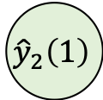

Dataset
X
W¹
z²
a²
W²
z³
$$\hat{Y}$$
Predictors
Responses
∫
$$x_{1}\left(1\right)$$
X₁
𝜎
$${\hat{y}}_{1}\left(1\right)$$
$$X_{1}$$ | $$X_{2}$$
$$Y$$
$$x_{1}\left(1\right)$$ | $$x_{2}\left(1\right)$$
$$x_{1}\left(2\right)$$ | $$x_{2}\left(2\right)$$
$$x_{1}\left(3\right)$$ | $$x_{2}\left(3\right)$$
$$x_{1}\left(4\right)$$ | $$x_{2}\left(4\right)$$
$$y\left(1\right)$$
$$y\left(2\right)$$
$$y\left(3\right)$$
$$y\left(4\right)$$
∫
$$L$$
X₂
𝜎
$${\hat{y}}_{2}\left(1\right)$$
$$x_{2}\left(1\right)$$
$$y\left(1\right)$$
∫

Slide 5

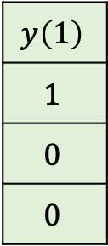


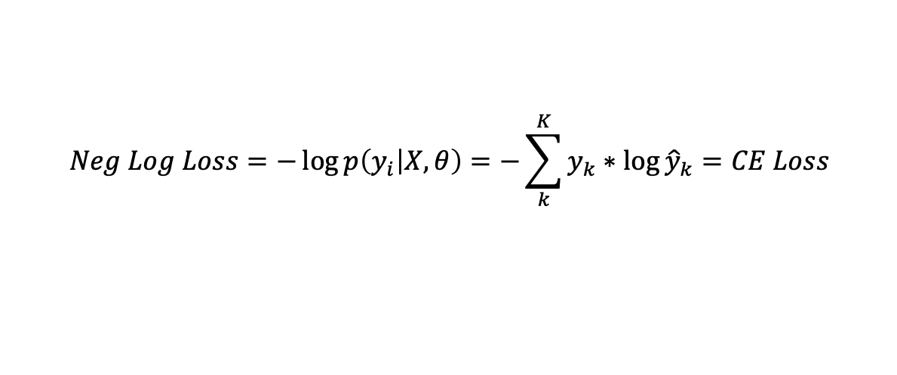

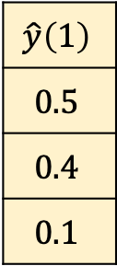


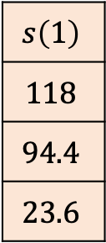






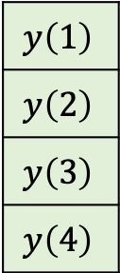

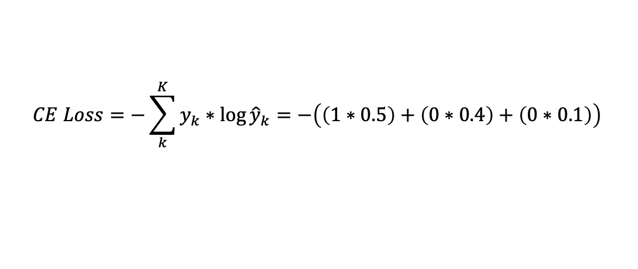
Dataset
X
W¹
z²
a²
W²
z³
$$\hat{Y}$$
Predictors
Responses
∫
SOFTMAX
$$x_{1}\left(1\right)$$
X₁
$$s_{1}\left(1\right)$$
$${\hat{y}}_{1}\left(1\right)$$
$$X_{1}$$ | $$X_{2}$$
$$Y$$
$$x_{1}\left(1\right)$$ | $$x_{2}\left(1\right)$$
$$x_{1}\left(2\right)$$ | $$x_{2}\left(2\right)$$
$$x_{1}\left(3\right)$$ | $$x_{2}\left(3\right)$$
$$x_{1}\left(4\right)$$ | $$x_{2}\left(4\right)$$
$$y\left(1\right)$$
$$y\left(2\right)$$
$$y\left(3\right)$$
$$y\left(4\right)$$
∫
$$s_{2}\left(1\right)$$
$${\hat{y}}_{2}\left(1\right)$$
$$CE$$
$$x_{2}\left(1\right)$$
X₂
$$s_{3}\left(1\right)$$
$${\hat{y}}_{3}\left(1\right)$$
$$y\left(1\right)$$
∫
$$s\left(1\right)$$
$$118$$
$$94.4$$
$$23.6$$
$$\hat{y}\left(1\right)$$
$$0.5$$
$$0.4$$
$$0.1$$
$$y\left(1\right)$$
$$1$$
$$0$$
$$0$$
$$CE Loss=−\sum_{k}^{K}{y_{k}∗\log{{\hat{y}}_{k}}=−\left(\left(1∗0.5\right)+\left(0∗0.4\right)+\left(0∗0.1\right)\right)}$$
$$Neg Log Loss=−\log{p\left(y_{i} | X,θ\right)}=−\sum_{k}^{K}{y_{k}∗\log{{\hat{y}}_{k}}}=CE Loss$$

