Slide 1
Producing Annotations - Schematic

Slide 2
HIGH LEVEL DIAGRAM

Slide 3




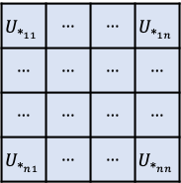


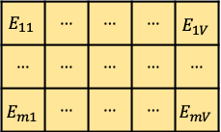

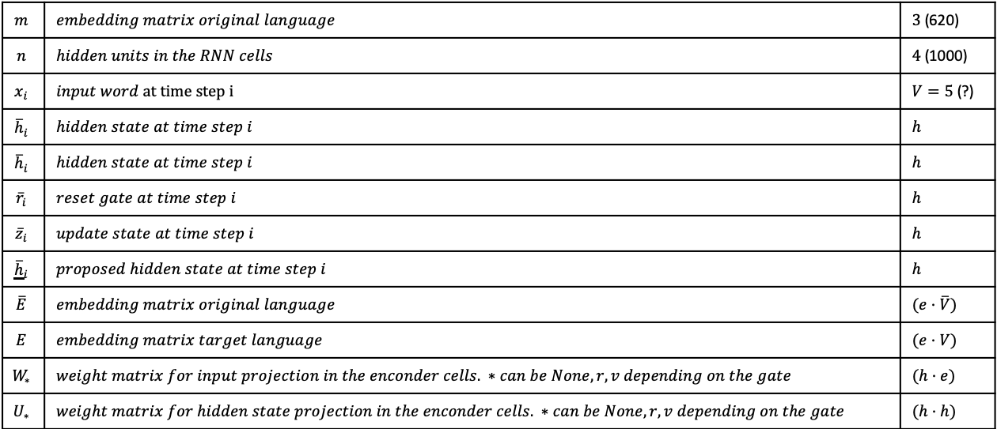




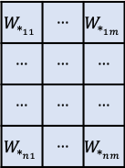


$E$ =
$$E_{11}$$ | ··· | ··· | ··· | $$E_{1V}$$
··· | ··· | ··· | ··· | ···
$$E_{m1}$$ | ··· | ··· | ··· | $$E_{mV}$$
$$m$$ | $$embedding matrix original language$$ | $3$ (620)
$$n$$ | $$hidden units in the RNN cells$$ | $4$ (1000)
$$x_{i}$$ | $input word at time step i$ | $V=5$ (?)
$${\overline{h}}_{i}$$ | $$hidden state at time step i$$ | $$h$$
$${\overline{h}}_{i}$$ | $$hidden state at time step i$$ | $$h$$
$${\overline{r}}_{i}$$ | $$reset gate at time step i$$ | $$h$$
$${\overline{z}}_{i}$$ | $$update state at time step i$$ | $$h$$
$${\underline{\overline{h}}}_{i}$$ | $$proposed hidden state at time step i$$ | $$h$$
$$\overline{E}$$ | $$embedding matrix original language$$ | $$(e·\overline{V})$$
$$E$$ | $$embedding matrix target language$$ | $$(e·V)$$
$$W_{∗}$$ | $$weight matrix for input projection in the enconder cells. ∗can be None, r, v depending on the gate$$ | $$(h·e)$$
$$U_{∗}$$ | $$weight matrix for hidden state projection in the enconder cells. ∗can be None, r, v depending on the gate$$ | $$(h·h)$$
$W_{∗}$ =
$$W_{∗_{11}}$$ | ··· | $$W_{∗_{1m}}$$
··· | ··· | ···
··· | ··· | ···
$$W_{∗_{n1}}$$ | ··· | $$W_{∗_{nm}}$$
$$U_{∗_{11}}$$ | ··· | ··· | $$U_{∗_{1n}}$$
··· | ··· | ··· | ···
··· | ··· | ··· | ···
$$U_{∗_{n1}}$$ | ··· | ··· | $$U_{∗_{nn}}$$
$U_{∗}$ =
$${\vec{h}}_{i}=$$
$${{\vec{h}}_{i}}_{1}$$
···
···
$${{\vec{h}}_{i}}_{n}$$
$${\underline{\vec{h}}}_{i}=$$
$${{\underline{\vec{h}}}_{i}}_{1}$$
···
···
$${{\underline{\vec{h}}}_{i}}_{n}$$
$${\vec{r}}_{i}=$$
$${{\vec{rs}}_{i}}_{1}$$
···
···
$${{\vec{r}}_{i}}_{n}$$
$${\vec{z}}_{i}=$$
$${{\vec{z}}_{i}}_{1}$$
···
···
$${{\vec{z}}_{i}}_{n}$$
$x_{i}$ =
$$x_{1}$$
···
···
···
$$x_{V}$$

Slide 4


















Encoder – RNN
$${{\vec{h}}_{1}}^{enc}$$
$${{\vec{h}}_{2}}^{enc}$$
$${{\vec{h}}_{m}}^{enc}$$
$$W_{h}$$
$$W_{h}$$
$${{\vec{h}}_{0}}^{enc}$$
$${{\vec{h}}_{1}}^{enc}$$
$${{\vec{h}}_{2}}^{enc}$$
$${{\vec{h}}_{m}}^{enc}$$
$${\vec{e}}_{0}$$
$${\vec{e}}_{1}$$
$${\vec{e}}_{2}$$
$$W_{e}$$
$$W_{e}$$
$$W_{e}$$
$${\vec{x}}_{0}$$
$${\vec{x}}_{1}$$
$${\vec{x}}_{2}$$
I
like
books

Slide 5
















Encoder - Bidirectional RNN
$${{\vec{h}}_{1}}^{enc}$$
$${{\vec{h}}_{2}}^{enc}$$
$${{\vec{h}}_{m}}^{enc}$$
$${{\vec{h}}_{1}}^{enc}$$
$${{\overset{⃖}{h}}_{1}}^{enc}$$
$${{\vec{h}}_{2}}^{enc}$$
$${{\overset{⃖}{h}}_{2}}^{enc}$$
$${{\vec{h}}_{m}}^{enc}$$
$${{\overset{⃖}{h}}_{m}}^{enc}$$
$${{\overset{⃖}{h}}_{1}}^{enc}$$
$${{\overset{⃖}{h}}_{2}}^{enc}$$
$${{\overset{⃖}{h}}_{m}}^{enc}$$
$$W_{h}$$
$$W_{h}$$
$${{\vec{h}}_{0}}^{enc}$$
$${{\vec{h}}_{1}}^{enc}$$
$${{\vec{h}}_{2}}^{enc}$$
$${{\vec{h}}_{m}}^{enc}$$
$${\vec{e}}_{0}$$
$${\vec{e}}_{1}$$
$${\vec{e}}_{2}$$
$$W_{e}$$
$$W_{e}$$
$$W_{e}$$
$${\vec{x}}_{0}$$
$${\vec{x}}_{1}$$
$${\vec{x}}_{2}$$
I
like
books

Slide 8
RNN SEARCH
ARCHITECTURE

Slide 9




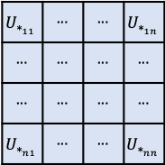


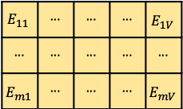

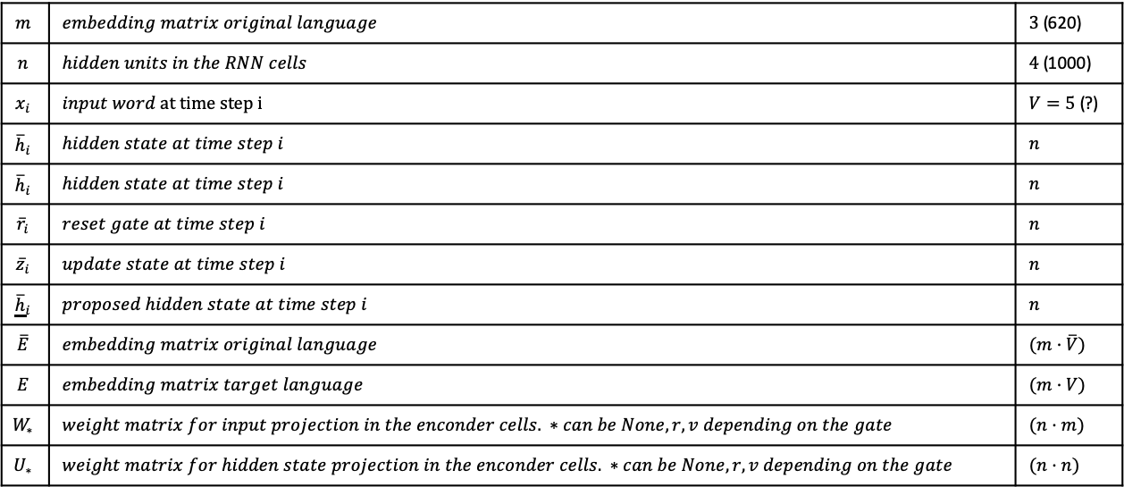




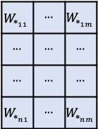


$E$ =
$$E_{11}$$ | ··· | ··· | ··· | $$E_{1V}$$
··· | ··· | ··· | ··· | ···
$$E_{m1}$$ | ··· | ··· | ··· | $$E_{mV}$$
$$m$$ | $$embedding matrix original language$$ | $3$ (620)
$$n$$ | $$hidden units in the RNN cells$$ | $4$ (1000)
$$x_{i}$$ | $input word at time step i$ | $V=5$ (?)
$${\overline{h}}_{i}$$ | $$hidden state at time step i$$ | $$n$$
$${\overline{h}}_{i}$$ | $$hidden state at time step i$$ | $$n$$
$${\overline{r}}_{i}$$ | $$reset gate at time step i$$ | $$n$$
$${\overline{z}}_{i}$$ | $$update state at time step i$$ | $$n$$
$${\underline{\overline{h}}}_{i}$$ | $$proposed hidden state at time step i$$ | $$n$$
$$\overline{E}$$ | $$embedding matrix original language$$ | $$(m·\overline{V})$$
$$E$$ | $$embedding matrix target language$$ | $$(m·V)$$
$$W_{∗}$$ | $$weight matrix for input projection in the enconder cells. ∗can be None, r, v depending on the gate$$ | $$(n·m)$$
$$U_{∗}$$ | $$weight matrix for hidden state projection in the enconder cells. ∗can be None, r, v depending on the gate$$ | $$(n·n)$$
$W_{∗}$ =
$$W_{∗_{11}}$$ | ··· | $$W_{∗_{1m}}$$
··· | ··· | ···
··· | ··· | ···
$$W_{∗_{n1}}$$ | ··· | $$W_{∗_{nm}}$$
$$U_{∗_{11}}$$ | ··· | ··· | $$U_{∗_{1n}}$$
··· | ··· | ··· | ···
··· | ··· | ··· | ···
$$U_{∗_{n1}}$$ | ··· | ··· | $$U_{∗_{nn}}$$
$U_{∗}$ =
$${\vec{h}}_{i}=$$
$${{\vec{h}}_{i}}_{1}$$
···
···
$${{\vec{h}}_{i}}_{n}$$
$${\underline{\vec{h}}}_{i}=$$
$${{\underline{\vec{h}}}_{i}}_{1}$$
···
···
$${{\underline{\vec{h}}}_{i}}_{n}$$
$${\vec{r}}_{i}=$$
$${{\vec{rs}}_{i}}_{1}$$
···
···
$${{\vec{r}}_{i}}_{n}$$
$${\vec{z}}_{i}=$$
$${{\vec{z}}_{i}}_{1}$$
···
···
$${{\vec{z}}_{i}}_{n}$$
$x_{i}$ =
$$x_{1}$$
···
···
···
$$x_{V}$$

Slide 10




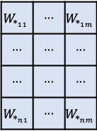

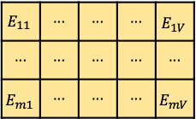
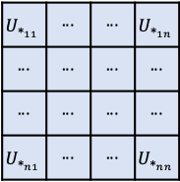
${\vec{r}}_{i}$ | ${\vec{z}}_{i}=sigmoid($
$$W_{∗_{11}}$$ | ··· | $$W_{∗_{1m}}$$
··· | ··· | ···
··· | ··· | ···
$$W_{∗_{n1}}$$ | ··· | $$W_{∗_{nm}}$$
$$E_{11}$$ | ··· | ··· | ··· | $$E_{1V}$$
··· | ··· | ··· | ··· | ···
$$E_{m1}$$ | ··· | ··· | ··· | $$E_{mV}$$
$$x_{1}$$
···
···
···
$$x_{V}$$
$$U_{∗_{11}}$$ | ··· | ··· | $$U_{∗_{1n}}$$
··· | ··· | ··· | ···
··· | ··· | ··· | ···
$$U_{∗_{n1}}$$ | ··· | ··· | $$U_{∗_{nn}}$$
$${{\vec{h}}_{i}}_{1}$$
···
···
$${{\vec{h}}_{i}}_{n}$$
$$)$$
+
${\vec{r}}_{i}$ | ${\vec{z}}_{i}=sigmoid($

Slide 11
















































































Producing Annotations - Detailed
·
·
·
$$h_{i−1}$$
·
·
·
$$h_{i}$$
·
·
·
$$h_{i+1}$$
CONCAT
CONCAT
CONCAT
$$\#$$
$$\#$$
$$\#$$
$$o$$
$${\overset{⃖}{h}}_{i−1}$$
$$o$$
$$\overset{⃖}{h_{i}}$$
$$o$$
$${\overset{⃖}{h}}_{i+1}$$
$${\underline{\overset{⃖}{h}}}_{i−1}$$
$$\overset{⃖}{U}$$
$$\overset{⃖}{U_{r}}$$
$$\overset{⃖}{U_{z}}$$
$$\underline{\overset{⃖}{h_{i}}}$$
$$\overset{⃖}{U}$$
$$\overset{⃖}{U_{r}}$$
$$\overset{⃖}{U_{z}}$$
$${\underline{\overset{⃖}{h}}}_{i+1}$$
$$\overset{⃖}{U}$$
$${\overset{⃖}{r}}_{i−1}$$
$$\overset{⃖}{U_{r}}$$
$$\overset{⃖}{U_{z}}$$
$$\#$$
$${\overset{⃖}{r}}_{i+1}$$
$${\overset{⃖}{z}}_{i+1}$$
$$\#$$
$$\overset{⃖}{r_{i}}$$
$$\overset{⃖}{z_{i}}$$
$$\#$$
$${\overset{⃖}{z}}_{i−1}$$
$${\vec{h}}_{i−2}$$
$$o$$
$${\vec{h}}_{i−1}$$
$$o$$
$${\vec{h}}_{i}$$
$$o$$
$${\vec{h}}_{i+2}$$
$$tanh$$
$$σ$$
$$σ$$
$$tanh$$
$$σ$$
$$σ$$
$$tanh$$
$$σ$$
$$σ$$
+
+
+
+
+
+
+
+
+
$$\vec{U_{z}}$$
$$\vec{U_{r}}$$
$$\vec{U}$$
$$\vec{U_{z}}$$
$${\vec{z}}_{i}$$
$$\vec{U_{r}}$$
$${\vec{r}}_{i}$$
$$\vec{U}$$
$${\underline{\vec{h}}}_{i}$$
$$\vec{U_{z}}$$
$$\vec{U_{r}}$$
$$\vec{U}$$
$$σ$$
$$σ$$
$$tanh$$
$$\overset{⃖}{W}$$
$$\overset{⃖}{W_{r}}$$
$$\overset{⃖}{W_{z}}$$
$$\overset{⃖}{W}$$
$$\overset{⃖}{W_{r}}$$
$$\overset{⃖}{W_{z}}$$
$$\overset{⃖}{W}$$
$$\overset{⃖}{W_{r}}$$
$$\overset{⃖}{W_{z}}$$
$$σ$$
$$σ$$
$$tanh$$
$$σ$$
$$σ$$
$$tanh$$
+
+
+
+
+
+
+
+
+
$$\vec{W_{z}}$$
$$\vec{W_{r}}$$
$$\vec{W}$$
$$\vec{W_{z}}$$
$$\vec{W_{r}}$$
$$\vec{W}$$
$$\vec{W_{z}}$$
$$\vec{W_{r}}$$
$$\vec{W}$$
E
E
E
$${\vec{x}}_{i−1}$$
$${\vec{x}}_{i}$$
$${\vec{x}}_{i+1}$$

Slide 12
















Producing Annotations – Detailed – GRU Cell
$$\#$$
$${\vec{h}}_{i}$$
$${\vec{h}}_{i−1}$$
$$o$$
$$\vec{U_{z}}$$
$${\vec{z}}_{i}$$
$$\vec{U_{r}}$$
$${\vec{r}}_{i}$$
$$\vec{U}$$
$${\underline{\vec{h}}}_{i}$$
$$σ$$
$$σ$$
$$tanh$$
+
+
+
$$\vec{W_{z}}$$
$$\vec{W_{r}}$$
$$\vec{W}$$
E
$${\vec{x}}_{i}$$

Slide 13














·
·
·
$$c_{i}$$
+
x
···
x
···
x
$$α_{i1}$$
···
$$α_{ij}$$
···
$$α_{iT_{x}}$$
$$Softmax$$
$$e_{i1}$$
$$e_{ij}$$
$$e_{iT_{x}}$$
x
$$tanh$$
+
$$v_{a}^{T}$$
$$U_{a}$$
$$W_{a}$$
·
·
·
·
·
·
·
·
·
···
···
$$h_{1}$$
$$h_{j}$$
$$h_{T_{x}}$$

