Slide 1
3rd ML Lab Session
Preprocessing • scikit‑learn pipeline • Linear regression
Today we will work through three notebooks, build intuition, and leave with runnable templates.
Notebooks:
ml03-warmup.ipynb
ml03-linreg.ipynb
ml03-exercise.ipynb
Lab overview slides

Slide 2

Agenda
What we’ll do
1) ml03-warmup.ipynb
2) ml03-linreg.ipynb
Introduces Ridge Linear Regression with a small dataset (murders.txt)
Shows train/test split and feature normalization
Implements ridge solution manually using formulas
Uses LOOCV to select the best regularization parameter λ
Real dataset: Life Expectancy prediction
Exploratory Data Analysis (EDA): distributions, missing values, categorical issues
Preprocessing pipelines (minimal vs more complete)
Linear, Lasso and Ridge regression comparison with cross-validation
3) ml03-exercise.ipynb
https://shorturl.at/FPsfG
Hands-on exercise using the bodyfat dataset
Optional advanced task with Life Expectancy data

Slide 3

Notebook 1
Notebook 1
File: ml03-warmup.ipynb
Core steps
This warm-up notebook focuses on understanding how regularization works mathematically. Instead of relying only on sklearn, it shows the ridge regression solution explicitly:
See how λ controls overfitting by shrinking coefficients.
Data is normalized first, highlighting good preprocessing practice.
LOOCV is used to select the best λ, linking theory with evaluation.
The main goal is intuition:
👉 how regularization stabilizes linear regression and prevents large coefficients.

Slide 4
Notebook 1
Notebook 2
File: ml03-linreg.ipynb
Core steps
This is the core lab notebook to move from toy examples to real messy data.
Real datasets require cleaning: NaNs, categories, scaling.
Different preprocessing strategies lead to different results.
Linear regression variants (OLS, Ridge, Lasso) illustrate:
overfitting
regularization
feature selection
This notebook connects:
👉 theory (linear models) → real ML workflow.

Slide 5
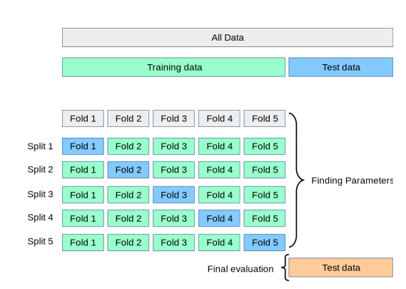
Notebook 1
Notebook 2
File: ml03-linreg.ipynb

Slide 6
Notebook 1
Notebook 3
File: ml03-exercise.ipynb
Core steps
This notebook is meant as an active exercise.
You must:
inspect the data visually
identify strange samples or outliers
improve performance through preprocessing decisions
The learning objective is:
👉 understanding that linear regression is very sensitive to outliers and data quality.

Slide 7
References
Useful references (papers)
Hoerl, A. E., & Kennard, R. W. (1970). “Ridge Regression: Biased Estimation for Nonorthogonal Problems.” Technometrics.
Tibshirani, R. (1996). “Regression Shrinkage and Selection via the Lasso.” Journal of the Royal Statistical Society: Series B.
Hastie, T., Tibshirani, R., & Friedman, J. (2009). “The Elements of Statistical Learning: Data Mining, Inference, and Prediction.” Springer.
Ng, A. Y. (2004). “Feature Selection, L1 vs. L2 Regularization, and Rotational Invariance.” Proceedings of the Twenty-First International Conference on Machine Learning.
End

