Slide 1
4th ML Lab Session
Preprocessing • scikit‑learn pipeline • Regularization
Lab overview slides

Slide 2

Agenda
What we’ll do
ml04-biasvariance.ipynb
Generate a synthetic dataset with correlated features to study linear regression behavior.
Visualize the MSE loss surface in the parameter space (w_1, w_2).
Study Ridge shrinkage paths as regularization increases.
Use Monte Carlo simulations to observe prediction variability.
https://shorturl.at/imi4h

Slide 3
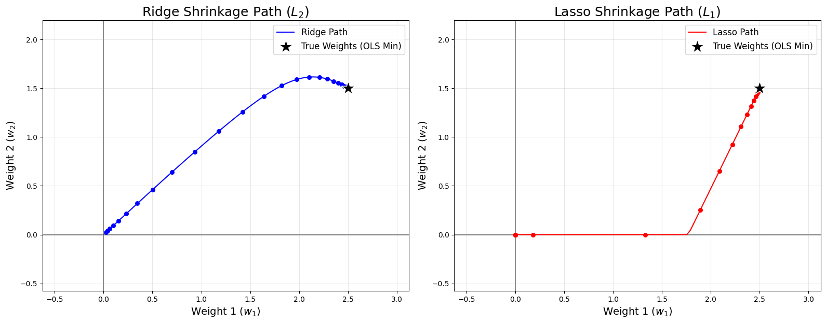
Notebook 1
Exercise

Slide 4
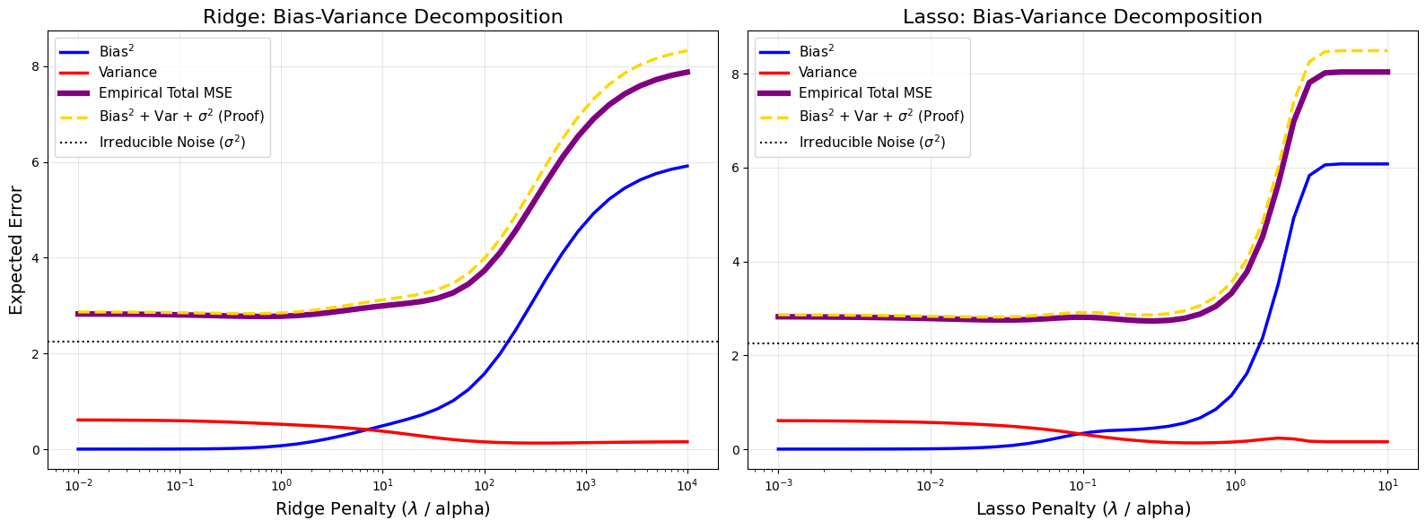
Notebook 1
Exercise

