Slide 1

Earthquake

Slide 2

Barriers
Missing data
Domain knowledge needed
Formatting

Slide 3
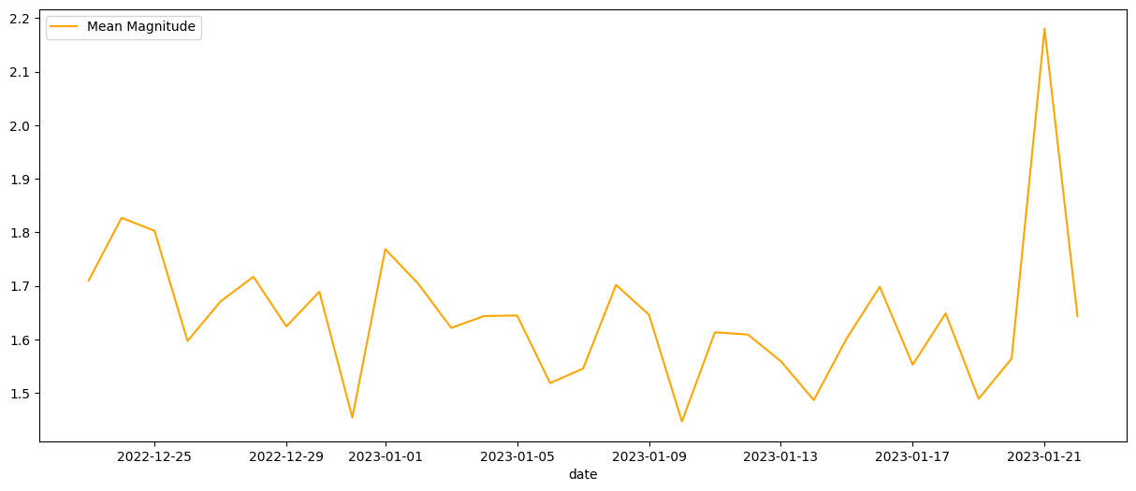
## Converting time column into date column EarthquakeData['time'] = pd.to_datetime(EarthquakeData['time']).dt.date print(EarthquakeData['time'].head()) ## magnitude Mean on Time Series MagSeries = EarthquakeData.groupby(['time']).mean('mag')['mag'].to_frame('Mean Magnitude').reset_index() print(MagSeries)

Slide 4
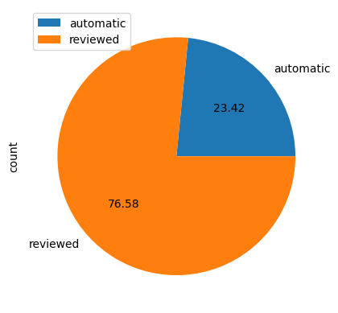
# Status Count Earthquakestatus = EarthquakeData.groupby(['status'])['status'].count().to_frame('count').reset_index() Earthquakestatus # Pie chart with Status count fig, ax = plt.subplots() Earthquakestatus.plot(kind = 'pie', y = 'count', labels = Earthquakestatus['status'], autopct = '%1.2f', ax = ax)
Automated – program receives seismic data from stations in real time
Reviewed – missed earthquakes that analysts add manually

Slide 5
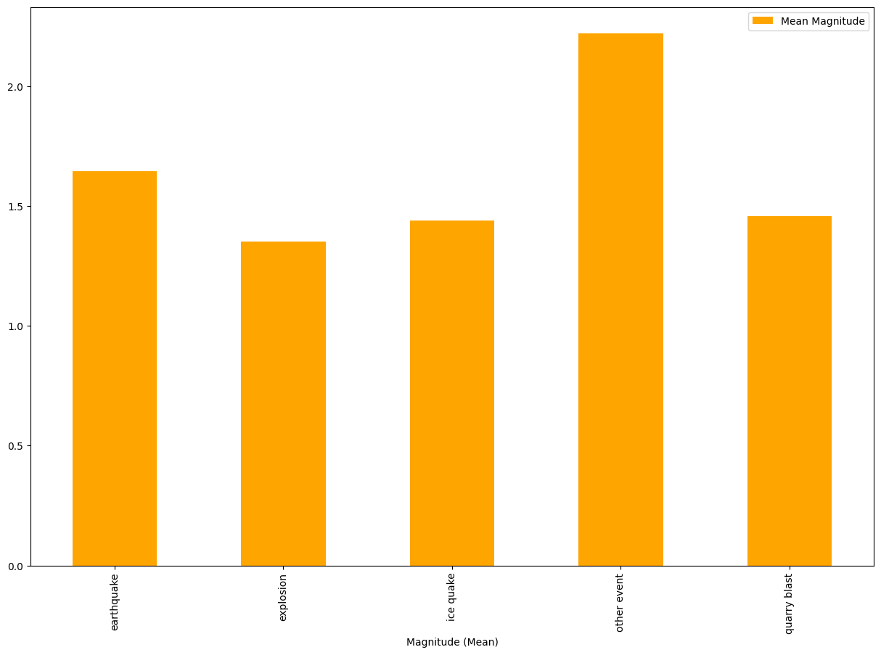
Bar chart by type

Slide 6
