Slide 1
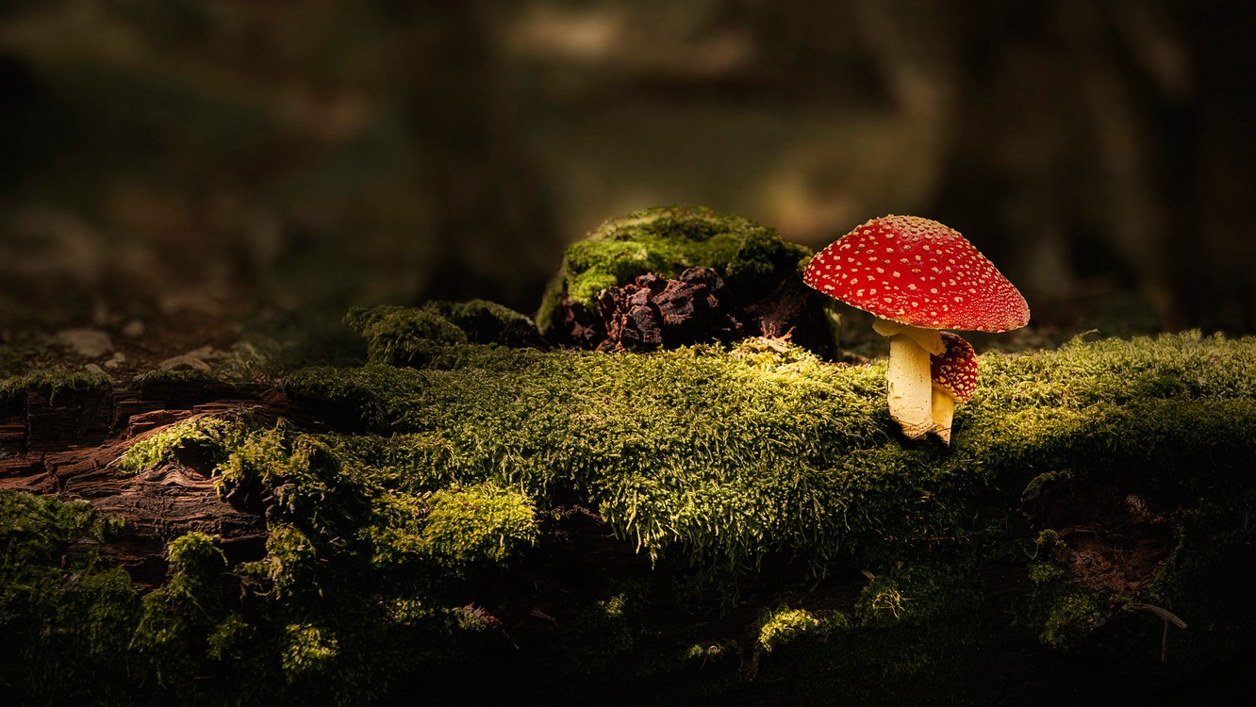
Poisonous mushrooms

Slide 2
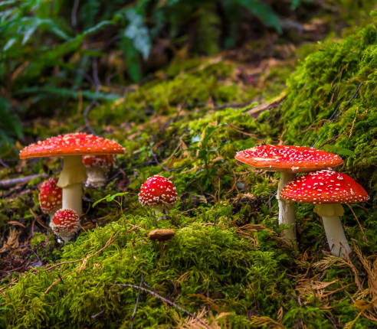
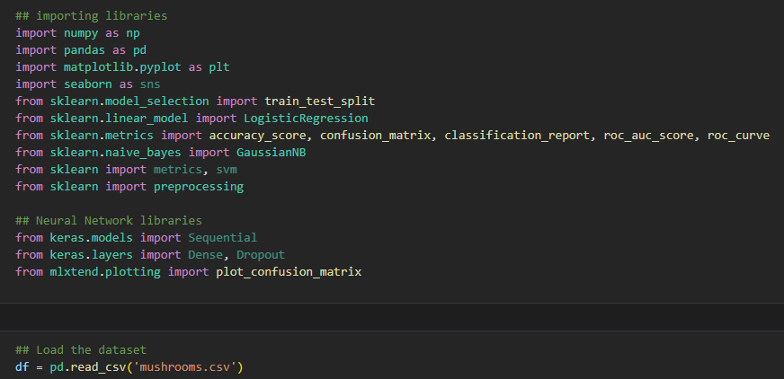
Libraries & loading dataset

Slide 3
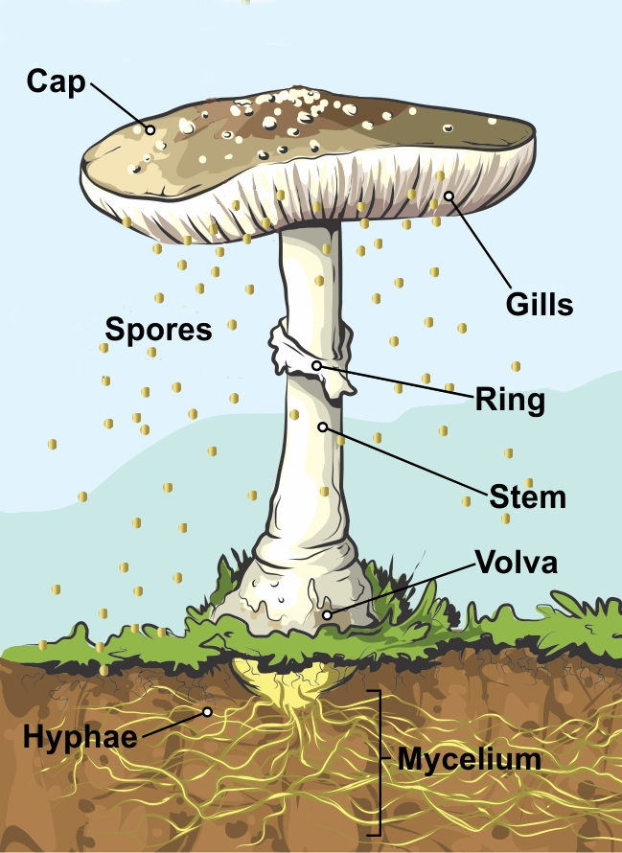
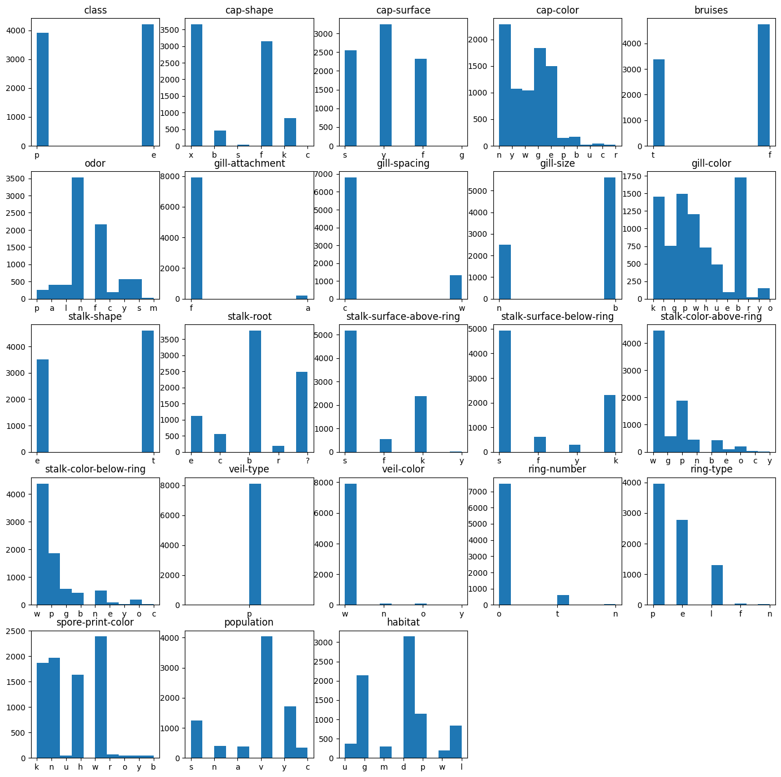
Exploratory Data Analysis
Notes:
* class: having a look at the first histogram, I can consider this dataset as balanced
* `cap shape` = convex and flat
* `cap surface` = scaly
* `cap color` = many colors, but predominantly brown
* `bruises` = a bit more without bruises
* `odor` = none. But many others with foul odor
* `gill attachment` = free
* `gill spacing` = close
* `gill size` = broad
* `gillcolor` = many colors, but predominantly buff
* `stalk shape` = most are tapering
* `stalk root` = bulbous
* `stalk surface above ring` = smooth
* `stalk color above ring` = white
* `stalk color below ring` = white
* `veil type` = all of them are partial
* `veil color` = almost all of them white
* `ring number` = most of them one
* `ring type` = pendant
* `spore print color` = white, followed by many others
* `population` = several
`habitat` = woods mostly

Slide 4
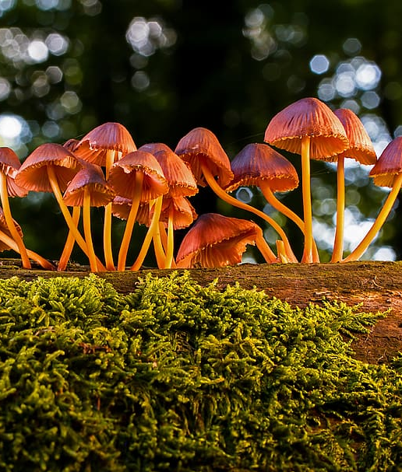
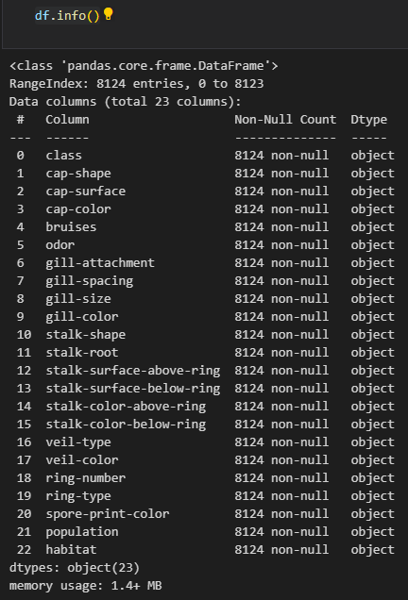
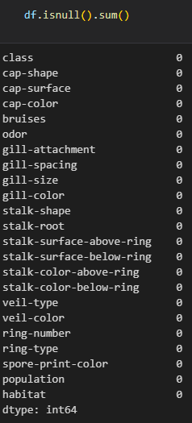
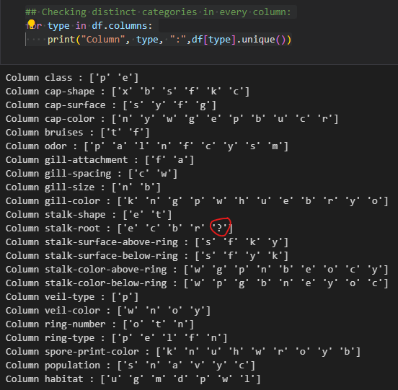

Slide 5
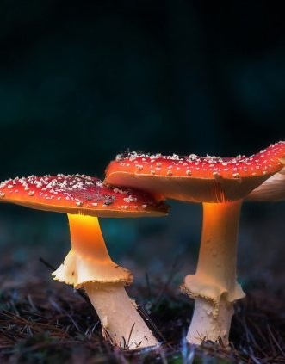
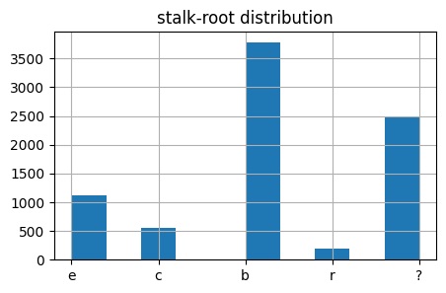
Exploratory Data Analysis

Slide 6
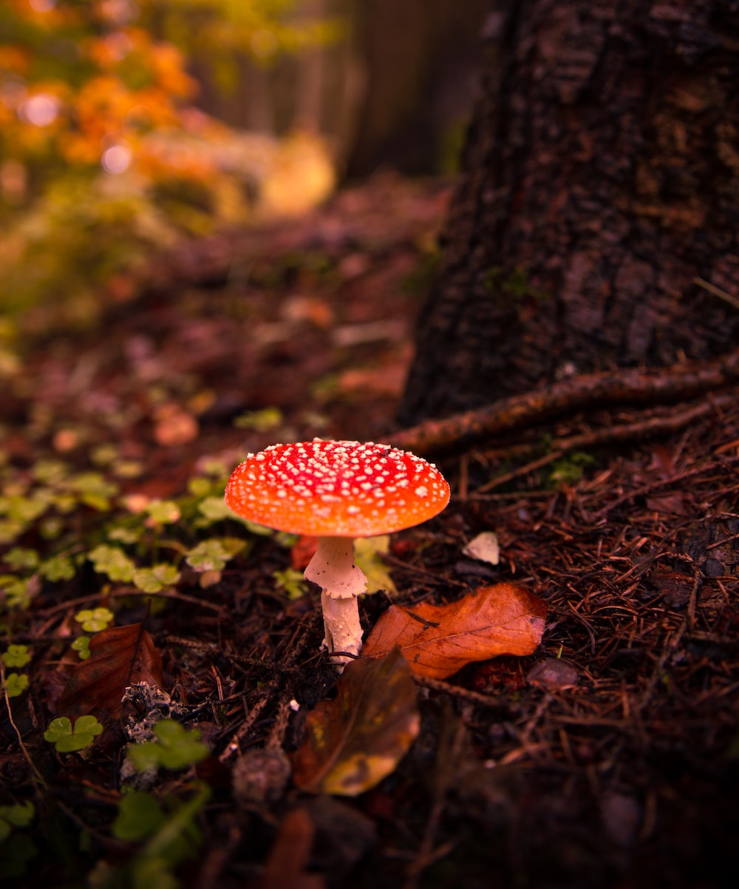
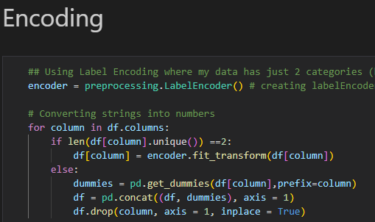

Data Preprocessing

Slide 7
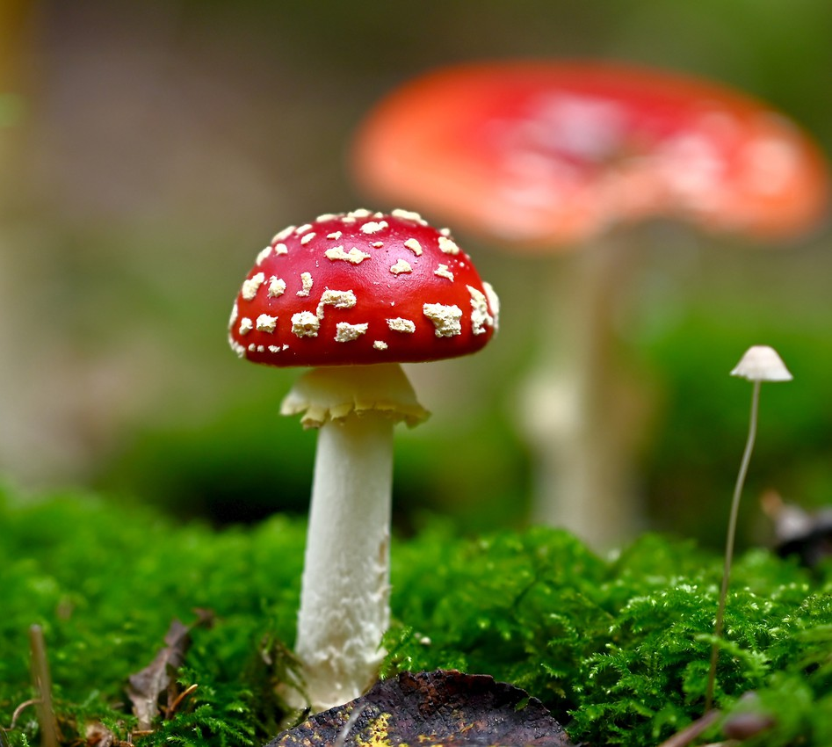
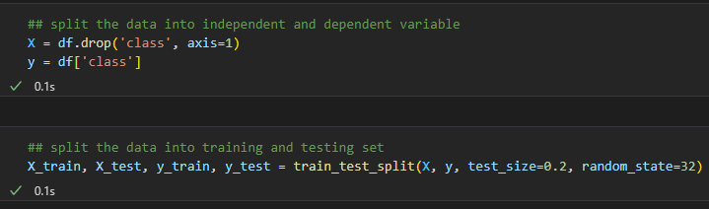
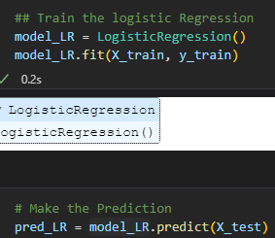
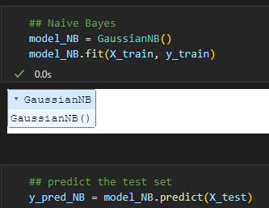
Supervised ML models
Logistic Regression | Naïve Bayes

Slide 8
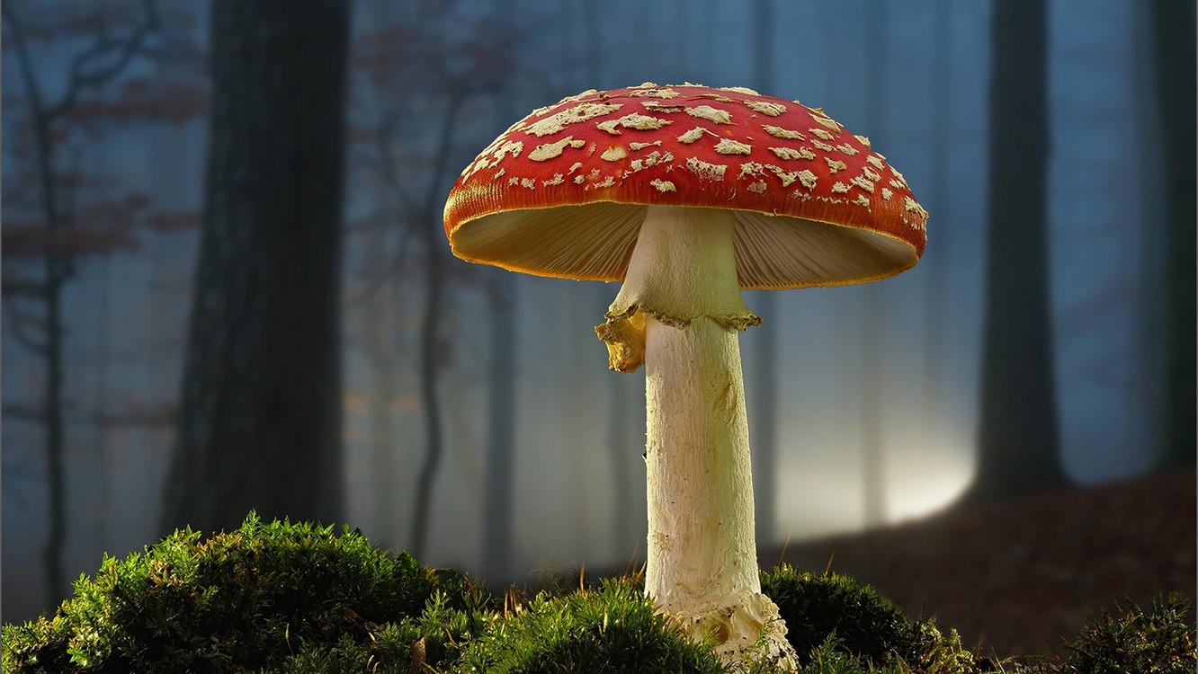
Evaluation Metrics

Slide 9
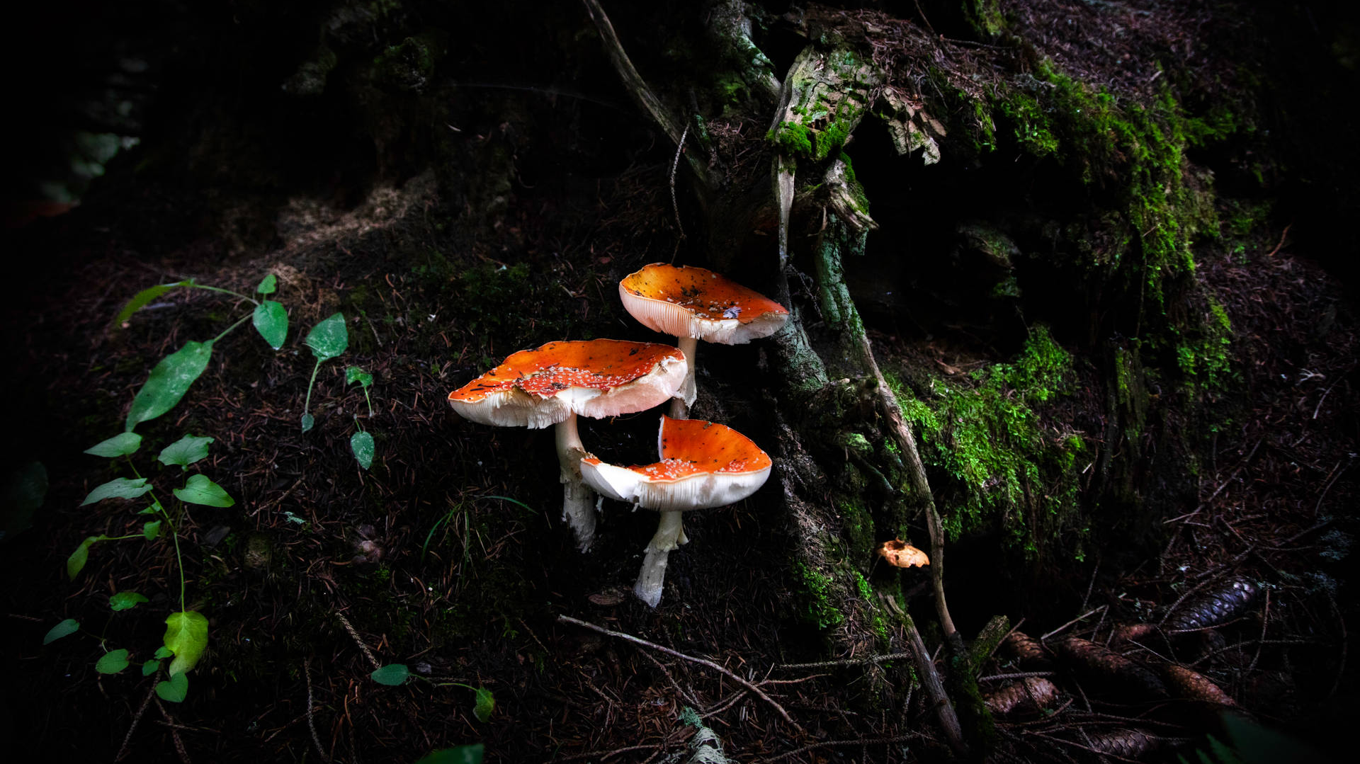
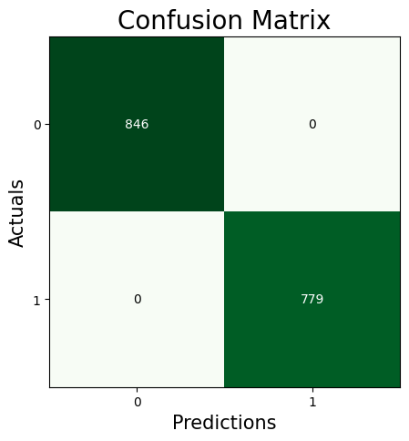
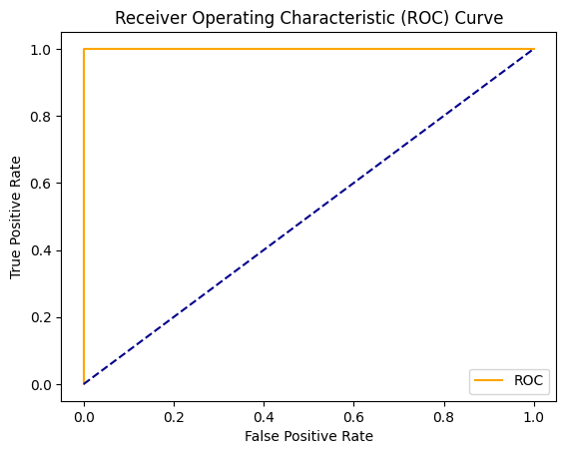
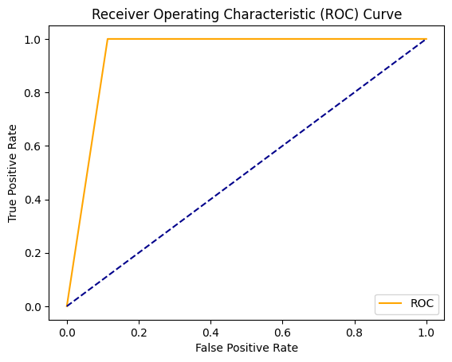
Logistic Regression
Naïve Bayes
 | Precision | Recall | F1-score
0 | 1.00 | 1.00 | 1.00
1 | 1.00 | 1.00 | 1.00
accuracy |  |  | 1
 | Precision | Recall | F1-score
0 | 1.00 | 0.89 | 0.94
1 | 0.89 | 1.00 | 0.94
accuracy |  |  | 0.94
AUC | 1.00
AUC | 0.943262

Slide 10

Thanks so Mush

