Slide 1

TITANIC

Slide 2

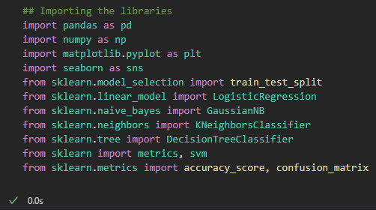

Importing the libraries and Dataset

Slide 3


Preparing the dataset

Slide 4
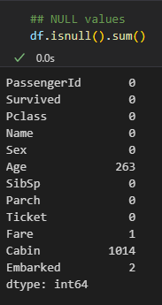

Checking NULLS

Slide 5
MISSING VALUES

Slide 6
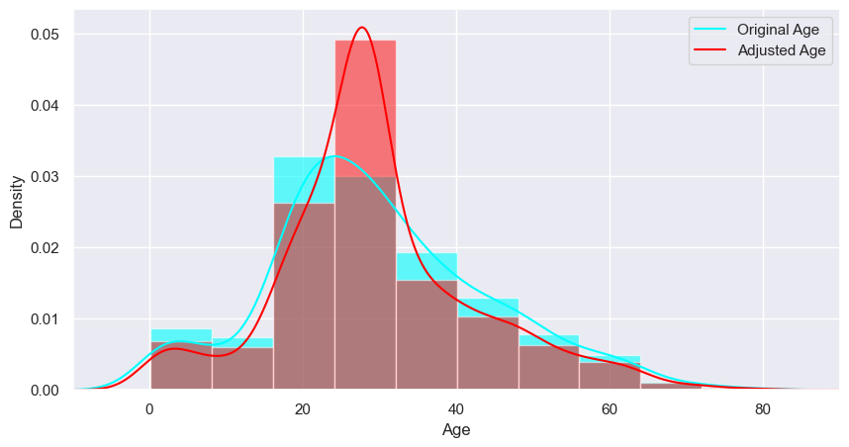
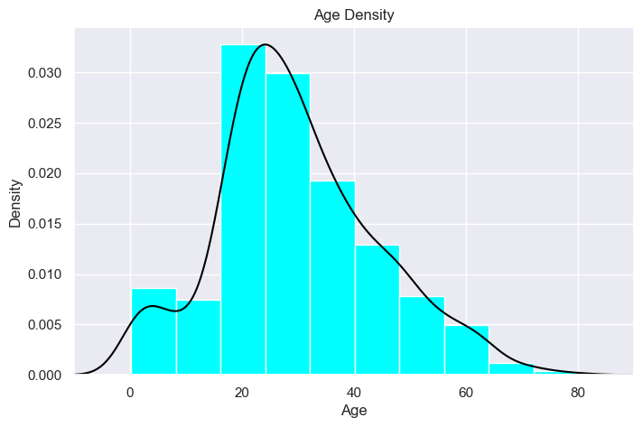
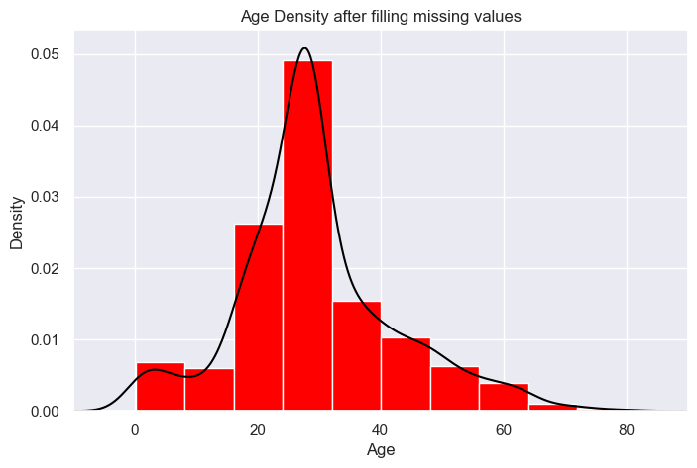
Age

Slide 7
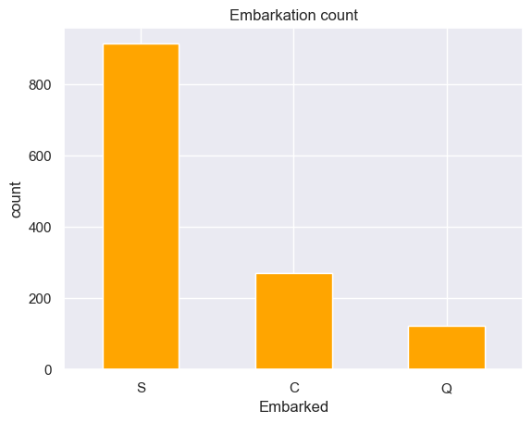

Embarked

Slide 8

Cabin

Slide 9
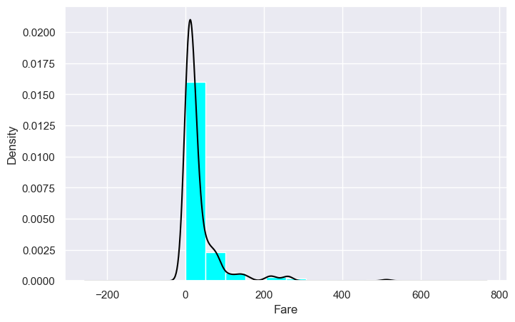

Fare

Slide 10
FEATURE WRANGLING

Slide 11



Slide 12
EXPLORATORY ANALYSIS

Slide 13
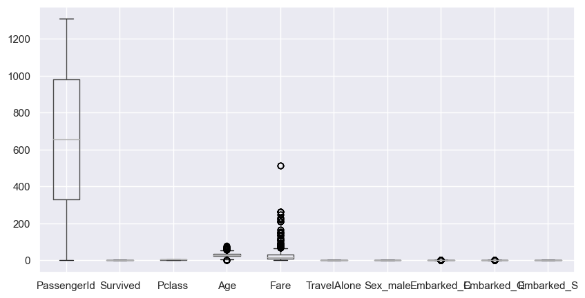
Outliers
Not removing outliers because it got rid of almost 50% of the data

Slide 14
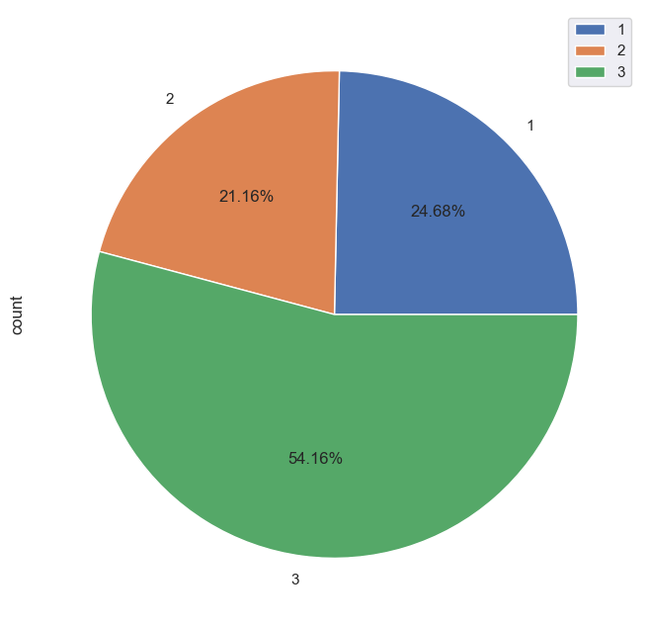
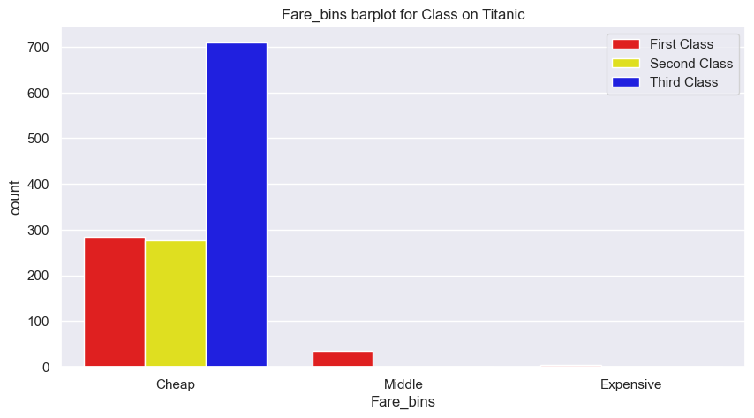
Class & Fare

Slide 15
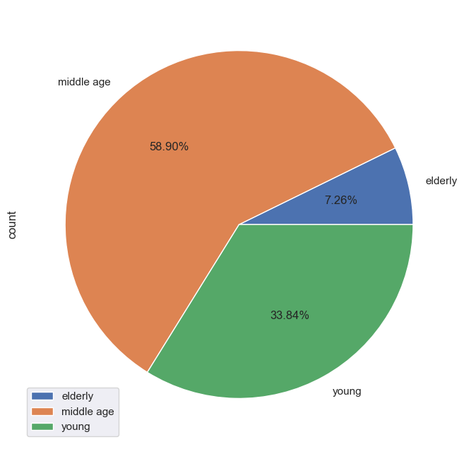
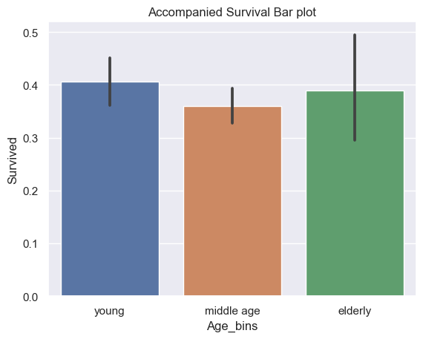
Age & Survived

Slide 16
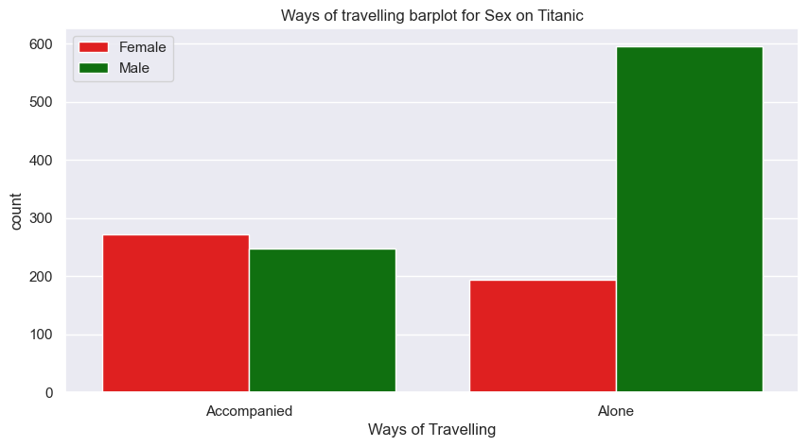
Traveling & Sex

Slide 17
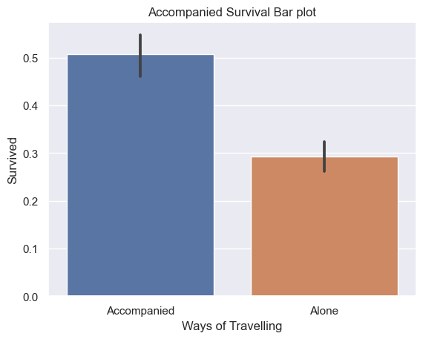
TravelAlone & Survived

Slide 18
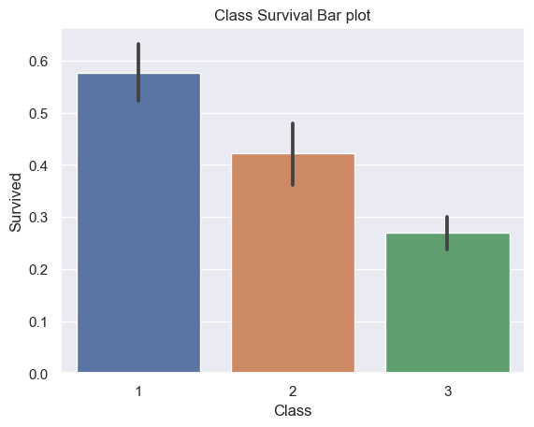
Class & Survived

Slide 19
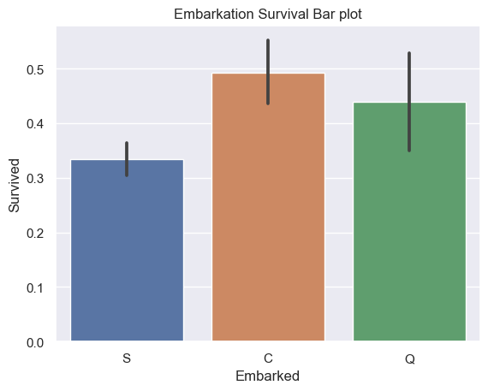
Embarkation & Survived

Slide 20
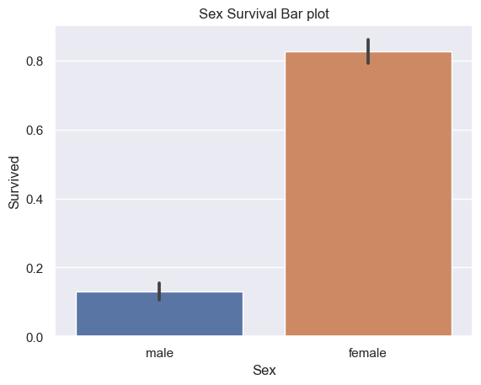
Sex & Survived

Slide 21
ML CLASSIFIER MODEL

Slide 22

Defining the data splits

Slide 23
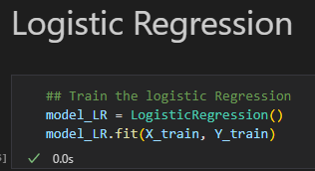

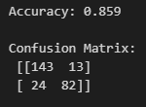
Logistic Regression Classifier

Slide 24
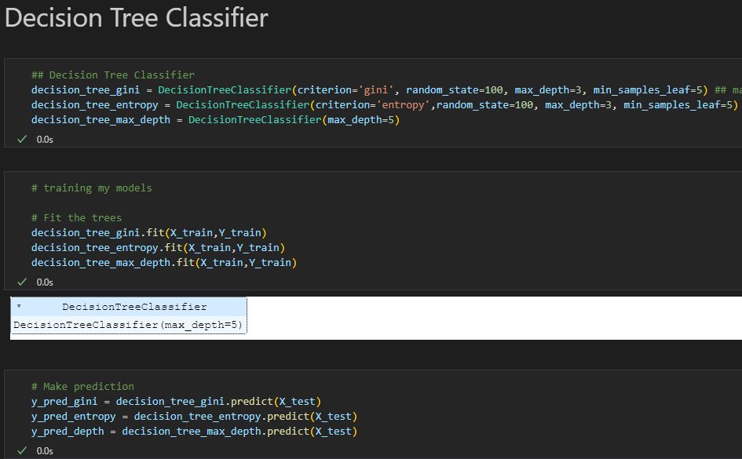
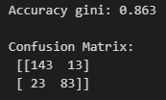
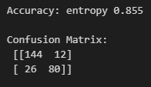
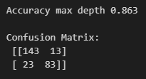
Decision Tree Classifier

Slide 25
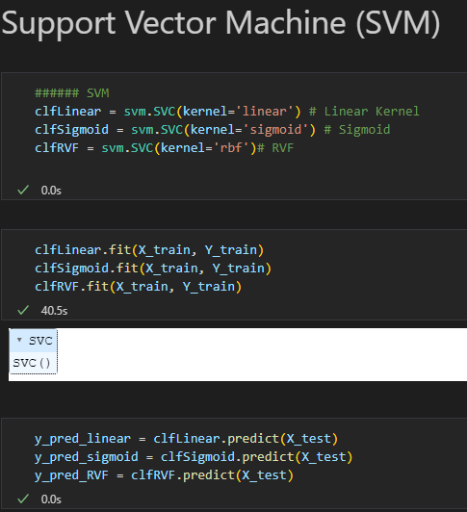

Support Vector Machine

Slide 26

Thank you

