Slide 1
Digital Design with Verilog

Slide 3
Agenda
Introduction
Designing with Verilog
Finite State Machines Review
Verilog for Synthesis

Slide 4
Introduction

Slide 5
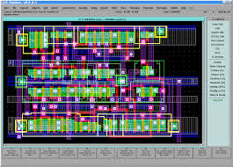
Before 1990 (synthesis)
always @(posedge clk)
begin
x = b & c;
y = a | x;
end
HDL description

Slide 6
So we are going to talk about design
And how to use an HDL language to design?

Slide 7
What is HDL?
Hard & Difficult Language?
No, means Hardware Description Language
High Level Language
To describe the circuits by syntax and sentences
As oppose to circuit described by schematics
Allows designers to model the concurrency of process found in hardware
Widely used HDLs
Verilog – Similar to C
SystemVerilog – Similar to C++
VHDL – Similar to PASCAL

Slide 8
What is HDL?
Hardware Description Language
High Level Language
To describe the circuits by syntax and sentences
As oppose to circuit described by schematics
Allows designers to model the concurrency of process found in hardware
Widely used HDLs
Verilog – Similar to C
SystemVerilog – Similar to C++
VHDL – Similar to PASCAL

Slide 9
Purpose of HDLs
Purpose of Hardware Description Languages
Capture design in RTL form
i.e. all registers specified
Use to simulate designs so as to verify correctness
Pass through synthesis tools to obtain reasonable optimal gate-level design that meets timing
Design productivity
Automatic synthesis
Capture design as RTL instead of schematic
Reduces time to create gate level design by an order of magnitude
Synthesis
Basically, a Boolean combinational logic optimizer that is timing aware

Slide 10
Verilog
1984:
Verilog was developed by Gateway Design Automation as a proprietary language for logic simulation.
1989:
Gateway was acquired by Cadence
1990:
Verilog was made an open standard under the control of Open Verilog International.
1995:
The language became an IEEE standard (IEEE STD 1364) and was updated in 2001 and 2005.
Notes:
One limitation: Description of digital systems only
2005 It fix some problems like for example naming a the generate statements

Slide 11

SystemVerilog
SystemVerilog is the industry's first unified hardware description and verification language
Started with Superlog language to Accellera in 2002
Verification functionality (base on OpenVera language) came from Synopsys
In 2005 SystemVerilog was adopted as IEEE Standard (1800-2005). The current version is 1800-2009
Notes:
Accellera Systems Initiative is an independent, not-for profit organization dedicated to create, support, promote, and advance system-level design, modeling, and verification standards for use by the worldwide electronics industry

Slide 12

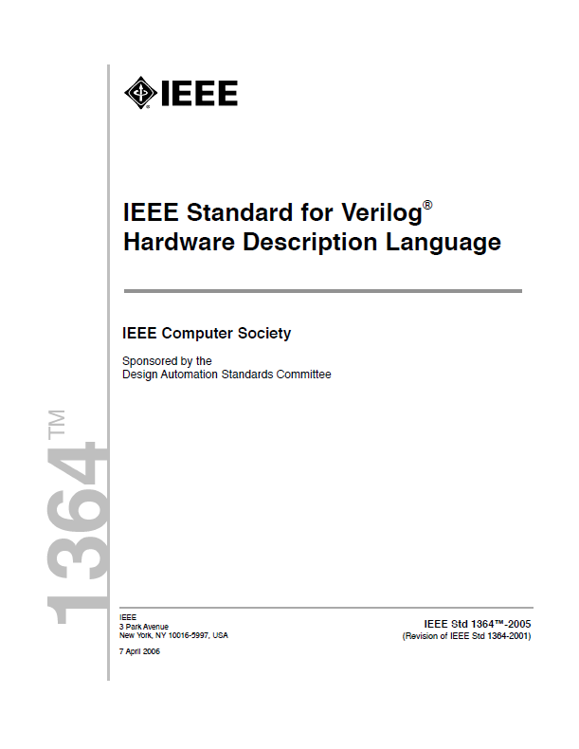

IEEE-1364 / IEEE-1800
Verilog 2005 (IEEE Standard 1364-2005) consists of minor corrections, spec clarifications, and a few new language features
SystemVerilog is a superset of Verilog-2005, with many new features and capabilities to aid design-verification and design-modeling
Notes:
SystemVerilog
- adds data structures and assertions for design
- provides advanced verification and modeling features
SystemVerilog design features details
New data types
logic
Multidimensional packed arrays
Enumerated
Structure and unions
Unique/priority if/case
Procedural blocks (always_comb, always_ff, always_latch)
Interfaces
Classes
Assertions
If we see verilog as a subset of System verilog, te first step to lear SV will be lear Verilog

Slide 13
Simulation and Synthesis
The two major purposes of HDLs are logic simulation and synthesis
During simulation, inputs are applied to a module, and the outputs are checked to verify that the module operates correctly
During synthesis, the textual description of a module is transformed into logic gates
Circuit descriptions in HDL resemble code in a programming language. But the code is intended to represent hardware
Not all of the Verilog commands can be synthesized into hardware

Slide 14
Simulation and Synthesis
Our primary interest is to build hardware, we will emphasize a synthesizable subset of the language
Will divide HDL code into synthesizable modules and test bench (simulation)
The synthesizable modules describe the hardware.
The test bench checks whether the output results are correct (only for simulation and cannot be synthesized)

Slide 15
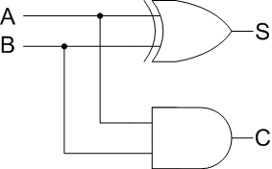
Types of modeling
Behavioral
Models describe what a module does.
Use of assignment statements, loops, if, else kind of statements
Structural
Describes the structure of the hardware components
Interconnections of primitive gates (AND, OR, NAND, NOR, etc.) and other modules
rst
Counter
If (rst)
cnt = 0;
else
cnt = cnt+1;
cnt [0:3]
clk
Notes:
As I said Verilog is a hardware description lenguage that describe circuits, we can describe/model in 2 ways
Behaivoral
Structural
(the mix on those styles is usually call RTL)

Slide 16
Behavioral - Structural
Behavioral
Structural
module cter (
input rst, clock,
output reg [1:0] count);
always@(posedge clock)
begin
if (rst) count = 0;
else count = count+1;
end
endmodule
module cter ( rst, clock, count );
output [1:0] count;
input rst, clock;
wire N5, n1, n4, n5, n6;
FD1 U0 (.D(N5), .CP(clock),
.Q(count[0]), .QN(n6));
FD1 U1 (.D(n1), .CP(clock),
.Q(count[1]), .QN(n5));
MUX21 U2 (.A(N5), .B(n4),
.S(n5), .Z(n1) );
NR2 U3 (.A(n6), .B(rst),
.Z(n4));
NR2 U4 (.A(count[0]), .B(rst),
.Z(N5));
endmodule
Notes:
Combination can be treat as RTL file or description

Slide 17
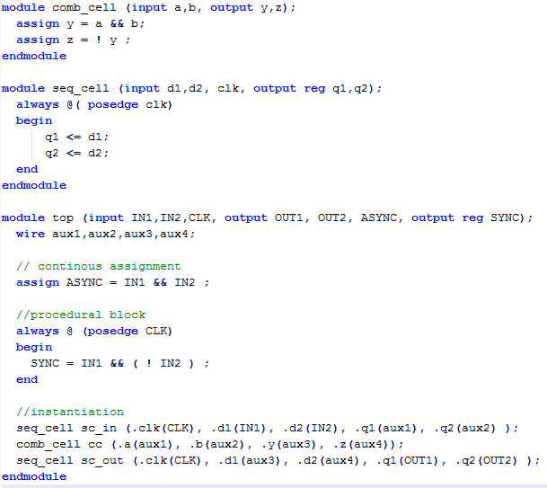
From this…

Slide 18
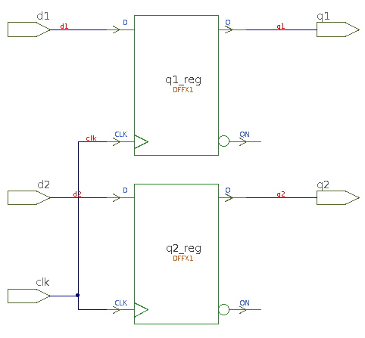
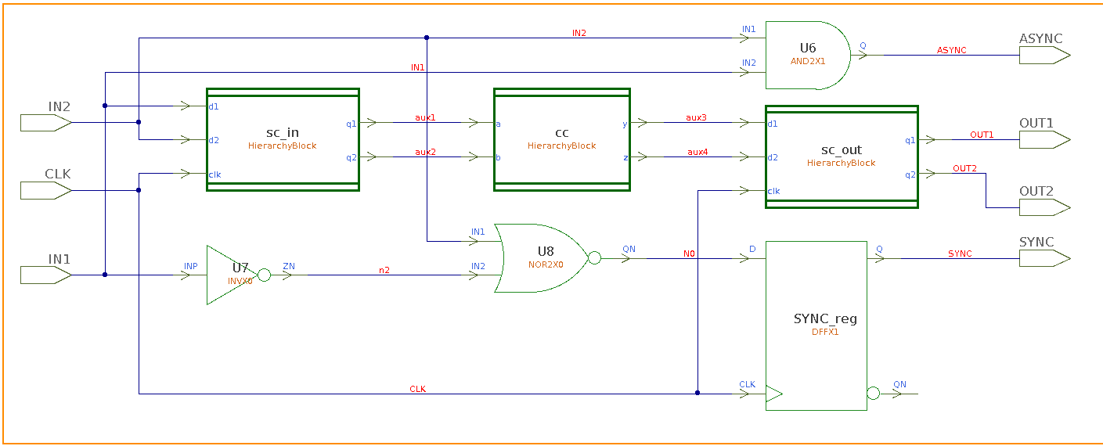
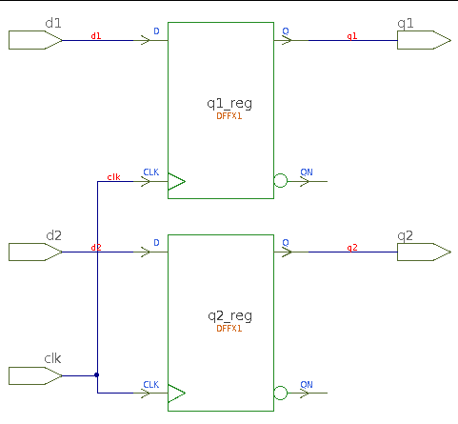
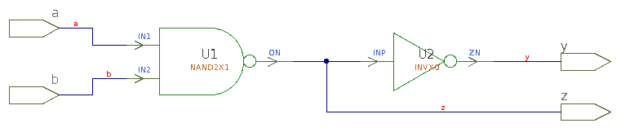
To this…
To This
Notes:
Sorry about the

Slide 19
Designing with Verilog

Slide 20
Design Mantras
One clock, one edge, Flip-flops only
Design BEFORE coding
Behavior implies function
Clearly separate control and datapath

Slide 21
Basic Verilog Constructs
Flip Flop
Behavior
For every positive edge of the clock Q changes to become equal to D
Write behavior as “code”
always @()
Triggers execution of the following code block
() called “sensitivity list”
Describes when execution triggered

Slide 22
Mantra # 3
Behavior implies function
Determine the behavior described by the Verilog code
Choose the hardware with the matching behavior
Code behavior
Q re-evaluated every time there is a rising edge of the clock
Q remain unchanged between rising edges
This behavior describes an edge-triggered Flip-Flop
always @(posedge clk)
Q <= D;

Slide 23
More Examples
What is the behavior and matching logic for this code fragment?
What is the behavior and code for this schematic?
always @(clk or D)
if (clock) Q >= D;

Slide 24
Flip - Flops
Every variable assigned in a block starting with
becomes the output of an edge-triggered flip –flop
This is the only way to build flip-flops
always @(posedge clk) or
always @(negedge clk)

Slide 25
Combinational Logic
Combinational logic example
How would you describe the behavior of this function in words?
And in code?

Slide 26
Behavior → Function
always @(a or b or c)
if (a) out = b ^ c;
else out = b | c;
All logical inputs in sensitivity list
If, else → multiplexor
Behavior: whenever input changes, out = mux XOR or OR
Same behavior as combinational logic

Slide 27
Procedural blocks
Statement block starting with an “always@” statement is called a procedural block
Statements in block are generally executed in sequence (i.e. procedurally)

Slide 28
Alternative Coding Style for Combinational Logic
Verilog has a short hand way to capture combinational logic
Called “continuous assignment”
LHS re-evaluated whenever anything in RHS changes
same as
assign out = a ? b ^ c : b | c;
f = a ? d : e;
if (a) f = d else f = e;

Slide 29
Input Logic to Flip-Flops
Can include some combinational logic in FF procedural block
Behavior → function
Out is reevaluated on every clock edge → output of FF
If; else → MUX
always @(posedge clk)
if (c)
out <= b;
else
out <= a;

Slide 30
RTL Coding Styles
Three coding styles
always @(???edge clock) → FF and input logic
always @(*) → Combinational logic (CL)
assign a = …. → Combinational logic (CL)
The hard part is not coding but design

Slide 31
Always Design Before Coding
Must code at register transfer level
Register and “transfer” (combinational) logic must be worked out before coding can start

Slide 32
Design Before Coding
Automatic synthesis does not relieve you of logic design
it does relieve you of
Logic optimization
Timing calculations and control
In many cases, detailed logic design
If you don’t design before coding, you are likely to end up with the following
A very slow clock (long critical path)
Poor performance and large area
Non-synthesizable Verilog
Many HDL lint errors

Slide 33
Avoid Temptation
Temptation # 1
“Verilog looks like C, so I’ll write the algorithm in C and turn it into Verilog with a few always @ statements”
Usual results: Synthesis problems, unknown clock level timing, too many registers
Temptation # 2
“I cant work out how to design it, so I’ll code up something that looks right and let Synthesis fix it”
Usual result: Synthesis does not fix it
Temptation #3
“Look at these neat coding structures available in Verilog, I’ll write more elegant code and get better results”
Usual result: Synthesis problems for neophytes
Better logic, not better code, gives a better design

Slide 34
Design Before Coding – Steps in Design
Work out the hardware algorithm and overall strategy
Identify and name all registers (flip – flops)
Determine system timing while doing that
Identify the behavior of each “cloud” of combinational logic
Translate design to RTL
Verify design
Synthesize design

Slide 35
Procedural Blocks
Code of the type
is referred as procedural code
Statements between begin and end are executed procedurally, or in order
Variables assigned (on the left hand side) in procedural code must be of a register data type. Type reg is used
It does not mean it is a register or a FF
The procedural block is executed when triggered by the always@ statement
The statement in parenthesis are referred to as the sensitive list
always @(input1 or input2 or …) begin
if or case statements
end

Slide 36
Blocking vs. Non-Blocking
Why use <= to specify flip-flops
Blocking
Assignment of C blocked until A = B completed → They executed in sequence
Non Blocking
Assignment of C not blocked until A = B completed → They executed in parallel
begin
A = B;
C = D;
end
begin
A <= B;
C <= D;
end

Slide 37
Blocking vs. Non-Blocking
Blocking
begin
a = b;
c = a;
end
Non-Blocking
begin
a <= b;
c <= a;
end

Slide 38
Blocking Statements
Hand execute the following
Results?
//test fixture
initial begin
a = 4’h3; b = 4’h4;
end
//code
always @(posedge clock)
c = a + b;
d = c + a;
end

Slide 39
Non Blocking Statements
Contrast it with this code
Results?
//test fixture
initial begin
a = 4’h3; b = 4’h4; c = 4’h2;
end
//code
always @(posedge clock)
c <= a + b;
d <= c + a;
end

Slide 40
Blocking vs. Non Blocking
Which describes better what you expect to see?
Non blocking assignment
Note
Use non blocking for flip flops
Use blocking for combinational logic
Logic can be evaluated in sequence
Not synchronized to clock
Don’t mix them ion the same procedural block

Slide 41
Common Problems and Fixes
Unintentional latches
Detected after reading the design
How to fix: make sure every variable is assigned for every way code is executed (except for flip flops)
If unfixed: you can have glitches on “irregular clock” to latch cause set up and hold problems in actual hardware (transient failures)
Problem code
always @(a or b) begin
if (a) c = ~b;
else d = |b;
end

Slide 42
Common Problems and Fixes
Incomplete sensitivity list
Detected after reading the design
How to fix: all logic inputs have to appear in sensitivity list or use always @(*) (Verilog 2001)
If unfixed: since simulation results won’t match what actual hardware will do, bugs can remain undetected
Problem code
always @(a or b) begin
if (a) c = b ^ a;
else c = d & e;
f = c | a;
end

Slide 43
Common Problems and Fixes
Unintentional wired-or logic
Detected after reading the design, variables cannot be assigned in more than one block
How to fix: redesign hardware so that every signal is driven by only one piece of logic (or redesign s a tri-state buf if that is the intention)
If unfixed: unsynthesizable, this is a symptom of not designing before coding
Problem code
always @(a or b)
c = |b;
always @(d or e)
c = ^e;

Slide 44
Common Problems and Fixes
Improper startup
Cannot be detected
How to fix: make sure don’t cares are propagated
If unfixed: possible undetected bug in reset logic
Problem code
always @(posedge clock)
if (a) q <= d;
Always @(q or e)
case (q)
0: f = e;
default: f = 1;
endcase

Slide 45
Common Problems and Fixes
Feedback in combinational logic
Either results in
Latches, when the feedback path is short
Timing Arcs when feedback path is convoluted
Fix by redesigning logic to remove feedback
Feedback can only be through FFs
WRONG
OK

Slide 46
Common Problems and Fixes
Incorrect use of FOR loops
Only correct use is to iterate through an array of bits
If in doubt, do not use it
Unconstrained timing
To calculate permitted delay, synthesis must know where the FFs are
If you have a path from input port to output port that does not path through a FF, synthesis cannot calculate timing
To fix: revisit modules partitioning (see later) to include FFs in all paths

Slide 47
Finite State Machines Review

Slide 48
Finite-State machine
Abstraction
Notes:
Synchronous sequential circuits can be drawn in the forms shown in
Figure 3.22. These forms are called finite state machines (FSMs). They get
their name because a circuit with k registers can be in one of a finite number
(2k) of unique states.

Slide 49
Finite-State machine Abstraction
Clocked Storage Elements: Flip-Flops and Latches should be viewed as synchronization elements, not merely as storage elements !
Their main purpose is to synchronize fast and slow paths:
Prevent the fast path from corrupting the state
Function of clock signals is to provide a reference point in time when the FSM changes states

Slide 50
FSM - Types
Moore machine
Outputs depend solely on state vector (simplest to design)
Mealy machine
Outputs depend on inputs and state vector (only use it if smaller or faster machines are needed)

Slide 51
Finite-State machine
State Changes
Notes:
Si extendemos el el diagrama de FSM en el tiempo tenemos un diseño pipeline
El diagrama se asume que el cambio de estado se produce cuando la señal clock, cambia de “0” a “1”, en este caso un FF
Como se puede ver sin la señal de reloj no se puede precisar cuando se produce un cambio de estado
Hay sistemas donde el cambio de estado se produce por el cambio de la data (y no por la señal de reloj) se llaman sistemas asíncronos, se han desarrollado microprocesadores para operar de manera asíncrona con pequeñas ventaja en el consumo de energía, pero solo trataremos sistemas síncronos

Slide 52
Finite-State machine
Critical Path
Critical path is defined as the chain of gates in the longest (slowed) path thought the logic
Notes:
En muchos caso el tiempo que toma la lógica combinatoria es mucho mayor y no alcanza a propagarse a la entrada de los clocked storage elements para el siguiente estado
En este case la máquina no cumple el critical path requierement y la FSM fallará en su operación, por que el cambios en la señales de entrada no tendrán el efecto
El tiempo para realizar el cambio de estado es muy corto para los cambios de la señales de entrada se propaguen (critical-path violation)
Critical path: se define como la cadena de compuertas en el path, mas largo (lento) que produce que una señal tope un cierta cantidad de tiempo para propagar la señal de la entrada a la salida

Slide 53

FSM Implementation
Design example
A level-to-pulse converter produces a single-cycle pulse each time its input goes high.
In other words, it’s a synchronous rising-edge detector.
Sample uses:
Buttons and switches pressed by humans for arbitrary periods of time
Single-cycle enable signals for counters
Level to Pulse Converter
L
P
Whenever input L goes from low to high...
...output P produces a single pulse, one clock period wide.
CLK
Notes:
Show all the steps that need to be done

Slide 54
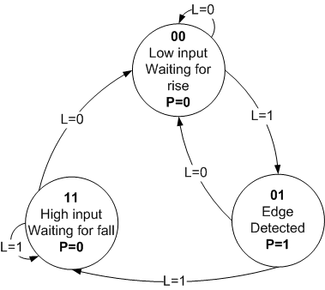
FSM Implementation
State Diagram (Moore implementation)
Current State |  | In | Next State |  | Out
S₁ | S₀ | L | S₁⁺ | S₀⁺ | P
0 | 0 | 0 | 0 | 0 | 0
0 | 0 | 1 | 0 | 1 | 0
0 | 1 | 0 | 0 | 0 | 1
0 | 1 | 1 | 1 | 1 | 1
1 | 1 | 0 | 0 | 0 | 0
1 | 1 | 1 | 1 | 1 | 0
Notes:
Moore implementation
Generamos un diagrama de transición y con esto la tabla de estados
Tenemos que generara una tabla para que indica que se tiene que poner en la entrada de los FF para que cambien de un estado a otro
En la tabla se muestra estado presente y el estado actual
Para cada tipo de FF tenemos que hacer una tabla para cada una de las entradas de los FF, para hacer que cambien a una cierta entrada, se responde la pregunta ¿Qué se tiene que poner en la entrada del FF para que se logre el cambio deseado?
Se genera una nueva columna que muestra que es lo que se tiene en la entrada de los FF

Slide 55
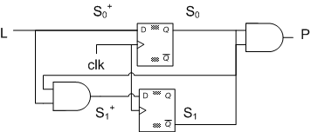
FSM Implementation
Logic implementation
P
Comb Logic
S⁺
Comb Logic
L
Flip-Flops
For S₁⁺:
S
For P:
L\S₁S₀ | 00 | 01 | 11 | 10
0 | 0 | 0 | 0 | X
1 | 0 | 1 | 1 | X
S₀\S₁ | 0 | 1
0 | 0 | X
1 | 1 | 0
For S₀⁺:
L\S₁S₀ | 00 | 01 | 11 | 10
0 | 0 | 0 | 0 | X
1 | 1 | 1 | 1 | X
Notes:
Definir el tipo de FF
Para el caso del FF D:
- se utiliza el estado presente y las entrada y se completa el M-K con los valores del estado futuro
Para el caso FF T
- se genera una tabla de entradas para que el FF cambie al estado deseado
- se utiliza el estado presente y las entrada y se completa el M-K con la nueva columna con las entradas del FF

Slide 56
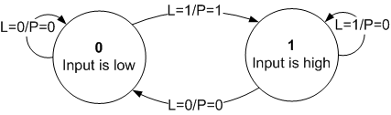
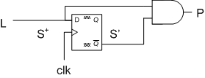
FSM Implementation
Mealy implementation
Since outputs are determined by state and inputs, Mealy FSMs may need fewer states than Moore FSM implementations
Pre State | In | Next State | Out
S | L | S⁺ | P
0 | 0 | 0 | 0
0 | 1 | 1 | 1
1 | 0 | 0 | 0
1 | 1 | 1 | 0
Notes:
Los cambios en la salidas son inmediatas dado que las salidas dependen tambien de las entradas
En este caso FSM es mas simple pues solo se recuerda el estado anterior de L

Slide 57
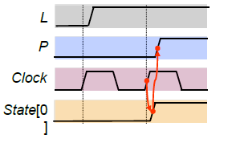
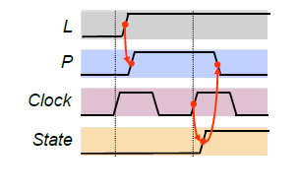
FSM Implementation
Moore/Mealy trade-off
Remember that the difference is in the output:
Moore outputs are based on state only
Mealy outputs are based on state and input
Therefore, Mealy outputs generally occur one cycle earlier than a Moore:
Compared to a Moore FSM, a Mealy FSM might...
Be more difficult to conceptualize and design
Have fewer states
Moore
Mealy
Notes:
The implementation, needs some extra work to optimize the implementation
Right selection of the state coding
Right selection of the registers
Eliminate the redundant states

Slide 58
HDL FSM Implementation
Binary Encoding
Straight encoding of states
S0=“00” S1=“01” S2=“10” S3=“11”
For n states, there are [log₂(n)] flip-flops needed
This gives the least numbers of flip-flops
Good for “Area” constrained designs
Number of possible illegal states = 2^{[log}₂^{(n)]}–n
Drawbacks:
Multiple bits switch at the same time = Increased noise and power
Next state logic is multi-level = Increased power and reduced speed
Notes:
Un a de las cosas que hicimos en la parte anterior fue definir
[] Escalón

Slide 59
HDL FSM Implementation
Gray-Code Encoding
Encoding using a gray code where only one bit switches at a time
S0=“00” S1=“01” S2=“11” S3=“10”
For n states, there are [log₂(n)]flip-flops needed
This gives low power and noise due to only one bit switching
Good for “power/noise” constrained designs
Number of possible illegal states = 2^{[log}₂^{(n)]}–n
Drawbacks:
The next state logic is multi-level = Increased power and reduced speed
Notes:
[] Escalon superior

Slide 60
HDL FSM Implementation
One-Hot Encoding
Encoding one flip-flop for each state
S0=“0001” S1=“0010” S2=“0100” S3=“1000”
For n states, there are n flip-flops needed
The combination logic is one level (i.e., a decoder)
Good for speed
Especially good for FPGA due to “Programmable Logic Block”
Number of possible illegal states = 2^{n}–n
Drawbacks:
Takes more area

Slide 61
HDL FSM Implementation
State Encoding Trade-Offs
Typically trade off Speed, Area, and Power
One-Hot
Speed
Area
Power
Binary
Gray

Slide 62
HDL FSM Implementation
FSM Coding goals
The FSM coding style should be easily modified to change state encodings and FSM styles
The coding style should be compact
The coding style should be easy to code and understand
The coding style should facilitate debugging
The coding style should yield efficient synthesis results
Notes:
Three different FSM designs will be examined
Un a de las cosas que hicimos en la parte anterior fue definir un codificacion de los estados, veamos las posibles opciones y sus caracteristicas

Slide 63
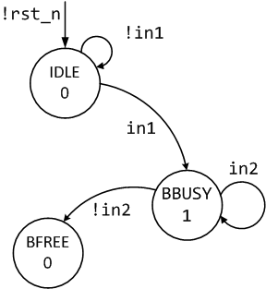
HDL FSM Implementation
Two Always Block FSM Style (Good Style)
One of the best Verilog coding styles
Code the FSM design using two always blocks,
One for the sequential state register
One for the combinational next-state and combinational output logic.
parameter [1:0]
IDLE=2'b00, BBUSY=2'b01,BFREE=2'b10;
reg [1:0] state, next;
always @(posedge clk or negedge rst_n)
if (!rst_n) state <= IDLE;
else state <= next;
always @(state or in1 or in2) begin
next = 2'bx; out1 = 1'b0;
case (state)
IDLE : if (in1) next = BBUSY;
else next = IDLE;
BBUSY: begin
out1 = 1'b1;
if (in2) next = BBUSY;
else next = BFREE;
end
//...
endcase
end
Notes:
Parameters are used to define state encodings instead of the Verilog `define macro definition construct[3].
The sequential always block is coded using nonblocking assignments.
The combinational always block sensitivity list is sensitive to changes on the state variable and all of the inputs referenced in the combinational always block.
Assignments within the combinational always block are made using Verilog blocking assignments.
Default output assignments are made before coding the case statement (this eliminates latches and reduces the amount of code required to code the rest of the)
Placing a default next state assignment on the line immediately following the always block sensitivity list is a very efficient coding style
- This is a useful technique to debug state machine designs, plus the X's will be treated as "don't cares" by the synthesis tool.

Slide 64
HDL FSM Implementation
Two Always Block FSM Style (Good Style)
Use parameters to define state names because the state name is a constant that applies only to the FSM module
The sequential always block is coded using nonblocking assignments, in order to module sequential logic (accurately simulate hardware)
parameter [1:0]
IDLE=2'b00, BBUSY=2'b01,BFREE=2'b10;
reg [1:0] state, next;
always @(posedge clk or negedge rst_n)
if (!rst_n) state <= IDLE;
else state <= next;
always @(state or in1 or in2) begin
next = 2'bx; out1 = 1'b0;
case (state)
IDLE : if (in1) next = BBUSY;
else next = IDLE;
BBUSY: begin
out1 = 1'b1;
if (in2) next = BBUSY;
else next = BFREE;
end
//...
endcase
end
1
2
Notes:
2: this help to accurately simulate hardware

Slide 65
HDL FSM Implementation
Two Always Block FSM Style (Good Style)
The combinational always block sensitivity list is sensitive to changes on the state variable and all of the inputs referenced in the combinational always block.
Assignments within the combinational always block are made using Verilog blocking assignments, in order to module sequential logic (accurately simulate hardware)
parameter [1:0]
IDLE=2'b00, BBUSY=2'b01,BFREE=2'b10;
reg [1:0] state, next;
always @(posedge clk or negedge rst_n)
if (!rst_n) state <= IDLE;
else state <= next;
always @(state or in1 or in2) begin
next = 2'bx; out1 = 1'b0;
case (state)
IDLE : if (in1) next = BBUSY;
else next = IDLE;
BBUSY: begin
out1 = 1'b1;
if (in2) next = BBUSY;
else next = BFREE;
end
//...
endcase
end
3
4
Notes:
3:

Slide 66
HDL FSM Implementation
Two Always Block FSM Style (Good Style)
parameter [1:0]
IDLE=2'b00, BBUSY=2'b01,BFREE=2'b10;
reg [1:0] state, next;
always @(posedge clk or negedge rst_n)
if (!rst_n) state <= IDLE;
else state <= next;
always @(state or in1 or in2) begin
next = 2'bx; out1 = 1'b0;
case (state)
IDLE : if (in1) next = BBUSY;
else next = IDLE;
BBUSY: begin
out1 = 1'b1;
if (in2) next = BBUSY;
else next = BFREE;
end
//...
endcase
end
Default output assignments are made before coding the case statement (this eliminates latches and reduces the amount of code required to code the rest of the)
Placing a default next state assignment on the line immediately following the always block sensitivity list is a very efficient coding style
6
5
Notes:
Placing a default next state assignment on the line immediately following the always block sensitivity list is a very efficient coding style
- This is a useful technique to debug state machine designs, plus the X's will be treated as "don't cares" by the synthesis tool.

Slide 67
HDL FSM Implementation
One Always Block FSM Style (Avoid This Style!)
parameter [1:0]
IDLE=2'b00, BBUSY=2'b01,BFREE=2'b10;
reg [1:0] state;
always @(posedge clk or negedge rst_n)
if (!rst_n) begin
state <= IDLE;
out1 <= 1'b0;
end
else begin
state <= 2'bx; out1 <= 1'b0;
case (state)
IDLE : if (in1) begin
state <= BBUSY;
out1 <= 1'b1;
end
else state <= IDLE;
BBUSY: if (in2) begin
state <= BBUSY;
out1 <= 1'b1;
end
else state <= BFREE;
endcase
end
One of the most common FSM coding styles in use today
It is more verbose
It is more confusing
It is more error prone
(comparable two always block coding style)
Notes:
A declaration is made for state. Not for next.
There is just one sequential always block, coded using nonblocking assignments.
The state assignments do not correspond to the current state of the case statement, but the state that case statement is transitioning to. This is error prone (but it does work if coded correctly).
All outputs will be registered (unless the outputs are placed into a separate combinational always block or assigned using continuous assignments). No asynchronous Mealy outputs can be generated from a single synchronous always block.

Slide 68
HDL FSM Implementation
One Always Block FSM Style (Avoid This Style!)
parameter [1:0]
IDLE=2'b00, BBUSY=2'b01,BFREE=2'b10;
reg [1:0] state;
always @(posedge clk or negedge rst_n)
if (!rst_n) begin
state <= IDLE;
out1 <= 1'b0;
end
else begin
state <= 2'bx; out1 <= 1'b0;
case (state)
IDLE : if (in1) begin
state <= BBUSY;
out1 <= 1'b1;
end
else state <= IDLE;
BBUSY: if (in2) begin
state <= BBUSY;
out1 <= 1'b1;
end
else state <= BFREE;
endcase
end
A declaration is made for state. Not for next.
The state assignments do not correspond to the current state of the case statement, but the state that case statement is transitioning to. This is error prone (but it does work if coded correctly).
1
2
Notes:
Since there is no next state, the state assignment, correspond the next state

Slide 69
HDL FSM Implementation
One Always Block FSM Style (Avoid This Style!)
There is just one sequential always block, coded using nonblocking assignments. Difficult to track the changes
All outputs will be registered. No asynchronous Mealy outputs can be generated from a single synchronous always block.
parameter [1:0]
IDLE=2'b00, BBUSY=2'b01,BFREE=2'b10;
reg [1:0] state;
always @(posedge clk or negedge rst_n)
if (!rst_n) begin
state <= IDLE;
out1 <= 1'b0;
end
else begin
state <= 2'bx; out1 <= 1'b0;
case (state)
IDLE : if (in1) begin
state <= BBUSY;
out1 <= 1'b1;
end
else state <= IDLE;
BBUSY: if (in2) begin
state <= BBUSY;
out1 <= 1'b1;
end
else state <= BFREE;
endcase
end
3
4
Notes:
3 difficult to see when the varaibles changes it values

Slide 70
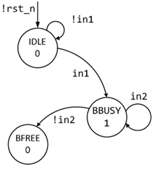
HDL FSM Implementation
One-hot FSM Coding Style (Good Style)
parameter [1:0] IDLE=0, BBUSY=1,BFREE=2;
reg [2:0] state, next;
always @(posedge clk or negedge rst_n)
if (!rst_n) state <= 3’b001;
else state <= next;
always @(state or in1 or in2) begin
next = 3’b000; out1 = 1'b0;
case (1’b1) //ambit synthesis case full, parallel
state[IDLE] : if (in1) next[BBUSY] = 1’b1;
else next[IDLE] = 1’b1;
state[BBUSY]: begin
out1 = 1'b1;
if (in2) next[BBUSY] = 1’b1;
else next[BFREE] = 1’b1;
end
//...
endcase
end
Efficient (small and fast) One-hot state machines can be coded using an inverse case statement

Slide 71
HDL FSM Implementation
Onehot FSM Coding Style (Good Style)
parameter [1:0] IDLE=0, BBUSY=1, BFREE=2;
reg [2:0] state, next;
always @(posedge clk or negedge rst_n)
if (!rst_n) state <= 3’b001;
else state <= next;
always @(state or in1 or in2) begin
next = 3’b000; out1 = 1'b0;
case (1’b1) //ambit synthesis case full, parallel
state[IDLE] : if (in1) next[BBUSY] = 1’b1;
else next[IDLE] = 1’b1;
state[BBUSY]: begin
out1 = 1'b1;
if (in2) next[BBUSY] = 1’b1;
else next[BFREE] = 1’b1;
end
//...
endcase
end
1
Index into the state register, not state encodings
One-hot requires larger declarations
State reset, set to 1 the IDLE bit
Next state assignment must make all-0's
2
3
4

Slide 72
HDL FSM Implementation
Onehot FSM Coding Style (Good Style)
parameter [1:0] IDLE=0, BBUSY=1, BFREE=2;
reg [2:0] state, next;
always @(posedge clk or negedge rst_n)
if (!rst_n) state <= 3’b001;
else state <= next;
always @(state or in1 or in2) begin
next = 3’b000; out1 = 1'b0;
case (1’b1) //ambit synthesis case full, parallel
state[IDLE] : if (in1) next[BBUSY] = 1’b1;
else next[IDLE] = 1’b1;
state[BBUSY]: begin
out1 = 1'b1;
if (in2) next[BBUSY] = 1’b1;
else next[BFREE] = 1’b1;
end
//...
endcase
end
Inverse case statement usage
Case branch check state values
Added “full” and parallel case pragmas
Only the next state bit
5
7
6
8
Notes:
Efficient (small and fast) one hot state machine can be coded using an inverse case statement
Full case (// synopsys full_case)
This directive prevents from generating logic to test for any value that is not covered by the case branches and creating an implicit default branch.
Set the full_case directive on a case statement when you know that all possible branches of the case statement are listed within the case statement.
Parallel case (// synopsys parallel_case)
Set the parallel_case directive on a case statement when you know that only one branch of the case statement will be true at a time.
This directive prevents Presto Verilog from building additional logic to ensure the first occurrence of a true branch is executed if more than one branch were true at one time.
The parallel_case statement tells the synthesis tool to not build a priority encoder even though in theory, more than one of the state bits could be set (as engineers, we know that this is a onehot FSM and that only one bit can be set so no priority encoder is required)

Slide 73
HDL FSM Implementation
Registered FSM Outputs (Good Style)
Registering the outputs of an FSM design
Insures that the outputs are glitch-free and frequently
Improves synthesis results by standardizing the output and input delay constraints of synthesized modules
output reg out1;
parameter [1:0] IDLE=2'b00, BBUSY=2'b01,BFREE=2'b10;
reg [1:0] state, next;
always @(posedge clk or negedge rst_n)
if (!rst_n) state <= IDLE;
else state <= next;
always @(state or in1 or in2) begin
next = 2'bx;
case (state)
IDLE : if (in1) next = BBUSY;
else next = IDLE;
BBUSY: if (in2) next = BBUSY;
else next = BFREE;
endcase
end
always @(posedge clk or negedge rst_n)
if (!rst_n) out1 <= 1'b0;
else begin
out1 <= 1'b0;
case (next)
IDLE, BFREE: ; // default outputs
BBUSY, BWAIT: out1 <= 1'b1;
endcase
end

Slide 74
Verilog for Synthesis

Slide 75
Outline
Lexical elements
Data type representation
Structures and Hierarchy
Operators
Blocks and Assignments
Control statements
Task and functions
Generate blocks
Notes:
Lexical elements: see lexical elements related to the language, line terminations, identifiers, keywords, compiler directives
Structures and Hierarchy: study the basic Verilog element module and how instantiate designs
Assignments: study how to assign variables, will see continuous assignments and procedural assignments
Data type: representation see data types and numbers representations
Operators: see available operators
Control statements: Control elements like if, case, for, etc.
Task and functions: task and function construct to simplify code
Generate blocks: to dynamic generate code

Slide 76
Outline
Lexical elements
Data type representation
Structures and Hierarchy
Operators
Blocks and Assignments
Control statements
Task and functions
Generate blocks
Notes:
Lexical elements: see lexical elements related to the language, line terminations, identifiers, keywords, compiler directives
Structures and Hierarchy: study the basic Verilog element module and how instantiate designs
Assignments: study how to assign variables, will see continuous assignments and procedural assignments
Data type: representation see data types and numbers representations
Operators: see available operators
Control statements: Control elements like if, case, for, etc.
Task and functions: task and function construct to simplify code
Generate blocks: to dynamic generate code

Slide 77
Lexical elements
Case sensitive - keywords are lower case
Semicolons(;) are line terminators
Comments:
One line comments start with // ...
Multi-line comments start with /* and end with */
System tasks and functions start with a dollar sign, ex $display, $signed
Notes:
System Task are defined by LRM, and provide functionally that can help on the simulation process for example

Slide 78
Lexical elements
Variable names have to start with an alphabetic character or underscore (_) followed by alphanumeric or underscore characters
Escaped identifiers (\)
Permit non alphanumeric characters in Verilog name
The escaped name includes all the characters following the backslash until the first white space character
wire \fo+o=a ; // Declare the varaible fo+o
wire \fo+o =a ; // Assign a to wire fo+o
Notes:
For example
wire \fo+o=a ; // Here we are declaring the varible fo+o=a=a
wire \fo+o =a ; // Here we are assigning a to the wire fo+o

Slide 79
Compiler directives
The directives start with a grave accent ( ` ) followed by some keyword
`define Text-macro substitution
`ifdef, `ifndef, `else, `endif Conditional compilation
`include File inclusion
`include “file1.v”
// Used as `WORD_SIZE in code
`define WORD_SIZE 32
module test ();
`ifdef TEST
// A implementation
`else
// B implementation
`endif
assign out = `WORD_SIZE{1’b1};
endmodule
Notes:
Show in the example
The difference usage od the macro
At the `ifdef we don’t include `
But on the macro replacement we include the `

Slide 80
Reserved keywords
Underline = supported by synthesis
always | and | assign | automatic | begin | buf | bufif0 | bufif1
case | casex | casez | cell | cmos | config | deassign | default
defparam | design | disable | edge | else | end | endcase | endconfig
endfunction | endgenerate | endmodule | endprimitive | endspecify | endtable | endtask | event
for | force | forever | fork | function | generate | genvar | highz0
highz1 | if | ifnone | incdir | include | initial | inout | input
instance | integer | join | large | liblist | library | localparam | macromodule
medium | module | nand | negedge | nmos | nor | noshowcancelled | not
notif0 | notif1 | or | output | parameter | pmos | posedge | primitive
pull0 | pull1 | pulldown | pullup | pulsestyle_ onevent | pulsestyle_ ondetect | rcmos | real
realtime | reg | release | repeat | rnmos | rpmos | rtran | rtranif0
rtranif1 | scalared | showcancelled | signed | small | specify | specparam | strong0
strong1 | supply0 | supply1 | table | task | time | tran | tranif0
tranif1 | tri | tri0 | tri1 | triand | trior | trireg | unsigned
use | uwire | vectored | wait | wand | weak0 | weak1 | while
wire | wor | xnor | xor
Notes:
Not all of them are supported by synthesis
The lenguage doesn’t allow varaible/module name with this words (this are reserved words)
The ones in blue are supprted by synthesis

Slide 81
Outline
Lexical elements
Data type representation
Structures and Hierarchy
Operators
Blocks and Assignments
Control statements
Task and functions
Generate blocks
Notes:
Lexical elements: see lexical elements related to the language, line terminations, identifiers, keywords, compiler directives
Structures and Hierarchy: study the basic Verilog element module and how instantiate designs
Assignments: study how to assign variables, will see continuous assignments and procedural assignments
Data type: representation see data types and numbers representations
Operators: see available operators
Control statements: Control elements like if, case, for, etc.
Task and functions: task and function construct to simplify code
Generate blocks: to dynamic generate code

Slide 82
Logical values
A bit can have any of these values
0 representing logic low (false)
1 representing logic high (true)
X representing either 0, 1, or Z
Z representing high impedance for tri-state (unconnected inputs are set to Z)
Notes:
X in synthesis is don’t care let the synthesis tool do optimizations
X in simulation is unknown

Slide 83
Logical values
Logic with multilevel (0,1,X,Z) logic values
Nand anything with 0 is 1
Nand two X get an X
True tables define the how outputs are compute
& | 0 | 1 | X | Z
0 | 0 | 0 | 0 | 0
1 | 0 | 1 | X | X
X | 0 | X | X | X
Z | 0 | X | X | X
| | 0 | 1 | X | Z
0 | 0 | 1 | X | X
1 | 1 | 1 | 1 | 1
X | X | 1 | X | X
Z | X | 1 | X | X
Notes:
What happens with X in synthesis?
This are elements that can be optimize, pick the value that helps to optimize the circuit
LRM have the true tables for all the operations
Show the example tables

Slide 84
Number representation
<size>'<base format><number>
<size>:
number of bits (optional)
<base format>:
It is a single character ' followed by one of the following characters b, d, o and h, which stand for binary, decimal, octal and hex, respectively.
<number>
Contains digits which are legal for the <base format>
‘_’ underscore can be use for readability
Notes:
Why we would like to define a size of the numer representation?

Slide 85
Number representation
Negative numbers are store as 2’s complement
Extended number
If MSB is 0, X or Z number is extended to fill MSBs with 0, X, Z respectively
If MSB is 1 number is extend to fill MSBs with 0/1, depending on the sign
3’b01=3’b001 3’bx1=3’bxx1 3’bz=3’bzz
3’b1=3’b001 -3’b1=-3’b01=3’b111
Notes:
From VCS (Extended numbers)
5'b1 = 00001
-5'b1 = 11111
5'b1x = 0001x
-5'b1x = xxxxx
-5'b01 =11111

Slide 86
Number representation
Unsized numbers (at least 32 bit)
549 // decimal number
'h8F_F // hex number
'o765 // octal number
Size numbers
4'b11 // 4-bit binary number 0011
3'b10x // 3-bit binary number with LSM bit unknown
8'hz // 8-bit binary high-impedance number
4'hz1 // 4’bzzz1
5'd3 // 5-bit decimal number
Signed numbers
-8'd6 // 8-bit two's complement of 6 (-6)
4'shF // 4-bit number ‘1111’ to be interpreted as
// 2’s complement number
Notes:
Note
For the negatives numbers
-8’d6=8’b11111010
4’shF=4’b1111 = -1
The others weird number definitions:
8'h0F = 8’b00001111
8'hF = 8’b00001111
8'hz = 8’bZZZZZZZZ
8'h0z = 8’b0000ZZZZ
8'h0x = 8’b0000XXXX
8'hx = 8’bXXXXXXXX

Slide 87
Data types (reg)
A reg (reg) stores its value from one assignment to the next (model data storage elements)
Don’t confuse reg with register
Default value is X
Default range is one bit
By default are unsigned, but can be declare signed, using keyword signed
Notes:
Don’t read a reg as a register!!

Slide 88
Data types (Nets)
Nets (wire) correspond to physical wires that connect instances
Nets do not store values
Have to be continuously driven
The default range is one bit
By default are unsigned
The wire declaration is used most frequently, other net types are wand, wor, tri, triand, trior, etc.
Notes:
Don’t read a reg as a register!!
Other wire type:
tri :
Denotes nets that have multiple drivers
Is there are 2 signal of appositive values, the results is X
wor, wand, trior, triand
Performs operations
wand: (and operation) if any value is 0, the value of the net is 0
wor: (or operation) if any value is 1, the value of the net is 1
trior, triand have the same functionality as wor, wand

Slide 89
Other data types
Integer (integer)
Convenient to counting purposes
At least 32-bit wide
Useful for loop
Real (real) simulation only
Can be specified in decimal and scientific notation

Slide 90
Verilog vectors
Know as BUS in hardware
Declare by a range following the type
<data type> [left range : right range] <Variable name>
Single element that is n-bits wide
reg [0:7] A, B; //Two 8-bit reg with MSB as the 0th bit
wire [3:0] Data; //4-bit wide wire MSB as the 4th bit
Vector part select (access)
A[5] // bit # 5 of vector A
Data[2:0] // Three LSB of vector Data
Vector operation
B = 32 + A;
Notes:
[0:7] Big endian notation
[7:0] Little endian notation
Shows that I can actually operate 2 vectors
This is a Systmet verilog packed array
It is possible to operate element write in little and big endian, but is not recomeneded

Slide 91
Verilog arrays
Array: range follows the name
<data type> <array name> [<array indices>]
reg B [15:0]; // array of 16 reg elements
Array of vectors
<data type> [<vector indices>]<array name>[<array indices>]
reg [15:0] C [1023:0]; // array of vectors
Memory access
<var name>[<array indices>] [<vector indices>]
Notes:
Array is a collection
Vectors : single element that is n-bits wide
Array: Multiple elements that are 1-bit or n-bits wide
Multi-dimentional arrays can be declared with any number of dimensions

Slide 92
Data storage and Verilog arrays
Simple RAM Model
module RAM (output [7:0] Obus,
input [7:0] Ibus,
input [3:0] Adr,
input Clk, Read
);
reg [7:0] Storage [15:0];
reg [7:0] ObusReg;
assign Obus = ObusReg;
always @(posedge Clk)
if (Read==1’b0) Storage[Adr] = Ibus;
else ObusReg = Storage[Adr];
endmodule
Notes:
module RAM (
output [7:0] Obus, // Vector 8 bit-wide
input [7:0] Ibus, // Vector 8 bit-wide
input [3:0] Adr, // Vector 3 bit-wide
input Clk, Read
);
reg [7:0] Storage[15:0]; // Array of Vectors // (16 elements of 8 bits)
reg [7:0] ObusReg;
assign Obus = ObusReg; // Vector assignment
always @(posedge Clk)
if (Read==1’b0)
Storage[Adr] = Ibus; // Vector assignment to one elements
//from the array of vectors
else
ObusReg = Storage[Adr];
endmodule

Slide 93
Data storage and Verilog arrays
Counter
module cter (input rst, clock, jmp,
input [7:0] jump,
output reg [7:0] count
);
always@(posedge clock)
begin
if (rst) count = 0;
else if (jmp) count = jump + count;
else count = count + 1;
end
endmodule
Notes:
module cter (input rst, clock, jmp,
input [7:0] jump, // vectors (bus) as ports
output reg [7:0] count
);
always@(posedge clock)
begin
if (rst) count = 8’h00;
else if (jmp) count = jump + count; // Operations with vectors
else count = count + 8’h1;
end
endmodule

Slide 94
Outline
Lexical elements
Data type representation
Structures and Hierarchy
Operators
Blocks and Assignments
Control statements
Task and functions
Generate blocks
Notes:
Lexical elements: see lexical elements related to the language, line terminations, identifiers, keywords, compiler directives
Structures and Hierarchy: study the basic Verilog element module and how instantiate designs
Assignments: study how to assign variables, will see continuous assignments and procedural assignments
Data type: representation see data types and numbers representations
Operators: see available operators
Control statements: Control elements like if, case, for, etc.
Task and functions: task and function construct to simplify code
Generate blocks: to dynamic generate code

Slide 95
Structures and Hierarchy
Hierarchical HDL structures are achieved by defining modules and instantiating modules
top.v
comp.v
mux.v
Notes:
Module TOP instantiate ALU and MEM designs are name U1 and U2…
This is one of the most importan elemetns, since it enable the creation of more complex designs

Slide 96
Module declaration
module <module name> #(<param list>) (<port list>);
<Declarations>
<Instantiations>
<Data flow statements>
<Behavioral blocks>
<Task and functions>
endmodule
Notes:
Module is the basic element.
<module name>: is an identifier that uniquely names the module.
#(<parameter list>) parameter are optional
<port list> : is a list of input, inout and output ports which are used to connect to other modules.
<declarations>: section specifies data objects as registers, memories, wires and parameters, port list declarations
<Data flow statements> : assign
<Instantiations> : instantiation off lower level modules
<Behavioral blocks> describe behavior, inside always or initial block
<task and functions>: task and function declarations

Slide 97
Module header
Start with module keyword, contains the I/O ports
Port declarations begins with output, input or inout follow by bus indices
Each directions are followed by one or more I/O names
Each declaration is separated by comma (,)
module ALU (output [15:0] res,
output cout,
input [15:0] A, B,
input clock, ena);
Notes:
Notes:
Bus indices are needed when the size of the ports are more than 1 bit width
Module header ends with ;
Also parameters can be defined

Slide 98
Port declaration
input and inout are declared as wire
outputs port can be declared wire as reg (holds a value)
2 flavors for port declaration:
module S1 (a, b, c, d, e);
input [1:0] a, b;
input c;
output reg [1:0] d;
output e;
//Verilog 1995 Style
endmodule
module S2 (input [1:0] a, b,
input c,
output reg [1:0] d,
output e);
//ANSI C Style
endmodule
Notes:
Verilog -1995 is other way that is repetitive
Verilg-2001 (Ansi-C) defines the directions in the module header

Slide 99
Parameters
Parameters are means of giving names to constant values
The values can be overridden when the design is compiled
Parameters cannot be used as variables
Syntax
parameter <name> = <constant expression>;

Slide 100
Parameter declaration
Default value need to be set at declaration time
32 bit wide by default, but may be declared of any width
2 declaration flavors:
Inside a module In module header
parameter [2:0] IDLE = 3’d0;
module test (... I/O’s ...);
parameter ASIZE = 32, BSIZE =16;
//...
reg [ASIZE -1:0] Abus, Zbus;
wire [BSIZE-1:0] Bwire;
//...
endmodule
module test
#(parameter ASIZE = 32, BSIZE =16)
(... I/O’s ...);
//...
reg [ASIZE -1:0] Abus, Zbus;
wire [BSIZE-1:0] Bwire;
//...
endmodule
Notes:
Show what can be done with the parameters, for example set the size of inputs
How do you think the instantiation is done now

Slide 101
Parameter example
module Adder (A, B, Cin, S,Cout, Clk);
parameter N=8;
input [N-1:0]A, B;
input Cin;
input Clk;
output [N-1:0] S;
output Cout;
reg [N-1:0] S;
reg Cout;
//module internals
endmodule
A[N-1:0]
Adder
N-bits (8 by default)
reg-ouputs
S[N-1:0]
B[N-1:0]
Cin
Cout
Clk
module Adder #(parameter N=8)
(input [N-1:0]A, B,
input Cin,
input Clk,
output reg [N-1:0] S,
output reg Cout
);
//module internals
endmodule
Verilog 95 Style
ANSI C style
Notes:
N by default is 8
Registered ouputs

Slide 102
Structures and Hierarchy
Instance of a module
Instantiation is the process of “calling” a module
Create objects from a module template
<module name> #(<parameter list>)
<instance name> (<port list>);
Where:
<module name> Module to be instantiated
<parameter list> Parameters values passed to the instance
<instance name> Identifies the instance of the module
<port list> Port list connection

Slide 103
Port List Connections
Ports list connections
Provide the interface by which a module can communicate with the environment
Port declarations (input, output, inout)
reg or net
net
reg or net
net
input
output
net
inout
net
Notes:
By default ports are declares as wire
Is legal to connect element with different sizes on port connections
Port declaration can be done in the declaration section or in the port list definition
Inputs:
Internally must be of net data type (e.g. wire)
Externally the inputs may be connected to a reg or net data type
Outputs:
Internally may be of net or reg data type
Externally must be connected to a net data type
Inouts:
Internally must be of net data type (tri recommended)
Externally must be connected to a net data type (tri recommended)

Slide 104
Port connections/Parameter overwrite
Named connection
Explicitly linking the 2 names for each side of the connection
my_mod #(.N(4)) U1 (.in1(a), .in2(b), .out(c));
Order connection
Expression shall be listed in the same order as the port declaration
my_mod #(4) U2 (a, b, c);
Notes:
Ask how to leave a port unconnected
ANS:
my_mod U1 (.in1(a), .in2(), .out(c));
my_mod U2 (a, , c);

Slide 105
Hierarchy Example
module TOP (input t1, t2, t3, output t4, t5, t6);
wire w1, w2, w3;
ALU #(.S(2)) U1 (.a1(t1), .a2(t2), .a3(t3), .a4(w1), .a5(w2), .a6(w3));
MEM U2 (w1, w2, w3, t4, t5, t6);
endmodule
module ALU (input a1, a2, a3, output a4, a5, a6);
parameter S=4;
reg rsl;
wire sig;
FIFO S1 (.f1(rsl), .f3(sig));
//...
endmodule
module FIFO #(parameter F=2)
(input f1, output reg f2);
//...
endmodule
TOP
U1
ALU
S1
FIFO
U2
MEM
Notes:
Module TOP instantiate ALU and MEM designs are name U1 and U2…

Slide 106
Outline
Lexical elements
Data type representation
Structures and Hierarchy
Operators
Blocks and Assignments
Control statements
Task and functions
Generate blocks
Notes:
Lexical elements: see lexical elements related to the language, line terminations, identifiers, keywords, compiler directives
Structures and Hierarchy: study the basic Verilog element module and how instantiate designs
Assignments: study how to assign variables, will see continuous assignments and procedural assignments
Data type: representation see data types and numbers representations
Operators: see available operators
Control statements: Control elements like if, case, for, etc.
Task and functions: task and function construct to simplify code
Generate blocks: to dynamic generate code

Slide 107
Relational operators
Mainly use in expression (e.g. if sentences)
Returns a logical value (1/true 0/false)
If there are any X or Z bit returns X (false on a expression)
< | a < b | // is a less than b?
> | a > b | // is a greater than b?
>= | a >= b | // is a greater than or equal to b
<= | a <= b | // is a less than or equal to b
Notes:
Relational Operators return 1-bit true/false

Slide 108
Arithmetic operators
Binary operators
Takes 2 operators
Unary operators (+/-)
Specify the sign of the operand
Negative numbers are represented as 2’s complement
* | c = a * b ; | // multiply a with b
/ | c = a / b ; | // int divide a by b
+ | sum = a + b ; | // add a and b
- | diff = a - b ; | // subtract b from a
% | amodb = a % b ; | // a mod(b)
Notes:
What happens if one of the elements have a X
Simulation, the entire expression is X
Synthesis, may be optimize

Slide 109
Logical operators
Logical operators evaluate to a 1-bit value
If an operand is not zero is treat as logical 1
If an operand is Z o X is treat as X (false)
&& | a && b ; | // is a and b true? returns 1-bit true/false
|| | a || b ; | // is a or b true? returns 1-bit true/false
! | if (!a) c = b; | // if a is not true assign b to c
A=3; B=0;
A&&B //Evaluates to 0 same to (logical-1 && logical-0)
!B //Evaluates to 1 same to (!logical-0)
A=2’b0x; B=2’b10;
A&&B //Evaluates to x same to (x && logical-0)
Notes:
Returns 1 bit

Slide 110
Equality and Identity operators
== | c == a ; | /* is c equal to a returns 1-bit true/false applies for 1 or 0, logic equality, using X or Z operands returns always false ('hx == 'h5 returns 0) */
!= | c != a ; | // is c not equal to a, returns 1-bit true
=== | a === b ; | // is a identical to b (includes 0, 1, x, z)
!== | a !== b ; | /* is a not identical to b returns 1-bit true/false*/
Notes:
=== and !== do a bit by bit comparison

Slide 111
Bitwise and Reduction operations
& | b = &a ; | /* AND all bits of a (reduction) */
| | b = |a ; | /*OR all bits (reduction)*/
^ | b = ^a ; | /*Exclusive or all bits of a (reduction)*/
~&,~|,~^ | c = ~& b ; | /* NAND, NOR, EX-NOR all bits together */
~,&,|,^ | b = ~a ; e = b | a | /*bit-wise NOT, AND, OR, EX-OR*/
~&,~|,~^ | e = a ~^ b ; | /*bit-wise NAND, NOR, EX-NOR*/

Slide 112
Shift and other operator
<< | a << 1 ; | // shift left a by 1-bit
>> | a >> 1 ; | // shift right a by 1
<<< | b <<< 1 ; | // arithmetic shift by 1
>>> | b >>> 1 ; | // arithmetic shift by 1
?: | c = sel ? a : b ; | /* if sel is true c = a, else c = b , ?: ternary operator */
{} | {co, sum} = a + b + ci; | /* add a, b, ci assign the overflow to co and the result to sum: operator is called concatenation */
{{}} | b = {3{a}} | /* replicate a 3 times, equivalent to {a,a,a} */

Slide 113
Operators precedence
Unary, Multiply, Divide, Modulus | +,-,!,~ | Highest
 | *, / %
Add, subtract, shift | +, -
 | <<. >>
Relational Equality | <, < =, >, >=
 | =, ==. !=
 | ===, !==
Reduction Logical | &, ~&
 | ^, ^~
 | |, ~|
 | &&
 | ||
Conditional | ?: | Lowest
Operator precedence
Notes:
Always you can use the extra () to be sure

Slide 114
Outline
Lexical elements
Data type representation
Structures and Hierarchy
Operators
Blocks and Assignments
Control statements
Task and functions
Generate blocks
Notes:
Lexical elements: see lexical elements related to the language, line terminations, identifiers, keywords, compiler directives
Structures and Hierarchy: study the basic Verilog element module and how instantiate designs
Assignments: study how to assign variables, will see continuous assignments and procedural assignments
Data type: representation see data types and numbers representations
Operators: see available operators
Control statements: Control elements like if, case, for, etc.
Task and functions: task and function construct to simplify code
Generate blocks: to dynamic generate code

Slide 115
Concurrent blocks
Blocks of code with no well-defined order relative to one another
Module instance is the most important concurrent block
Continuous assignments are concurrent within a module
Procedural blocks are concurrent within a module
module AND (input A, B, output C);
wire w;
NAND U1 (A, B, w);
NAND U2 (w, w, C);
endmodule
Notes:
For example verilog source file can be compiled in a specific order, but it doesn’t define the order of simulation
Typo it should say
Continuous assignments, and procedural blocks are concurrent within a module

Slide 116
Continuous assignments
Continuous assignments imply that whenever any change on the RHS of the assignment occurs, it is evaluated and assigned to the LHS
Continuous assignments always implement combinational logic
Continuous assignments drive wire variables
wire A;
assign A = (B|C)&D;
Notes:
Delays are ignore on synthesis

Slide 117
Continuous assignments
Implicit continuous assignment
Continuous assignment can be placed when the net is declared
Implicit net declaration (not recommended)
If a signal name is used to the left of a continuous assignment, a implicit net declaration will be inferred
wire A = i1 & i2;
wire i1, i2;
assign A = i1 & i2;

Slide 118
Example
A
module NAND (A, B, C);
input A, B;
output C;
// Continuous assignments
assign C = ~(A&B);
endmodule
C
B
module AND (A, B, C);
input A, B;
output C;
wire w;
// 2 NAND instantiations
NAND U1 (A, B, w);
NAND U2 (w, w, C);
endmodule
A
C
B

Slide 119
Procedural blocks
Each procedural block represent a separate activity flow in Verilog
Procedural blocks
always blocks
Model a block of activity that is repeated continuously
initial blocks simulation only
Model a block of activity that is executed at the beginning
Multiple behavioral statements can be grouped using keywords begin and end
Notes:
Verilog is a concurrent programming language
C is sequential in nature
Each procedural block represent a separate activity flow in Verilog

Slide 120
Procedural assignments
Procedural assignment changes the state of a reg
Used for both combinational and sequential logic inference
All procedural statements must be within always (or initial) block
reg A;
always @ (B or C)
begin
A = ~(B & C);
end

Slide 121
Always block – Event control (@)
Always blocks model an activity that is repeated continuously
@ can control the execution
posedge or negedge make sensitive to edge
@* / @(*), are sensitive to any signal that may be read in the statement group
Use “,”/or for multiple signals
Notes:
Sensitivity list options
always @* // looks for any changes in the variables read inside the always block
always @ (event)
always @ (event1 or event2)
always @ (event1 , event2) // same as or was introduce en 2001
always @ (event1 and event2) // Not allowed

Slide 122
Always block – Event control (@)
module M1 (input B, C, clk, rst, output reg X, Y,Z);
// controlled by any value change in B or C
always @ (B or C)
X = B & C;
// Controlled by positive edge of clk
always @(posedge clk)
Y = B & C;
// Controlled by negative edge of clk or rst
always @(negedge clk, negedge rst)
if (!rst) Z = 1’b0;
else Z = B | C;
endmodule
Notes:
This is the first slide where the if and else is show, explain a little bit

Slide 123
Example
D
Q
D
Q
R
G
module FFD (input Clk, R, D,
output reg Q);
always @ (posedge Clk)
begin
if (R)
Q = 1'b0;
else
Q = D;
end
endmodule
module LD (G, D, Q);
input G, D;
output Q;
reg Q;
always @ (G or D)
if (G)
Q = D;
endmodule
Notes:
DFF has a synchronous reset
How we can transform this to an asynchronous reset DFF?
If the sensitivity list is like this “always @ (posedge Clk or positive R)” the DFF has an asynchronous reset

Slide 124
Blocking / Non-Blocking assignment
Blocking assignment
(= operator) acts much like in traditional programming languages
The whole statement is done before control passes on to the next statement.
Non-blocking assignment
(<= operator) Evaluates all the right-hand sides for the current time unit and assigns the left-hand sides at the end of the time unit.
always @(posedge Clk)
begin
//blocking procedural assignment
C = C + 1;
A = C + 1;
end
always @(posedge Clk)
begin
//non-blocking procedural assignment
D <= D + 1;
B <= D + 1;
end
Example: During every clock cycle
A is ahead of C by 1
B is same as D
Notes:
ASK: Which are the values of A and C; and D and B!
HERE
Agregar un dibujo con la inferencia de registros que se obtiene

Slide 125
Blocking/Non-Blocking example
module t (input clk, A,
output reg B, C);
always @(posedge clk)
begin
B <= A;
C <= B;
end
endmodule
module t (input clk, A,
output reg B, C);
always @(posedge clk)
begin
B = A;
C = B;
end
endmodule
B
B
DFF
DFF
DFF
A
D
Q
D
Q
C
A
D
Q
C
CLK
CLK
Notes:
Non-blocking: is like taking a picture B and C willl have the value of the registers (B and C will be updated at the same time)
Blocking: C will be updated after B is update, so they have the same value

Slide 126
Procedural blocks (summary)
Blocks of code within a procedural block are read (simulated, executed) in order
Procedural blocks may contain:
Blocking assignments
Non-blocking assignments
Procedural control statements (if, for, case)
function, or task calls
Event control (‘@’)
Nested procedural blocks enclosed in begin … end
Notes:
REVIEW

Slide 127
Outline
Lexical elements
Data type representation
Structures and Hierarchy
Operators
Blocks and Assignments
Control statements
Task and functions
Generate blocks
Notes:
Lexical elements: see lexical elements related to the language, line terminations, identifiers, keywords, compiler directives
Structures and Hierarchy: study the basic Verilog element module and how instantiate designs
Assignments: study how to assign variables, will see continuous assignments and procedural assignments
Data type: representation see data types and numbers representations
Operators: see available operators
Control statements: Control elements like if, case, for, etc.
Task and functions: task and function construct to simplify code
Generate blocks: to dynamic generate code

Slide 128
Conditional statements (if … else)
The statement occurs if the expressions controlling the if statement evaluates to true
True: 1 or non-zero value
False: 0 or ambiguous (X)
Explicit priority
always @ (WRITE or STATUS)
begin
if (!WRITE)
begin
out = oldvalue;
end
else if (!STATUS)
begin
q = newstatus;
end
end
if (<expression>)
// statement1
else if (<expression>)
// statement2
else
// statement3
Notes:
The expression is considered to be true is it non-zero, and false if it zero, X, or Z

Slide 129
Conditional statements (case)
case, casex, casez: case statements are used for switching between multiple selections
If there are multiple matches only the first is evaluated
Breaks automatically
casez treats Z as don’t care
casex treats Z and X as don’t care
case (<expression>)
<alternative 1> : <statement 1>;
<alternative 2> : <statement 2>;
default : <default statement>;
endcase
Notes:
Case statement compared 0, 1, x, z values in the expression and the alternatives bit for bit

Slide 130
Conditional statements (case)
always @(s, a, b, c, d)
case (s)
2'b00: out = a;
2'b01: out = b;
2'b10: out = c;
2'b11: out = d;
endcase
always @*
casex (state)
/*
during comparison : 3'b01z,
3'b01x, 3b'011 ... match case
3'b01x
*/
3'b01x: fsm = 0 ;
3'b0xx: fsm = 1 ;
default: fsm = 1 ;
endcase
always @*
casez (state)
// 3'b11z, 3'b1zz,... match 3'b1??
3'b1??: fsm = 0;
3'b01?: fsm = 1;
endcase
Notes:
always @* is a verilog-2001 feature
is it possible to do something similar with if sentences
Answer ==! and ===
Notes:
- if in one case have 2 or more branch that are the same option the first one will be use

Slide 131
Example
module mux(a, b, c, d, s, out);
input [7:0] a, b, c, d;
input [1:0] s;
output [7:0] out;
reg [7:0] out;
// used in procedural statement
always @ (s or a or b or c or d)
case (s)
2'b00: out = a;
2'b01: out = b;
2'b10: out = c;
2'b11: out = d;
endcase
endmodule
a
b
8-bit
4-to-1
multiplexer
out
c
d
s[0]
s[1]

Slide 132
Latches / Muxes (Comb logic)
Assuming only level sensitivity on a always block:
A variable or signal when is fully specified (it is assigned under all possible conditions) a mux or combinational logic.
If a variable or signal is not fully specified a latch will be inferred
always @ (a,b,sel) if (sel==1’b1) z=a; else z=b; | always @ (DATA, GATE) if (GATE) Q = DATA; | always @ (DATA, GATE) begin Q = 0; if (GATE) Q = DATA; end
MUX
LATCH
COMB LOGIC
Notes:
ASK which are the 3 blocks MUX/LATCH/COMB LOGIC
Assuming only level sensitive (no edge sensitivity)
Mux can be implemented as combinational logic
The last case will depend on the synthesis tool behavior
MUX: if-else is fully specified
LATCH: what happens if GATE is 0, nobody know, so the tools creates a latch to keep that value
COMB LOGIC: is like a mux, but the coding style doesn’t infer a MUX, this depends on the Synthesis tools

Slide 133
Loop statements (for)
Works the same ways as C
Unary increment/decrement is not allowed
for (<loop var init>; <loop var reentry expr>; <loop var update>)
<statement>;
// General purpose loop
interger i;
always @*
for (i=0 ; i<=7 ; i=i+1)
memory[i] = 0;
Notes:
Repeat is not supported by synthesis

Slide 134
Loop statements (while)
Loop execute until the expression is not true
always @*
while(delay)
// Multiple statement groups with begin-end
begin
ldlang = oldldlang;
delay = delay – 1;
end

Slide 135
Loop statements (repeat)
Repeat statement a specified number of times
The number is evaluated only at the beginning
always @*
repeat(`BIT-WIDTH)
begin
if (a[0]) out = b + out;
a = a << 1;
end
Notes:
What happens if the number that control the repeat loop is not a constant? Synthesis /simulation differences?

Slide 136
Outline
Lexical elements
Data type representation
Structures and Hierarchy
Operators
Blocks and Assignments
Control statements
Task and functions
Generate blocks
Notes:
Lexical elements: see lexical elements related to the language, line terminations, identifiers, keywords, compiler directives
Structures and Hierarchy: study the basic Verilog element module and how instantiate designs
Assignments: study how to assign variables, will see continuous assignments and procedural assignments
Data type: representation see data types and numbers representations
Operators: see available operators
Control statements: Control elements like if, case, for, etc.
Task and functions: task and function construct to simplify code
Generate blocks: to dynamic generate code

Slide 137
Tasks and Functions
Task and function serve the same purpose on Verilog as subroutines do in C
Task
Declare with task and endtask
May have zero arguments or more arguments of type input, output, inout
Do not return with a value, can pass values through output and inout arguments
Functions
Declare with function and endfunction
Must have at lease one input
Always return a single value (cannot have output or inout arguments)

Slide 138
Tasks and Functions - example
module top (input a1, a2, output reg [1:0] b1, b2);
always @ (a1, a2)
begin
b1 = out (a1, a2); // Function calling
out_task (a1, a2, b2); // Task calling
end
function [1:0] out (input in1, in2); // Function Declaration
begin
if (in1) out = {in2,in1}; else out = {in1,in2};
end
endfunction
task out_task (input in1, in2, output [1:0] out); // Task Declaration
begin
if (in1) out = {in2,in1}; else out = {in1,in2};
end
endtask
endmodule

Slide 139
Task and Functions
Functions are simpler
Data Sharing
Functions and task could be declare as automatic
A static function retains the value of all it's internal variables between calls. An automatic function re-initializes them each call
Function | Task
Can call another function | Can call another function or task
Can modify only one value | Can modify multiple values
Notes:
I terms of synthesis, a static function requires state elements (probably latches), while an automatic call is purely combinational
I terms of simulation, a static function allow recursive functions
function automatic [63:0] factorial;
input [31:0] n;
if (n == 1)
factorial = 1;
else
factorial = n * factorial(n-1);
endfunction

Slide 140
Outline
Lexical elements
Data type representation
Structures and Hierarchy
Operators
Blocks and Assignments
Control statements
Task and functions
Generate blocks
Notes:
Lexical elements: see lexical elements related to the language, line terminations, identifiers, keywords, compiler directives
Structures and Hierarchy: study the basic Verilog element module and how instantiate designs
Assignments: study how to assign variables, will see continuous assignments and procedural assignments
Data type: representation see data types and numbers representations
Operators: see available operators
Control statements: Control elements like if, case, for, etc.
Task and functions: task and function construct to simplify code
Generate blocks: to dynamic generate code

Slide 141
Generate blocks
Allow to generate Verilog code dynamically at elaboration time
Facilitated the parameterized model generation
Required the keywords generate – endgenerate
Generate instantiations can be
Module instantiations
Continuous assignments
initial / always blocks
Typically used are generate loop and conditional generate

Slide 142
Generate loop
module top( input [0:3] in1,
output [0:3] out1);
// genvar control the loop
genvar I;
generate
for(I=0; I<=3; I=I+1 )
begin
sub U1 (in1[I], out1[I]);
end
endgenerate
endmodule
Notes:
4 copies of design sub will be place
The naming standard is defined in the LRM
The genvar reserved word is used as the index control variable by generate for loops

Slide 143
Conditional generate
module top #(parameter POS=0)
(input in, clk, output reg out);
generate
if(POS==1)
always @ (posedge clk)
out = in;
else
always @ (negedge clk)
out = in;
endgenerate
endmodule

