Slide 1
Less is More:
Human and AI Summarization for Sentiment Analysis
Pablo T. Campos campos72@purdue.edu
Laura Martínez mart2180@purdue.edu

Slide 2
Introduction
Sentiment Analysis is of great importance for ecommerce. With companies having to analyze great bodies of text, it would be cheaper to analyze summaries of said texts.
However not all bodies of text come with a summary provided by the user. Could this summary be efficiently produced by a computer rather than by a human?

Slide 3

Research Question
Can we perform sentiment analysis on summaries instead of the original texts?
If so, may AI generated summaries convey more precise information than human summaries about the original texts?

Slide 4
Modeling
Fine tune a transformer model to perform abstractive summarization
Changed transformer model from BERT to T5 for computational reasons
For sentiment analysis, BoW logistic regression and a LSTM with randomly initialized embeddings
Used only a sample of the original dataset for computational reasons (10%)

Slide 5
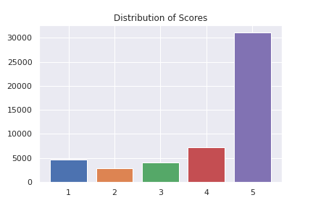
Experimental Setup: Dataset
Amazon Fine Food Reviews
Text | Summary | Score | Label
Review left by user | Summary of the review by said user | Score of the product, ranging from 1-5 | Scores 1 & 2: 0 (Negative) Scores 3: 1 (Neutral) Scores 4 & 5: 2 (Positive)

Slide 6
Experimental Setup: Tasks
Abstractive Summarization
Fine tune pretrained transformer model on Text with target Summary
Generate summaries for all instances: Generated Summary
Text | Summary | Generated Summary | Label
Review left by user | Summary of the review by said user | Summary generated by fine tuned transformer model from attribute Text | Scores 1 & 2: 0 (Negative) Scores 3: 1 (Neutral) Scores 4 & 5: 2 (Positive)

Slide 7
Experimental Setup: Tasks
Sentiment Analysis
3 Logistic regression models trained with BoW features on Text, Summary and Generated Summary to predict Label (Baseline model)
3 LSTM model trained on randomly initialized embeddings on Text, Summary and Generated Summary to predict Label

Slide 8
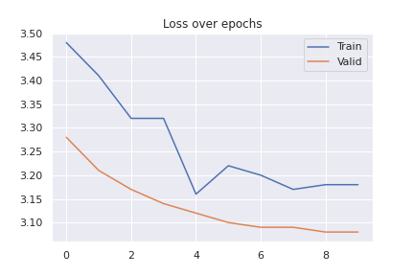
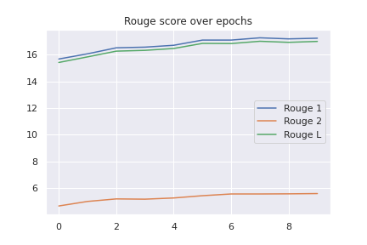
Experimental Results
Abstractive Summarization
Summary | Generated Summary
Good Quality Dog Food | Great product
Not as Advertised | Jumbo Salted Peanuts - I had this!
“Delight” says it all | The most flavorful treat
Cough Medicine | Best product in the industry
Great taffy | Great taffy

Slide 9
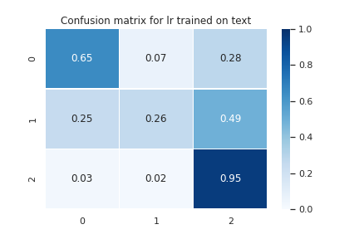
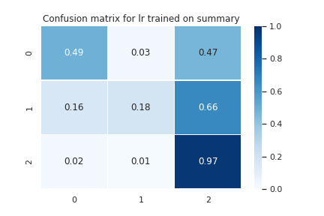
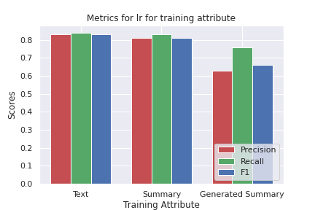
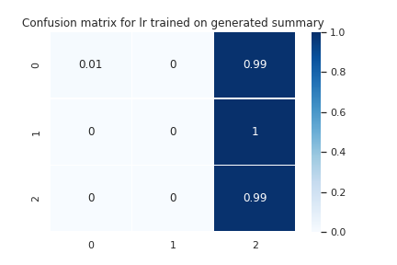
Experimental Results
Sentiment Analysis
Logistic Regression

Slide 10
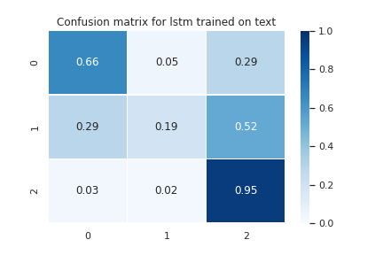
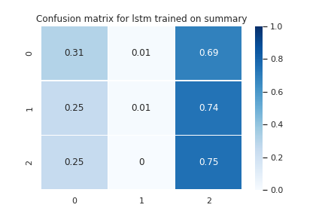
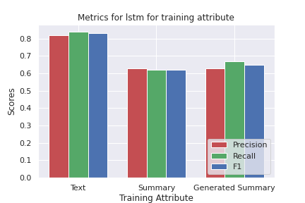
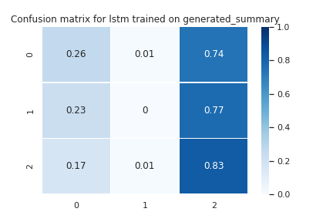
Experimental Results
Sentiment Analysis
LSTM

Slide 11
Discussion
Both models trained with either Summary or Generated Summary performed worse than those trained on Text
LSTM model trained on Generated Summary outperformed its counterpart trained on Summary
Logistic Regression trained on Generated Summary performed worse than its counterpart trained on Summary

Slide 12

THANKS!
Any questions?
You can find us at
campos72@purdue.edu Pablo T. Campos
mart2180@purdue.edu Laura Martínez

