Slide 1
Using Web workers in Javascript
Vitaliy Tarnavskyy
Jun 26, 2013

Slide 2
Agenda
Before the workers: history
Simple examples
Accessibility and environment
Workers features
Shared workers
Usage tips
Examples

Slide 3
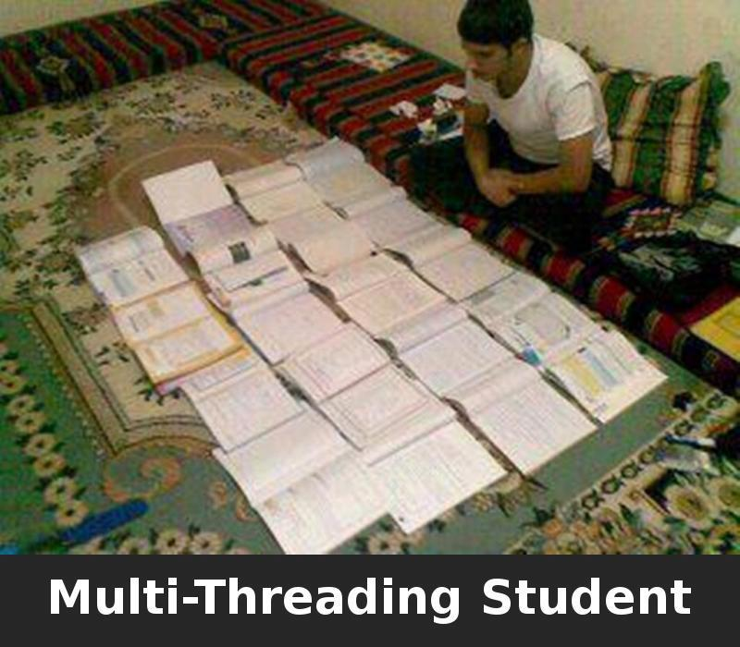
Multi-threading?

Slide 4
Before the Workers
Javascript historical limitation
All execution process remains inside a unique thread
Main UI thread
In charge of handling all the visual elements and
associated tasks: drawing, refreshing, animating, user inputs
events

Slide 5
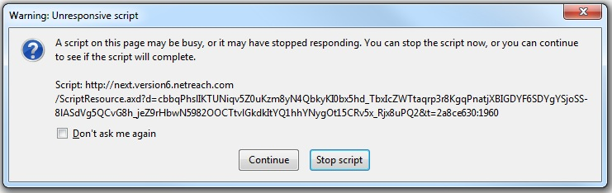
Annoying popup

Slide 6
Overloading the thread
Browser protection mechanism
Alerts users when a long-running suspect script occurs
Mechanism can’t tell the difference
Between a script not written correctly and a script that just
needs more time

Slide 7
Solve concurrency problem
Simulating with setTimeout(), setInterval()
XMLHttpRequest
DOM Events

Slide 8
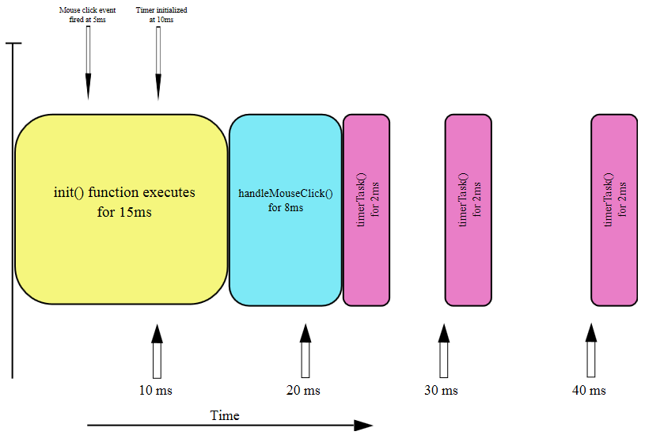
DOM Events concurrency illusion

Slide 9

What is Web Worker?

Slide 10
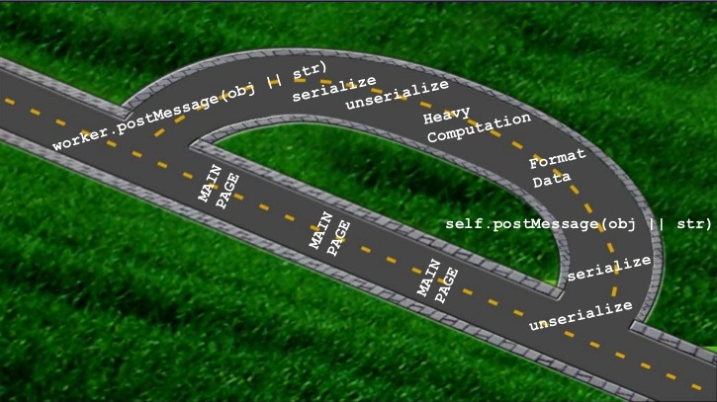
What is Web Worker?

Slide 11
What are Web Workers?
Scripts running in background
Heavy Weight Scripts

Slide 12
Simple example
Initializing the worker
var worker = new Worker('doWork.js');
worker.addEventListener('message', function(e) { console.log('Worker said: ', e.data);
}, false);
/* worker.onmessage = … */
worker.postMessage('Hello World');

Slide 13
Simple example
Creating the worker
self.addEventListener('message', function(e) {
self.postMessage(e.data);
}, false);
Result
Worker said: Hello World!

Slide 14
Passing JSON
…
function sayHI() {
worker.postMessage({'cmd': 'start', 'msg': 'Hi'});
}
…
…
switch (data.cmd) {
case 'start':
self.postMessage('WORKER STARTED: ' + data.msg); break;
}
…

Slide 15
Passing Javascript objects
Structured Clone Algorithm is used
Can pass
RegExp objects
Blob, File, and FileList objects
ImageData objects
Circular references
Limitations
Error objects, Functions, or DOM objects
Property descriptors, setters, and getters are not saved
Prototype chain is not copied

Slide 16
Passing Transferrable objects
Data is transferred from one context to another
Pass-by-reference if you're from the C/C++ world
worker.postMessage(arrayBuffer, [arrayBuffer]);

Slide 17
Tips
Check on existence
if (!!window.Worker)
Stop the worker outside
worker.terminate()
Stop the worker inside
self.close()

Slide 18
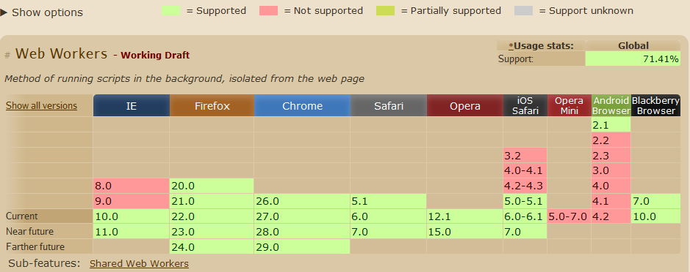
Browser support
Can I use: http://caniuse.com/#search=worker

Slide 19
Browser support
Modernizr: http://modernizr.com/
<html class="js canvas canvastext no-webgl no-touch geolocation postmessage websqldatabase no-indexeddb hashchange history webworkers applicationcache svg inlinesvg smil svgclippaths">
Modernizr.load({
test: Modernizr.webworkers,
yep: 'magic_fast_worker.js',
nope: 'slow_stupid_script.js'
});

Slide 20
Environment: scope
This and Self reference the global scope
onmessage = function(e) {
this.postMessage(e.data);
});
addEventListener('message', function(e) {
postMessage(e.data);
}, false);

Slide 21
Available features
The navigator object
The location object (read-only)
XMLHttpRequest
setTimeout(), setInterval()
The Application Cache
Importing external scripts
Spawning other web workers
JavaScript objects such as Object, Array, Date, Math, String

Slide 22
No access to
The DOM (it's not thread-safe)
The window object
The document object
The parent object

Slide 23
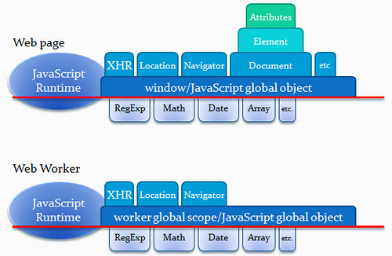
DOM and Workers

Slide 24
Loading External Scripts
Import
importScripts();
importScripts('foo.js');
importScripts('foo.js', 'bar.js');
May be downloaded in any order
Will be executed in the pass order

Slide 25
Sub-workers
Worker
var num_workers = 10;
var items_per_worker = 1000000;
var result = 0;
var pending_workers = num_workers;
for (var i = 0; i < num_workers; i += 1) {
var worker = new Worker('core1.js');
worker.postMessage(i * items_per_worker);
worker.postMessage((i+1) * items_per_worker);
worker.onmessage = storeResult;
}

Slide 26
Sub-workers
Worker
function storeResult(event) {
result += 1*event.data;
pending_workers -= 1;
if (pending_workers <= 0)
console.log(result);
}
Sub-worker
onmessage = function (e) {
postMessage(e.data);
}

Slide 27
Sub-workers limitations
Hosting
Must be hosted within the same origin as the parent page
URIs within sub-workers
Are resolved relative to their parent worker's location (as opposed to the main page)
Separate processes for each worker
Be cautious about hogging too many of the user's system resources

Slide 28
Inline workers
Creating the worker
var blob = new Blob(["onmessage = function(e) { postMessage('msg from worker'); }
"]);
var blobURL = window.URL.createObjectURL(blob);
var worker = new Worker(blobURL);

Slide 29
Inline workers
Release a Blob URLs
window.URL.revokeObjectURL(blobURL);
Chrome page with Blobs
chrome://blob-internals/
blob:blobinternal%3A///85c562e6-9c76-4bff-a165…
Type: data
Length: 59

Slide 30
Inline workers
<script id="worker1" type="javascript/worker"> self.onmessage = function(e) { self.postMessage('msg from worker');
};
</script>
var blob = new Blob([
document.querySelector('#worker1').textContent
]);

Slide 31
Inline workers
Work only with absolute URIs
var blob = new Blob(["onmessage = function(e) { importScripts('xxx.js'); }
"]);
// Uncaught Error: SyntaxError: DOM Exception 12
Solution - pass URL into worker
worker.postMessage({url: document.location});

Slide 32
Shared workers
One worker for many windows
// Window 1 var aSharedWorker = new SharedWorker("SharedWorker.js", "Worker1");
// Window 2 var aSharedWorker = new SharedWorker("SharedWorker.js", "Worker2");

Slide 33
Shared workers
Scope of Shared Workers
Window 1 creates a shared worker
Window 2 connects to it
Window 1 is closed
Window 2 is still connected
The shared worker thread remains
Even though Window 2 didn't originally create it

Slide 34
Shared workers
Initializing the worker
var worker = new SharedWorker("SharedWorker.js");
function onMsg (e) {
console.log('Worker said: ', e.data);
}
worker.port.addEventListener('message', onMsg, false);
worker.port.start();
worker.port.postMessage("Hello World");

Slide 35
Shared workers
Creating the worker
var i = 0;
onconnect = function (evt) {
evt.ports[0].onmessage = function (e) {
OnControllerMessage(e, port);
}
}
function OnControllerMessage(e, port) {
i++;
port.postMessage(e.data + i);
}

Slide 36
Shared workers
Another way
var i = 0;
onconnect = function (evt) {
evt.ports[0].onmessage = OnControllerMessage;
}
function OnControllerMessage(e) {
i++;
e.target.postMessage(e.data + i);
}

Slide 37
Shared workers
Results
Window 1 call – Hello World 1
Window 1 call – Hello World 1
Window 2 call – Hello World 2
Window 1 call – Hello World 3

Slide 38
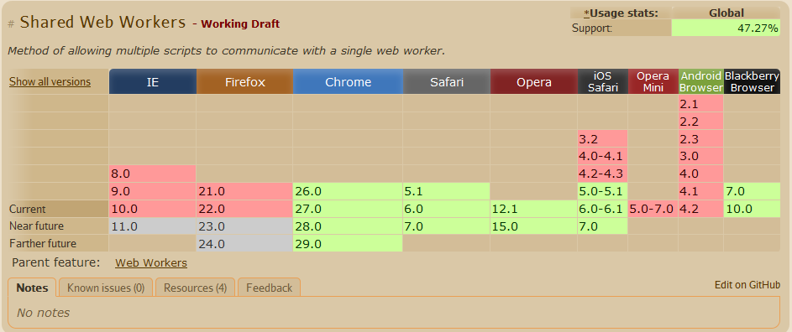
Browser support
Can I use: http://caniuse.com/#search=worker

Slide 39
Error handling
Setting up onerror handler
function onError(e) {
console.log(
'ERROR: Line ' + e.lineno + ' in ' + e.filename, + ': ' + e.message
);
}
worker.addEventListener('error', onError, false);

Slide 40
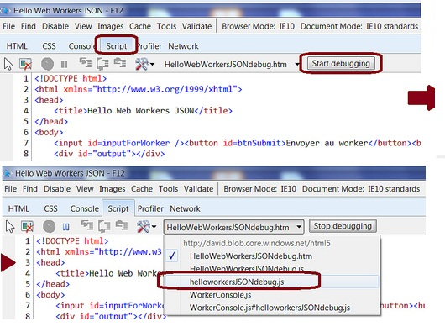
Debugging: IE 10

Slide 41
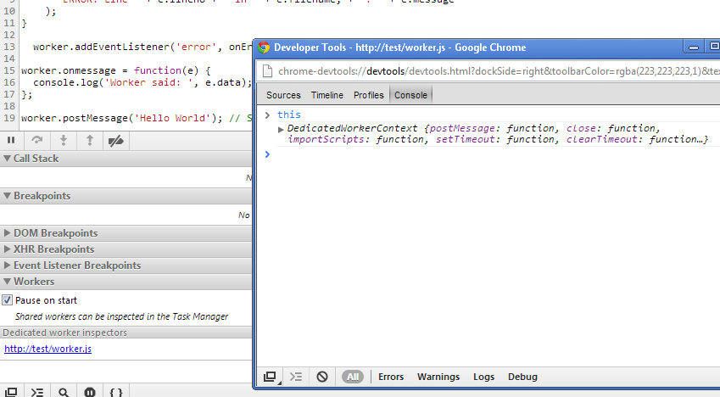
Debugging: Chrome

Slide 42
Debugging: console
No console.log() in worker
Uncaught ReferenceError: console is not defined
WorkerConsole.js
https://github.com/davidflanagan/WorkerConsole/

Slide 43
Tips
Live until killed
Since they aren’t automatically garbage collected, it’s up to you to control their state
Won’t run locally
Due to Google Chrome's security restrictions, workers will not run locally (e.g. from file://)
Must be same scheme
E.g. https: page cannot start worker scripts that begin with http: URLs.

Slide 44
Where to use
Image processing
Big amount of data
Background text analysis
Concurrent requests against a local database
Prefetching and/or caching data
Background I/O or polling of web services
Image filtering in <canvas>

Slide 45
Pay attention
The initializing time and the communication time
The memory cost of using several Workers
The dependency of the code blocks

Slide 46
Summary
Use web workers
or at least
take a look into that,
because that’s interesting!

Slide 47

Questions?

Slide 48
Sources
The Basics of Web Workers By Eric Bidelman
http://www.html5rocks.com/ru/tutorials/workers/basics/
HTML Living Standard / Web Workers
http://www.whatwg.org/specs/web-apps/current-work/multipage/workers.html
Introduction to HTML5 Web Workers: The JavaScript Multi-threading Approach
http://msdn.microsoft.com/en-us/hh549259.aspx
A Deeper Look at HTML 5 Web Workers
http://cggallant.blogspot.com/2010/08/deeper-look-at-html-5-web-workers.html
An Introduction to HTML 5 Web Workers
http://cggallant.blogspot.com/2010/08/introduction-to-html-5-web-workers.html

Slide 49

Thanks

