Slide 1
Geo-distributed Messaging with RabbitMQ
Real World Case Study
by Andriy Shapochka
System Architect @ SoftServe

Slide 2
Context
Security Management SaaS Solution with availability and scalability issues

Slide 3
Goal
To build highly available, geo-distributed clustered solution based on the original implementation.
Clients can have their servers in the US, Europe, and elsewhere.
Amazon and data centers are to be supported
The data should always stay consistent in the sense of CAP theorem.

Slide 4
Architecture Drivers
Nodes communicate over WAN and must account for high latencies and possible connectivity interruptions.
The main quality attributes to achieve are:
High Availability
Eventual state consistency on each active node (primary and replicas)
Inter-node communication security (transport protocol encryption and authentication)
The secondary quality attributes to achieve are:
Performance
Thin maintenance windows

Slide 5
CAP Theorem by Brewer
Consistency – roughly meaning that all clients of a data store get responses to requests that ‘make sense’. For example, if Client A writes 1 then 2 to location X, Client B cannot read 2 followed by 1.
Availability – all operations on a data store eventually return successfully. We say that a data store is ‘available’ for, e.g. write operations.
Partition tolerance – if the network stops delivering messages between two sets of servers, will the system continue to work correctly?
Consistency, Availability, Partition Tolerance: Pick two only.

Slide 6
Partition is network property – not our choice
Partition Tolerance means data copying strategy for consistency or for availability
In a distributed system that may drop messages we cannot have both consistency and availability of the data – only one of them!

Slide 7

Primary Decision
To use RabbitMQ as a platform for the data bus between the nodes in the cluster.
AMQP Broker with extensions implemented in Erlang.
Clients in Java, Python, .NET, REST, etc.
Performance, HA, Federation, Clustering, Flexible Routing, Security

Slide 8
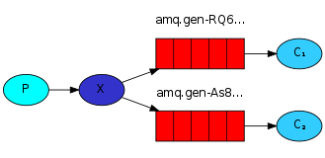
Messaging in RabbitMQ
Exchanges: fan-out, direct, topics; can be bound to exchanges
Queues bound to exchanges
Routing keys
Acknowledgements
RPC with correlation ids

Slide 9
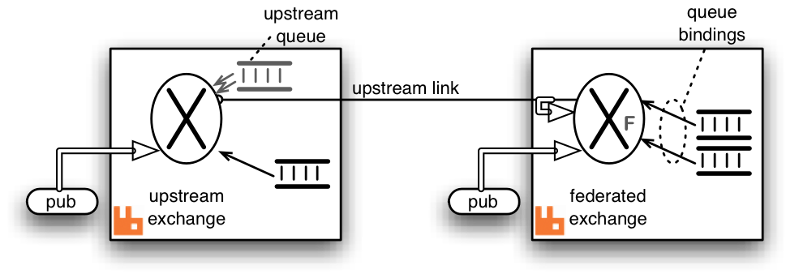
Geo-Distribution in RabbitMQ
Federation plugin to the rescue

Slide 10
Design Strategy: Components
Application Node – the nodes are geo-distributed and can play a role of
primary node - single node serving user requests in the entire cluster
replicas - all the other nodes updated with the changes on the primary node
Cluster Controller – a single node controlling the cluster state and assigning the primary and replica roles to the application nodes.

Slide 11
Design Strategy: Decisions - 1
All the application nodes are equivalent in the sense each of them can become primary or a replica at the runtime.
The application node status (active, primary, replica, etc.) is controlled by the cluster monitor.
The replicas receive updates from the current primary node by means of exchange federation.
Each replica monitors its transaction flow state and validates it against every new incoming primary update.

Slide 12
Design Strategy: Decisions - 2
When the replica finds its transaction flow state to become inconsistent it switches to the catch-up mode which involves two steps in order to offload additional processing and communication from the primary node:
To request the missing transactions from the other replicas.
In case no replica succeeds in replying with the requested transactions to fall back to the catch-up request toward the primary node.
The bus construction is based on the official RabbitMQ Federation plugin which works by way of propagating the messages published in the local upstream exchanges to the federated exchanges owned by the remote brokers.

Slide 14
Design Strategy: RPC Catch-up

Slide 15
Design Strategy: Extra Mile
Security – communication is secured by means of the https protocol, server and client certificates supported by RabbitMQ Federation. It is configured in the upstream part.
Cluster Configuration – runtime roulette. The upstream configuration occurs at the deployment time. The exchange creation does at runtime. Cluster Controller selects and promotes the new primary and notifies replicas.
Cluster Controller – non-trivial task to build a cluster controller which would be HA and would avoid the split-brain issue. Zookeeper and other controller distribution options were evaluated. At the end it was decided to build it on top of AWS infrastructure using Multi-AZ RDS as a configuration storage.

Slide 16
Thank You! Questions, please!

