Slide 1

Olympic Data Analysis

Slide 2

Ingest data from various sources into the data ecosystem.
Transform and store data efficiently for analysis.
Enable data analysis and reporting capabilities for Olympic Games insights.
Ensure data security and compliance with relevant regulations.
Objectives

Slide 3













Data Engineering Architecture Diagram
P1
P1
P2
P1, P2 ,P3
COPY
INTO
P2
P3
P3
Data Resource
ETL /Ingestion
Storage/Analysis
Visualization

Slide 4


Data Source

Slide 5
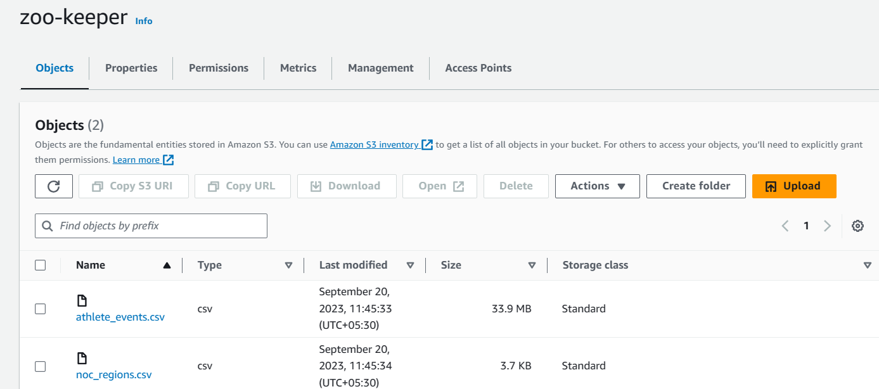
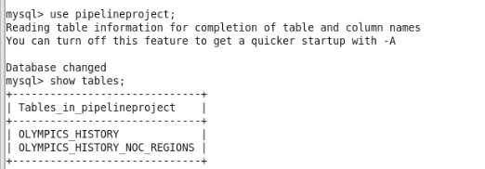
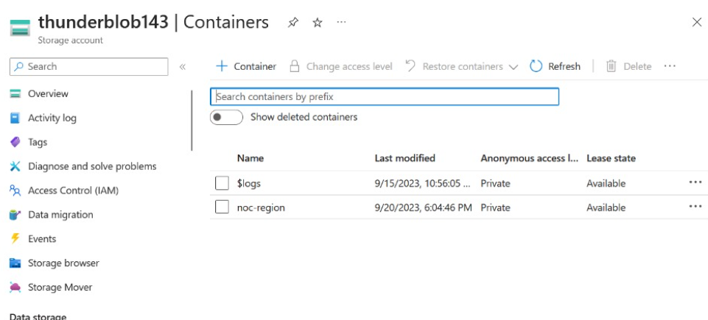
Amazon S3 Bucket
MYSQL DB
Azure Blob Container

Slide 6

Ingestion/ETL
COPY
INTO

Slide 7
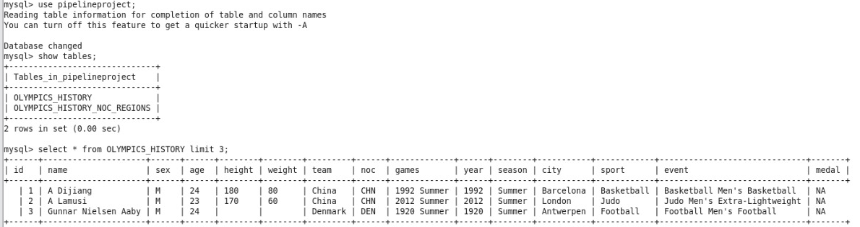
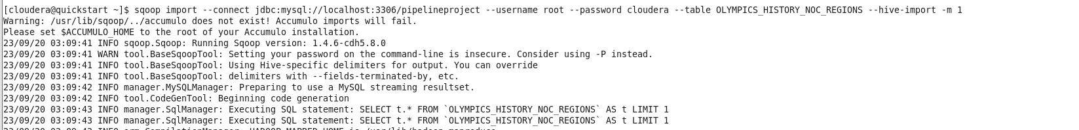
MYSQL to HIVE (SQOOP)
Importing Data Using Sqoop

Slide 8
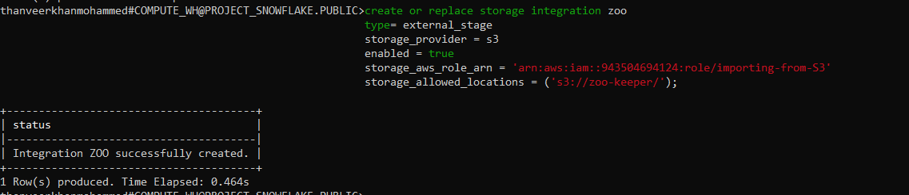
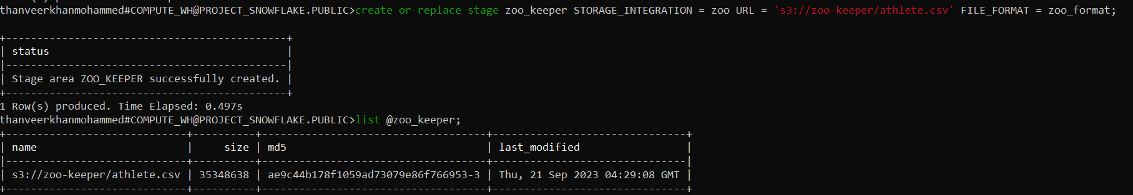
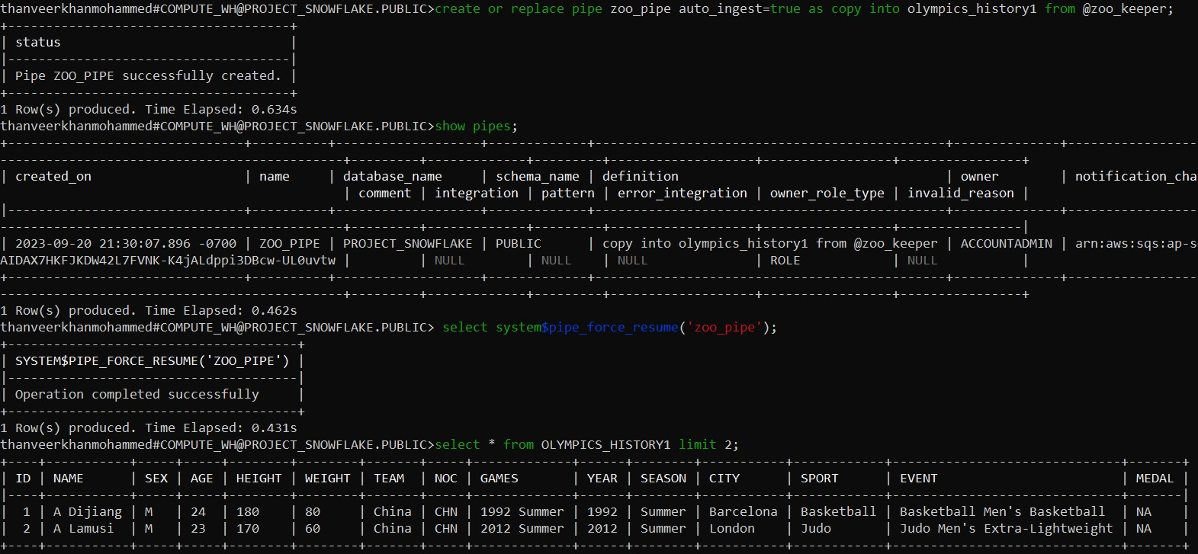
Amazon S3 to Snowflake (Snow pipe)

Slide 9
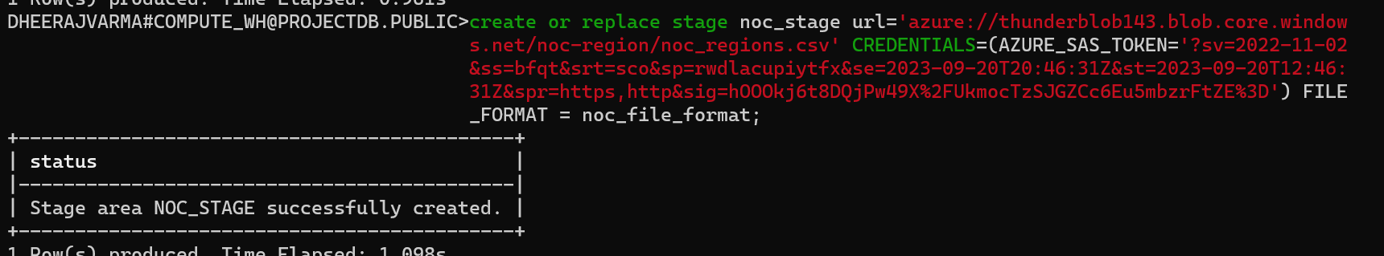
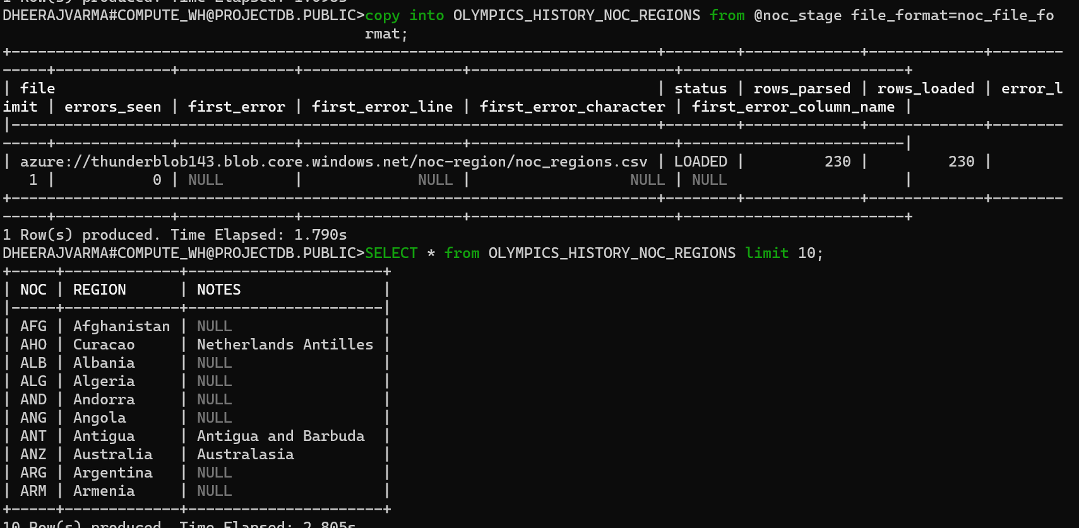
Azure Blob to Snowflake (COPY INTO)

Slide 10

Storage and Analysis

Slide 11

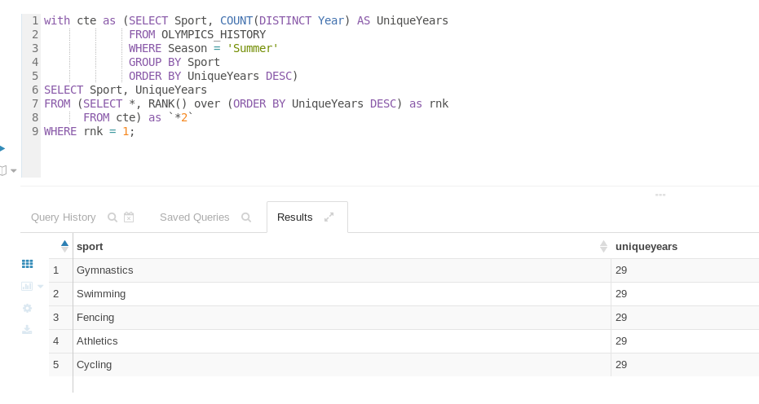
Problem Statement : Identify the sport which was played in all summer Olympics.

Slide 12
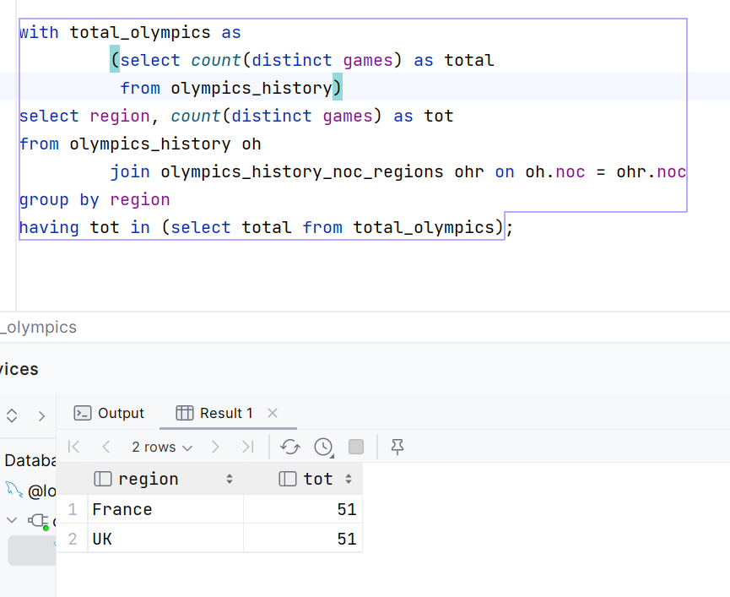
Problem Statement : In which country has participated in all Olympic games.

Slide 13
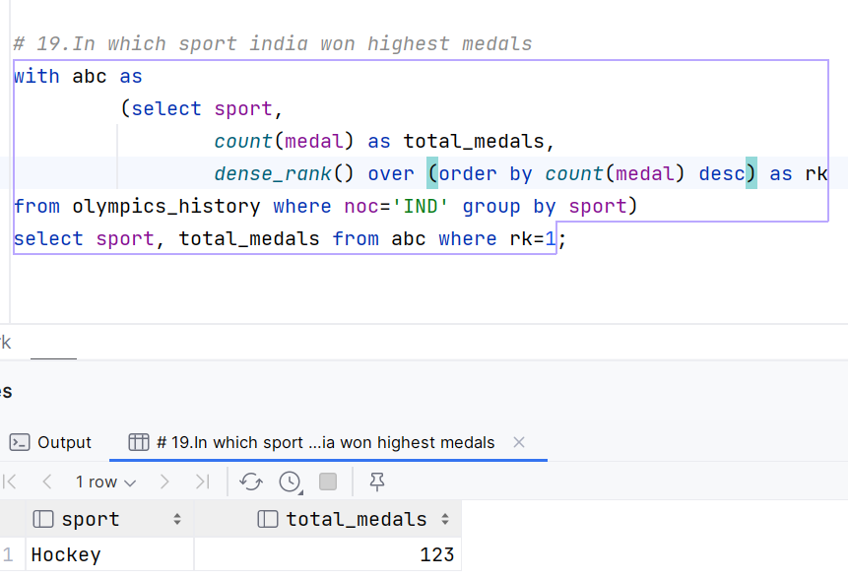
Problem Statement : In which sport India won highest medals

Slide 14
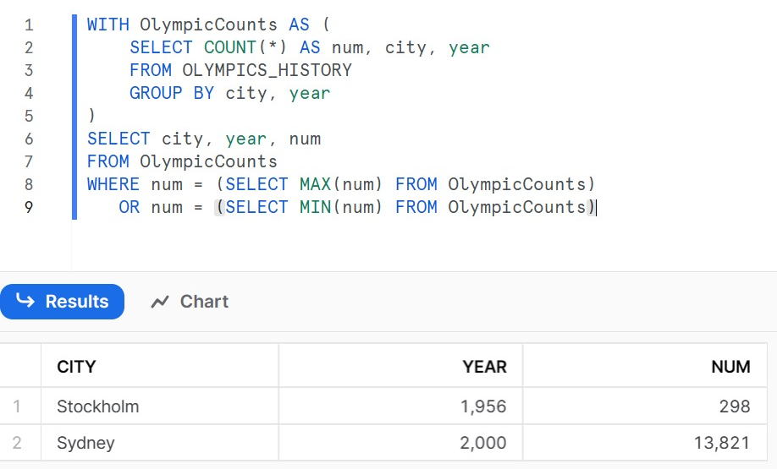
Problem Statement : Which year saw the highest and lowest no of countries participating in Olympics

Slide 15

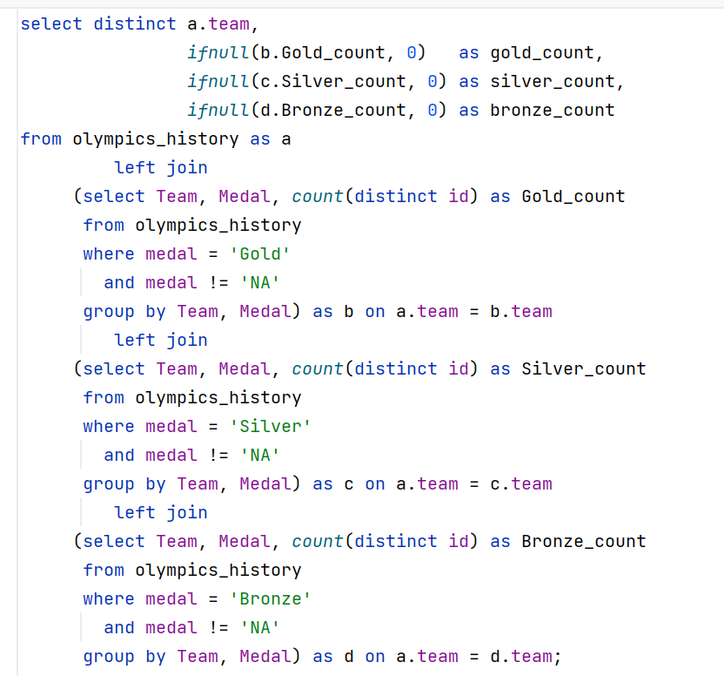
Problem Statement : List down total gold, silver and bronze medals won by each country

Slide 16
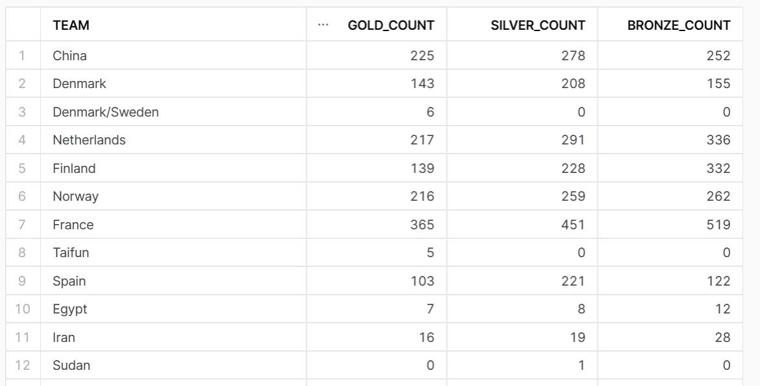

OUTPUT

Slide 17
Visualization

Slide 18
