Slide 1
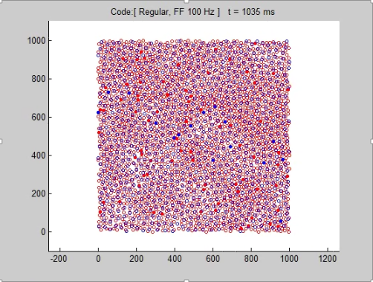
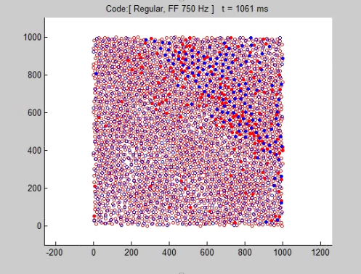
Low Input Frequency (10Hz)
High Input Frequency(75Hz)
Activity of Neuron Network
Neuron network with propagation activity

