Slide 1
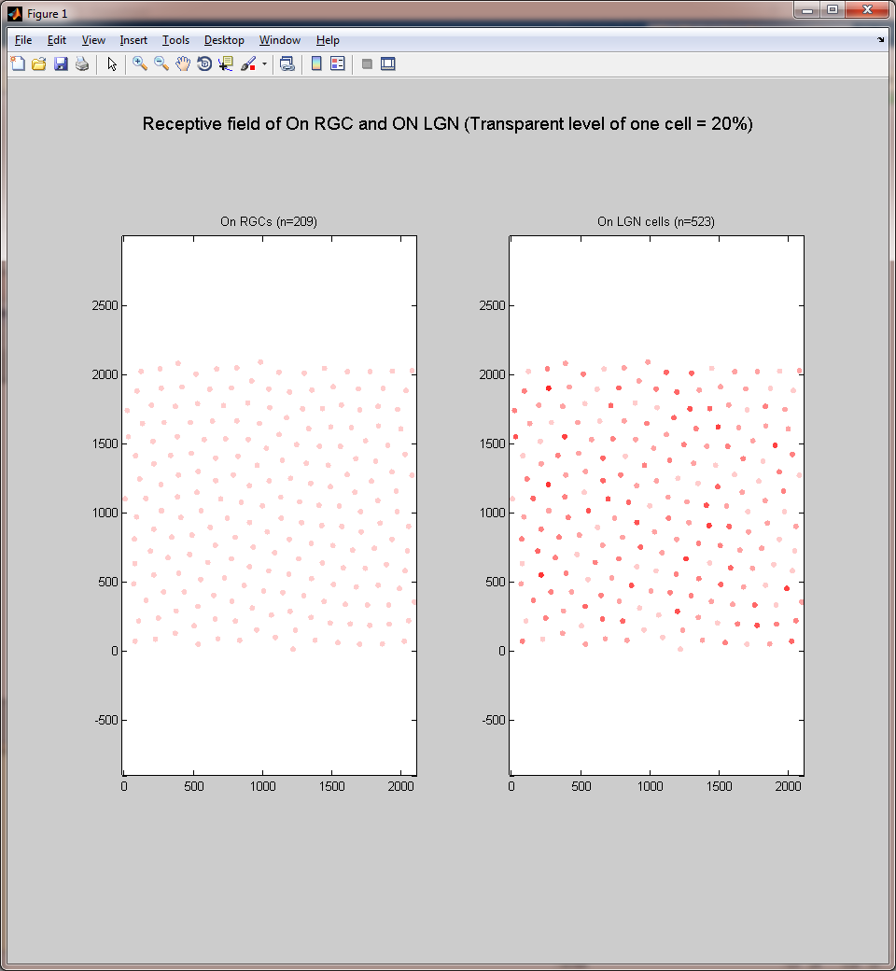
A
B
Network 2
Connection Probability
&
Target
Connection
Strength
Source
Network 1

