Slide 1
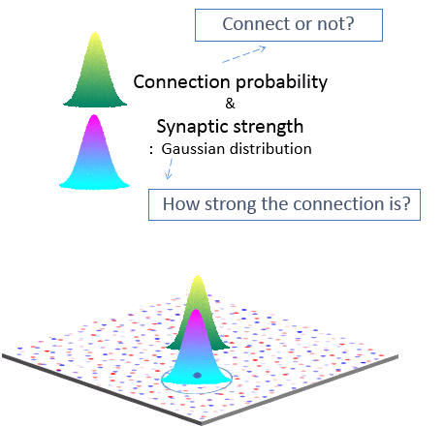
A
E-E
B
E
E-I
I-E
I
I-I
Excitatory neuron(E)
Inhibitory neuron(I)

