Slide 1
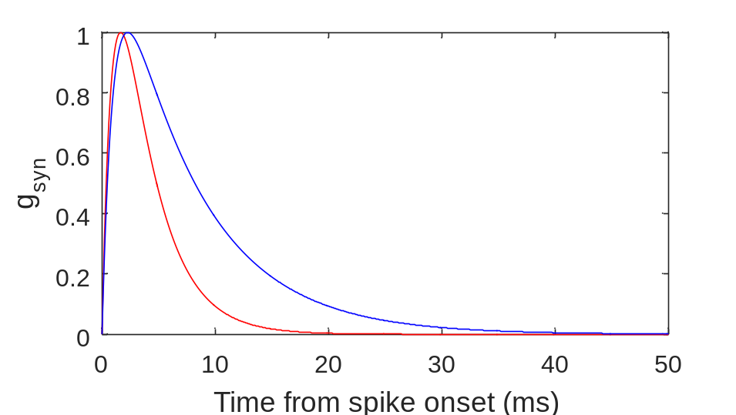
- Excitatory
- Inhibitory

