Slide 1
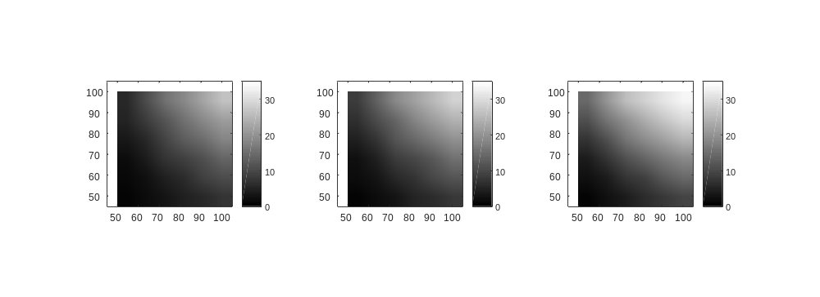
Activity Matrix
3 Types of Input
Static(S)
Weak Oscillation (WO)
Strong Oscillation (SO)
Convergent Connection
Ex. Average Output Firing rate at Layer 2
Target
Fr(Hz)
W -> strength
27
22
Source
17
Range [um]
# of source cell
13
Range -> # of source cells
10
7
Convergent conditions
(R and W)
3 Types of Convergent
Uniform-Uniform
Gaussian - Gaussian
Uniform - Exponential
W [a.u.]

