Slide 1
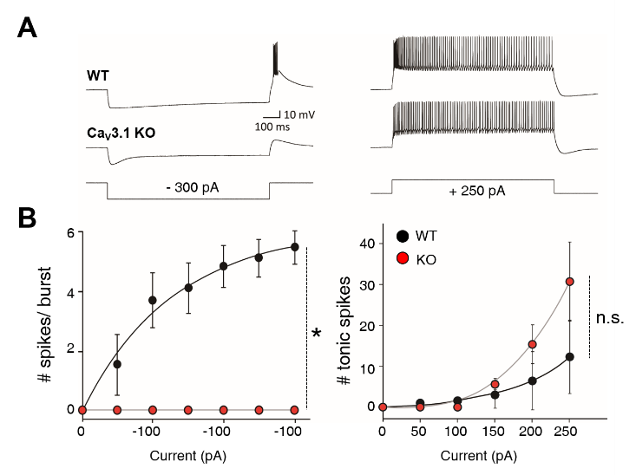
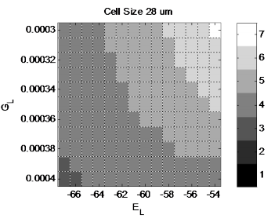
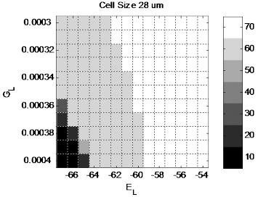
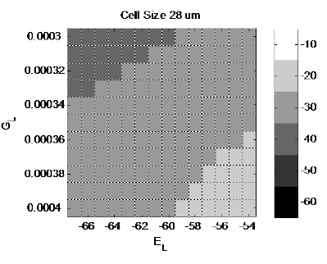

1) Number of Bursting spikes
2) Number of Tonic spikes
3) Voltage drop (20-30mV)
Exp data from personal communication
(Kim et al, unpublished)
-100
-200
-300
#
#
$$∆E$$
✔
✔
✔
✔
✔
✔
G_{L} : Conductance of leakage channel E_{L} : Reversal Potential of leakage channel
Notes:
[Script]
old
This is one example of parameter search. When I change two parameters; Conductance of leakage channel and Reversal Potential of leakage channel, it change the output and this is the summary of this output. This is the variation of output.
So use this kind of graph, I can select the proper range of this and this parameter that satisfy the criteria by compare with experimental data. Here is we get the experimental data from personal communication, this is not our data. I showed it here just for comparing the result.

