Slide 1
MIND BLASTER

Slide 2
DATABASE
Room Persistence Library
PuzzleDatabase.java
Puzzle
Data Access Object
Puzzle
DataProcess
Name
Question
Answer
Solution
Complexity

Slide 3
Overall Program Flow

Slide 4
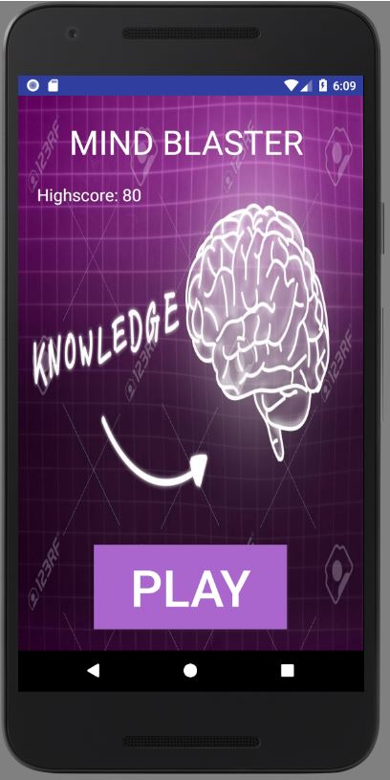
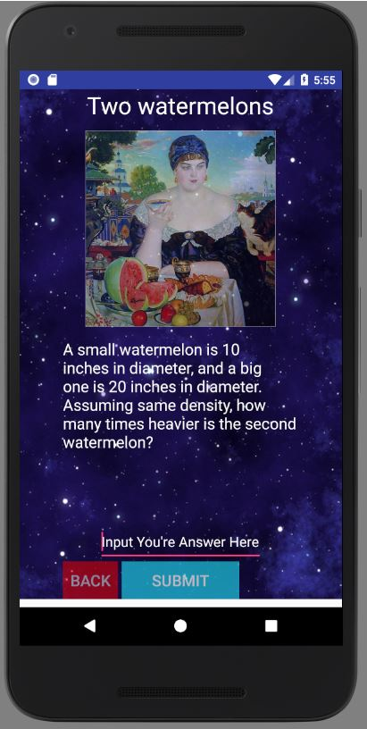
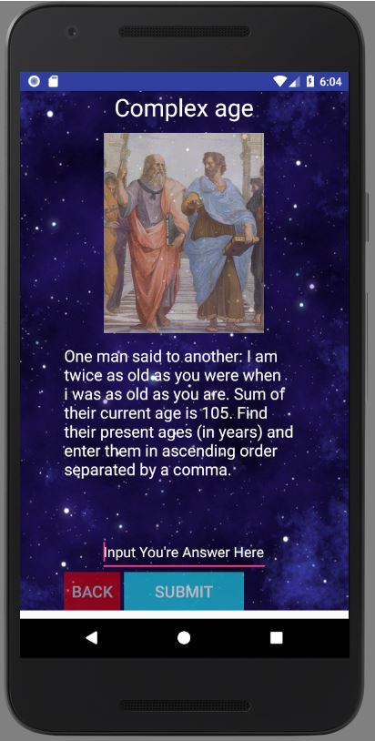
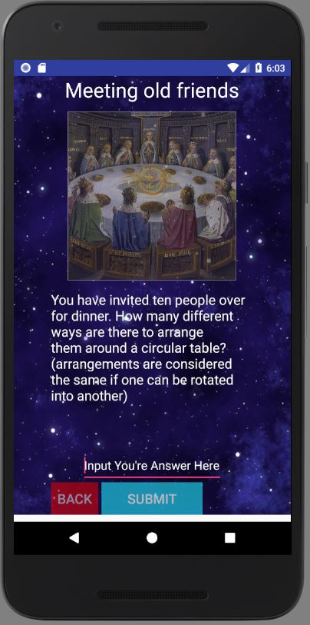
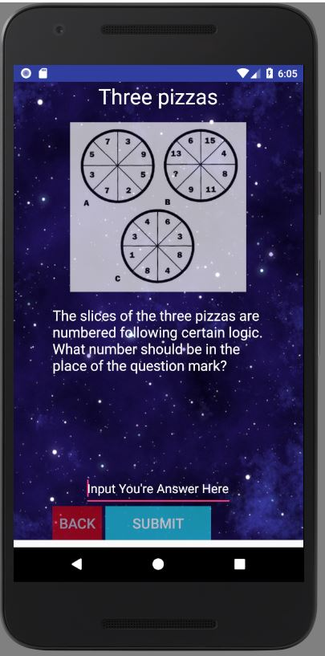
App Screenshots
Homescreen
A puzzle of complexity 5
A puzzle of complexity 15
A puzzle of complexity 20
A puzzle of complexity 25

