Slide 1

2023
Data Mining
Text Analysis with Artificial Intelligence
By Vivaldo Pasquale & Micea Radu

Slide 2
Data Mining techniques used
Web Scraping
Data Cleaning & Preprocessing
Language Models
Sentiment Analysis
TF-IDF
PoS tags

Slide 3
Contents
01
Sentiment Analysis
Sentiment Analysis results
02
Where we found the data? - Web Scraping
03
Movie vs book content analysis
04
05
Results movie vs book

Slide 4
01
Sentiment Analysis
One of the main ideas of our project

Slide 5
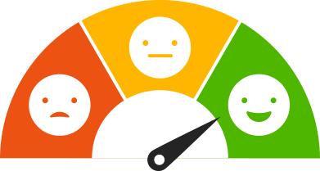
Sentiment Analysis
One of the main ideas of our project
Sentiment analysis, commonly referred to as opinion mining, is a method of natural language processing that entails the extraction and analysis of subjective data from text in order to ascertain the sentiment or emotional tone that the author or speaker is attempting to communicate. It seeks to comprehend and categorize the expressed opinions' polarity as positive, negative, or neutral.

Slide 6
The 2 Basic AI Emotions
Simplest and most basic emotion an AI can have
Happiness
Sadness

Slide 7
The 3 More Advanced AI Emotions
Some more advanced emotion an AI can have
Happiness
Neutrality
Sadness

Slide 8
How are we analyzing the data?
the AI models that are going to give us some “emotions”
Simple AI - 2 emotions
Nickname “Bob”
Smart AI - 3 emotions
Nickname “Mary”
Multi-purpose AI
ChatGPT as a comparison factor

Slide 9
How are we analyzing the data?
the AI models that are going to give us some “emotions”
AI “Bob” :
positive or negative emotions with no in-between
no context analysis
simple and naive point of view on the subjects
AI “Mary” :
capable of identifying 3 emotions (negative, neutral and positive)
much more advanced AI
wide gradient to express them
context analysis
She has various scales and ways to express her emotions
AI “ChatGPT”:
capable of identifying 3 emotions (negative, neutral and positive)
much more advanced AI
wide gradient to express them
context analysis
He has various scales and ways to express his emotions
contendent for Mary

Slide 10
02
Sentiment Analysis AI
comparisons & results
Results and conclusions of the Sentiment Analysis

Slide 11
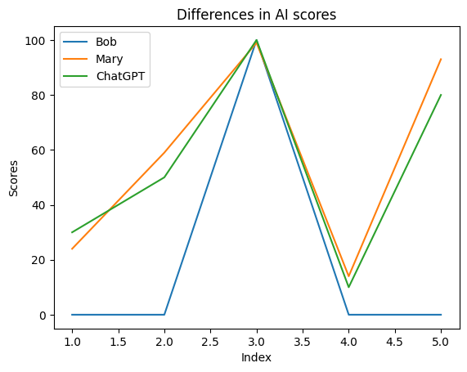
"The weather is slightly gloomy today."
"The sack of Rome on 24 August 410 AD was undertaken by the Visigoths led by their king, Alaric … friends and foes of the Empire alike."
"I love winning the championship"
"I am dying of an heart attack"
"I am dying, I can't stop laughing"

Slide 12
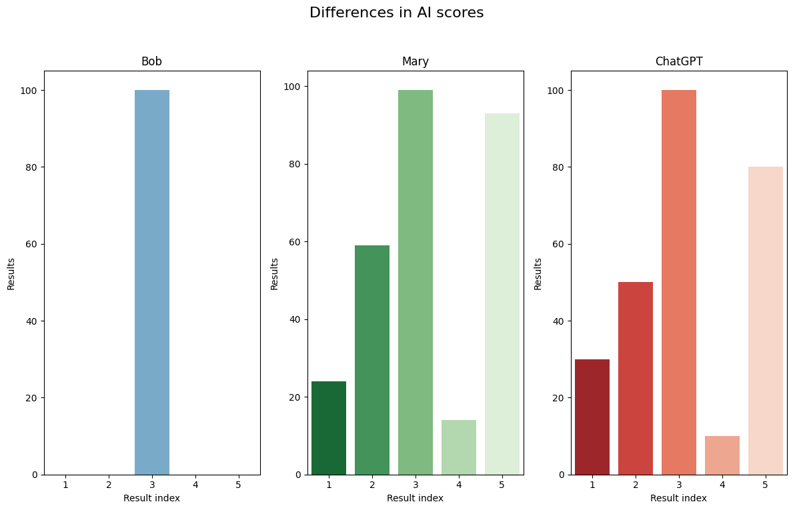
"The weather is slightly gloomy today."
"The sack of Rome on 24 August 410 AD was undertaken by the Visigoths led by their king, Alaric … friends and foes of the Empire alike."
"I love winning the championship"
"I am dying of an heart attack"
"I am dying, I can't stop laughing"

Slide 13
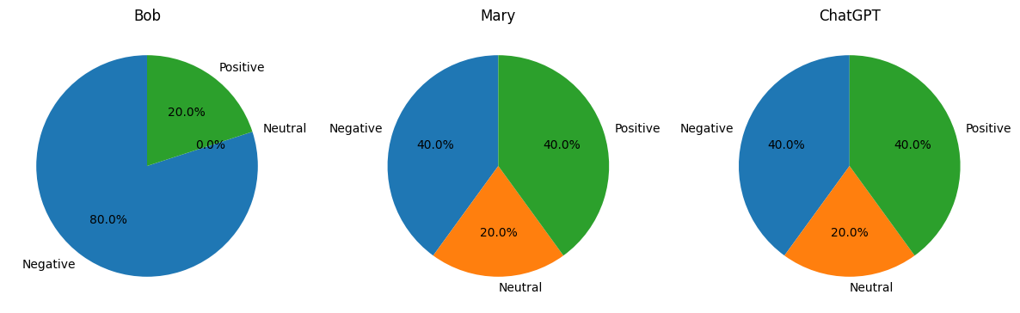
"The weather is slightly gloomy today."
"The sack of Rome on 24 August 410 AD was undertaken by the Visigoths led by their king, Alaric … friends and foes of the Empire alike."
"I love winning the championship"
"I am dying of an heart attack"
"I am dying, I can't stop laughing"

Slide 14
03
Where we found the data? Web Scraping

Slide 15
Web Scraping
Because we wanted our project to be configurable and work with various data sets, we chose to obtain the data set at runtime using web scraping according to user input.
A typical flow is the following: user sets the variable ‘names’ with an array of movie / book titles they would like to obtain data for.
Once the scraping starts, for each title in names, the program will query http://gutenberg.org/. Using Beautiful Soup the resulted HTML will be parsed and the book’s code will be retrieved. Based on this code, using ‘gutenbergpy’, the book’s text will be downloaded and stripped of headers and footers.
Once the books are downloaded, for each title in names, the program will query https://imdb.com/. Again, a code will be retrieved from the first result using Beautiful Soup.
This code will be used when querying https://opensubtitles.org/. The highest rated english subtitle zip will be downloaded and a srt file will be extracted. This file will be parsed and ready to be used.

Slide 16
04
Movie vs book content analysis

Slide 17
Content analysis
Cleaning & preprocessing, sentiment analysis using language model, TF-IDF, and PoS Tagging
Based on ‘n’ given by user input, the book and subtitle texts are split in n equal parts, after being cleaned up.
Along with title and author (for books) or year (for movies), the parts are used to build a pandas data frame for each title.
Sentiment Analysis is performed on the parts using the pretrained language model RoBERTa. Because the length of the parts exceeds the model’s kernel size, we stride over the text and compute the sentiment for a bunch of overlapping segments. Then we return the mean of the results.
Afterwards, using TfidfVectorizer from ‘sklearn’, we compute the TF-IDF of each word and return the most relevant m words for each part. These words will act as the ‘context’ of the part, or of the scene.
Finally, we use ‘spacy’ to perform PoS Tagging in order to return the most common names and verbs. This will help add further context to the part (or scene).

Slide 18
05
Results Movie Vs Book
What we obtain after applying the DM techniques & conclusions

Slide 19
Three titles: ‘Titanic’, ‘Wuthering Heights’, and ‘Pride and Prejudice’

Slide 20
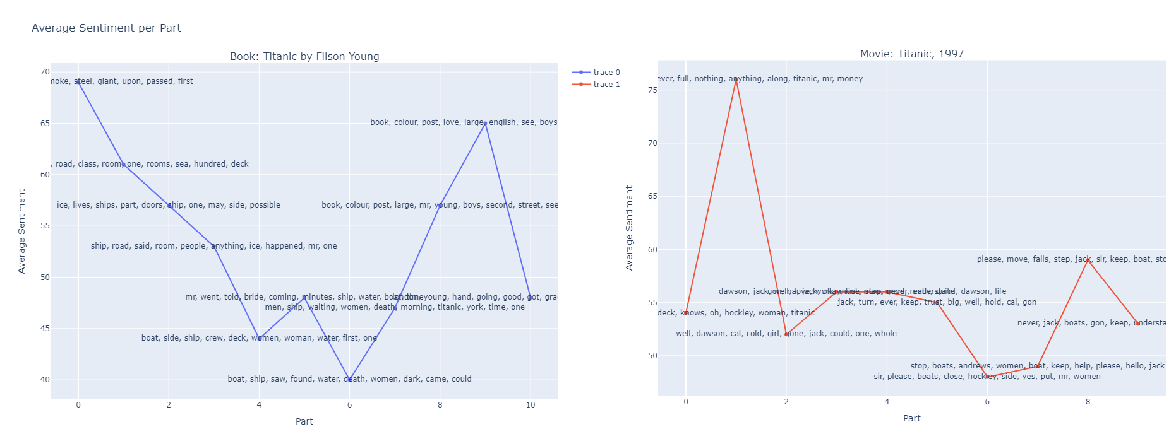
Sentiment Analysis / Split graph + most relevant words for ‘Titanic’ according to TF-IDF
Even though the movie ‘Titanic’ is not an adaptation of the book, and it is a dramatization of the true story, both the book and the movie follow a similar sentimental trendline.
Both take a sharp turn downsides near the beginning, have their lowest point at split 6, and form a concave shape at the middle.
Finally, they both go up a little and then back down.
In this case, the words don’t offer much context. Because the movie is a dramatization and the book is composed of interviews, that is to be expected.
Nevertheless, they both follow the same action emotions-wise.

Slide 21
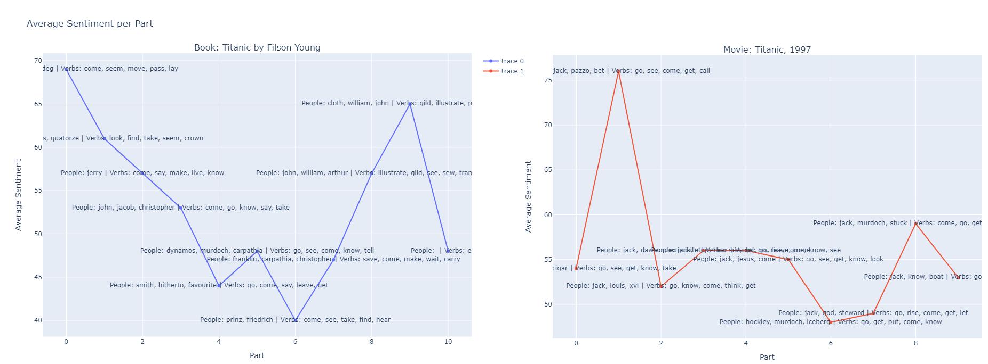
Sentiment Analysis / Split graph + names and verbs for ‘Titanic’ using PoS Tagging
Again, because the movie is a dramatization, and the character Jack is fictional, the person names don’t offer much information.
It is interesting to note however that the verbs ‘come’, ‘see’, ‘go’ are used a lot in the same places, especially when the sentiment is negative. This might indicate that these verbs might be commands one character tells the other to do, in order to maximize survival chances.

Slide 22
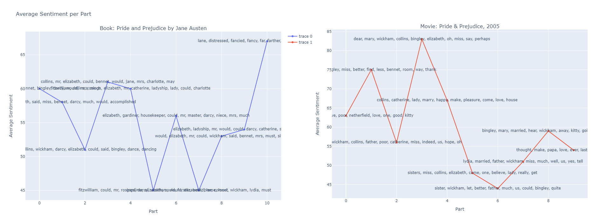
Sentiment Analysis / Split graph + most relevant words for ‘Pride and Prejudice’ according to TF-IDF
From far away, the trendlines seem to match. But the closer you look, you can see that details are missing from the movie.
This might suggest that some content is either compressed or missing from the adaptation.
We can also see that the lowest point (part 7 in the book and part 6 in the movie) match perfectly; TF-IDF gives a lot of context; we can observe in the movie the words: sister, BIngley, and in the book the words: Elizabeth. This matches with the fact that one of the saddest scenes is when Elizabeth discovers the truth about Darcy's involvement in separating her sister from Bingley.
In both, happiest part includes the names Collins, Elizabeth, so we also have a match here.

Slide 23

Sentiment Analysis / Split graph + most relevant words for ‘Pride and Prejudice’ using PoS Tagging
The information presented earlier are even more apparent in this case: in the book, at part 7 we have the following names: Elizabeth, Bingley, Darcy, and in the movie at part 6 we have Bingley. A perfect match!

Slide 24
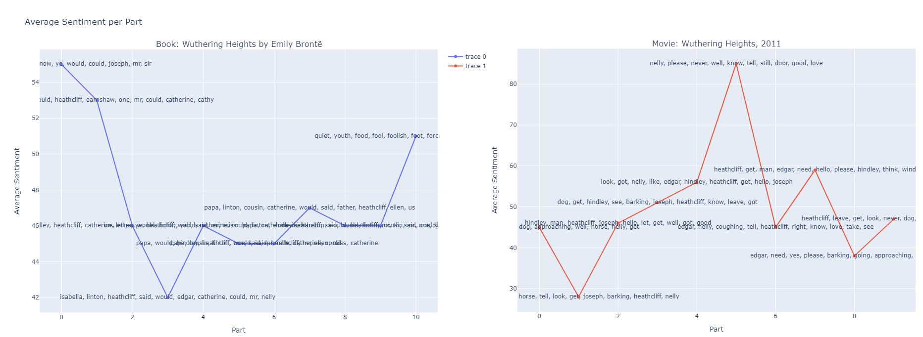
Sentiment Analysis / Split graph + most relevant words for ‘Wuthering Heights’ according to TF-IDF
Apart from the fact that the beginning seems to be a little compressed, but otherwise the same, no other similarity is apparent from the sentiment trendline and words. We can see that the movie is a lot more optimistic, featuring a very happy scene right in the middle. The book, however, does not feature it.

Slide 25
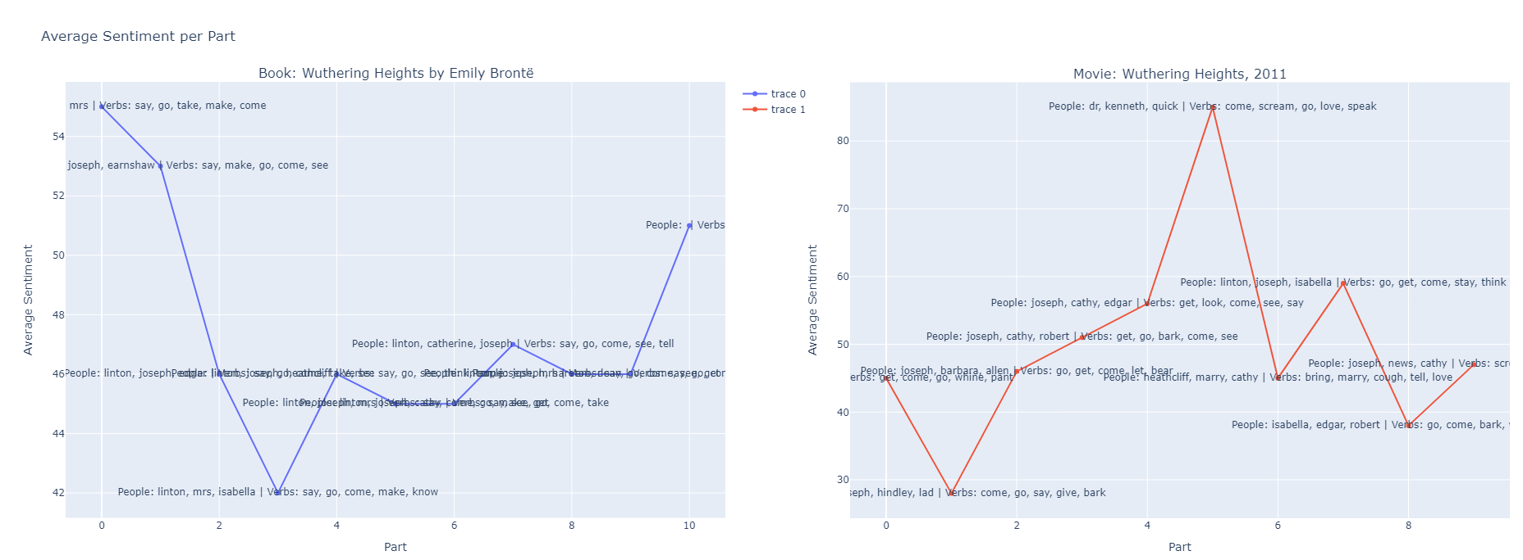
Sentiment Analysis / Split graph + most relevant words for ‘Wuthering Heights’ using PoS Tagging
The names don’t match either. We can theorize that the adaptation is not faithful, apart from the very beginning of the movie. Luckily, a quick Google search does confirm this!

Slide 26
Bibliography
The bibliography of our project
https://github.com/
https://gutenberg.org/
https://huggingface.co/
https://opensubtitles.org/
https://github.com/
https://imdb.com/
https://www.techtarget.com/
https://aws.amazon.com/

Slide 27

THE END
Thank you !

