Slide 1
Traffic Data Modelling

Slide 2
Quick Overview
date_time | weather_general | weather_detailed | clouds_coverage_pct | temperature | rain_mm | snow_mm | traffic
01.10.2014 00:00 | Clear | sky is clear | 1 | 11.5 | 0 | 0 | 508
01.10.2014 01:00 | Clear | sky is clear | 1 | 10.3 | 0 | 0 | 323
01.10.2014 02:00 | Clear | sky is clear | 1 | 8 | 0 | 0 | 274
01.10.2014 03:00 | Clear | sky is clear | 1 | 7.9 | 0 | 0 | 372
01.10.2014 04:00 | Clear | sky is clear | 1 | 6.4 | 0 | 0 | 812
01.10.2014 05:00 | Clear | sky is clear | 1 | 5.5 | 0 | 0 | 2720

Slide 3
Quick Overview
Day
Month
(Year)
Weekday
Hour
date_time | weather_general | weather_detailed | clouds_coverage_pct | temperature | rain_mm | snow_mm | traffic
01.10.2014 00:00 | Clear | sky is clear | 1 | 11.5 | 0 | 0 | 508
01.10.2014 01:00 | Clear | sky is clear | 1 | 10.3 | 0 | 0 | 323
01.10.2014 02:00 | Clear | sky is clear | 1 | 8 | 0 | 0 | 274
01.10.2014 03:00 | Clear | sky is clear | 1 | 7.9 | 0 | 0 | 372
01.10.2014 04:00 | Clear | sky is clear | 1 | 6.4 | 0 | 0 | 812
01.10.2014 05:00 | Clear | sky is clear | 1 | 5.5 | 0 | 0 | 2720

Slide 4
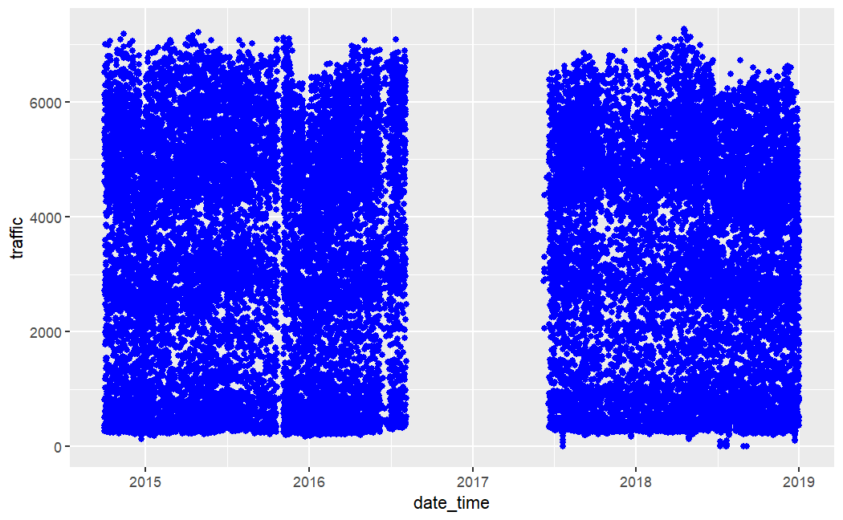
Data Split

Slide 5
Data Split
Random 70/30

Slide 6
Snow and Rain
as Near Zero Variance
Exclude them?

Slide 7
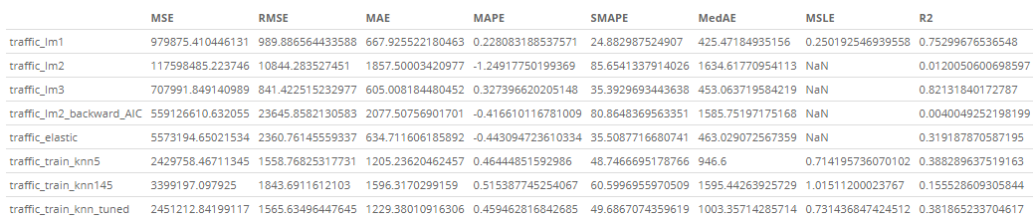
Select Model

Slide 8
Select Model
Traffic ~ clouds, temperature, month, hour, weekday

Slide 9
Expected MAPE
0.3273

