Slide 1
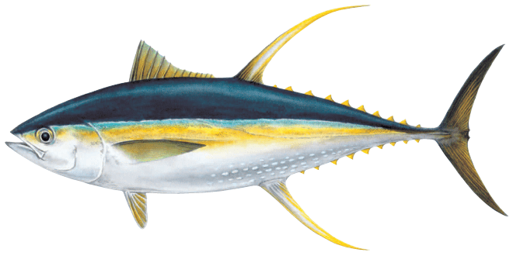
2023 SPC Pre-assessment Workshop
25-28th April
Conditional Age-at-Length Data Summary for Yellowfin Tuna
P10 – Arni Magnusson

Slide 2
Background
Conditional age-at-length otolith data were used in the YFT 2020 assessment
Otoliths provide information useful for estimating a growth curve, internal or external of the stock assessment model

Slide 3
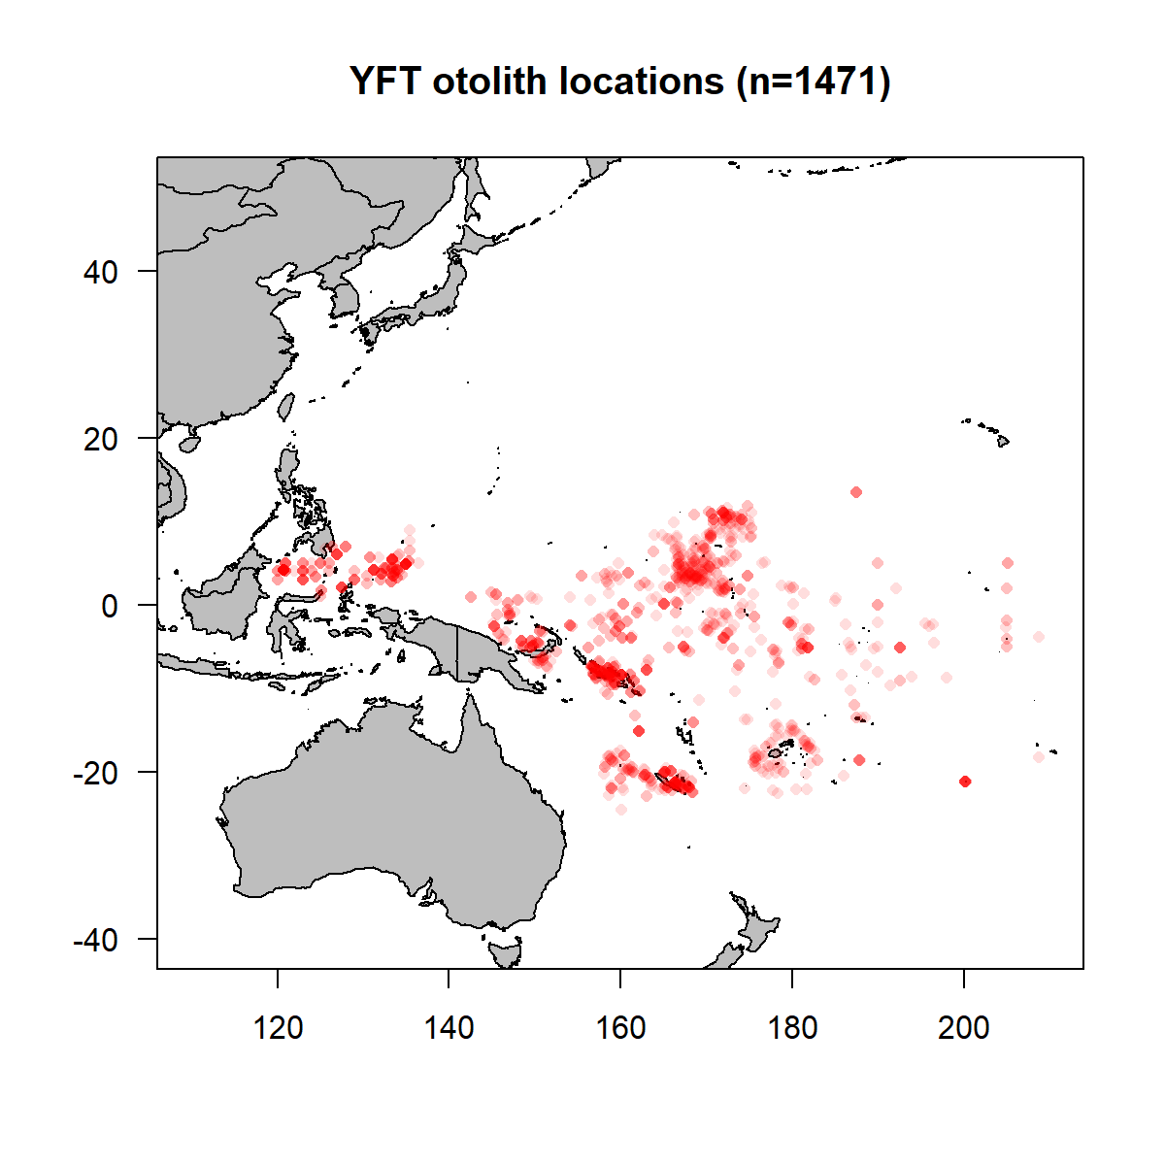
Otolith Samples

Slide 4
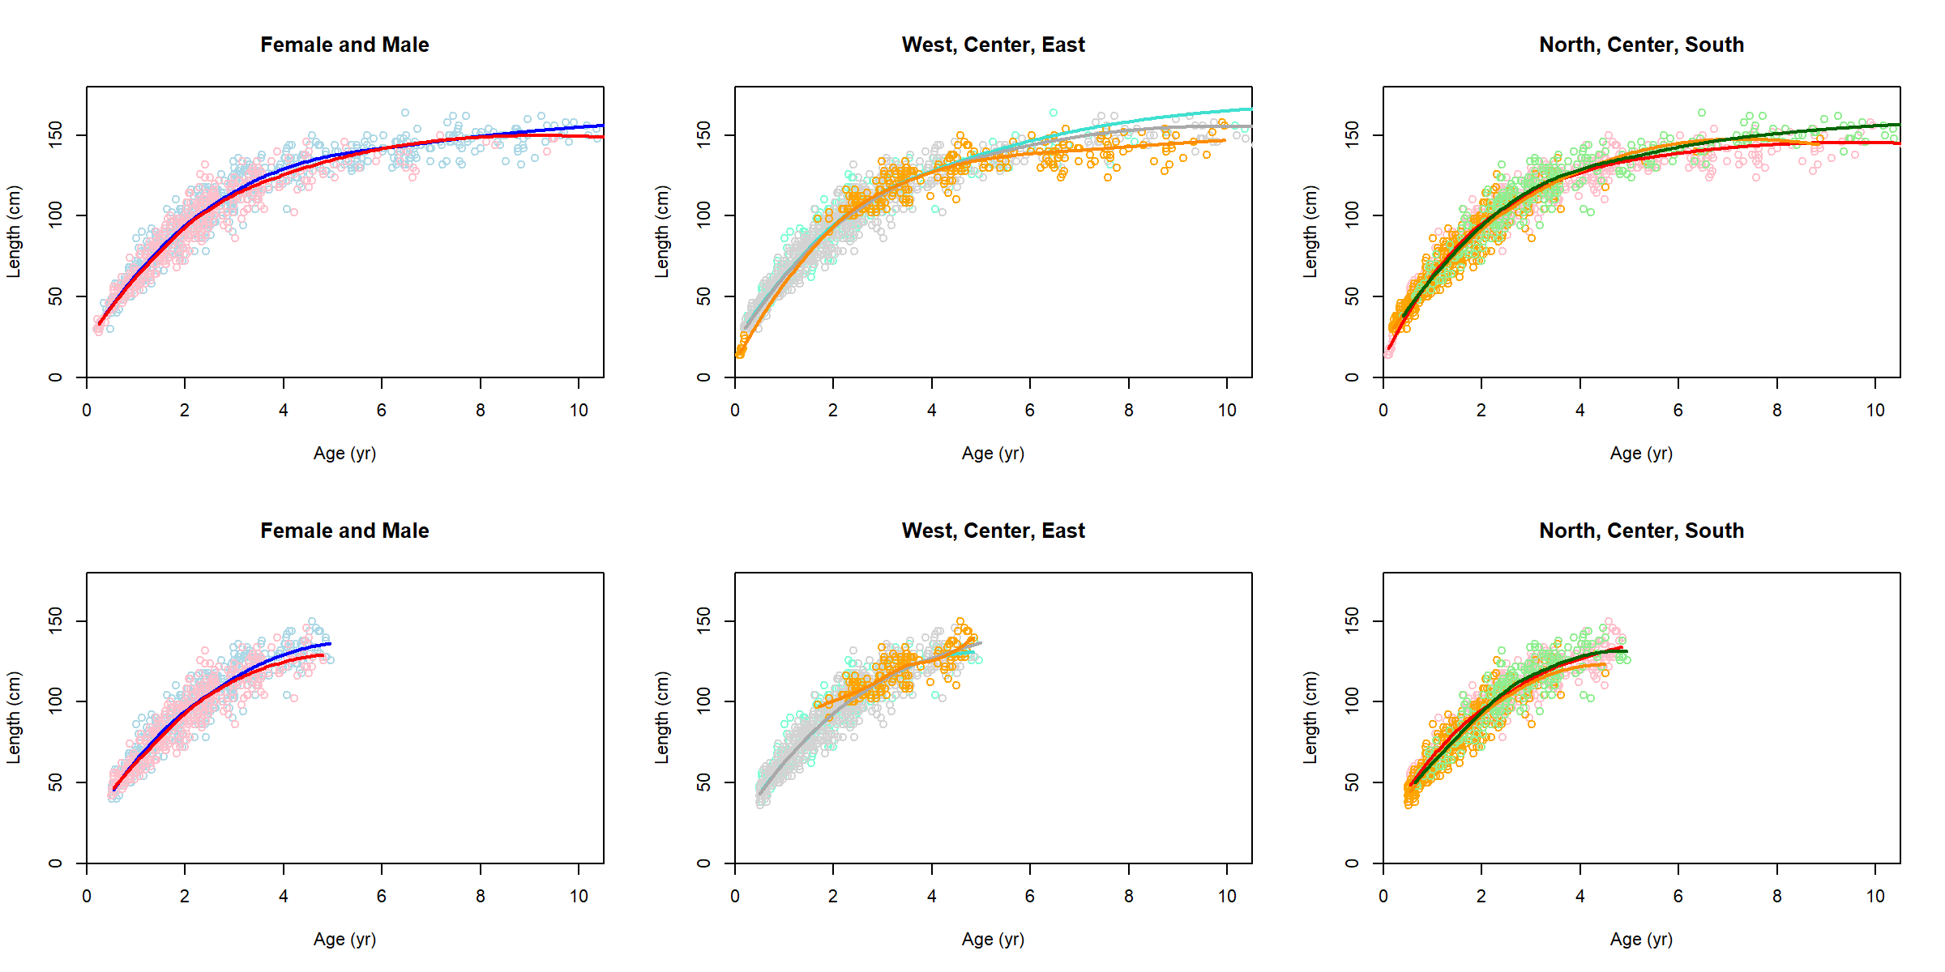
Exploratory Data Analysis
Simple loess
smooth lines
Ages 0.5 - 5 yrs
constitute >90% of
the current biomass
Male (blue)
Female (red)
West of 140°E (orange)
Center (gray)
East of 170°E (turquoise)
North of 0° (red)
Center (orange)
South of 10°S (green)

Slide 5
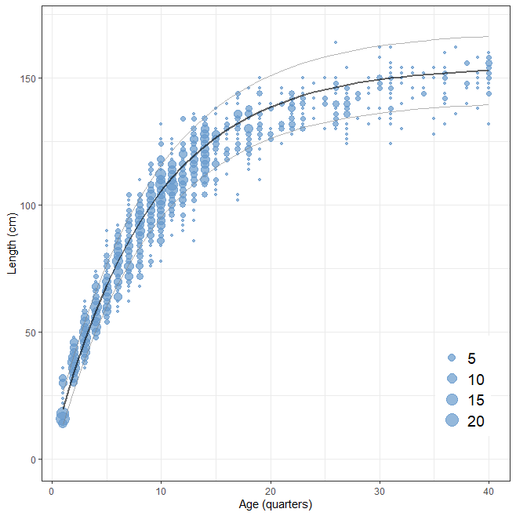
Growth Curve
Von Bertalanffy curve
internally estimated in
the YFT 2020 assessment

