Slide 1
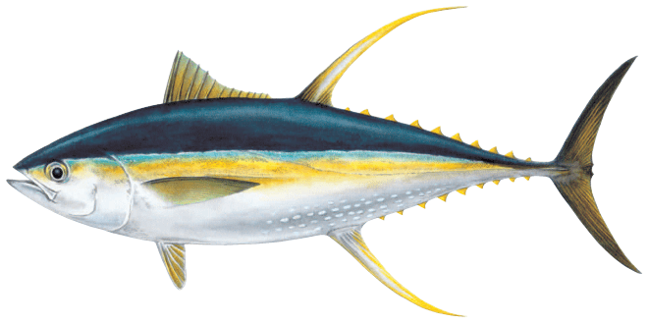
2023 SPC Pre-assessment Workshop
25-28th April
Previous Yellowfin Tuna Assessment Summary
P1 – Arni Magnusson

Slide 2
Model
MULTIFAN-CL
Length-based, Age-structured, 9 regions
Fitting to: CPUE, Length comps, Weight comps, Tags, Otoliths
Quarterly time steps 1952 -2018
32 extraction fisheries, 9 index fisheries (LL)

Slide 3
New Features
Growth curve estimated from otoliths, internally or externally, or based on modal pregression
Spatio-temporal analysis of CPUE indices, incorporated into MFCL as Index fisheries
Tag mixing enforced to be 182 days
New tagging data from the Japanese Tagging Program (JPTP)
Maturity at age calculated from maturity at length, spawning fraction no longer used
Plus group at 10 yrs

Slide 4
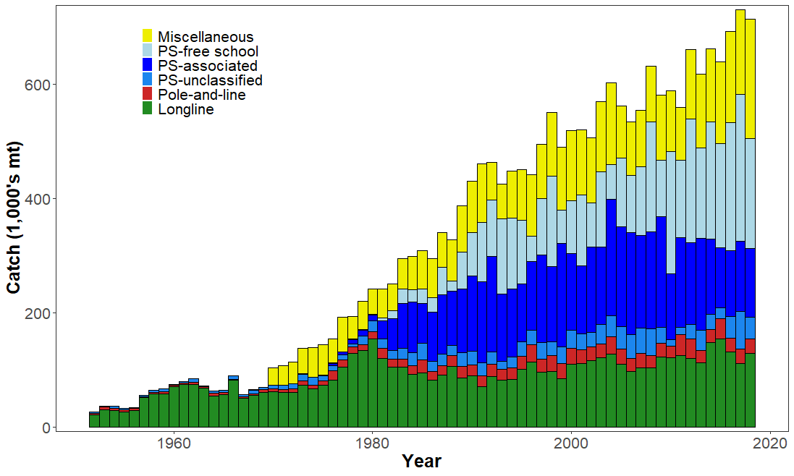
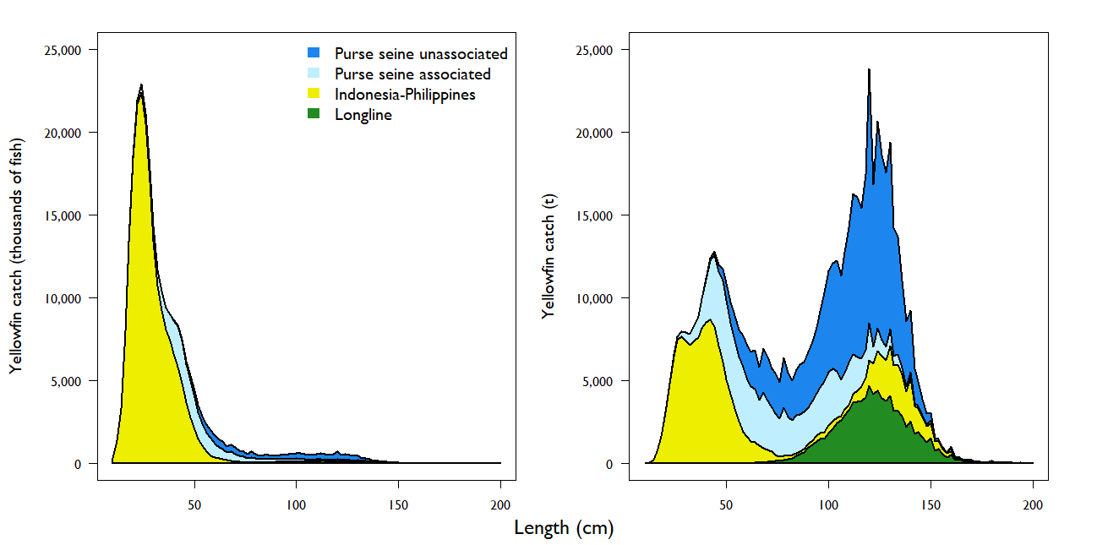
Catches
The smallest fish are
caught especially in the
Indonesian - Philippine
fisheries

Slide 5
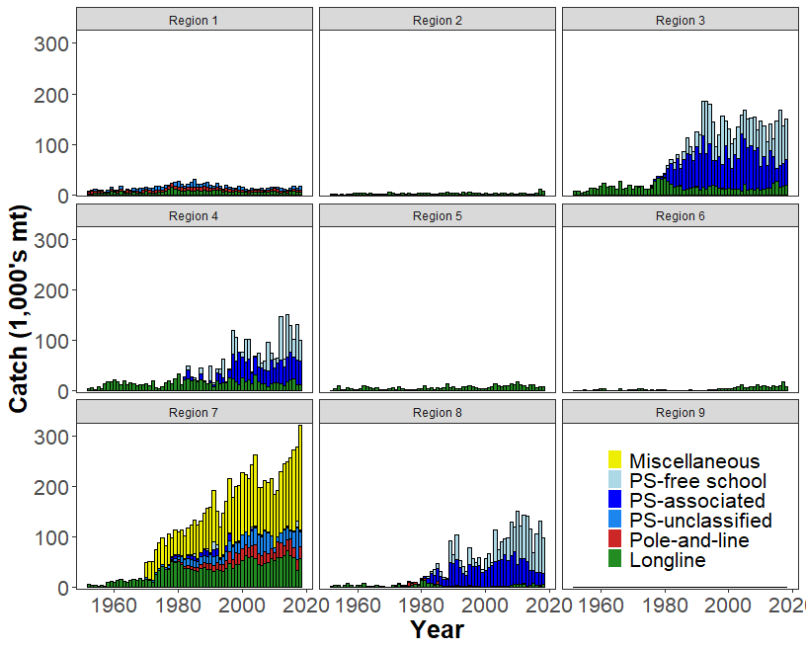
Catches
The vast majority of catches are
caught in the Equatorial regions (3, 4, 7, and 8)

Slide 6
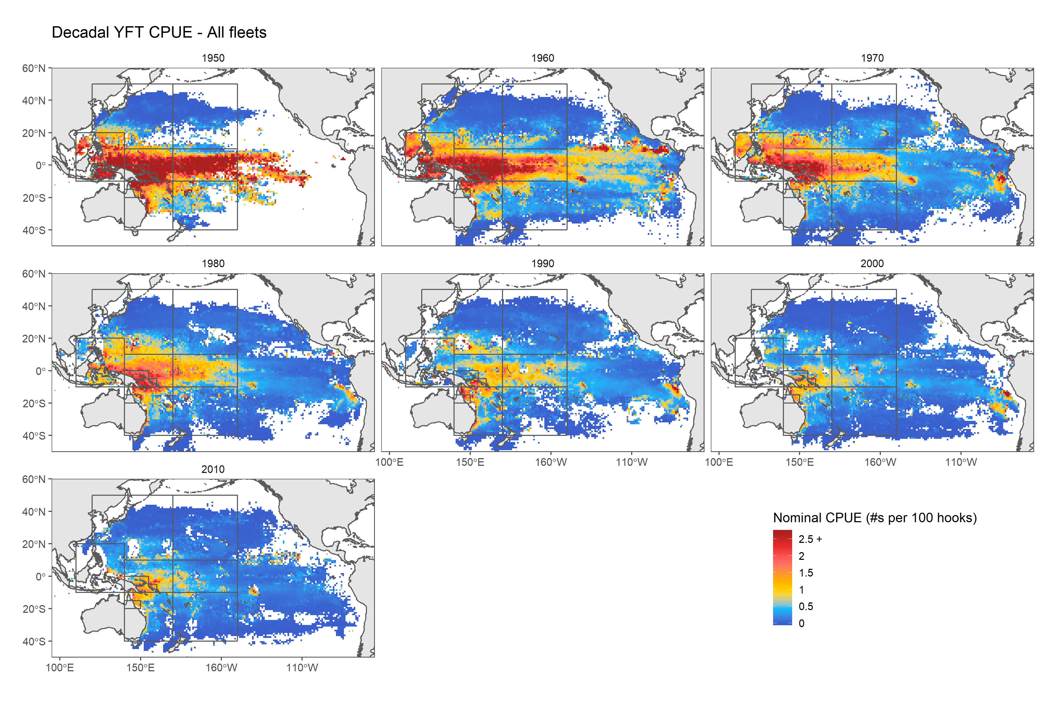
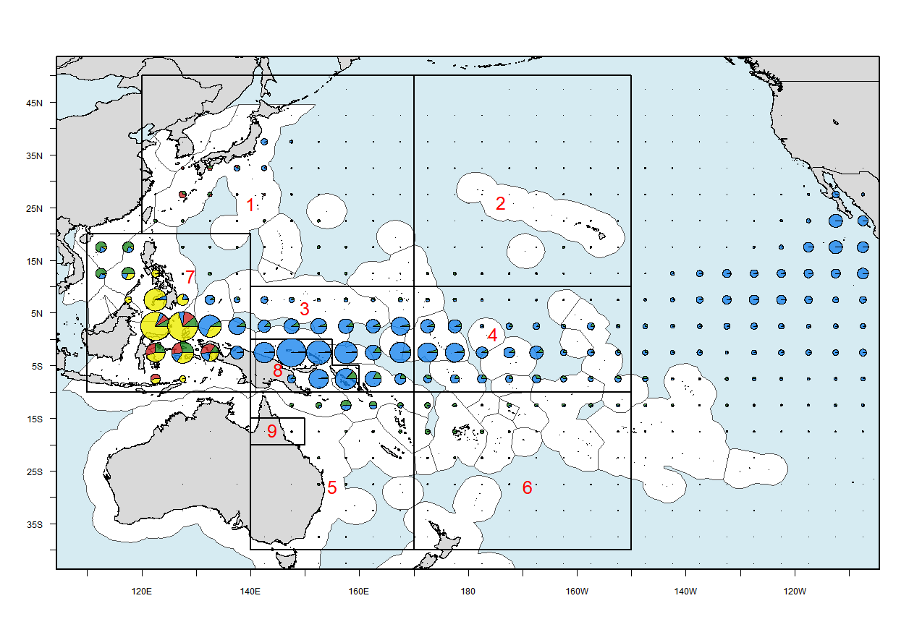
Spatial Distribution
Catches
Catch and CPUE data indicate that around
80% are in the Tropical regions, and around
20% are in the Northern & Southern regions

Slide 7
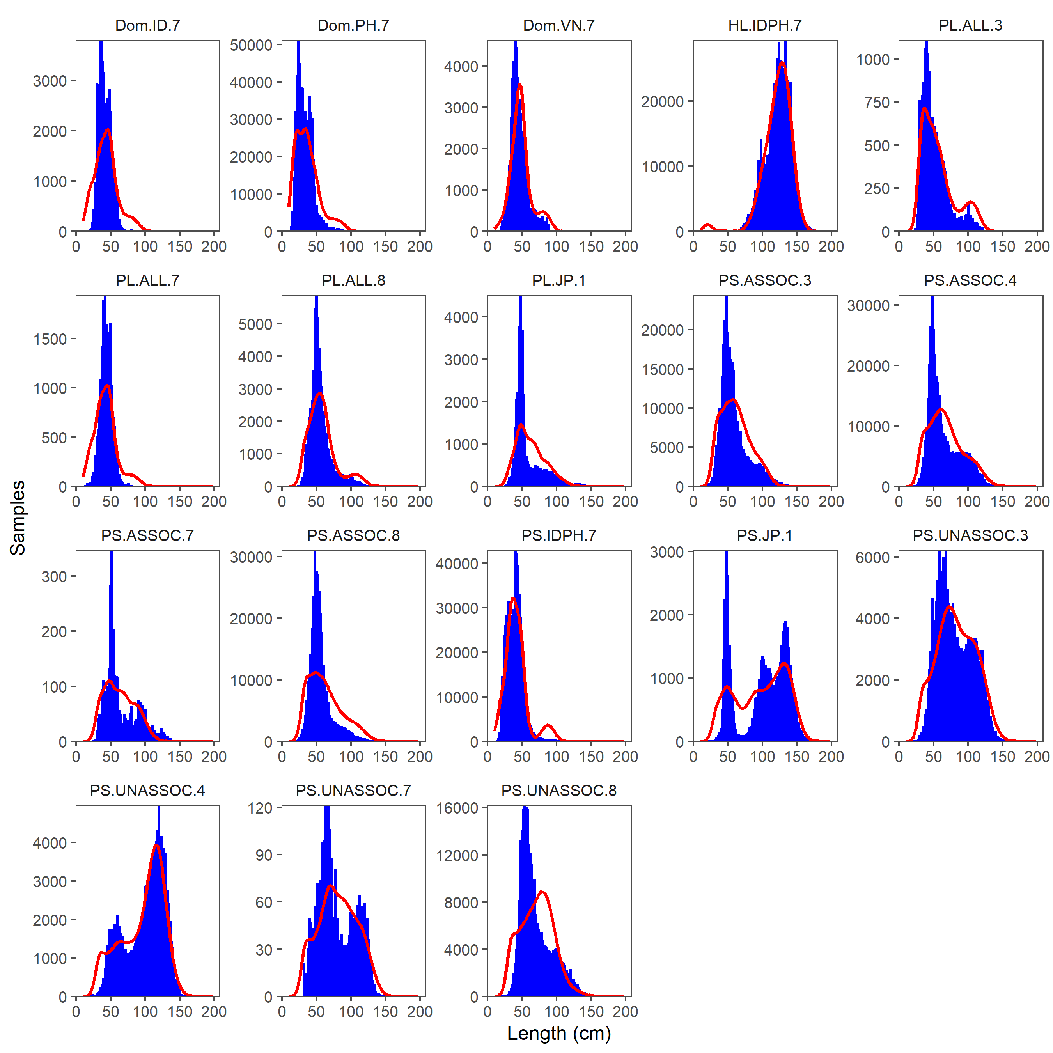
Fit to Length Comps

Slide 8
Fit to Length Comps

Slide 9
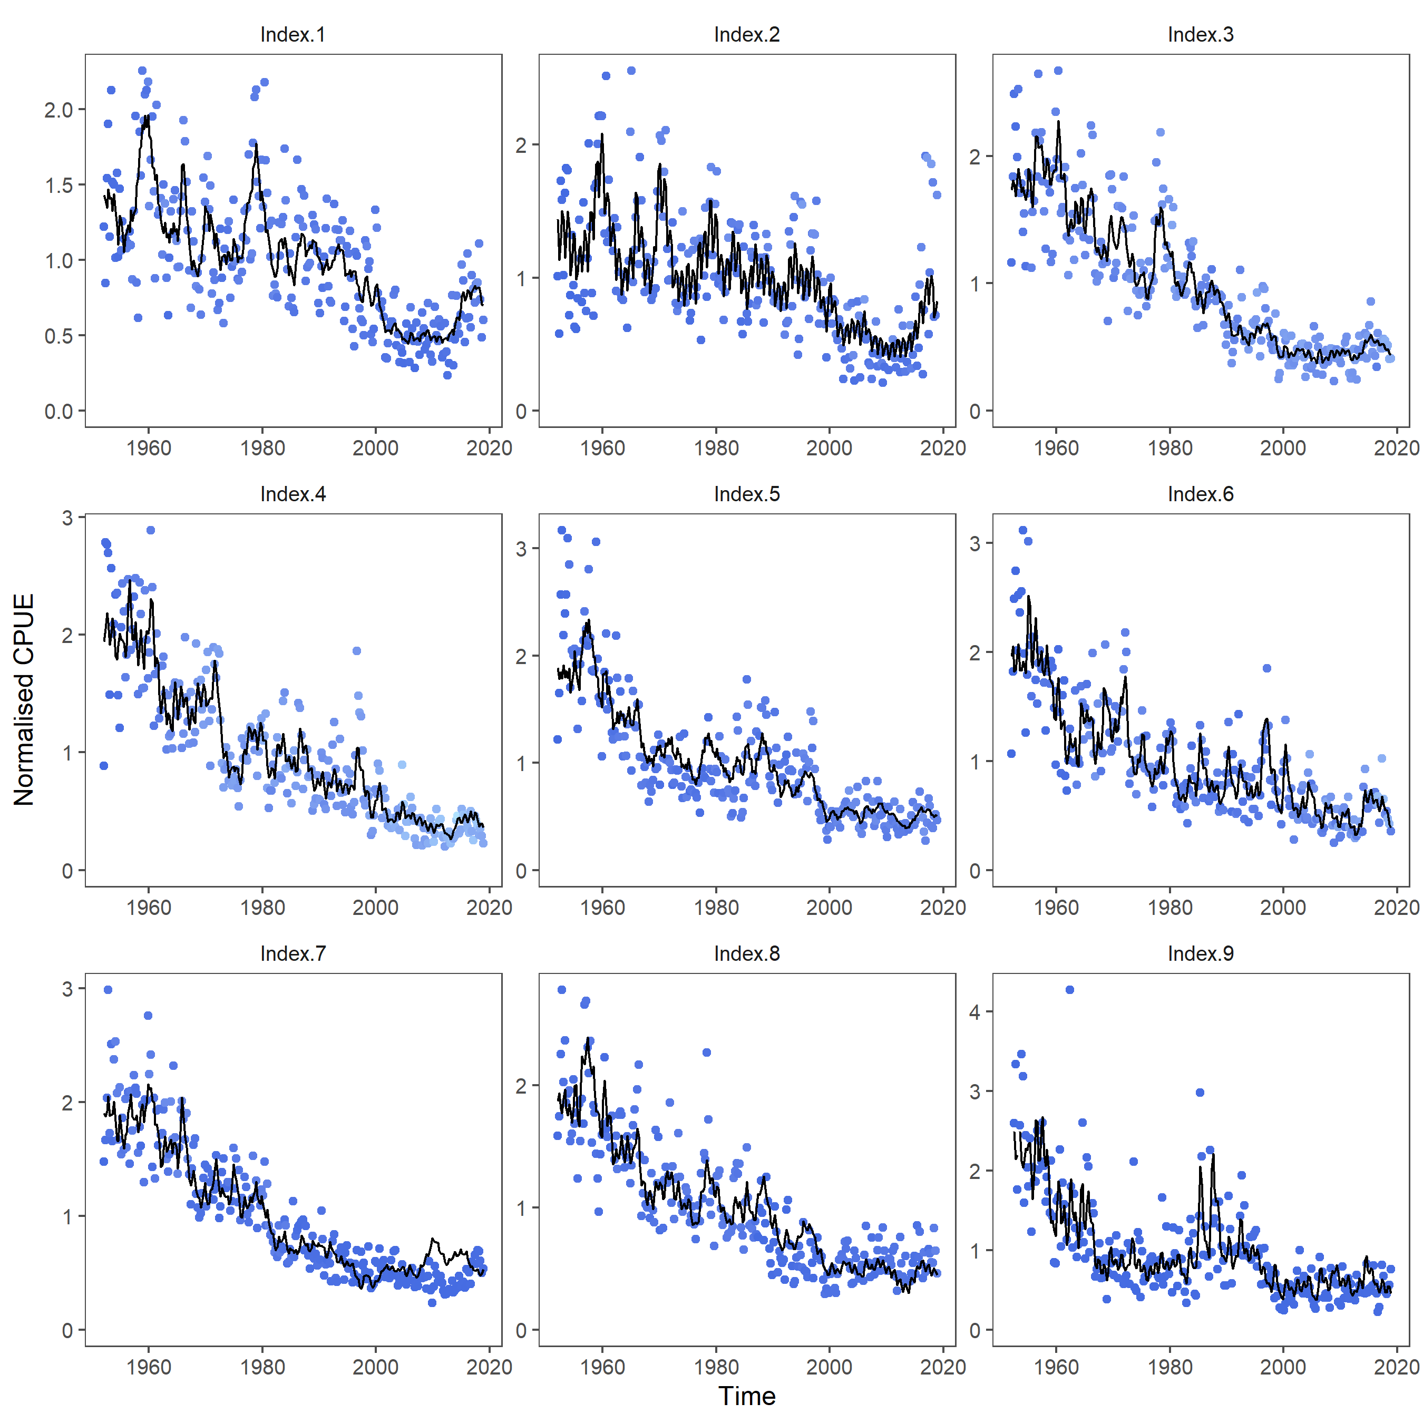
Fit to CPUE

Slide 10
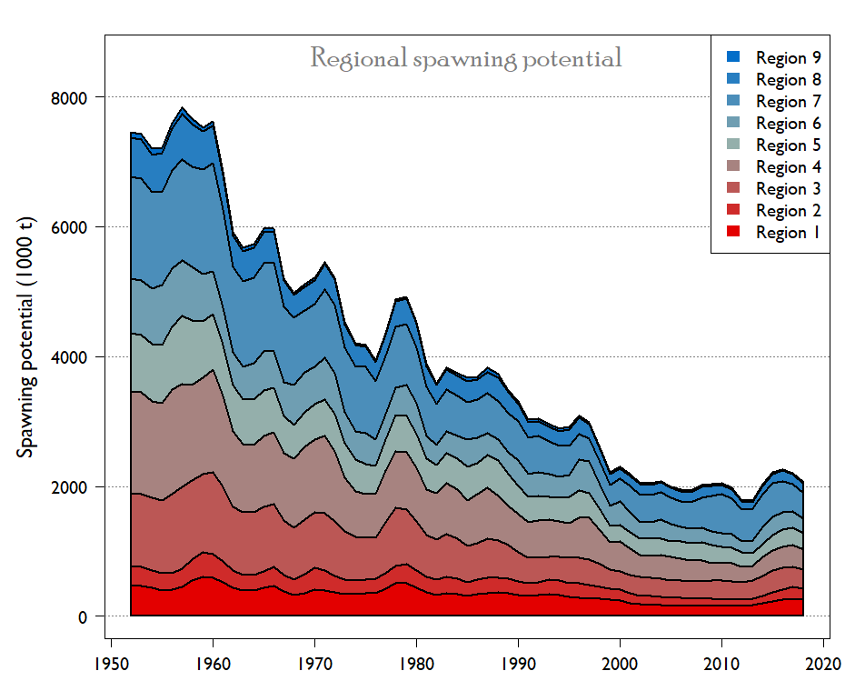
Biomass

Slide 11
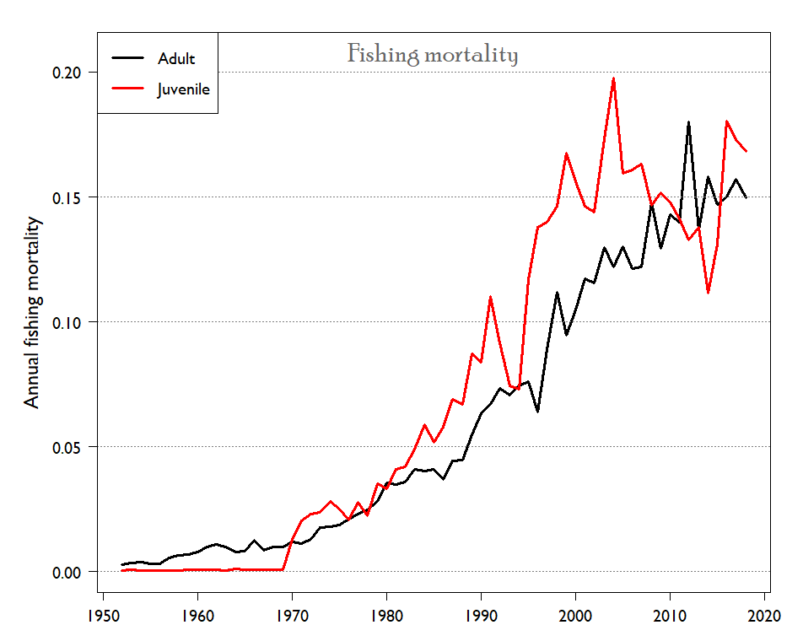
Fishing Mortality

Slide 12
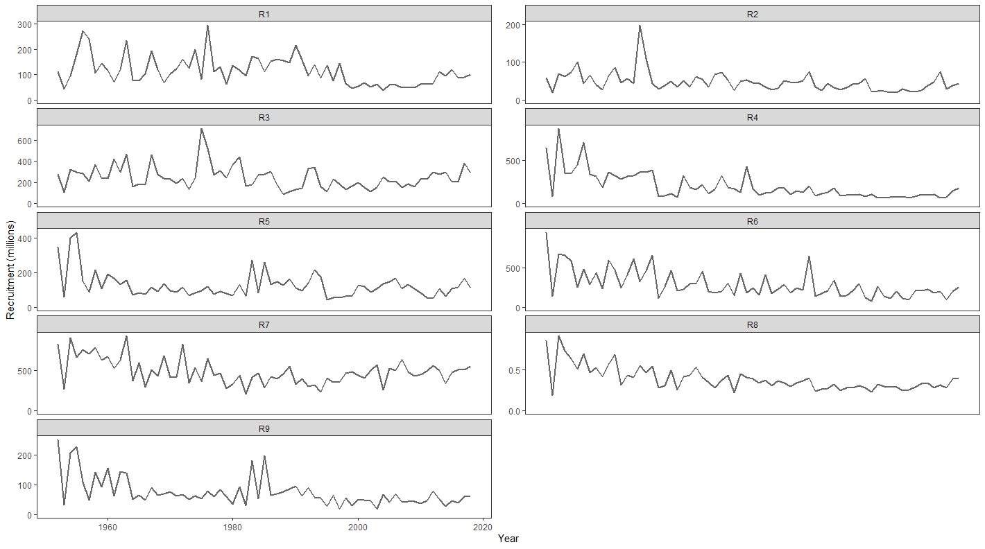
Recruitment

Slide 13
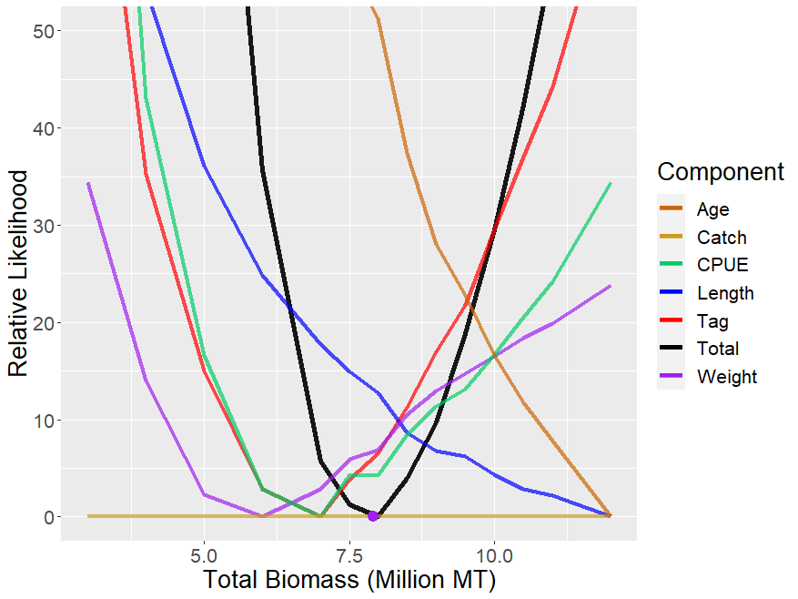
Likelihood Profile

Slide 14
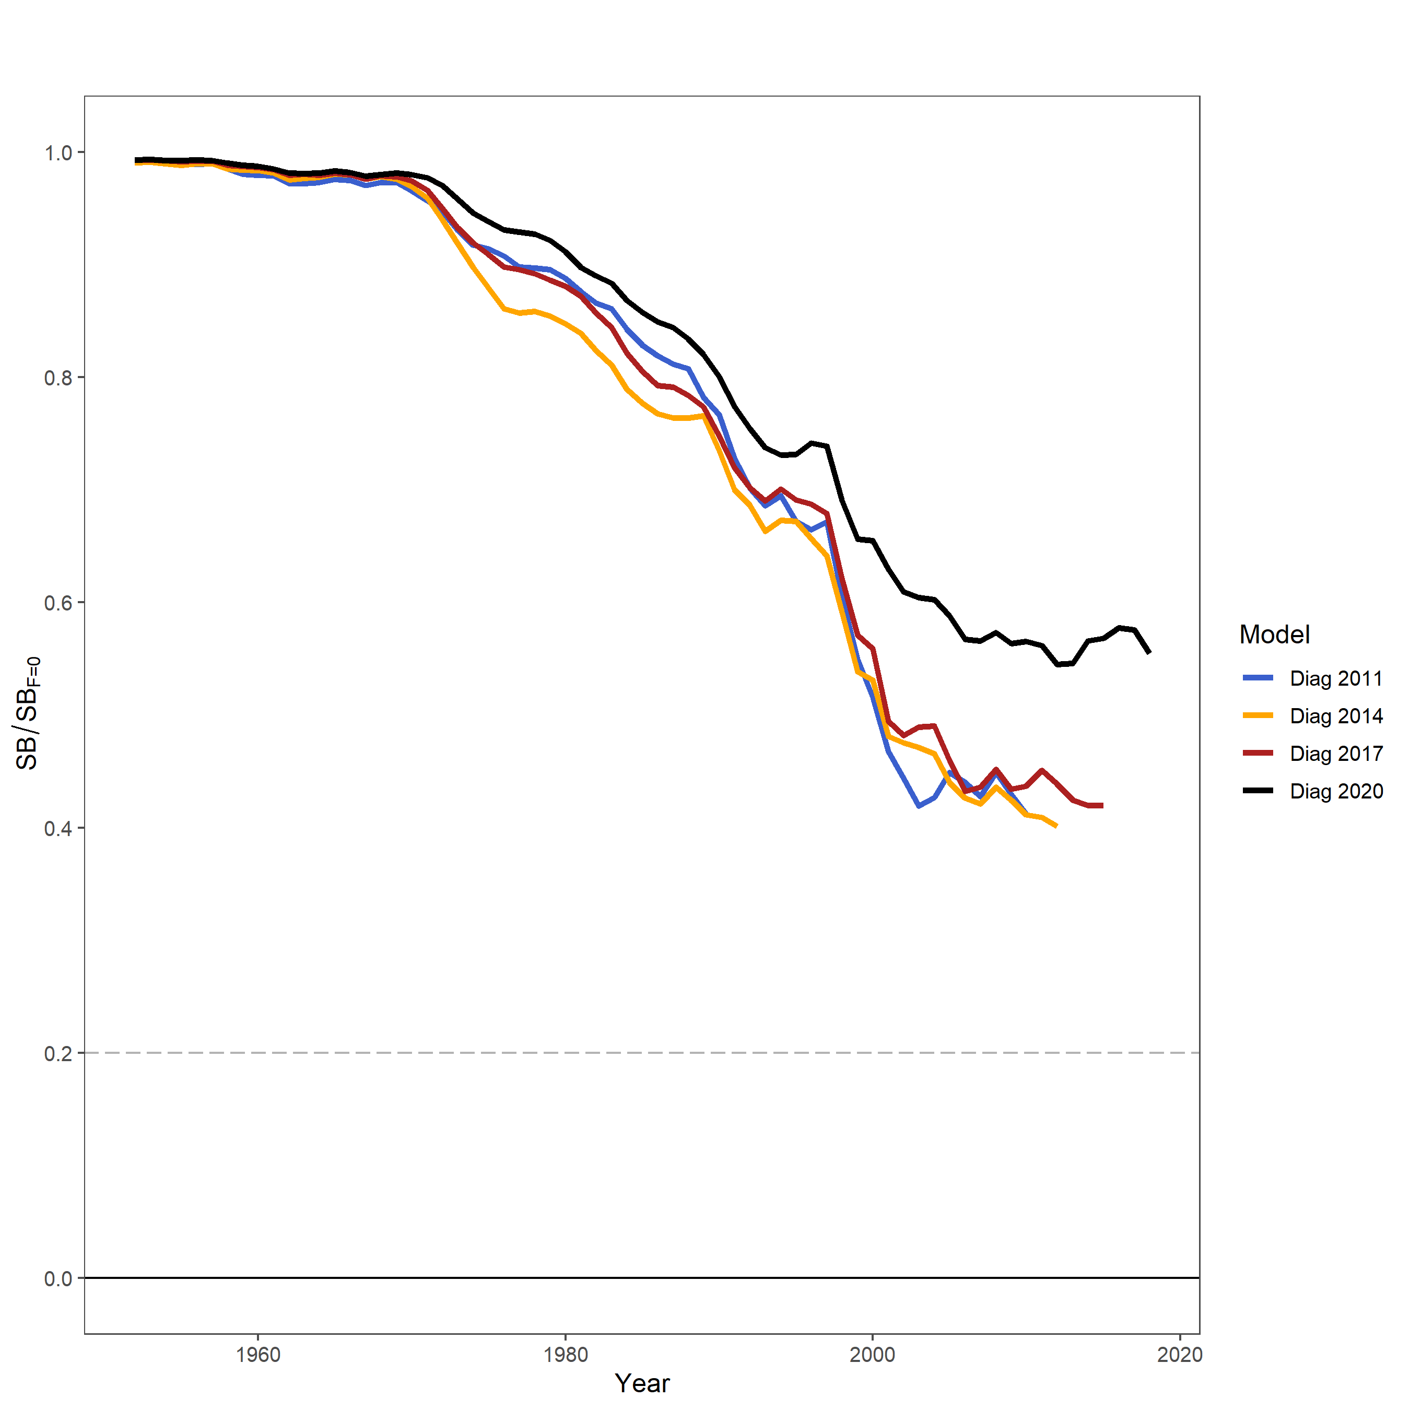
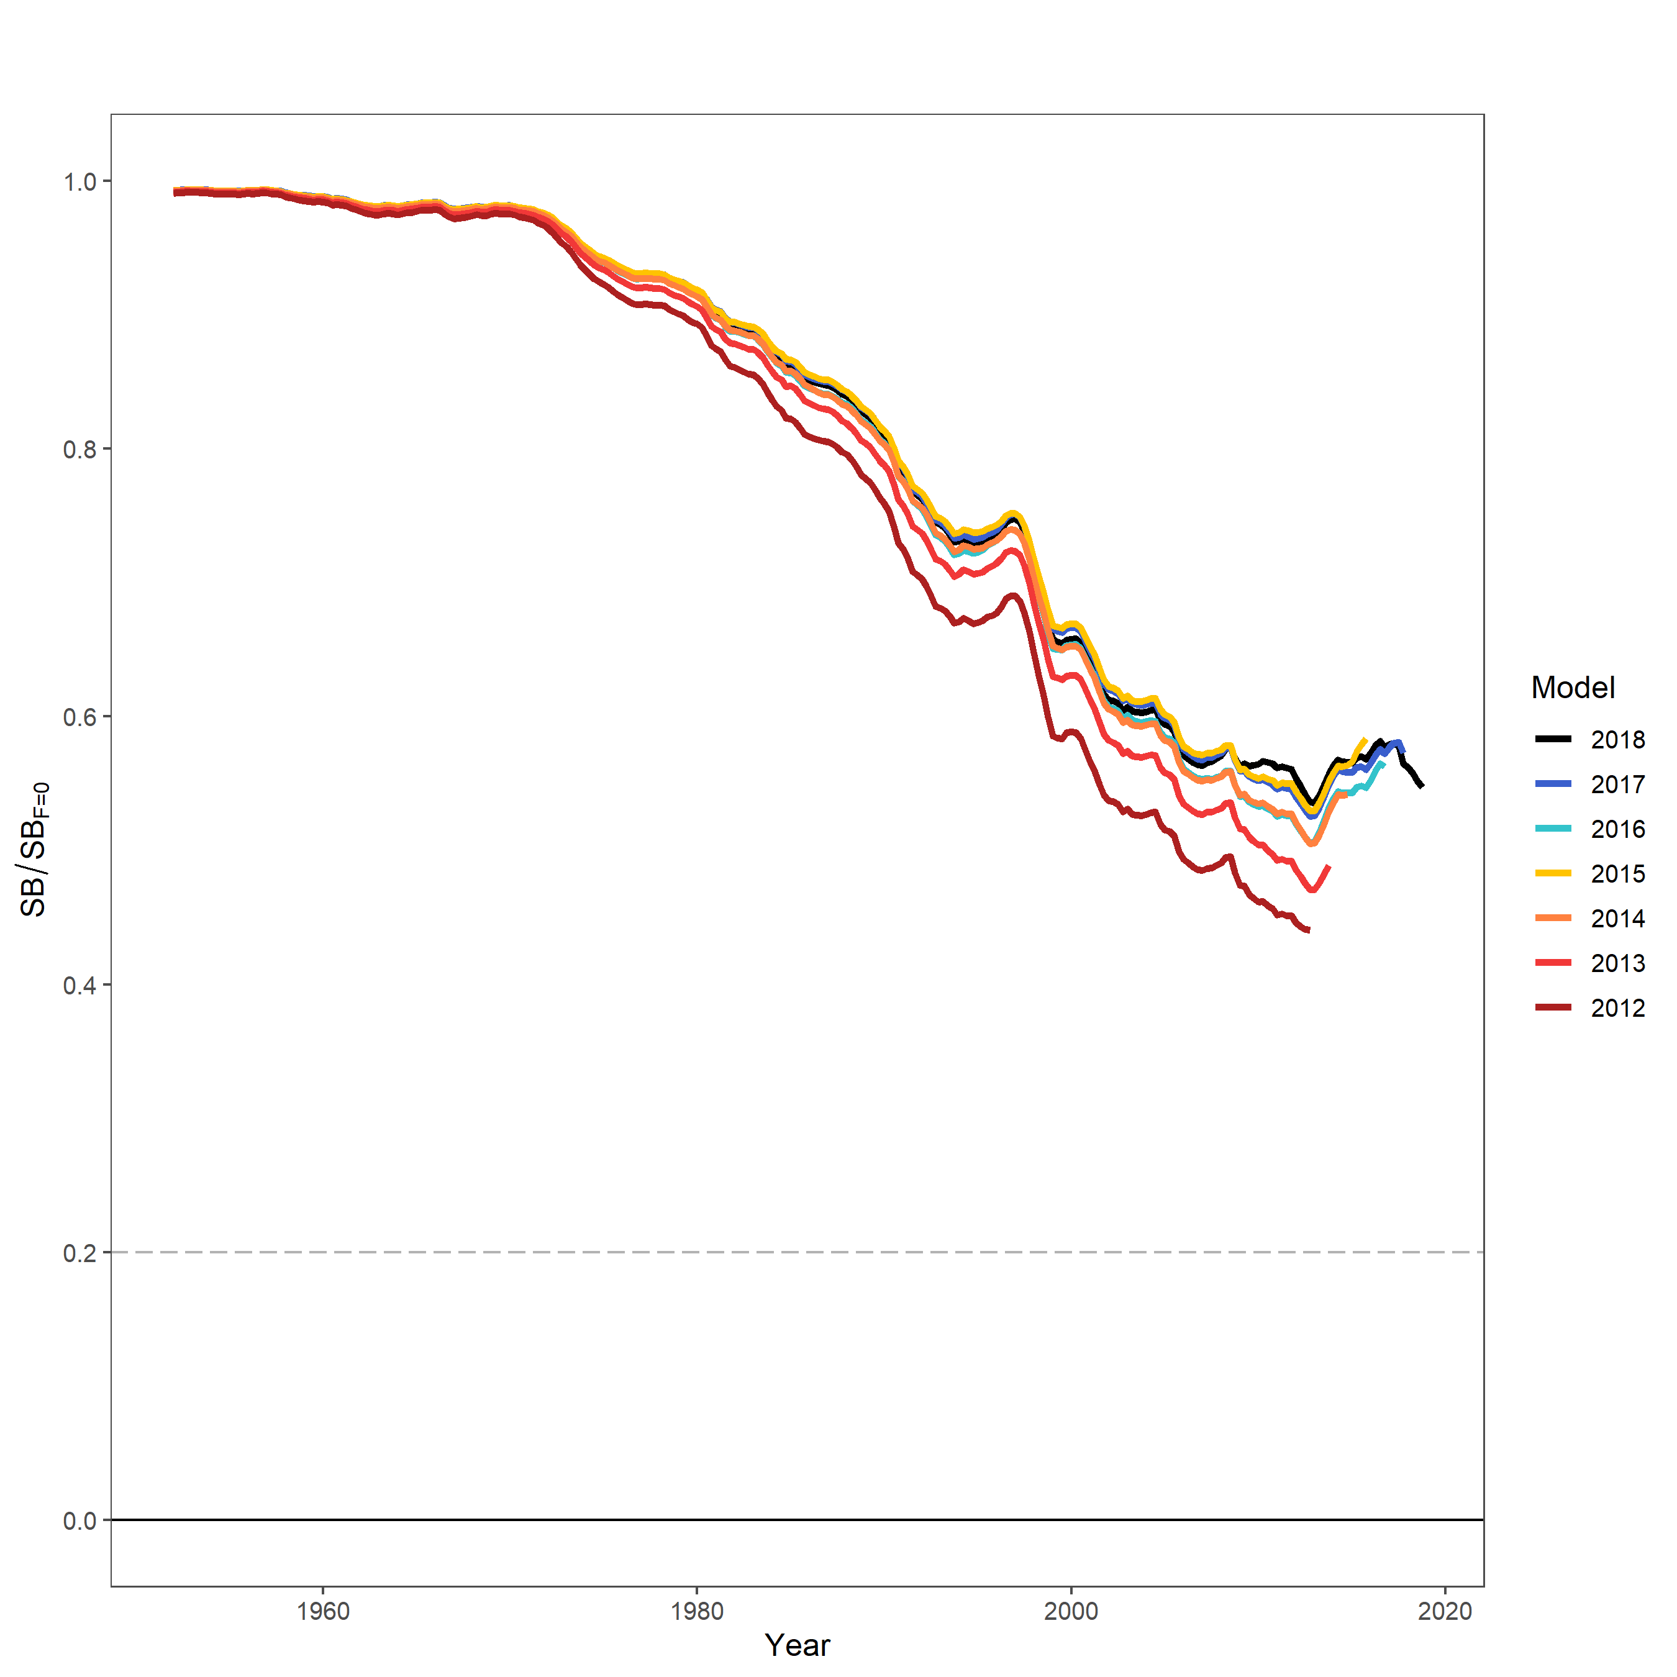
Retrospectives
Assessments
Data peels

Slide 15
Uncertainty Grid
Axis | Value 1 | Value 2 | Value 3 | Value 4
Growth | Modal | CondAge* | Otolith
Steepness | 0.65 | 0.8* | 0.95
Size Scalar | 20 | 60* | 200 | 500
Mixing Period | 1 quarter | 2 quarters*
Most important uncertainties were
growth, mixing period, steepness
72 models (3 x 3 x 4 x 2)

Slide 16
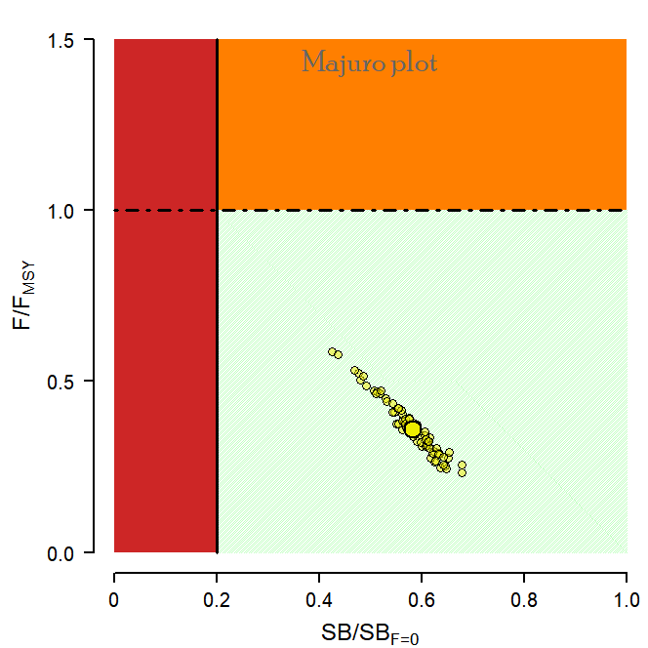
Stock Status
Median
SB_{recent} / SB_{F=0} = 0.583
F_{recent} / F_{MSY} = 0.357

