Slide 1
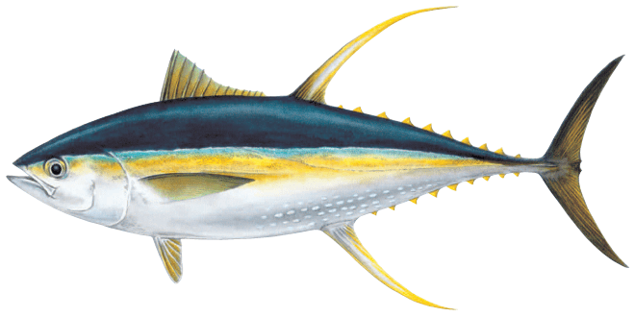
2023 SPC Pre-assessment Workshop
25-28th April
Growth, Natural Mortality, and Maturity of Yellowfin Tuna
P12 – Arni Magnusson

Slide 2
Growth
The YFT 2020 assessment used three approaches to estimate growth:
1. Modal - estimate von Bertalanffy growth curve using size composition data only
2. CondAge - estimate von Bertalanffy curve using otoliths and all other data in the assessment model
3. Otolith - fixed Richards growth curve is input into the stock assessment model, after being externally estimated
The Peer Review panel recommends estimating the growth curve internally

Slide 3
Growth
MULTIFAN-CL supports von Bertalanffy and Richards growth curves
Internal estimation of a Richards growth curve was explored during the Peer Review, but the initial results were subject to some estimation problems

Slide 4
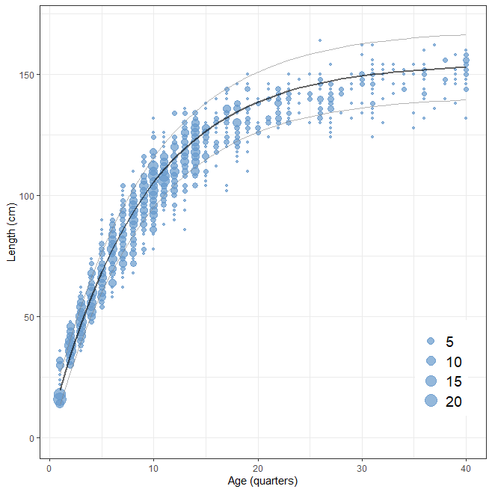
Growth

Slide 5
Natural Mortality
The YFT 2020 assessment used a three-phase natural mortality curve to account for the higher mortality of females at older ages
M-at-age was calculated using an approach applied to other tunas in the WCPO and EPO
The generally increasing proportion of males observed in the catch with increasing size is assumed to be due to an increase in the natural mortality of females at larger sizes

Slide 6
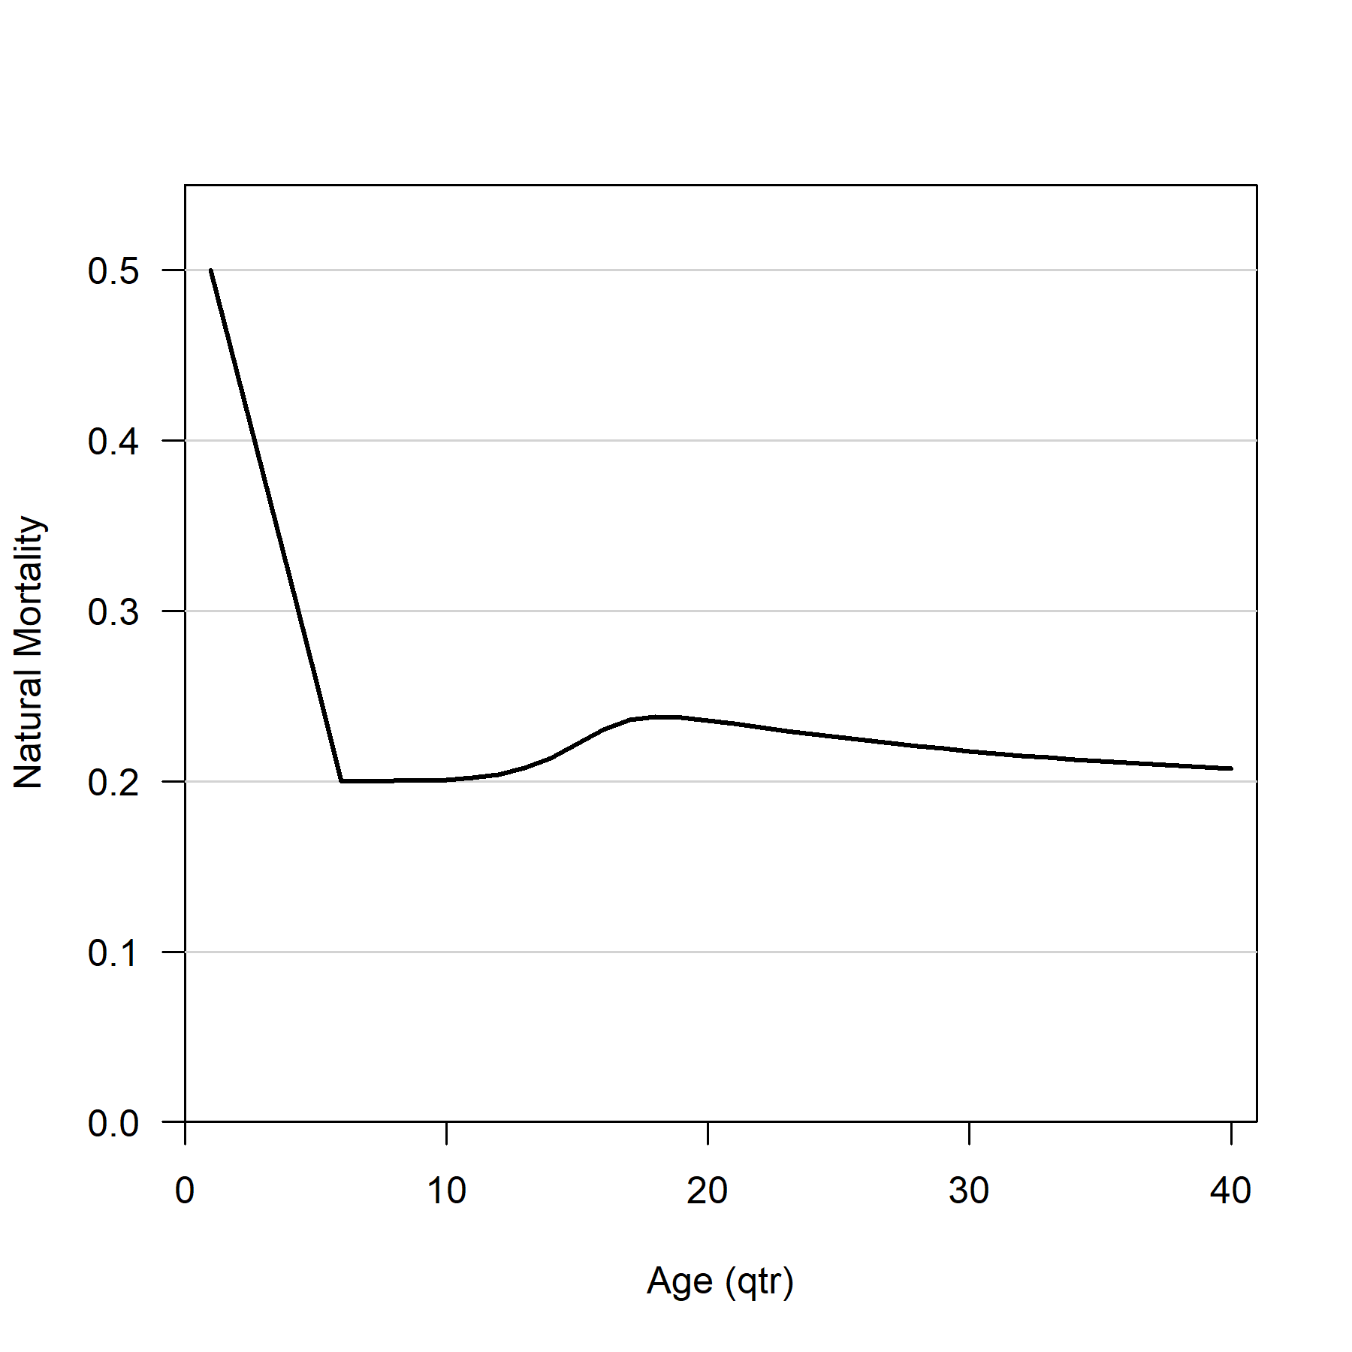
Natural Mortality

Slide 7
Natural Mortality
The growth curve and sex-ratio-at-length vector are key inputs for calculating M-at-age
The Review Panel endorsed the general approach for estimating M-at-age
The Review Panel recommends continuing the current approach with the base M set to 0.2 but including alternative values for base M in the uncertainty grid

Slide 8
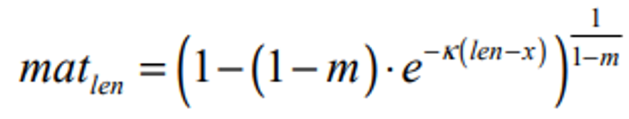

Reproductive Potential
Reproductive potential is calculated as the product of three length-based processes:
1. Proportion of females at length
2. Maturity at length (of females)
3. Fecundity at length (of mature females)
Sex ratio at length is calculated from Regional Observer Program data in SPC holdings
Maturity and fecundity are calculated as functions of length, using coefficients (Itano 2000)

Slide 9
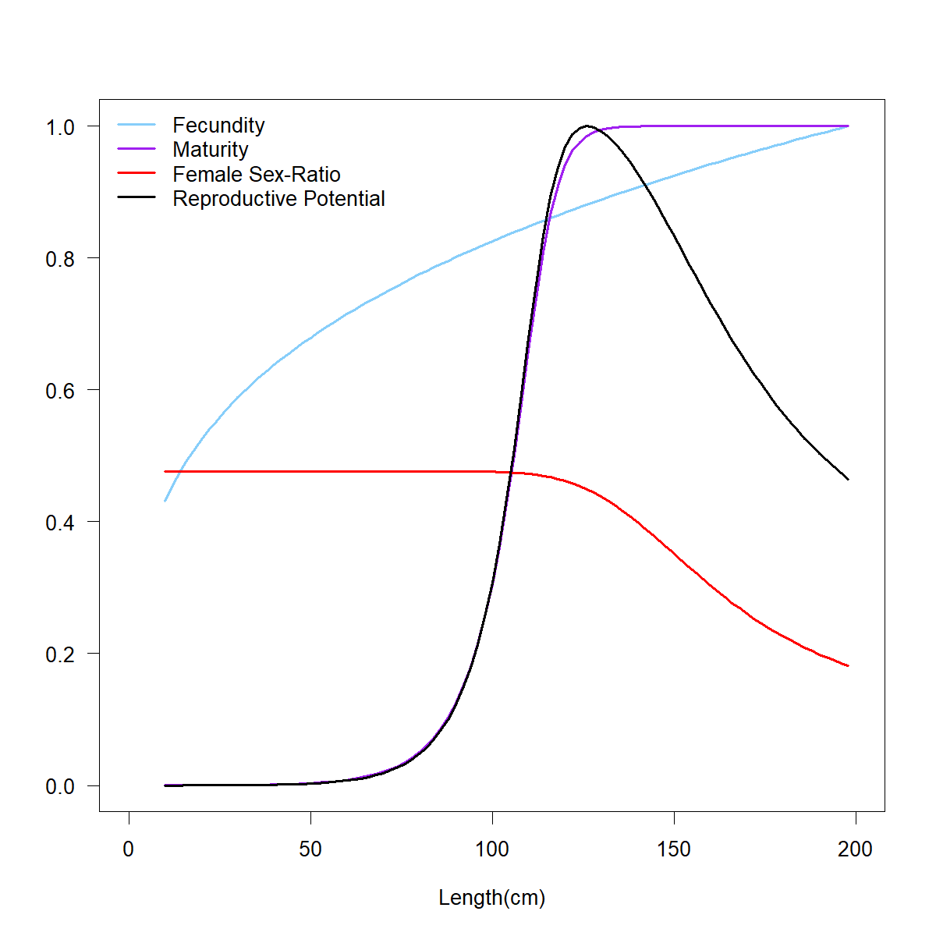
Reproductive Potential
The YFT 2020 assessment used a
new feature in MFCL, converting
maturity-at-length to maturity-at-age
within the model, rather than externally

Slide 10
Reproductive Potential
The YFT 2020 assessment used a new feature in MFCL, converting maturity-at-length to maturity-at-age within the model, rather than externally
The Review Panel noted that the YFT 2020 assessment used an updated vector of sex-ratio-at-length for the WCPO, differing substantially from the 2017 assessment
The Review Panel also noted that future assessments of YFT and ideally other species should provide consistent output on how changes in assumptions (e.g., M) affect sex ratios and reproductive output (and vice versa)

