Slide 1
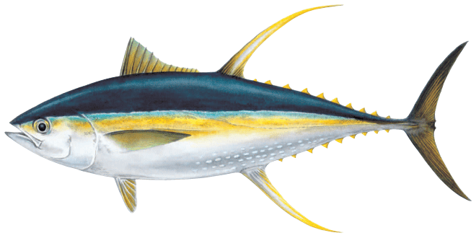
2023 SPC Pre-assessment Workshop
25-28th April
Model Development and Initial Results for Yellowfin Tuna
P14 – Arni Magnusson

Slide 2
Catch Conditioning and Hessian
Initial model development conducted so far has revolved mainly around two important technical improvements that have been encouraged at previous PAW and SC meetings:
Catch conditioning and survey index likelihood for CPUE
Application of techniques that can help achieve a positive definite Hessian convergence

Slide 3
Catch Conditioning and Hessian
The 2022 SKJ assessment implemented catch conditioning and during follow-up work after that assessment, John Hampton achieved a positive definite Hessian convergence for newly developed SKJ model runs
Following these successes, he has made similar improvements to exploratory BET and YFT runs

Slide 4
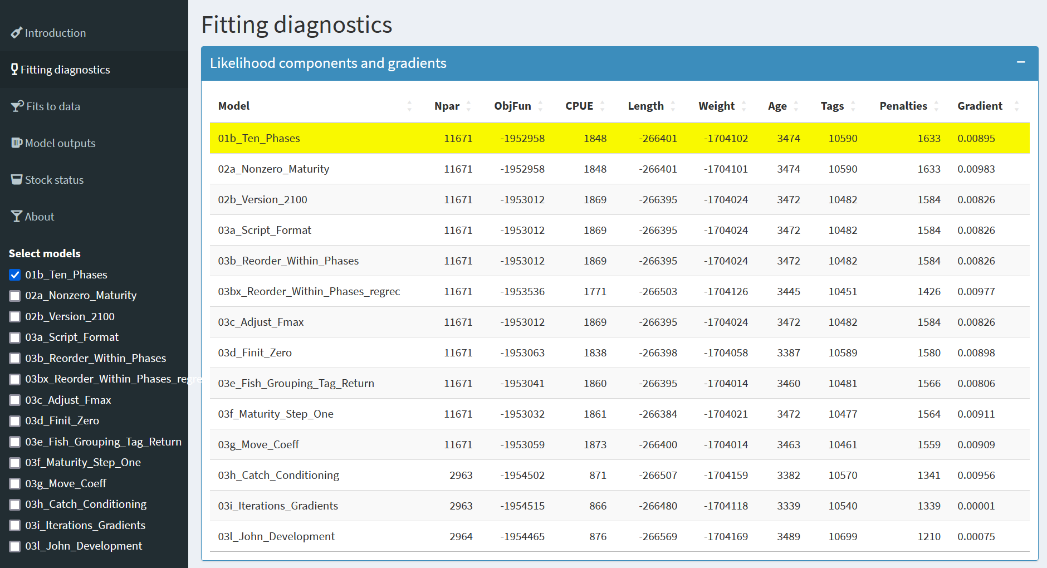
Shiny Demo

Slide 5
Two Focus Topics
We have compiled recommendations provided by the Peer Review panel (Punt et al. 2023), the previous stock assessor (Vincent et al. 2020, Section 8.4), along with PAW and SC feedback, which have guided our internal discussions and exploratory analyses
So far, the SAM team has prioritized two focus topics for the YFT 2023 assessment that have formed a broad theme for the ongoing analyses presented at our weekly technical meetings:
1. Regional scaling 2. Spatial structure

Slide 6
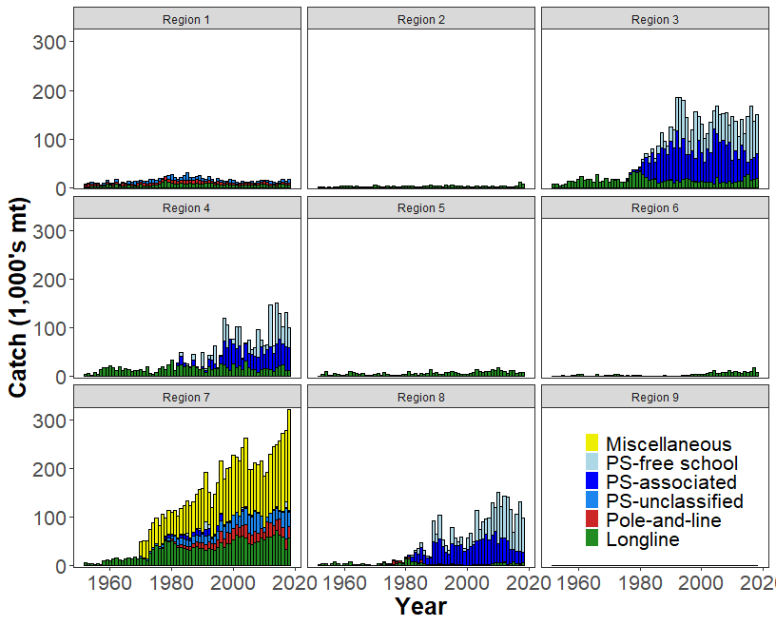
Regional Scaling
The vast majority of catches are
caught in the Equatorial regions (3, 4, 7, and 8)

Slide 7
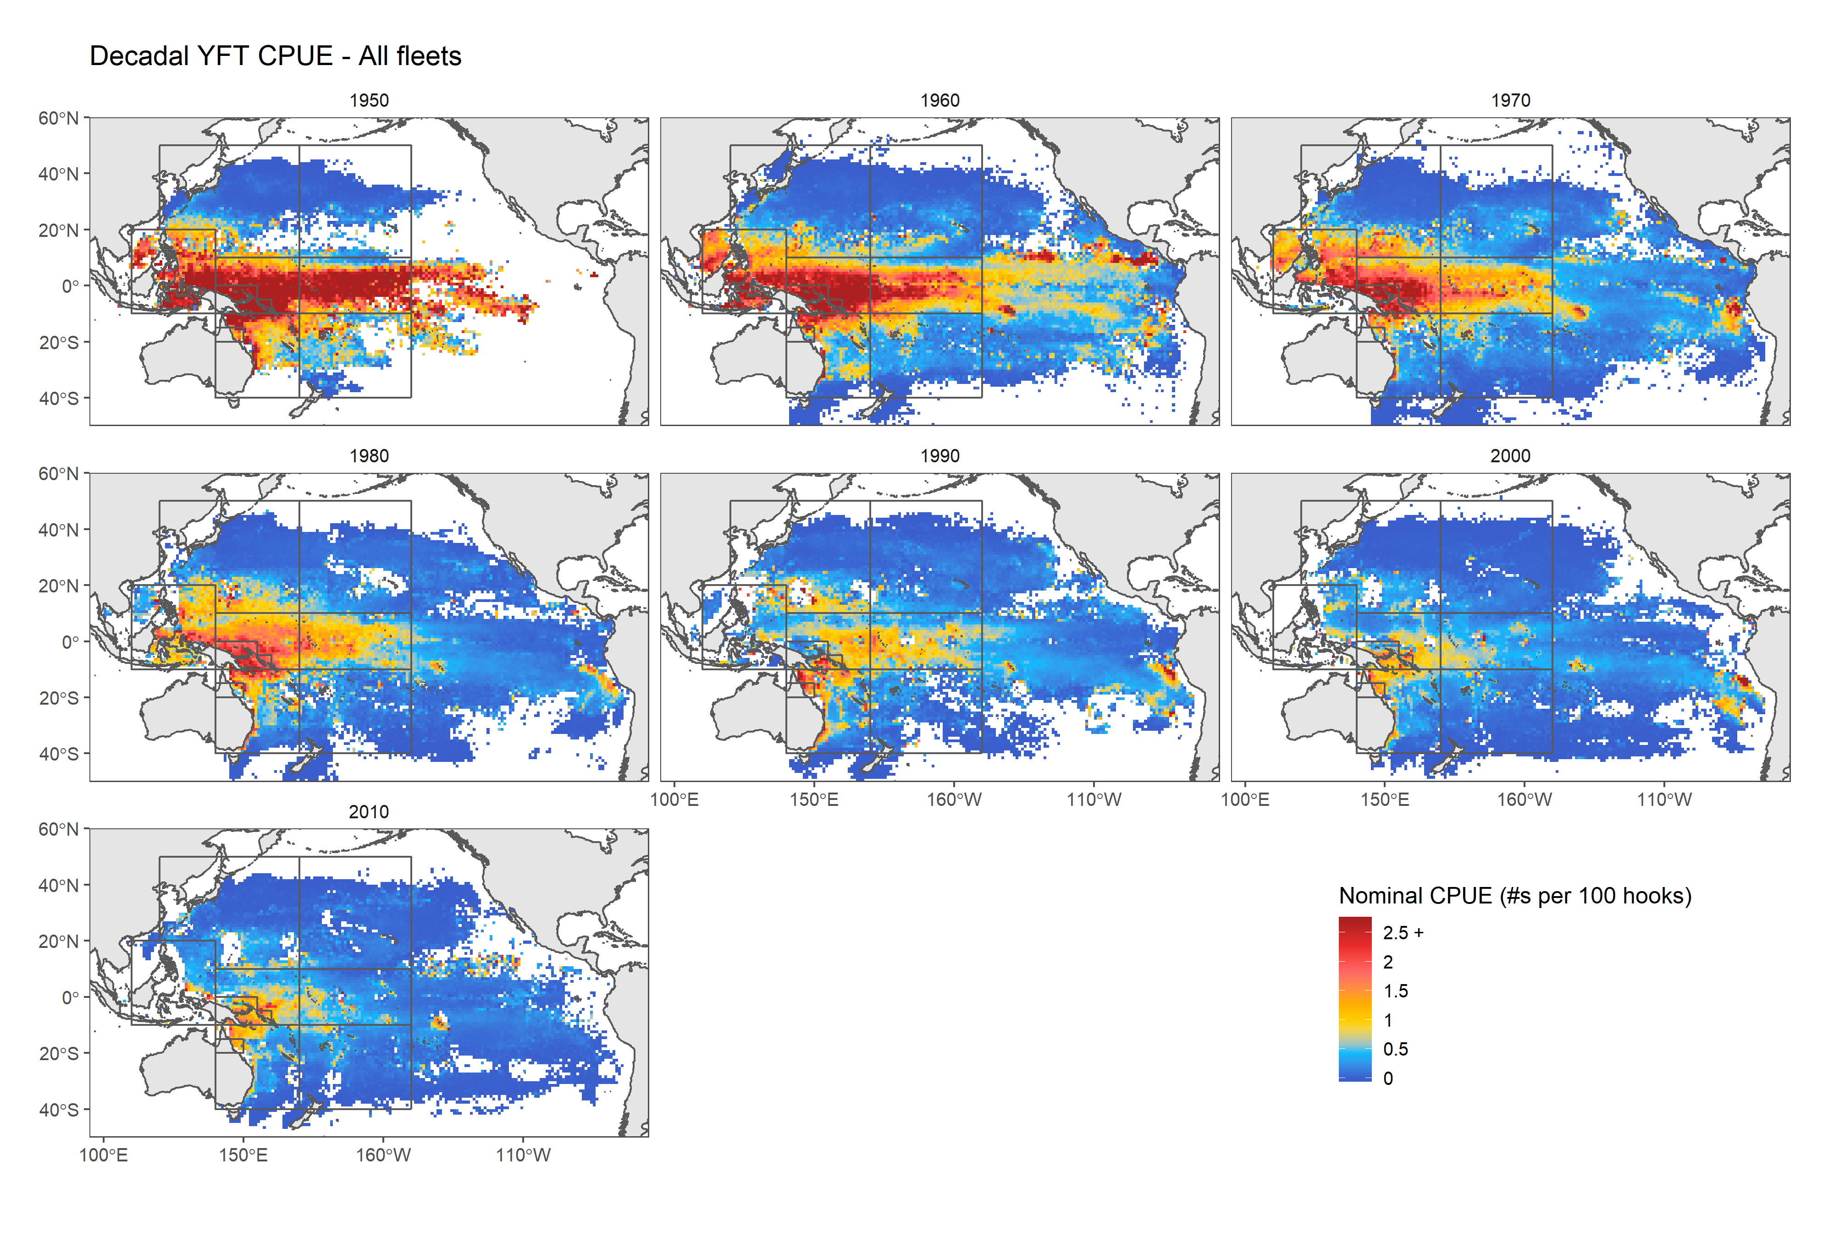
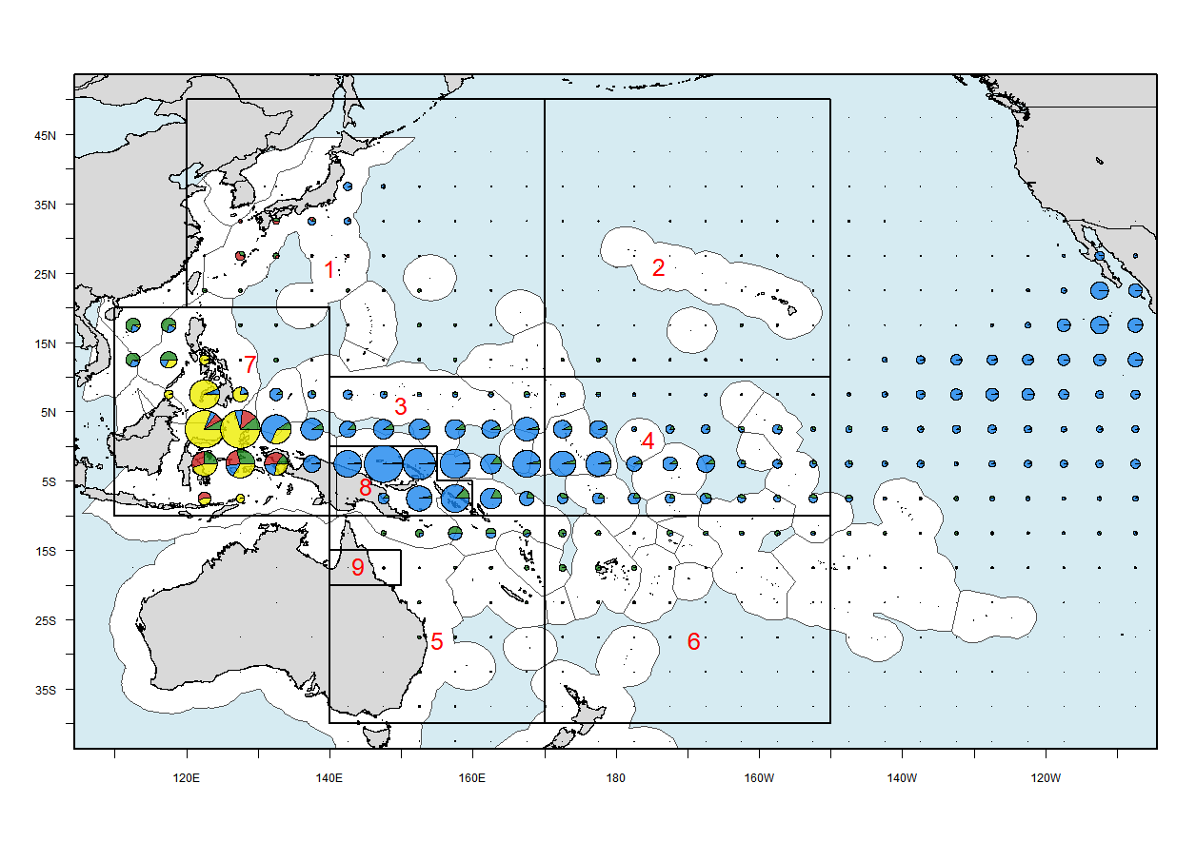
Regional Scaling
Catches
Catch and CPUE data indicate that around
80% are in the Equatorial regions, and around
20% are in the Northern & Southern regions

Slide 8
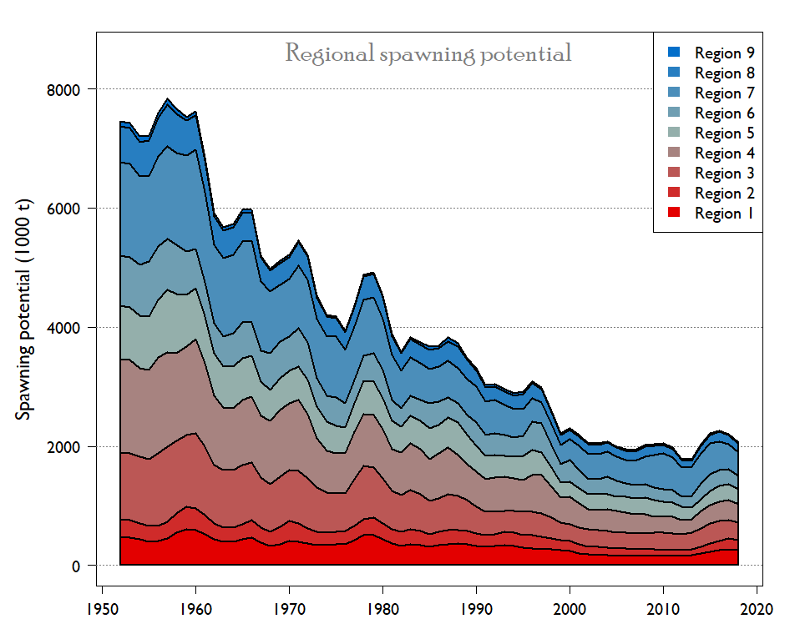
Regional Scaling
What does the model
say about the proportion
of the biomass that is in
the Equatorial regions?
80% perhaps?

Slide 9
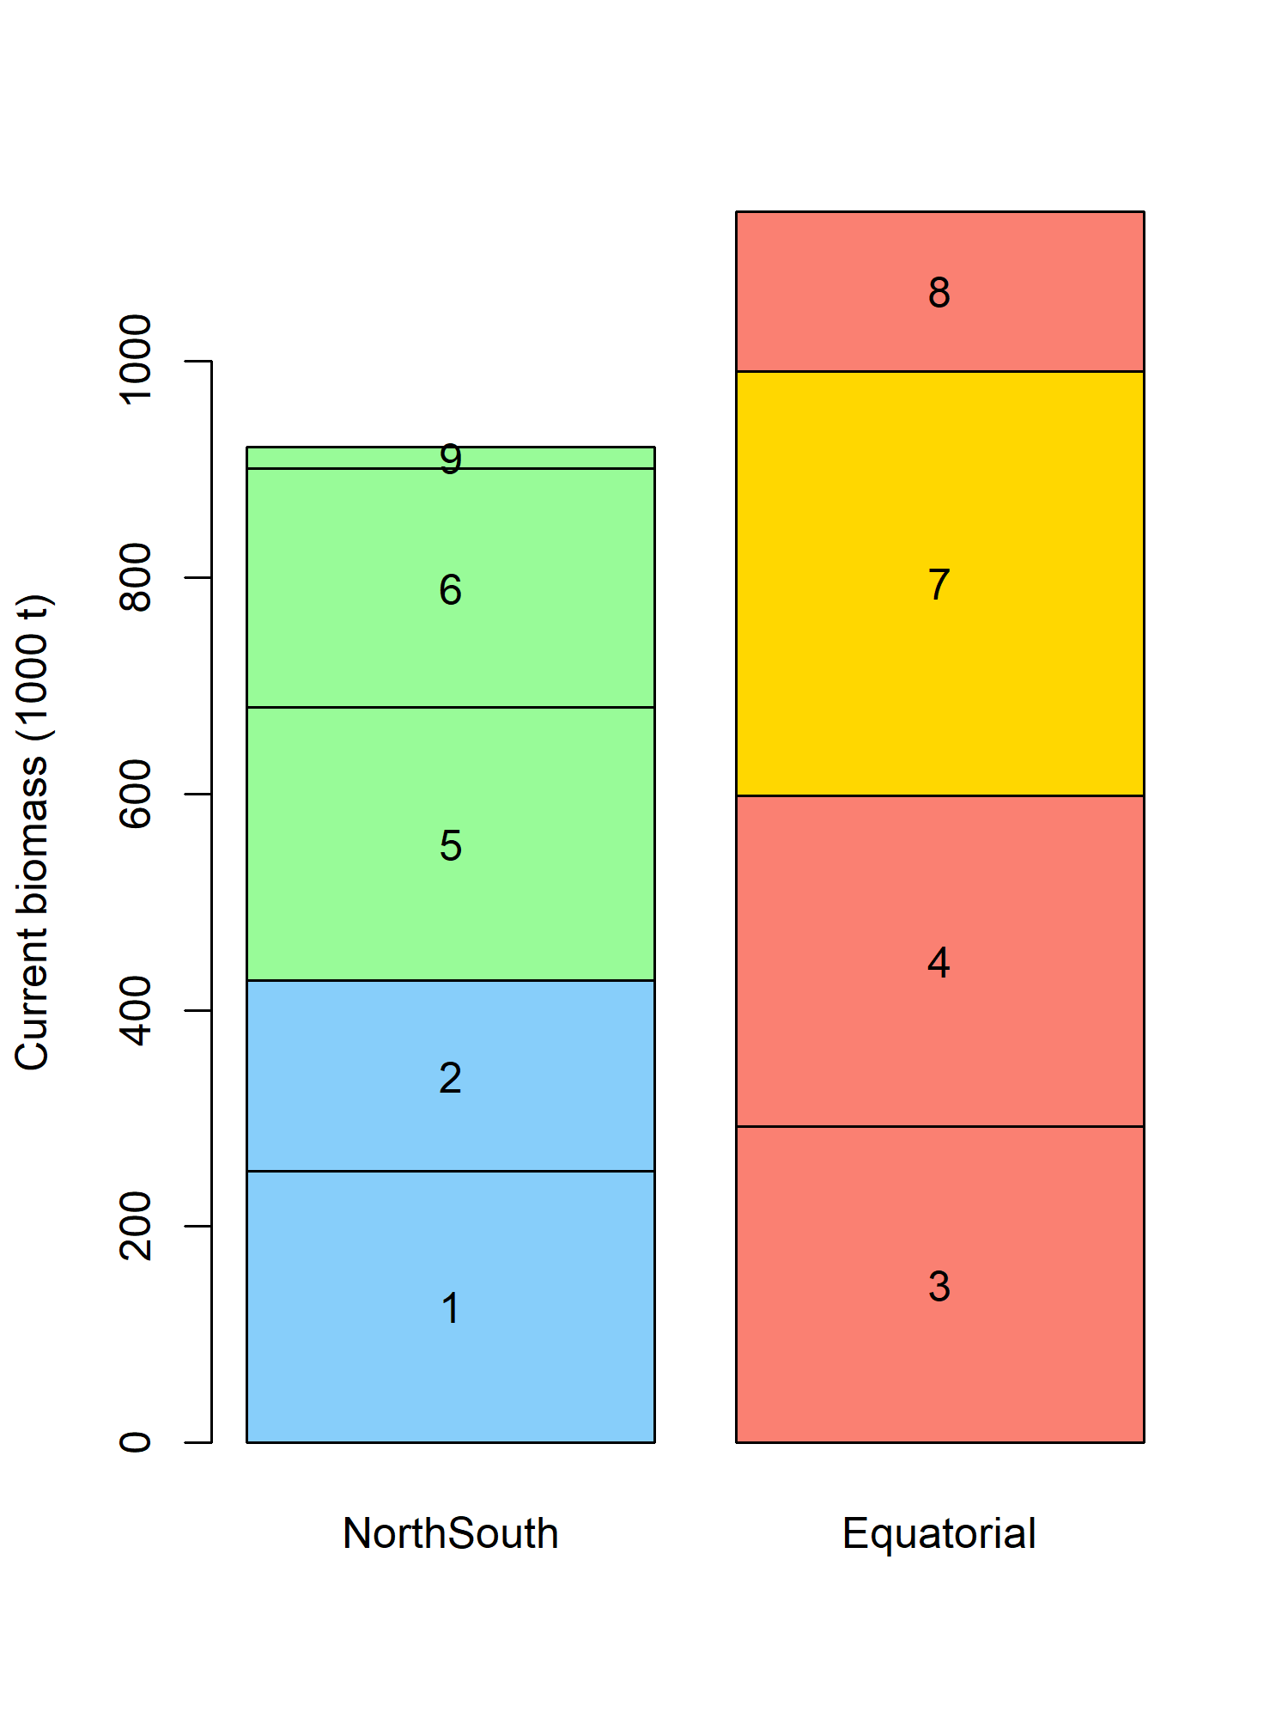
Regional Scaling
45% of the biomass is in the Northern & Southern regions
55% of the biomass is in the Equatorial regions

Slide 10
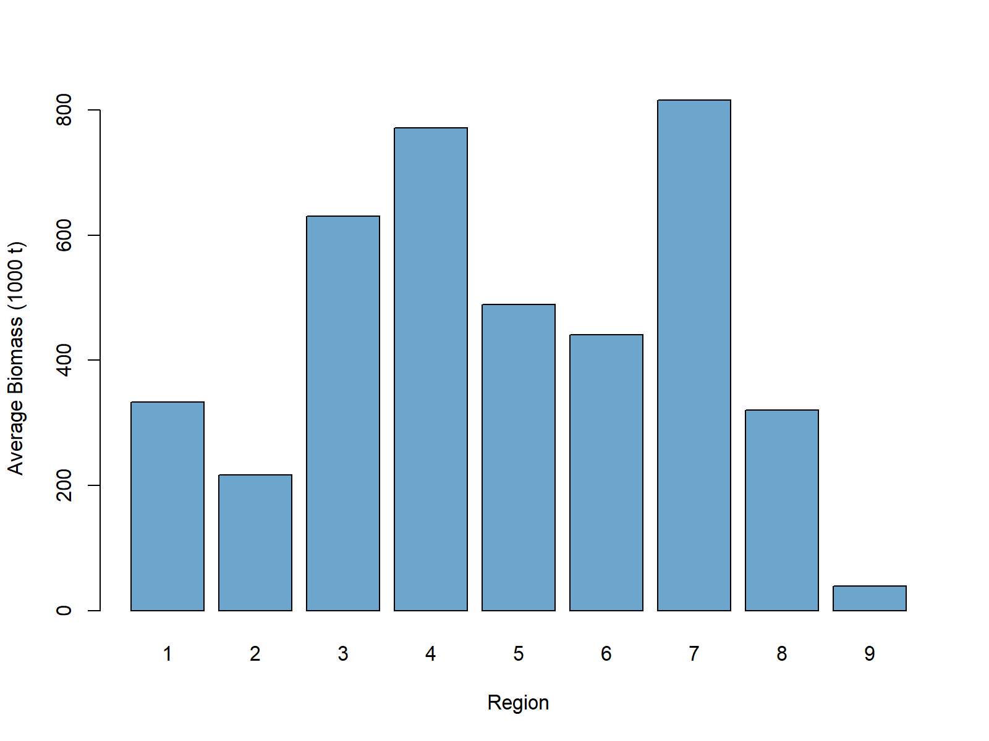
Regional Scaling

Slide 11
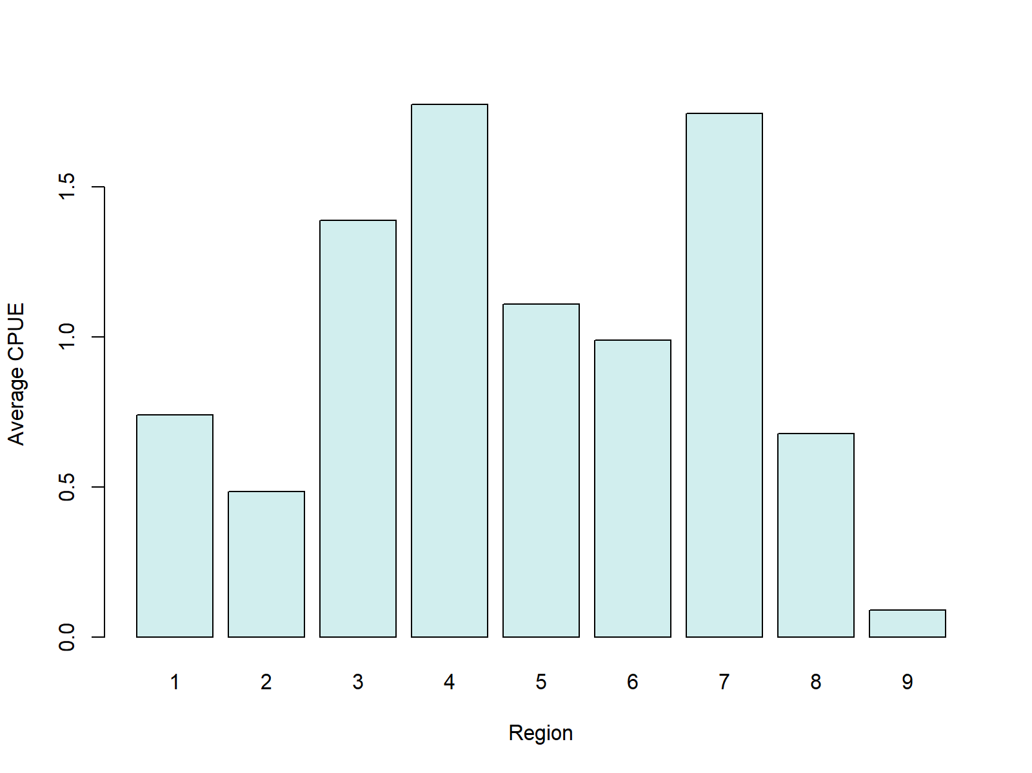
Regional Scaling

Slide 12
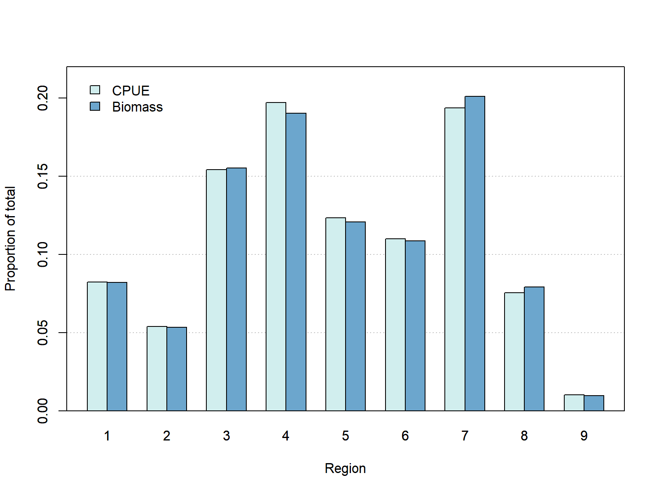
Regional Scaling

Slide 13
Regional Scaling
To a great extent, the stock assessment estimation of population trends and spatial distribution are determined by the analytical approach used to produce the CPUE indices
The spatial distribution in the YFT 2020 assessment is considerably different from the general indications in the data, as the model puts too much biomass in the North and South areas
This could introduce a bias in the stock status estimates and thus undermine the reliability of the management advice; we are therefore exploring alternative analytical approaches to produce the CPUE indices

Slide 14
Recruitment by Region
Enough about
biomass
by region...
Let’s revisit
recruitment
by region

Slide 15
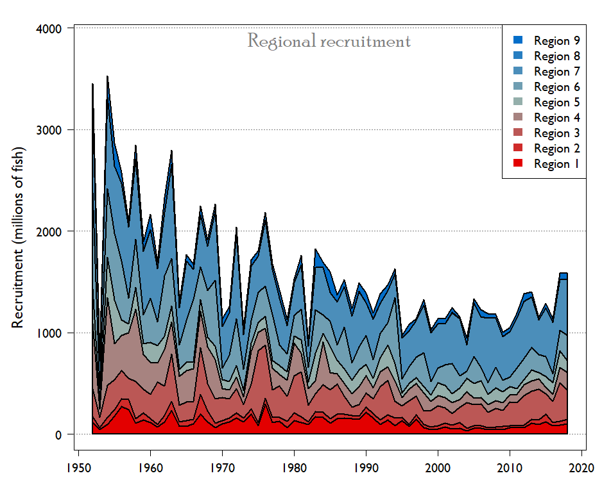
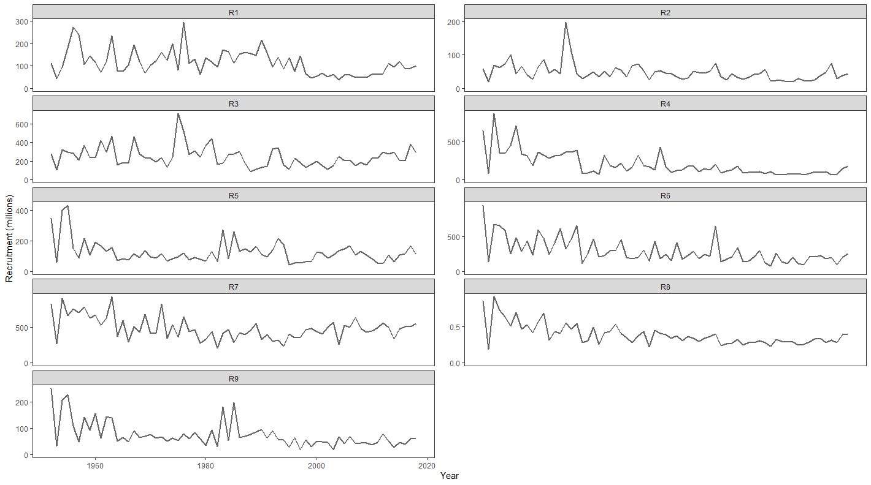
Recruitment by Region

Slide 16
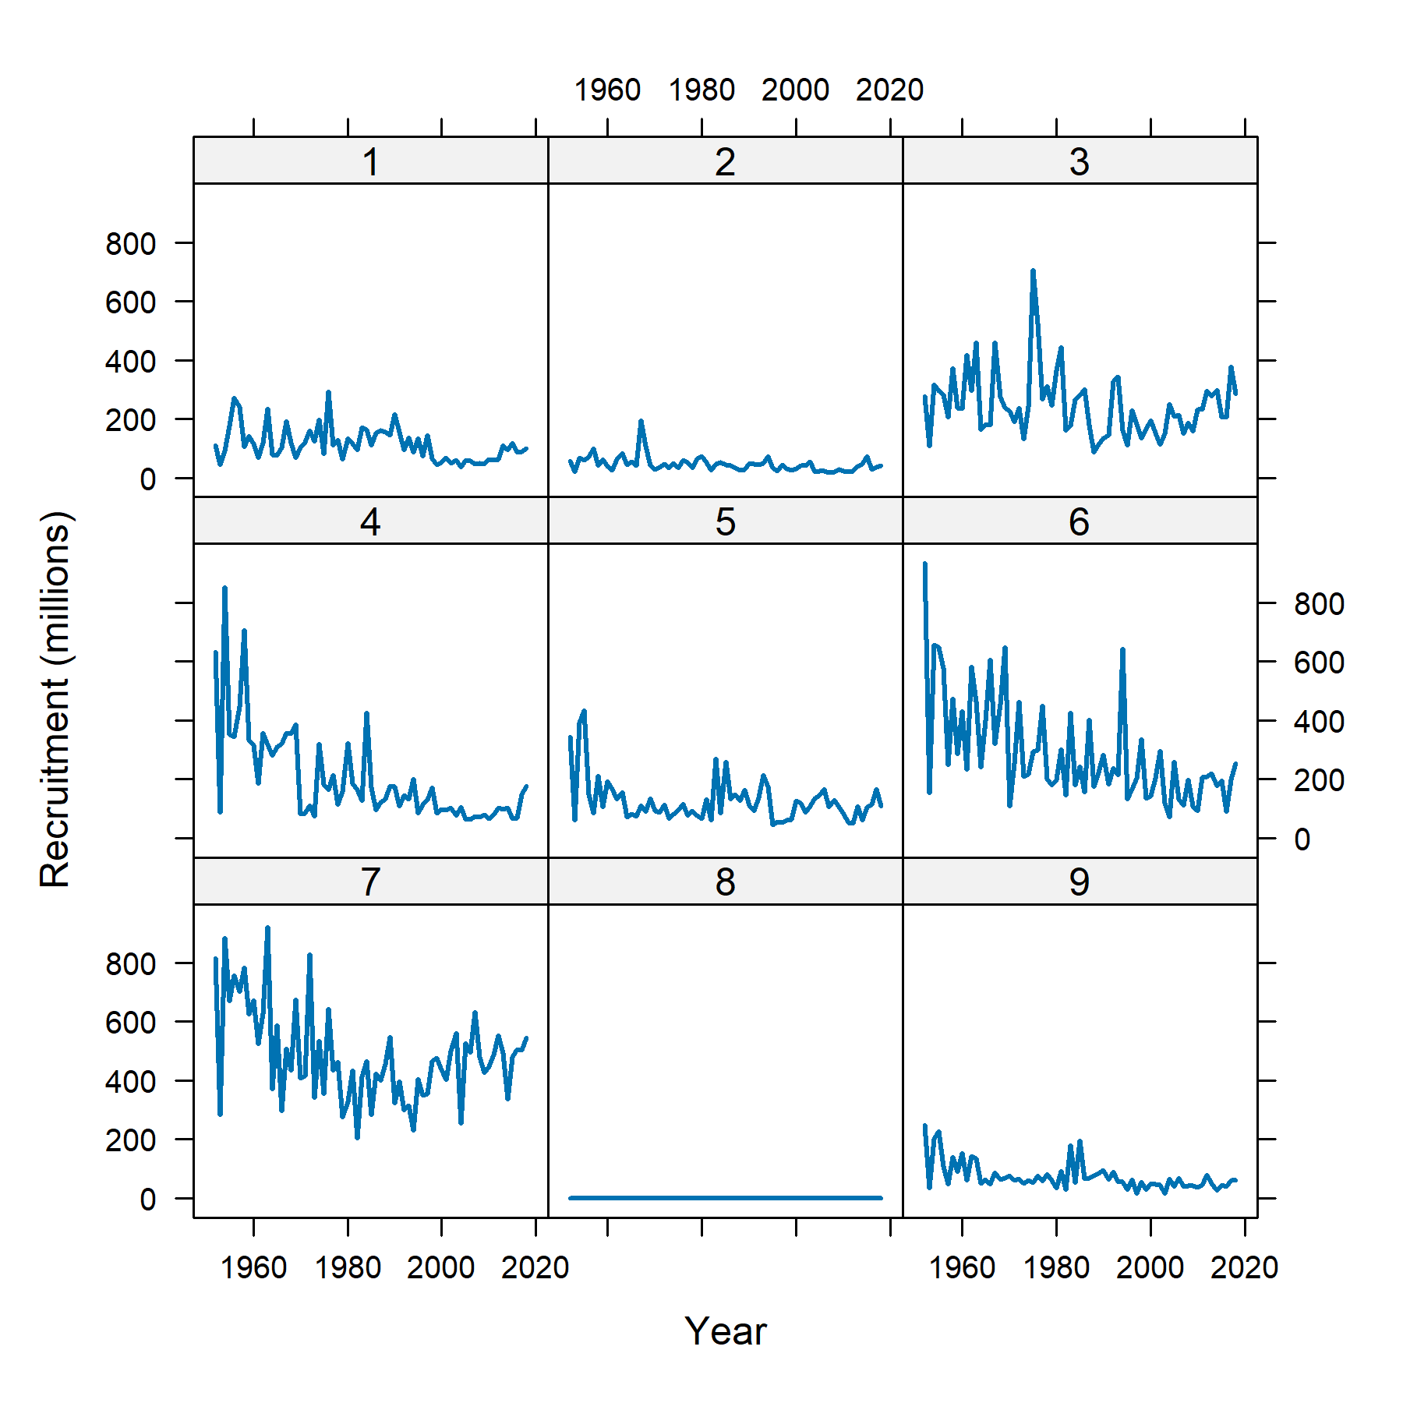
Recruitment by Region
2020 Assessment
2020 assessment -
no recruitment in
region 8

Slide 17
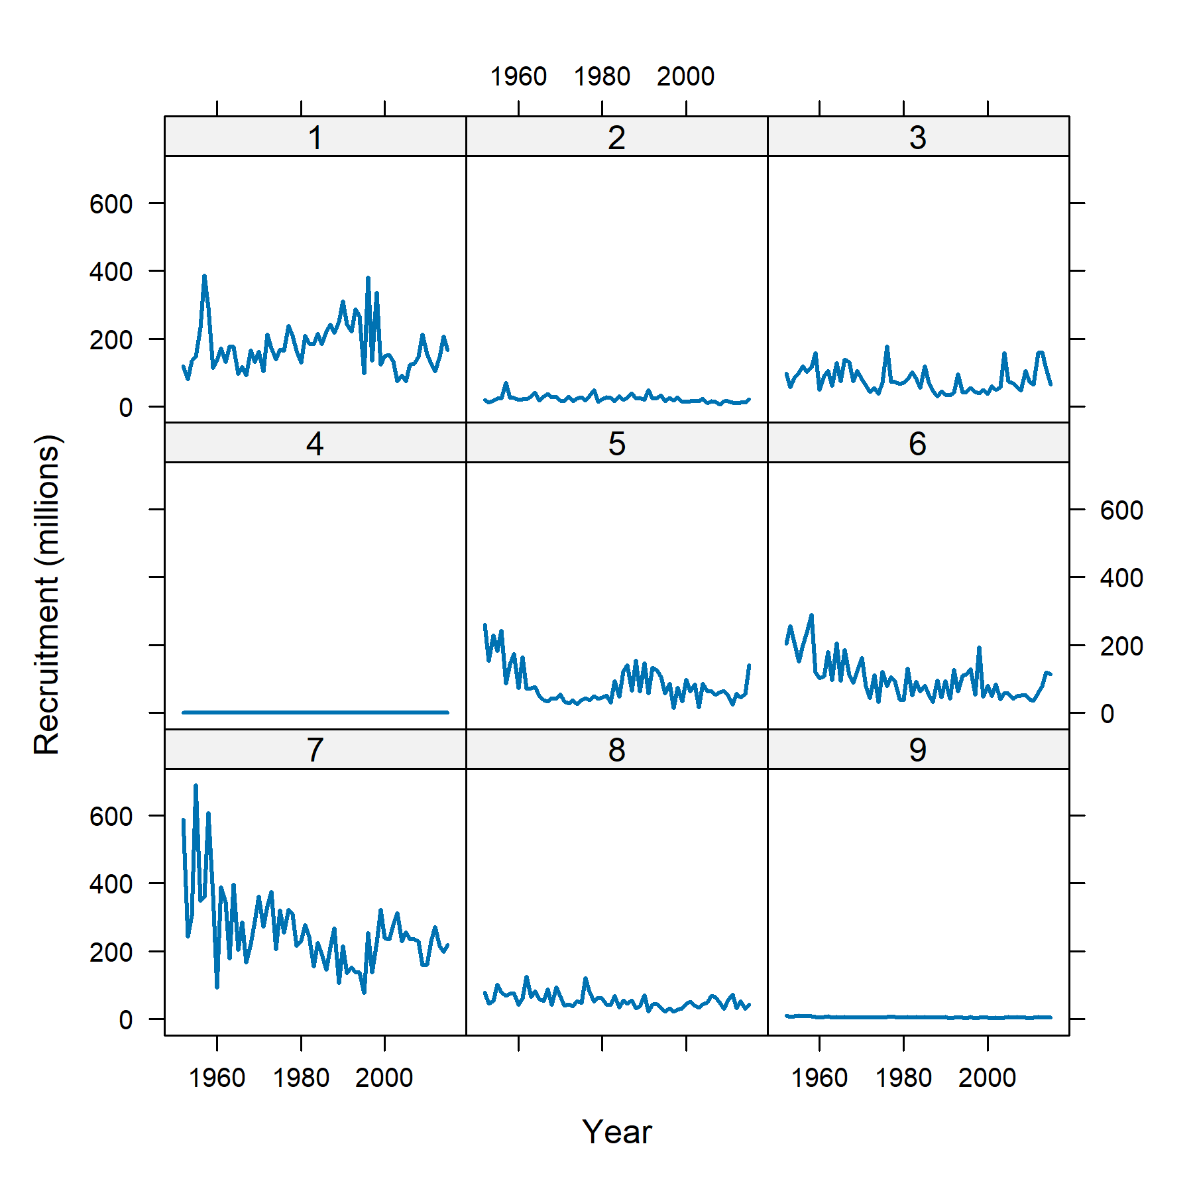
Recruitment by Region
2017 Assessment
2017 assessment -
no recruitment in
region 4
2020 assessment -
no recruitment in
region 8

Slide 18
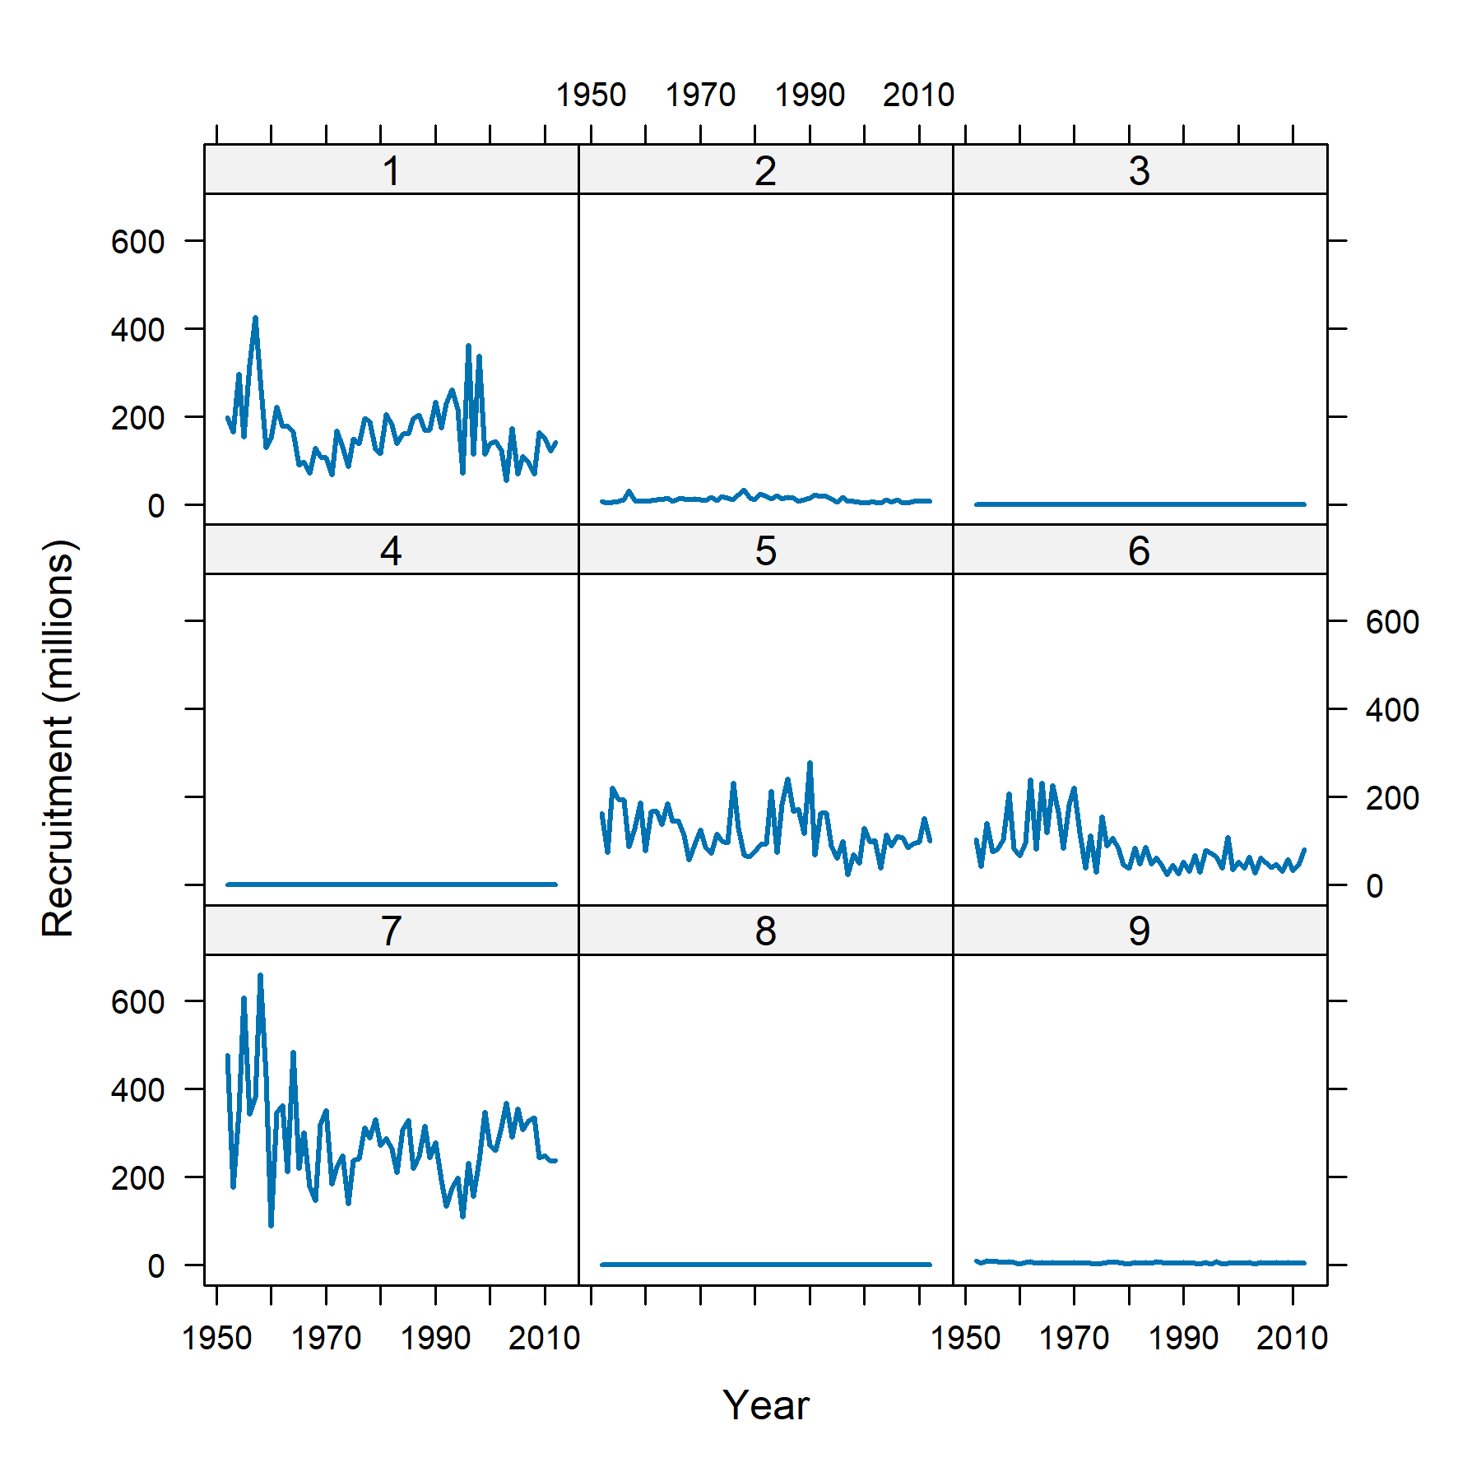
Recruitment by Region
2014 Assessment
2014 assessment -
no recruitment in
region 3, 4, 8
2017 assessment -
no recruitment in
region 4
2020 assessment -
no recruitment in
region 8

Slide 19
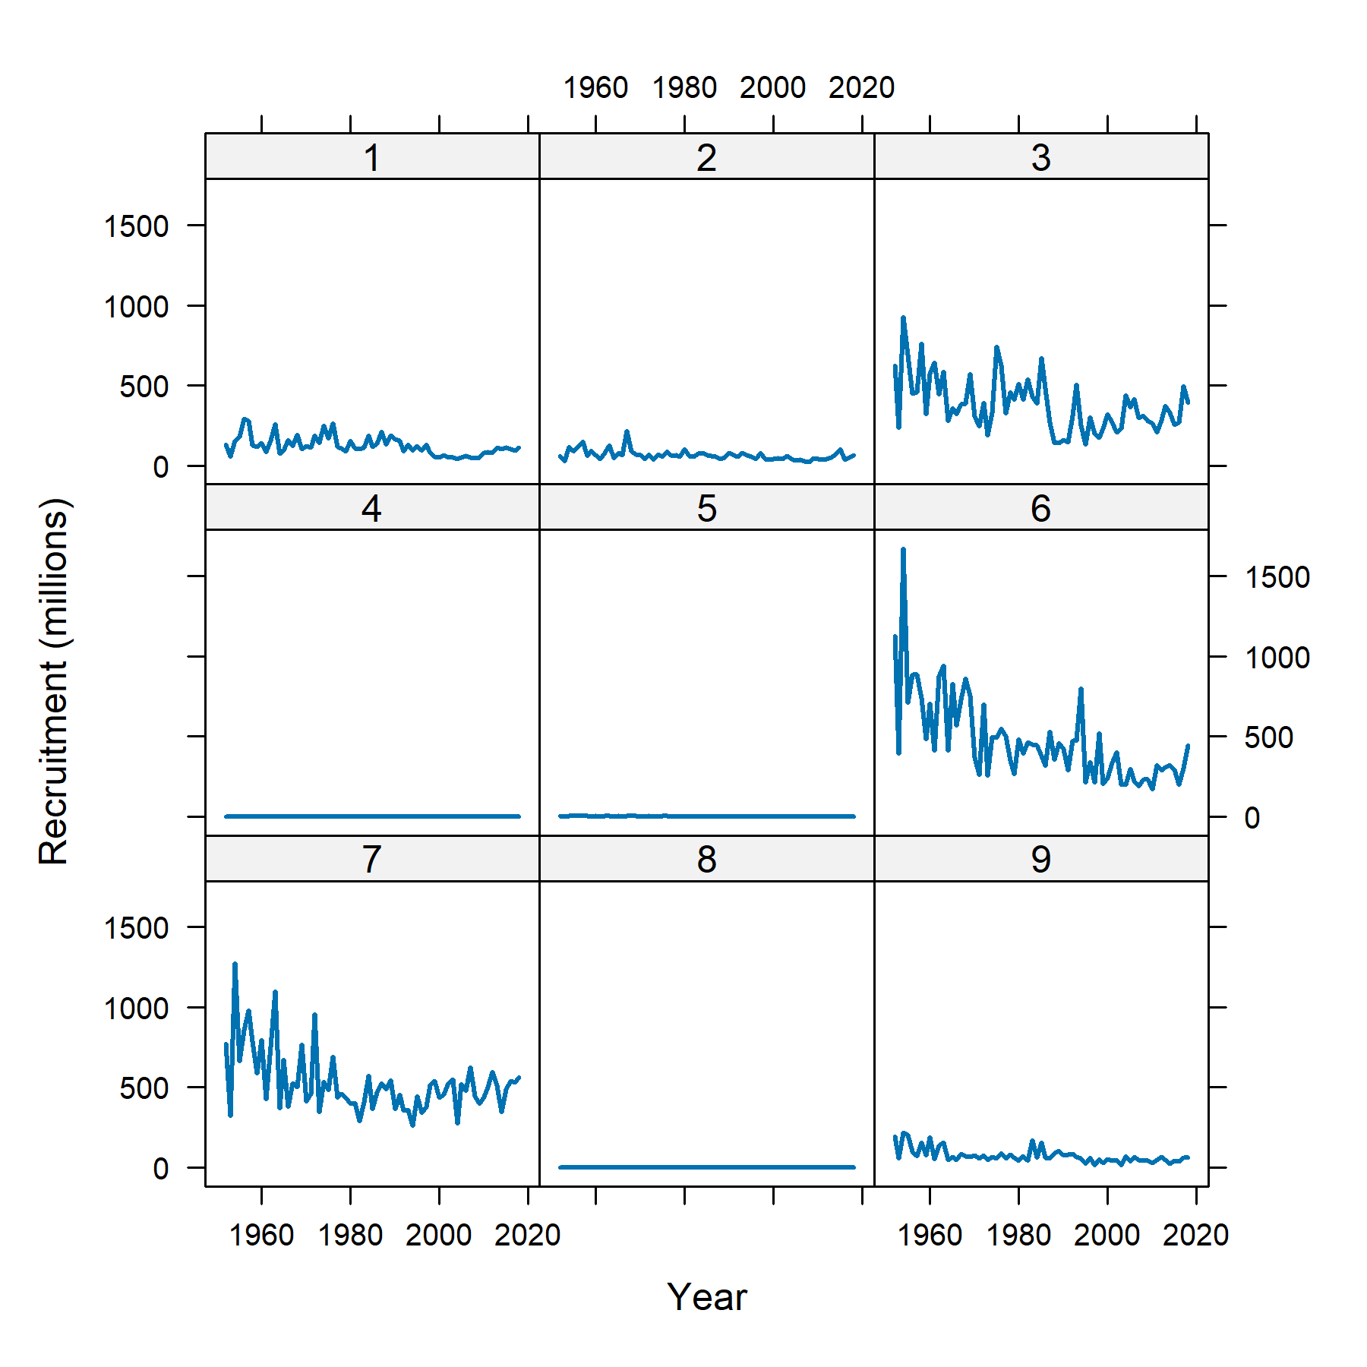
Recruitment by Region
2023 Assessment*
2014 assessment -
no recruitment in
region 3, 4, 8
2017 assessment -
no recruitment in
region 4
2020 assessment -
no recruitment in
region 8
2023 assessment -
no recruitment in
region 4, 5, 8

Slide 20
Spatial Structure
As pointed out in recommendations regarding the YFT 2020 assessment, there are indications that the high complexity of the model makes the statistical estimation unstable
As a result, some of the model predictions fluctuate between uncrealistic scenarios in a manner that could undermine the reliability and usefulness of the model as a basis for providing management advice
It appears that the estimation of processes such as recruitment and movement between 9 regions would require more informative data than what is available

Slide 21
Spatial Structure
As pointed out in recommendations regarding the YFT 2020 assessment, there are indications that the high complexity of the model makes the statistical estimation unstable
As a result, some of the model predictions fluctuate between uncrealistic scenarios in a manner that could undermine the reliability and usefulness of the model as a basis for providing management advice
It appears that the estimation of processes such as recruitment and movement between 9 regions would require more informative data than what is available

Slide 22
Model Complexity
With the YFT 2020 assessment model, often a small change in the model settings causes large differences in the model fit and the estimated stock status, or prevents model convergence
The high sensitivity to small changes in model assumptions, as well as a general instability when fitting the model, are signs that the model complexity is too high given the modest information in the data
Simplifying the model to have 4 or 5 regions could results in a model that is better estimable and robust to small changes in assumptions - a more reliable tool for providing management advice

Slide 23
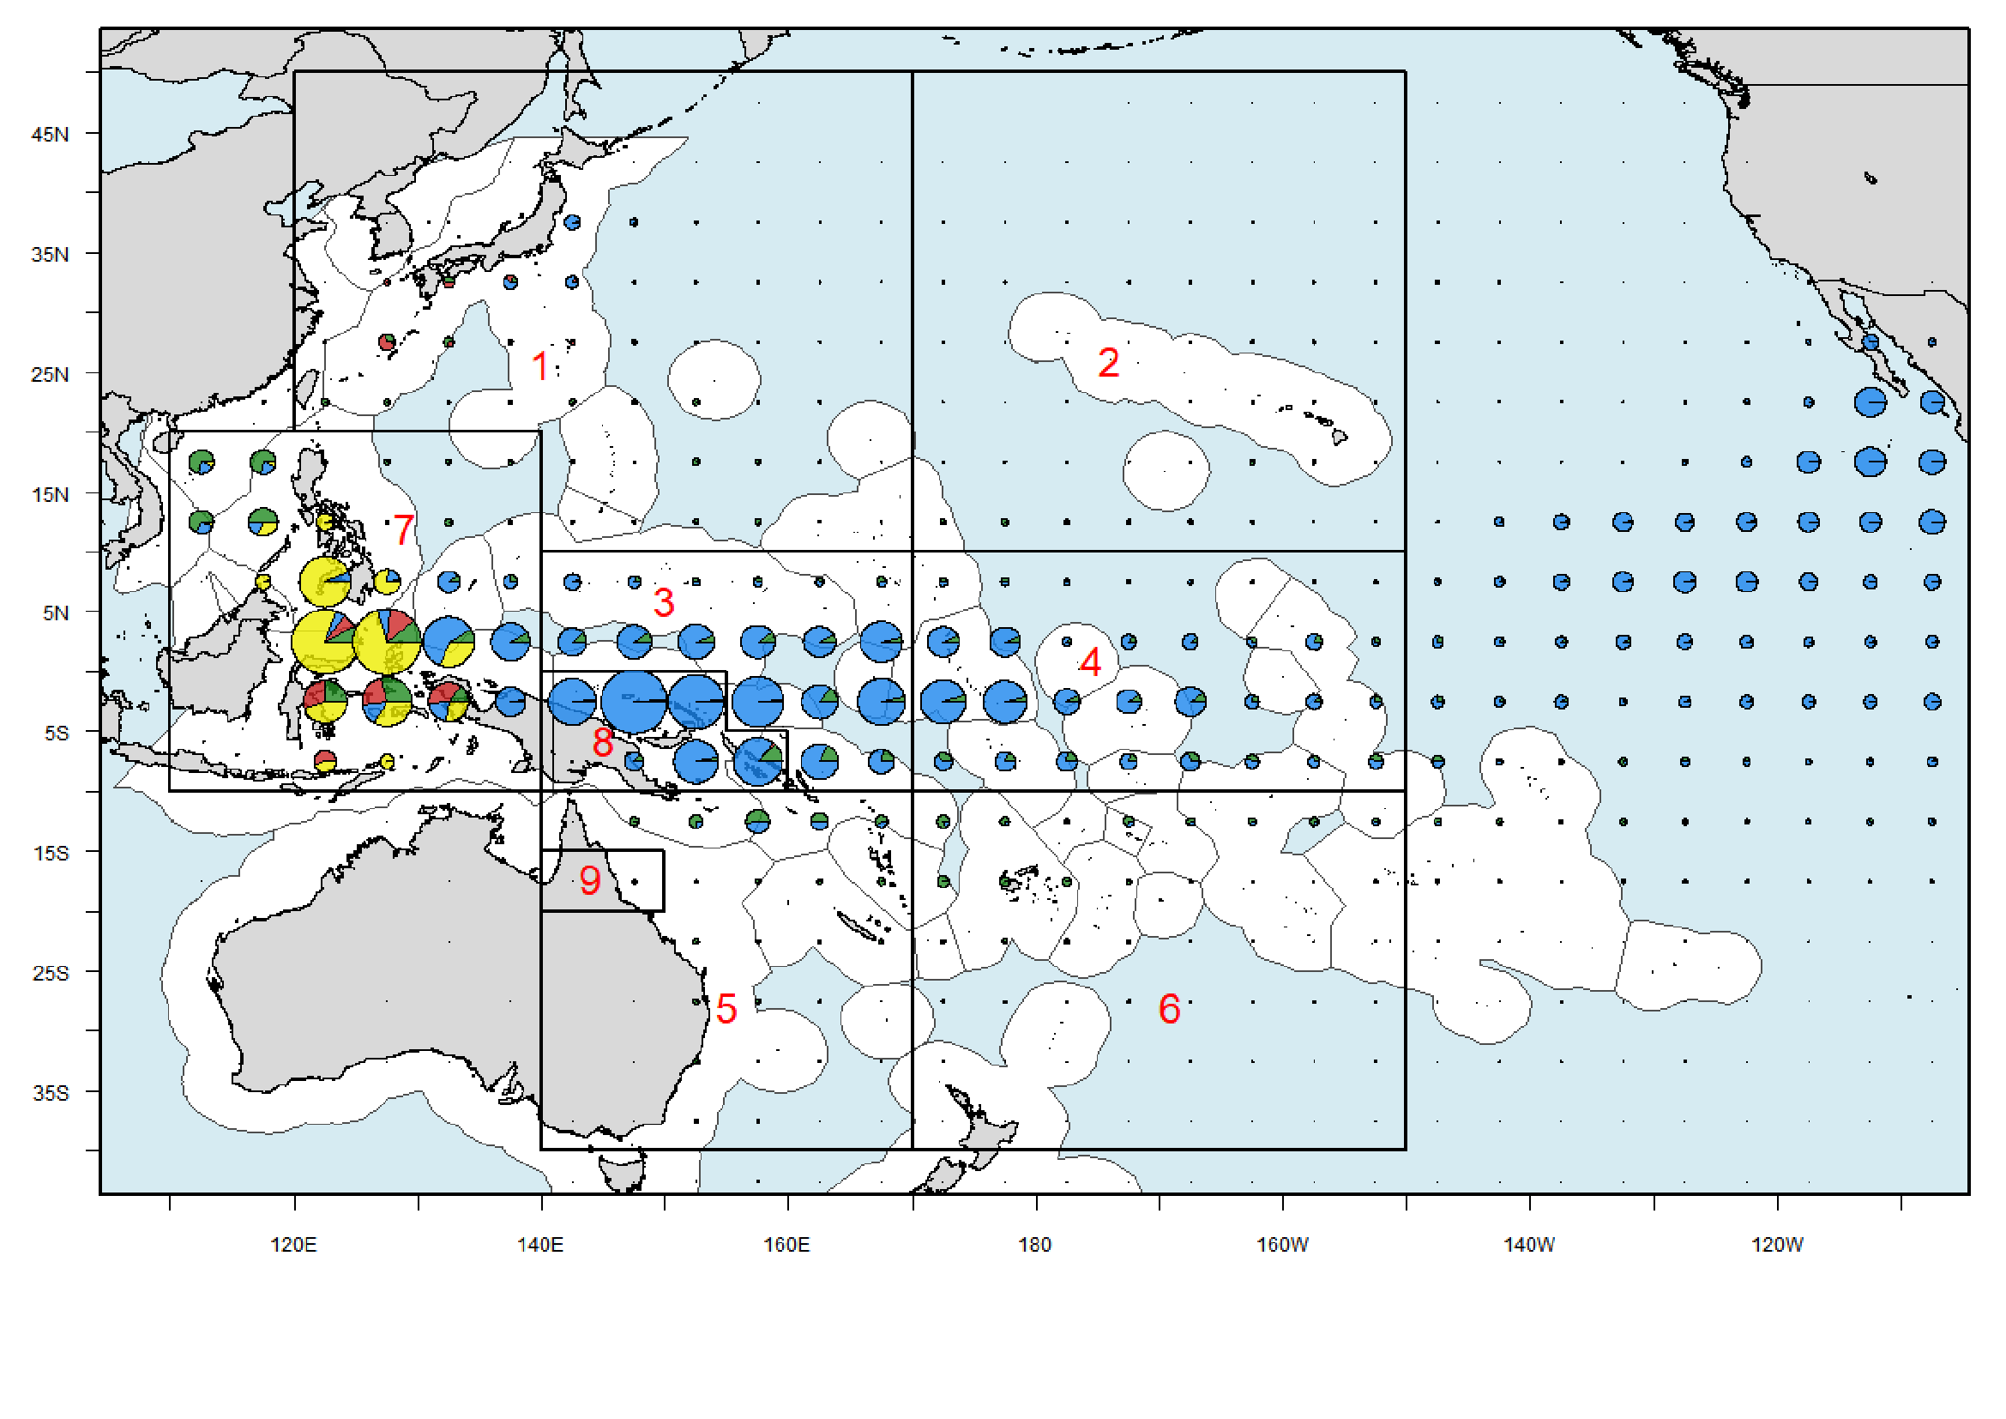
Regions: 9, 4, or 5?

Slide 24
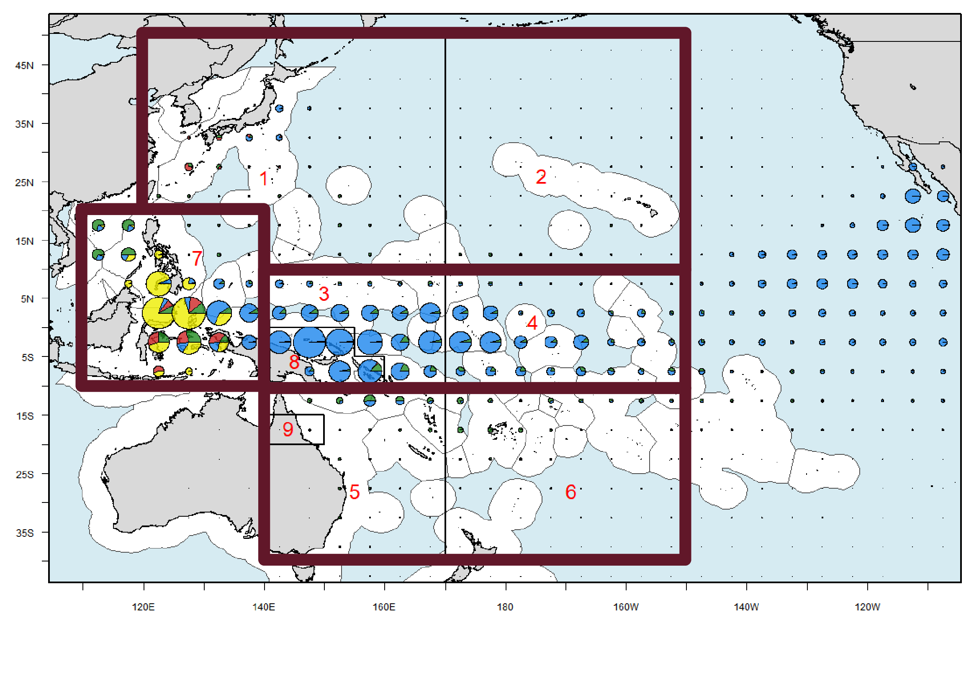
Regions: 9, 4, or 5?

Slide 25
Regions: 9, 4, or 5?

Slide 26
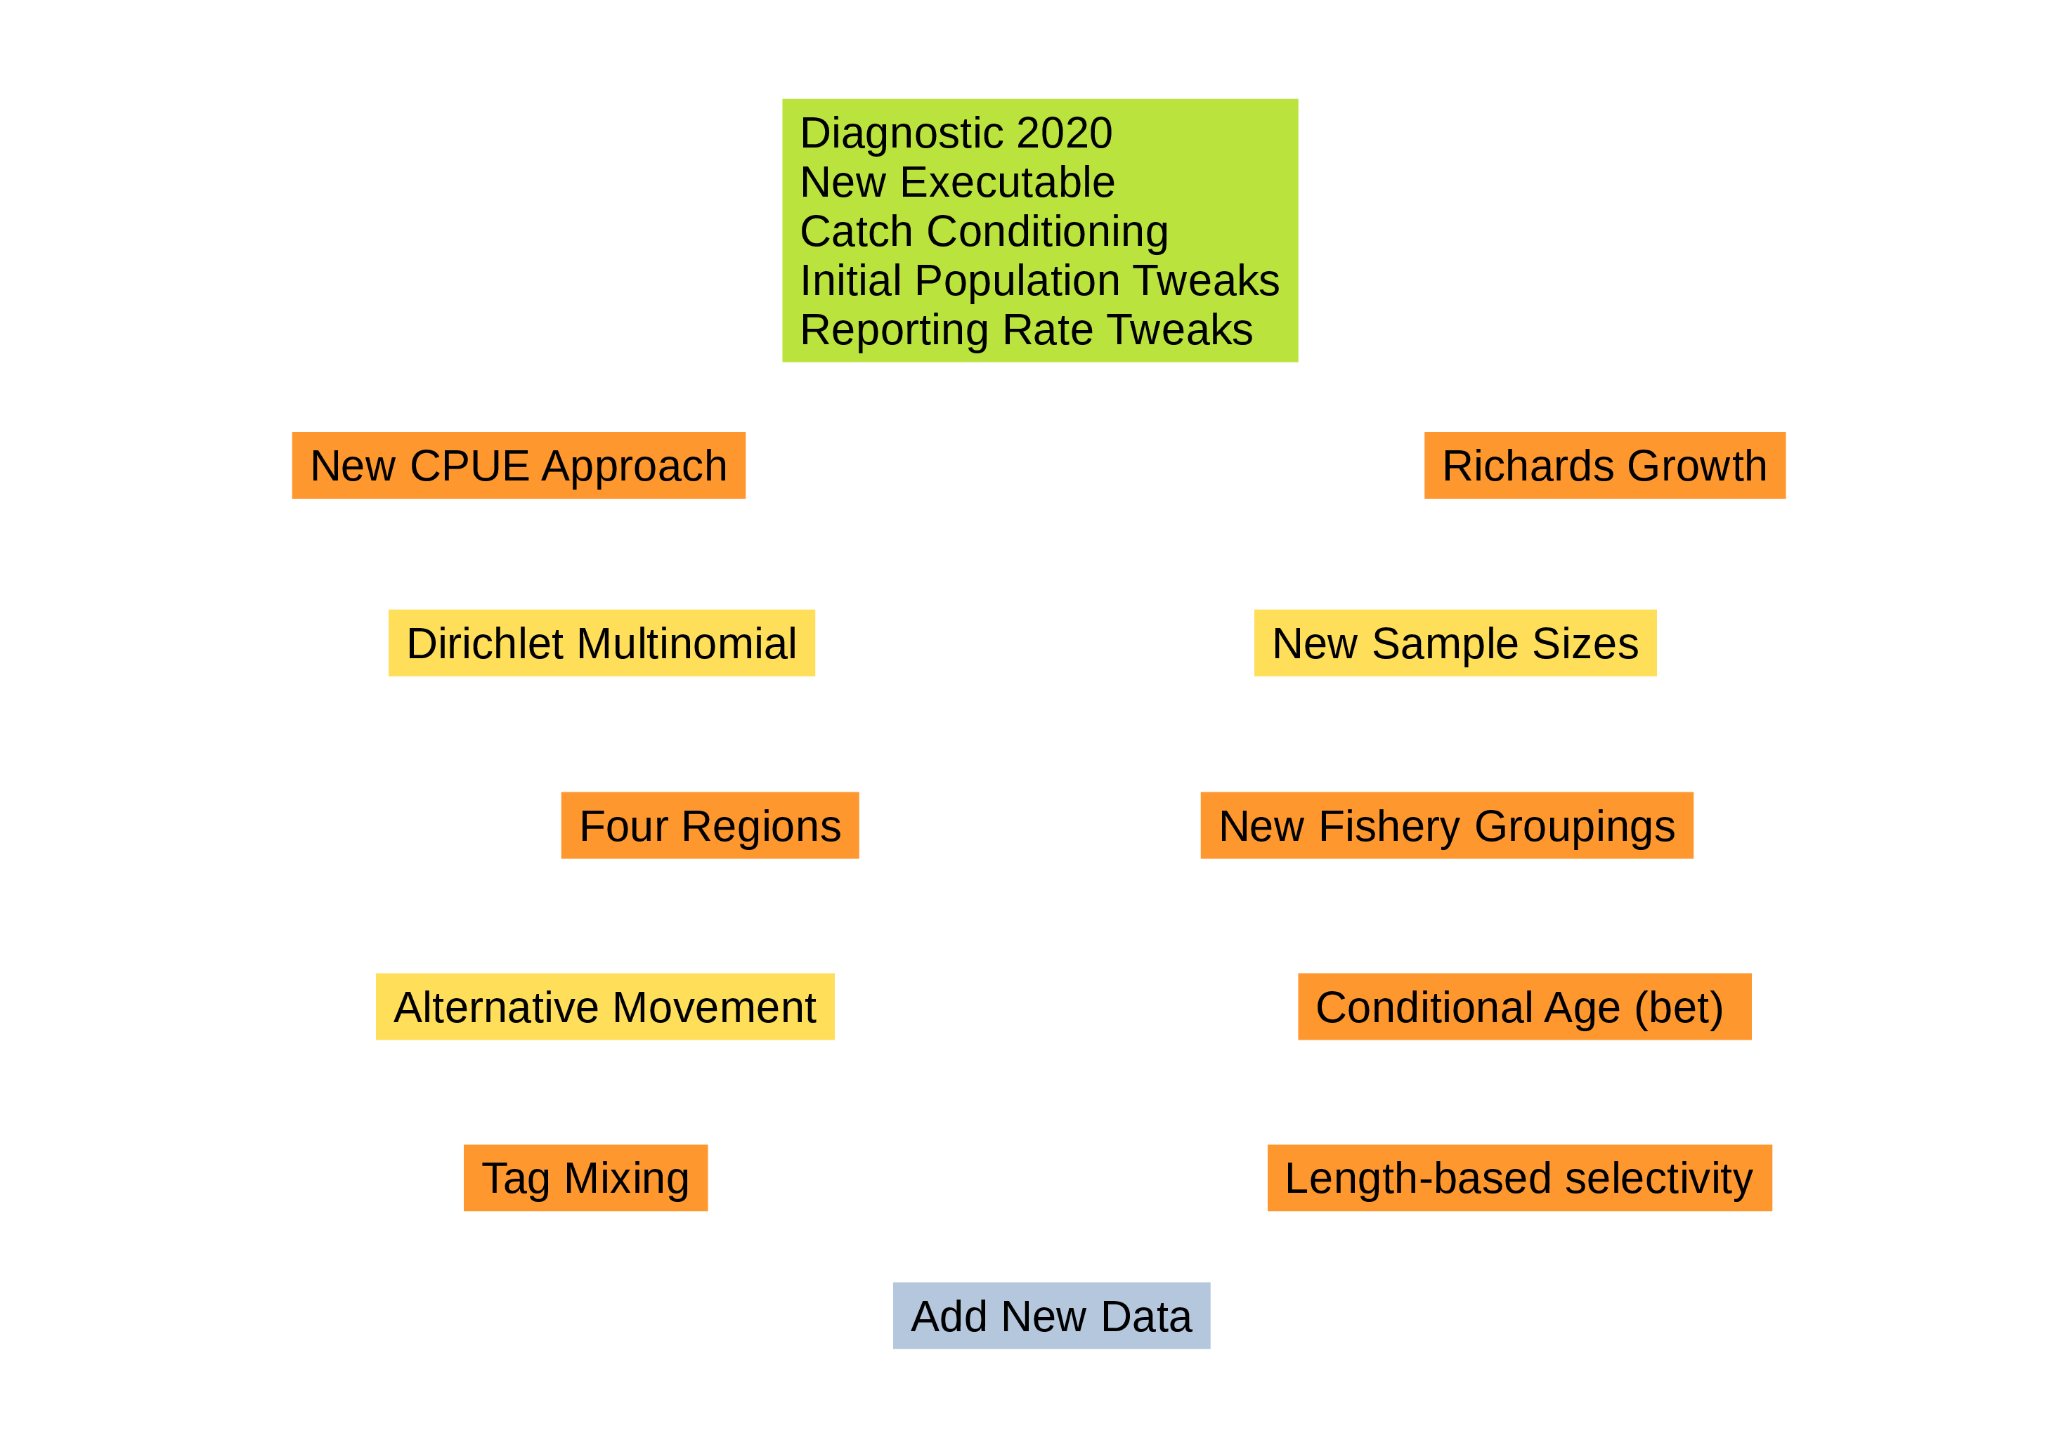
Exploratory Model Runs

Slide 27
Improvements in the Toolchain
Tool | Purpose | Feature | Improvement
MFCL | Fit model | Objective function | Consistent +/- sign of objfun, also in .par
FLR4MFCL | R-to-MFCL | MFCLLikelihood | Reads in negative objfun, reads in Age likelihood
" |  | Parameter correlation | read.MFCLCor, mat2MFCLCor, corFilter, corLabel
" |  | Compare flags | diffFlags, diffFlagsStepwise, flagMeaning
" |  | Find model results | finalPar, finalRep
Shiny | Explore runs | Code reorganization | Easier to adapt to new stock, common trunk
" |  | Likelihood table | Includes CPUE and Age
" |  | Official app collection | In one place, ofp-sam-shinyMFCL
condor | R-to-Condor | Package on CRAN | User scripts become much shorter
" |  | Submit/list/download | Efficient and reliable Condor runs: stepwise and grid
makeit | Automation | Package on CRAN | One R script runs other R scripts when needed
" |  | Run R scripts if needed | Efficient and reliable R jobs: all plots and tables
Proper | Project mgmt | Standard dir structure | Allows us to develop and use shared tools across stocks
" |  | " | Guarantee that next assessor can find and reuse all components
" |  | R script checks | Strengthens reproducibility of analyses

