Slide 1
MULTIFAN-CL
Longevity
Valuable features for tuna dynamics

Slide 2
Longevity of MULTIFAN-CL
December 2021, Dave Fournier retired, since project focus is to:
consolidate recent new features
undertake enhancements of existing features, and
complete documentation
Support ongoing requirements of OFP stock assessments as they explore alternative model configurations and for projection simulations for MSE
Reasonably regular and comprehensive testing of development versions is done preceding merges to the repository "master" branch
Can continue this through a smooth transition phase to using the next assessment platform (3-4 years ?)

Slide 3
1. Space partition
Rationale:
to explicitly describe spatial processes that lead to heterogeneity within the fish stock
to account for heterogeneity in fleet structure or management measures
In summary - to explicitly describe the variable effects of fishing mortality on the stock by area
Notes:
Now the first partition in respect of space.
For all the obvious reasons, spatial partitioning is sometimes desirable.
Read bullet points:
In terms of biology one may want to…
In terms of fishing mortality one aims to…
In respect of the first bullet point, this may be expected with highly migratory species such as Pacific tuna

Slide 4
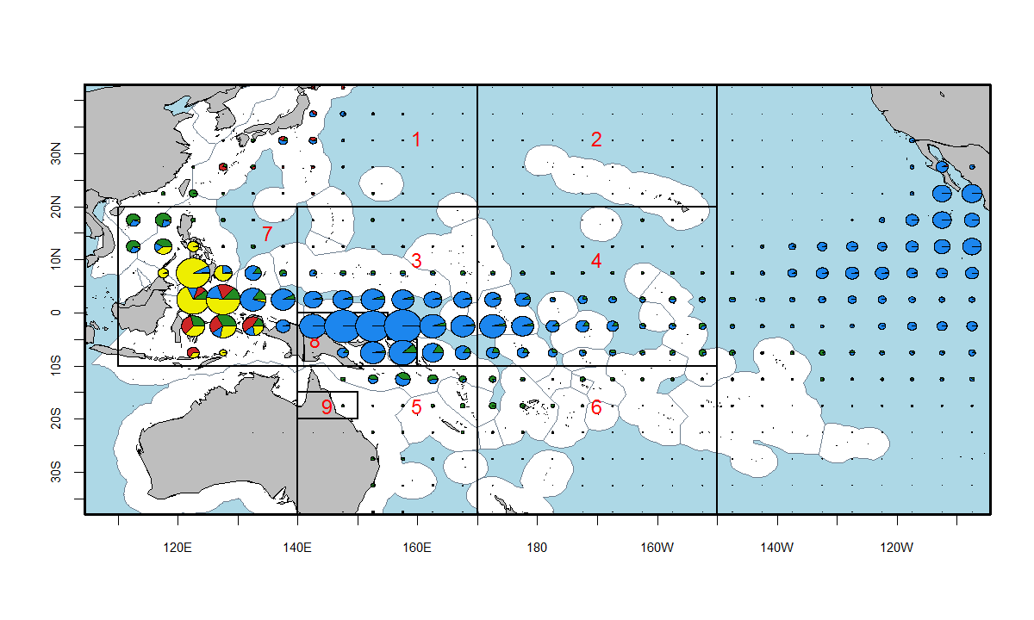
Spatial complexity in WCPO
Heterogeneity:
fisheries
biology
Notes:
This shows the complex spatial distribution of the various fisheries within the yellowfin WCPO – purse seine fisheries (in blue) are in the central and eastern parts, while domestic ID/PH small scale fisheries are to the west, red PL.
The 9 regions shown are the current spatial partitioning used for the YFT and BET assessment models using MULTIFAN-CL.

Slide 5
Movement parameterisation
Temporal:
Flexibility for number of movements per year (e.g. each quarter)
Flexibility for grouping (shared) movements for particular time periods, e.g. 1 2 2 1 rather than 1 2 3 4
Spatial:
coefficients estimated are region boundary-specific, so flexibility for:
number of regions
adjacent regions
Notes:
Movement must take account of the model’s temporal-spatial configuration and what assumptions are being made for the process.
Therefore – there is flexibility for:
the timing of movement events, and for sharing coefficients among time periods
the spatial configuration for the number of regions and which regions are adjacent

Slide 6
Movement processes in MULTIFAN-CL cont.
Movement matrix in respect of regions
e.g. yellowfin tuna
Destination region
R2 R3 R4 R5 R6 R7 R8 R9
Region of origin
R1------------------
R2------------------
R3------------------
R4------------------
R5------------------
R6------------------
R7------------------
R8------------------
# Incidence matrix
1 1 0 0 0 1 0 0
0 1 0 0 0 0 0
1 1 0 1 1 0
0 1 0 0 0
1 0 1 1
0 0 0
1 0
0
Notes:
This is an example having 9 regions, with arrows indicating adjacency, from which a movement incidence matrix is generated.
Matrix entries for adjacent regions have a value of 1
This provides a pointer for assigning the coefficients in the model.
Note: movement is in both directions and therefore the matrix is symmetric.

Slide 7
2. Tag partition
Tagged population model
MULTIFAN-CL is age-structured. Tag releases are length-specific – transformed to be age-specific via the estimated growth function
A mixing period is specified for assumed random mixing of tagged population
Grouping of recaptures: specified fisheries for which recaptures can be aggregated
The reporting rate from each fishery can be fixed and/or estimated
Notes:
Initially several steps are taken to set up the tagged population within the general population model:
Firstly the numbers released at length must be transformed to numbers at age
There is provision for a mixing period following the time of release, to allow for the assumption that the tagged population has mixed within the region of release
For certain fisheries, the recaptures may be aggregated into a group for the likelihood calculation. This may help when the reported fishing method of capture is unreliable.

Slide 8
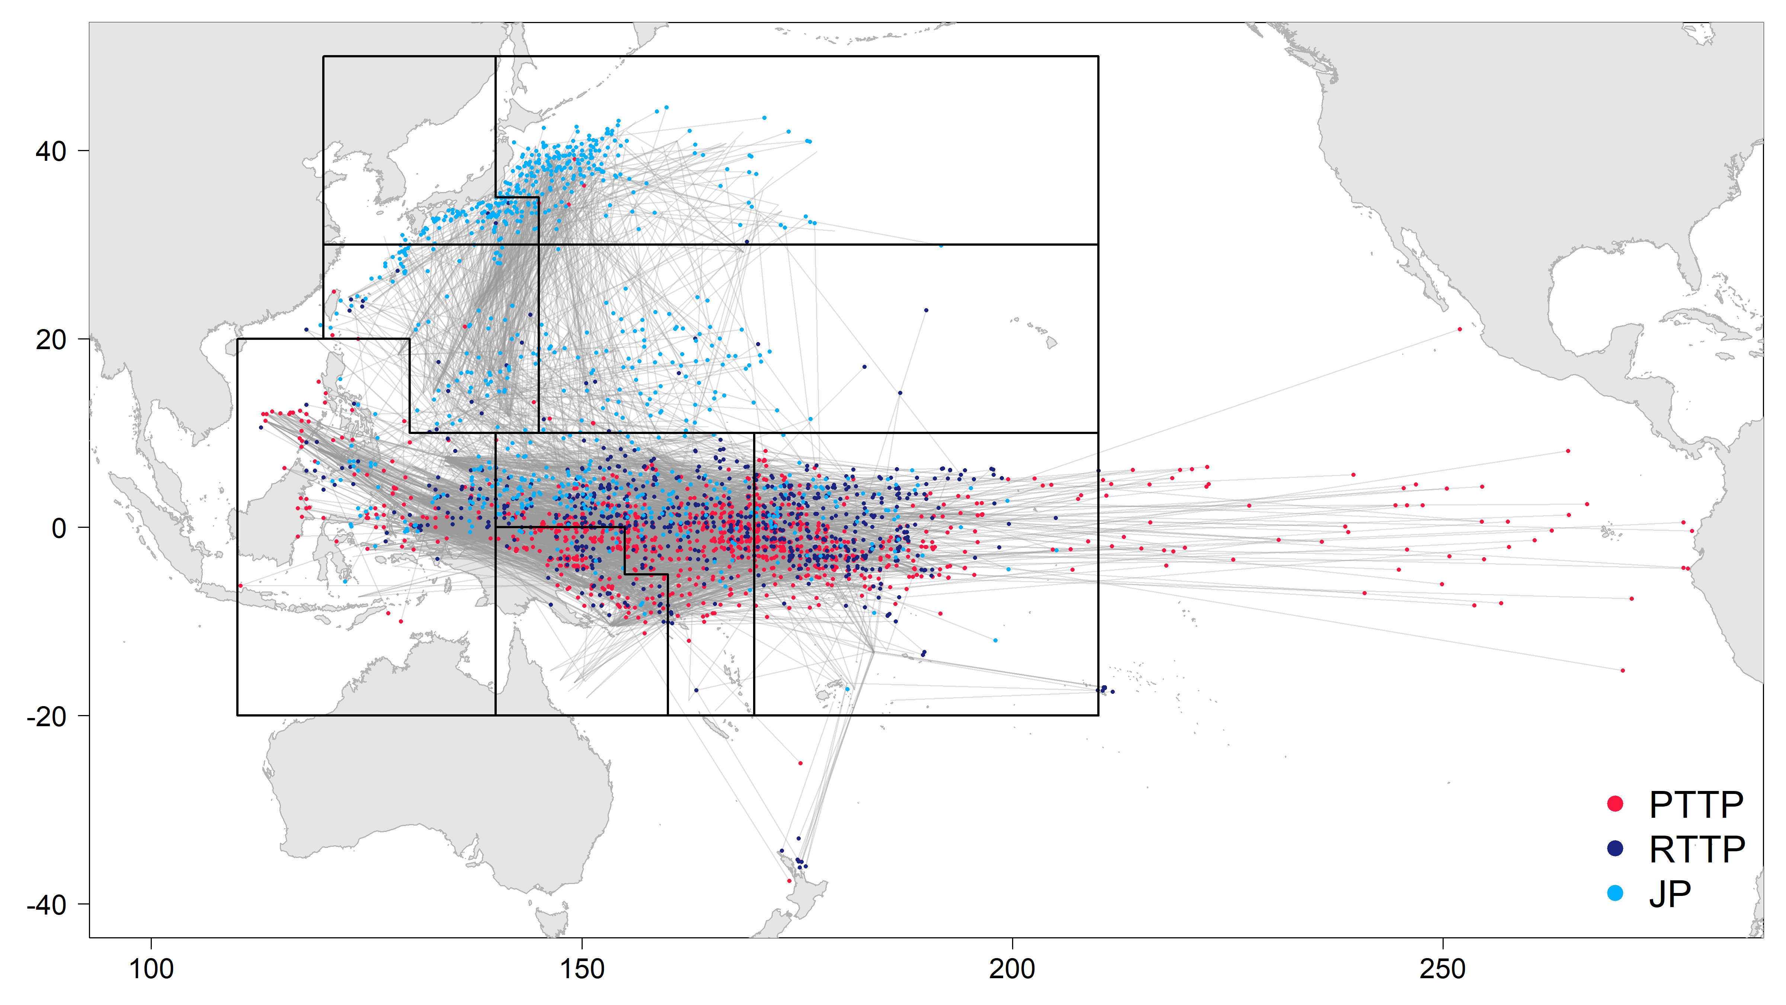
Tag movements - SKJ
269 release groups 329,811 releases 56,092 recaptures
Notes:
This illustrates the released and recaptured skipjack from the three tagging programs conducted. Only recaptures >1,000 nautical miles shown
These programs were conducted over a number of regions and model time periods, and therefore comprise 269 region-periods; i.e. there were 269 cohorts added to the tagged population partition.
This represents an enormous amount of data on movement input to the model; with over 56,000 recaptures.

