Slide 1
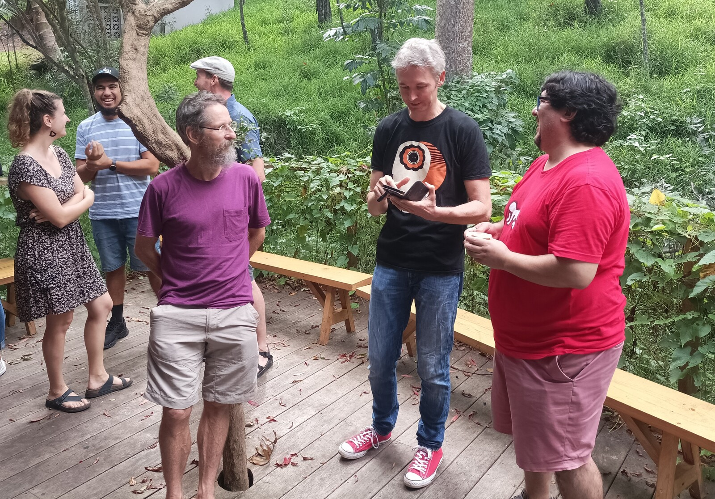
Stock Assessment Team
Reflections from the Zoo
Team Meeting, 19 May 2022

Slide 2
Things to Achieve in 2022
SKJ assessment report and SC meeting (incl. data preparation, CPUE analysis)
YFT review, the starting point for YFT and BET 2023 assessments
Paper to present at the CAPAM meeting: how the SKJ assessments have been improving over the years, what are the next challenges for SKJ assessments in the Pacific region
Exploration and development of a Stock Synthesis (SS) model for an SPC stock assessment, continuing the ALB assessment model developed in 2021
Internal report describing the current handling of tags in SS, shortcomings and possible improvements
Increasing use of GitHub and TAF to strengthen reproducibility: this year SKJ and YFT

Slide 3
Challenges
Initiate a transition plan to produce SPC assessments in platforms other than MFCL
Added workload during the upcoming transition phase, producing exploratory and candidate assessments, while also delivering the normal MFCL assessments and related products
How much to invest in learning something for a 3 yrs contract
Takes a very long time to acquire SPC-specific knowledge, before being able to produce assessments and related analyses
Time frame for assessment data preparation, would be good to make available in a place where we can all see that we’re on track and how things are linked together
Clear comparisons of data inputs in new assessment and previous assessment
Reproducibility varies greatly between SPC analyses, often difficult to pick up previous work to update and extend

Slide 4
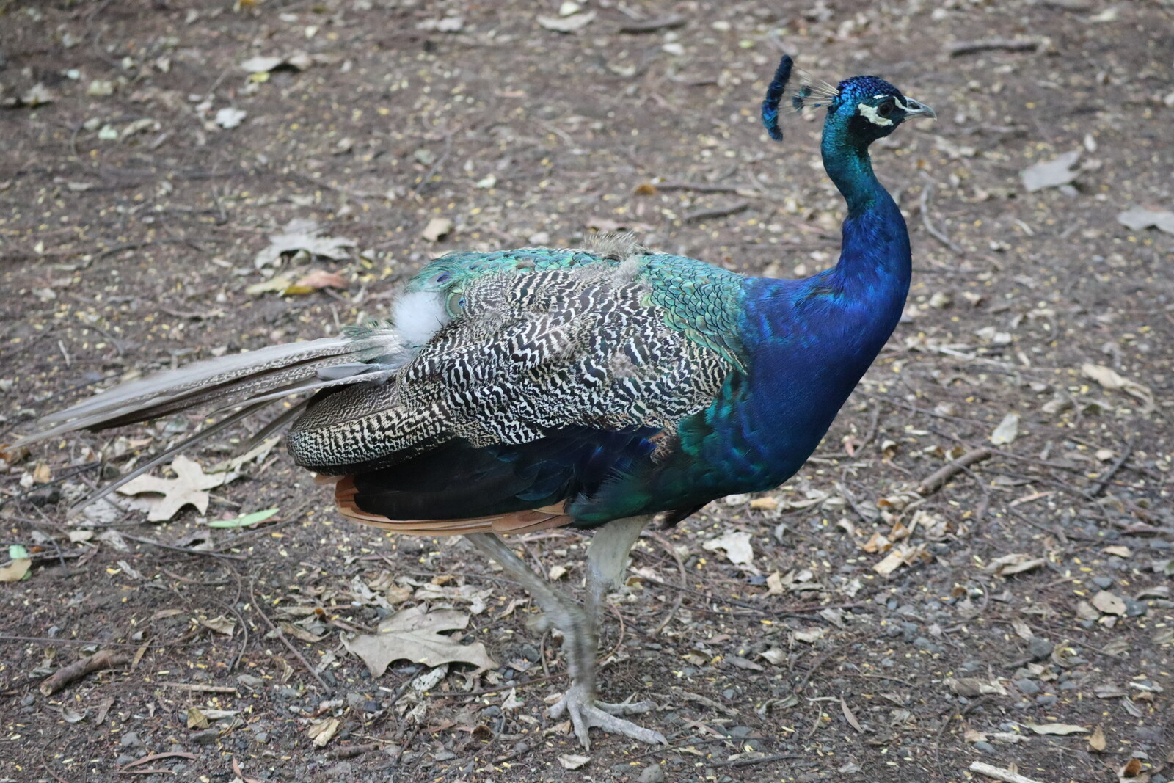
Challenge 1 - Need for a Transition Plan

Slide 5
Need for a Transition Plan
MFCL may not be used in SPC assessments 5 or 10 years from now
Switching to another software platform involves a development and exploration phase of some years where MFCL and other software platforms are used in parallel and compared
Candidate software platforms for SPC assessments include:
Stock Synthesis, including the possibility to expand and improve its ability to handle tagging data
SAM, after adding the ability to handle length data and regions
TMB model for Patagonian toothfish (by Rich Hillary) – 2 areas, 1 boat, interest in CKMR
CASAL2, handles regions, length data, tags (better than Stock Synthesis), first released in 2020
Gadget, handles regions, length data, tags
General commentary: CAPAM special issue (https://doi.org/10.1016/j.fishres.2020.105617)

Slide 6
Stock Synthesis
Pros and cons
Stock Synthesis is used in a large number of tuna assessments, has the largest user base that overlaps with the FIMS project group, so future FIMS stock assessment software will facilitate easy transfer from Stock Synthesis, SPC has a lot of in-house Stock Synthesis expertise
Stock Synthesis is in its second half of its lifetime. This is largely addressed by its close ties to FIMS and the large user base, so there will be continuity between today’s Stock Synthesis and future stock assessment software.
Stock Synthesis may also be lacking in some modelling areas that are important in current and future SPC assessments, such as tagging data and close-kin mark-recapture data. There has been interest and experimental development to improve the modelling of tagging data.

Slide 7
Transition Plan - The Process
High priority, Additional work
The topic of medium-term plans for MFCL and other stock assessment platforms is acknowledged and understood as a high priority by everyone at SPC. The decision makers need input and insights from us stock assessment experts to move forward.
When evaluating alternative stock assessment platforms, Stock Synthesis is a strong contender for the larger SPC assessments. To fast-track the process, SPC could bring in additional Stock Synthesis experts, either as contractors and/or schedule Stock Synthesis workshops including external experts.
The amount of work just doing MFCL assessments and related data preparation and report writing absorbs most of our time, so it may not be realistic to add many layers of work on top of that.

Slide 8
Transition Plan - The Process
Exploration, Improving SS tag module
It is clear that MFCL has and continues to deliver good science, and no one is criticizing or questioning its use for the next few years.
What is needed on the technical front is exploring and documenting the shortcomings of current Stock Synthesis for handling the SPC tuna stock assessments. Claudio started this process last year and implemented a prototype ALB assessment, and this research effort should continue and increase.
Improving the tagging module in Stock Synthesis is something that SPC could potentially contribute to Stock Synthesis. This could be organized as a FIMS project, to establish collaboration and to design the module so it can ported to TMB as well.

Slide 9
Transition Plan - Four Stages
The current stage: MFCL is the only assessment model for all SPC tuna stocks.
Development and exploration stage: testing and tweaking of candidate models, other than MFCL, for some or all SPC tuna stocks.
Overlapping stage: a full candidate model, in addition to MFCL, has been implemented and presented for at least one of the SPC tuna stocks.
Decision stage: decision is made regarding the adoption of a new stock assessment platform for at least one of the SPC tuna stocks.
Chances are that many, if not all of us, will have moved from SPC before we reach stage 4. That makes it even clearer that the process is not about personal preferences but about critical needs of SPC in the medium term. It as our responsibility as the current stock assessment team to move the process to stages 2 & 3 in the short term.

Slide 10
Model Development and Exploration - SS, SAM, TMB
Stock Synthesis and other platforms
Although Stock Synthesis will likely be the primary focus, it would also be wise to allocate effort and resources into exploring SAM (adding a length module) and other TMB assessment platforms.
Current research efforts in fisheries science have shown that TMB allows highly efficient and stable estimation of complex models, involving a large number of random effects but relatively few estimated parameters. This modelling approach is central to the design of TMB and seems especially relevant for the SPC tuna stock assessments.

Slide 11
FIMS Collaboration
Develop new TMB modules
Acknowledging that MFCL might not be used anywhere 5 or 10 years from now, it becomes important to carry forward the best features of MFCL (tags, migrations, etc.) to make them available as modules that can be included in future stock assessment software.
This is a good strategy to ensure that future stock assessment software will exist that matches the needs of SPC. This effort fits perfectly with how the FIMS project operates, as it’s centered on international collaboration and implementation of TMB modules that can be linked together.

Slide 12
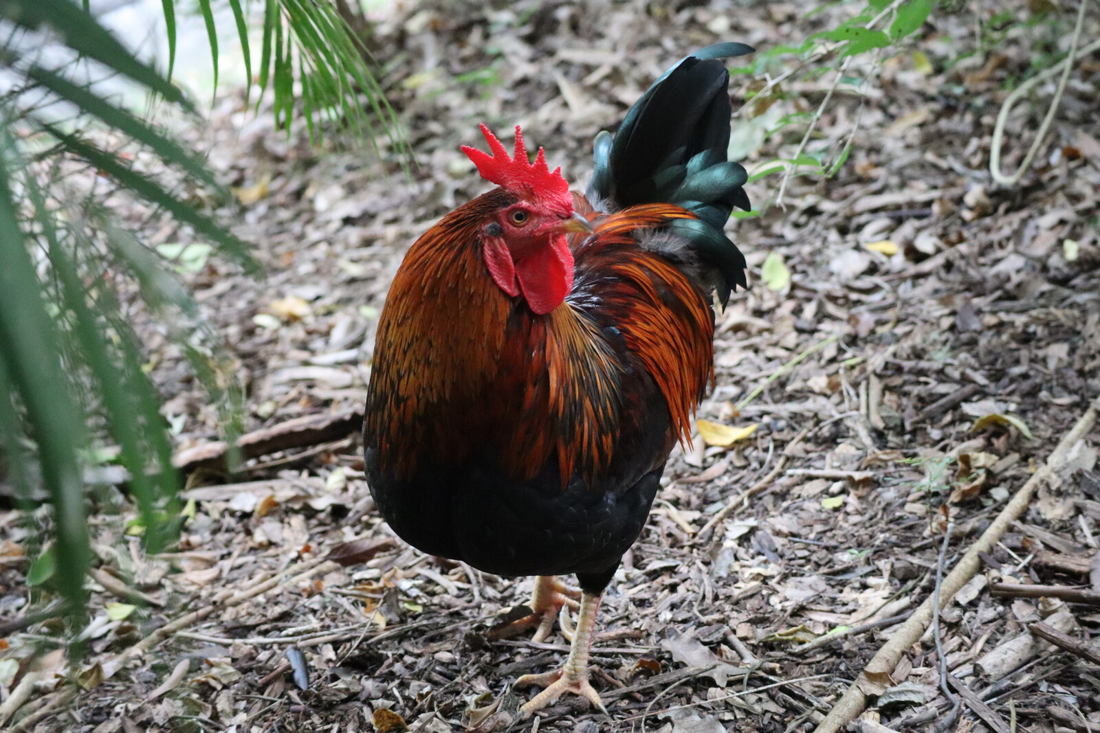
Challenge 7 - Reproducibility of SPC Analyses

Slide 13
Reproducibility of SPC Analyses
Problem
Difficult to pick up previous work to update and extend
⇒ Time lost
⇒ Prevents us from producing the highest quality analyses and deliverables
Proposed solution
Increase the use of GitHub and TAF to strengthen reproducibility
⇒ GitHub workshop (April)
⇒ TAF workshop (upcoming)

Slide 14
Transparency in Fisheries Management
Transparent = open and reproducible
as a result, reviewable and traceable
A growing question in all fisheries around the world:
⇒ Is the management of this stock based on open and reproducible science?
If not, which criteria are still missing?

Slide 15
How Reproducible?
A gradient from low → high quality of science, in terms of reproducibility:
Here’s the management advice – trust me, I did the math
I used the model published in this paper and here are the data tables and results
I used these exact equations and preprocessed the data in this manner
Here are some scripts that give the general idea
Here are scripts that run on my computer, as a complete workflow without errors
Here are scripts that should run on your computer, along with all input files and software dependencies
I’ve cleaned up the directory to include only files required to run the core analysis, tested on another computer, with exact instructions on how to run
Adopted a standard reproducible format for the analysis
Non-reproducible results are not accepted in fields like climate research and medical research
Reproducibility distinguishes between arbitrary analyses and science

Slide 16
GitHub vs. Shared drive
 | GitHub | Shared drive
Backups | Every change is saved as snapshot | Some
Collaboration | Pull requests, view contributions, issues | Difficult to see what others do
Open science | Can share with the world | Local network only
Large files | Each repo < 1 GB plus assets | No limits
Expertise | Requires Git/GitHub skills | Easy to copy files
Used for | Analyses, software, data hub, information | Same
Expectation | Should (ideally) run on any computer | Can be anything
Style | Minimalistic, organized | Kitchen sink

Slide 17
Standard Repositories for SPC Assessments
Data preparation
skj-2022-cpue-purse-seine, skj-2022-cpue-pole-and-line, skj-2022-cpue-archipelago
skj-2022-tags
skj-2022-length-comps
Assessment
skj-2022-stepwise
skj-2022-diagnostic
skj-2022-sensitivities
skj-2022-grid
skj-2022-retro
Write up
skj-2022-plots
skj-2022-report

Slide 18
Reproducibility - Tasks
This year
GitHub and TAF workshops
GitHub and TAF support
Track progress: which repositories were created for the SKJ assessment
Ideas
Develop a standard check of whether and how reproducible an analysis is
Maybe just a list of check boxes to calculate score
Maybe an R function to semi-automate this, your friendly Reproducible Robot

Slide 19
Challenges
Initiate a transition plan to produce SPC assessments in platforms other than MFCL
Added workload during the upcoming transition phase, producing exploratory and candidate assessments, while also delivering the normal MFCL assessments and related products
How much to invest in learning something for a 3 yrs contract
Takes a very long time to acquire SPC-specific knowledge, before being able to produce assessments and related analyses
Time frame for assessment data preparation, would be good to make available in a place where we can all see that we’re on track and how things are linked together
Clear comparisons of data inputs in new assessment and previous assessment
Reproducibility varies greatly between SPC analyses, often difficult to pick up previous work to update and extend

