Slide 1
MULTIFAN-CL
Longevity
Valuable features for tuna dynamics
Notes:
Good afternoon.
I was asked to describe to you how partitions for space, tagged populations, species, stocks and gender are dealt with in MULTIFAN-CL, including how it was developed. I am presenting this on behalf of OFP (SPC) I want to thank Dave, John, Matt Vincent and Nicholas Ducharme-Barth for helping me put this presentation together.

Slide 2
Longevity of MULTIFAN-CL
December 2021, Dave Fournier retired, since project focus is to:
consolidate recent new features
undertake enhancements of existing features, and
complete documentation
MFCL project has long-been under-resourced, is now even more so, with only 1 staff engaged with maintaining the software, with some software administrative support provided by Fabrice Bouyé
project currently is able to support the ongoing requirements of OFP stock assessments as they explore alternative model configurations and for projection simulations for MSE
Reasonably regular and comprehensive testing of development versions is done preceding merges to the repository "master" branch
Other important support functions, such as maintaining user's documentation, are sorely neglected
can continue this through a smooth transition phase to using the next-gen-mod (3-4 years ?)

Slide 3
Current MULTIFAN-CL work plan
YFT2020 Peer Review recommendations:
variability in weight-at-length can be taken into account
specify the number of spline knots when defining selectivity and where they are located with respect to age (length)
account taken of age-reading error when fitting to conditional age-at-length data
add the ability to specify overdispersion in CPUE as an additive rather than multiplicative factor
integrate the calculation of M-at-age from the sex-ratio data into MULTIFAN-CL unless a sex-specific assessment is used- User's Manual documentation
MSE projections capability for effort-conditioned fisheries
Upgrade the simulation generation of pseudo-observations of tagging data for the catch-conditioned model
Test the multi-sex model capability for: the catch-conditioned method and for projections

Slide 4
1. Space partition
Rationale:
to explicitly describe spatial processes that lead to heterogeneity within the fish stock
to account for heterogeneity in fleet structure or management measures
In summary - to explicitly describe the variable effects of fishing mortality on the stock by area
Notes:
Now the first partition in respect of space.
For all the obvious reasons, spatial partitioning is sometimes desirable.
Read bullet points:
In terms of biology one may want to…
In terms of fishing mortality one aims to…
In respect of the first bullet point, this may be expected with highly migratory species such as Pacific tuna

Slide 5
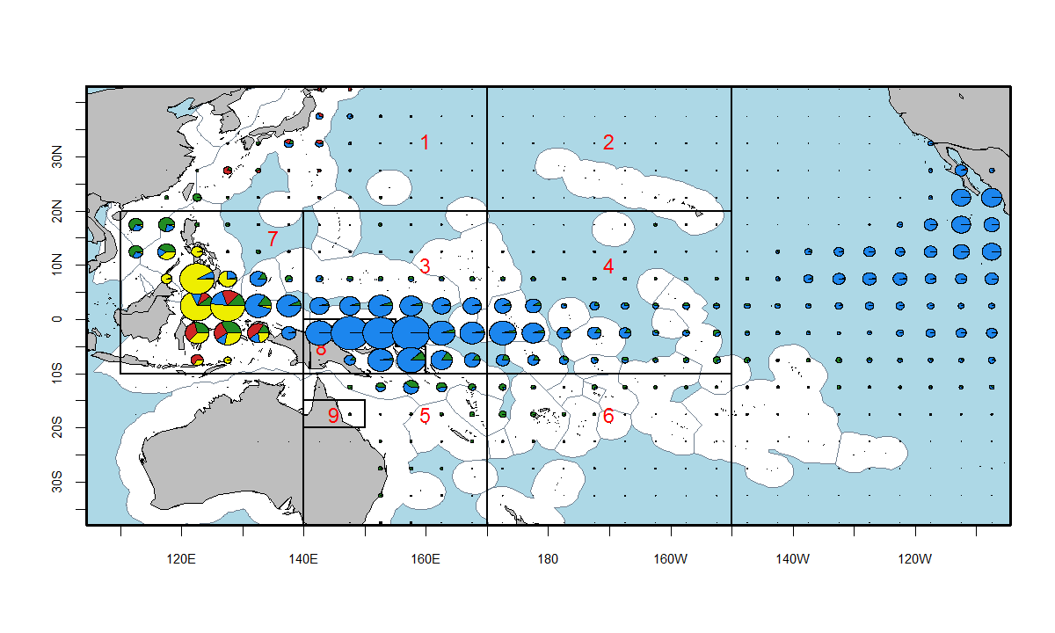
Spatial complexity in WCPO
Heterogeneity:
fisheries
biology
Notes:
This shows the complex spatial distribution of the various fisheries within the yellowfin WCPO – purse seine fisheries (in blue) are in the central and eastern parts, while domestic ID/PH small scale fisheries are to the west, red PL.
The 9 regions shown are the current spatial partitioning used for the YFT and BET assessment models using MULTIFAN-CL.

Slide 6
Movement parameterisation
Temporal:
Flexibility for number of movements per year (e.g. each quarter)
Flexibility for grouping (shared) movements for particular time periods, e.g. 1 2 2 1 rather than 1 2 3 4
Spatial:
coefficients estimated are region boundary-specific, so flexibility for:
number of regions
adjacent regions
Notes:
Movement must take account of the model’s temporal-spatial configuration and what assumptions are being made for the process.
Therefore – there is flexibility for:
the timing of movement events, and for sharing coefficients among time periods
the spatial configuration for the number of regions and which regions are adjacent

Slide 7
Movement processes in MULTIFAN-CL cont.
Movement matrix in respect of regions
e.g. yellowfin tuna
Destination region
R2 R3 R4 R5 R6 R7 R8 R9
Region of origin
R1------------------
R2------------------
R3------------------
R4------------------
R5------------------
R6------------------
R7------------------
R8------------------
# Incidence matrix
1 1 0 0 0 1 0 0
0 1 0 0 0 0 0
1 1 0 1 1 0
0 1 0 0 0
1 0 1 1
0 0 0
1 0
0
Notes:
This is an example having 9 regions, with arrows indicating adjacency, from which a movement incidence matrix is generated.
Matrix entries for adjacent regions have a value of 1
This provides a pointer for assigning the coefficients in the model.
Note: movement is in both directions and therefore the matrix is symmetric.

Slide 8
Flexibilty in respect of the vectors of movement coefficients in respect of: spatial structure, temporal assumptions
nvar = 12 coefficients; m_{ij}
i j
1 4
1 5
2 4
2 5
3 4
3 5
4 1
4 2
4 3
5 1
5 2
5 3
Region structure
Incidence matrix
 | 2 | 3 | 4 | 5
1 | 0 | 0 | 1 | 1
2 |  | 0 | 1 | 1
3 |  |  | 1 | 1
4 |  |  |  | 0
Notes:
Complete flexibility is afforded so as to deal with odd spatial structures, such as this case where corridors might be entertained, but also all possible temporal assumptions.

Slide 9
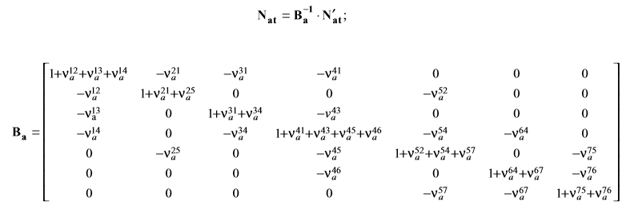
Movement processes cont.
Fully implicit solution → movement can occur to all regions (including non-adjacent) in a single time step
guarantees numerical stability
Notes:
… through this system of equations describing movement. Fully implicit solution solved in reverse time.
In vector form, N is region-specific vector of numbers at age by time, before movement takes place
N’ is the vector after movement has taken place (beginning of the time period)
Ba is the age-specific movement transition matrix
Diagonals are the probablility of post-movement “survivorship” in the region, non-zero non-diagonal elements (Nu’s) are the probabilities of moving from one region to another.
It is fully implicit in allowing a small amount of movement among non-adjacent regions in a single time step.

Slide 10
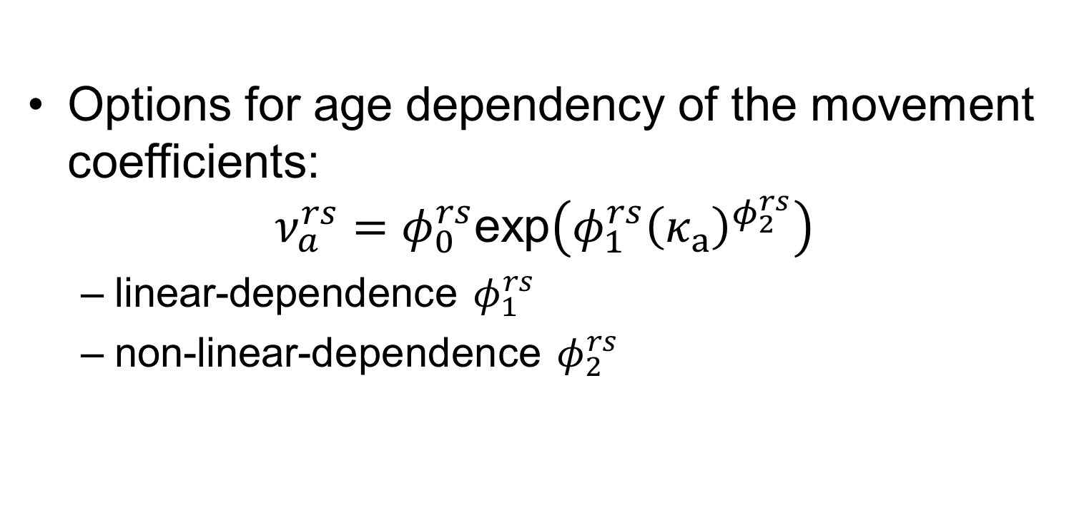
Movement processes cont.
Options for age dependency of the movement coefficients:
$$ν_{a}^{rs}=φ_{0}^{rs}\text{exp}\left(φ_{1}^{rs}{\left(κ_{a}\right)}^{φ_{2}^{rs}}\right)$$
linear-dependence $φ_{1}^{rs}$
non-linear-dependence $φ_{2}^{rs}$
Notes:
Can be made age-dependent: linear or non-linear (SKJ is linear)
Age dependency specified using a simple function that can allow increasing or decreasing movement with age. Kappa age is scaled from -1 to 1.

Slide 11
2. Tag partition
Tagged population model
Each release event represents a “parallel” tagged population
tagnum_fish(1,tag_events,1,nregions,1,nperiods, 1,nage)
shares most of the dynamic processes with the model (un-tagged) population
Identical movement and growth processes
The exception process is recruitment: where for the tagged population a “cohort” is a release event comprising a “recruitment” in numbers at length
Notes:
Now moving to the tagged partition.
Simply the tagged population runs in parallel to the untagged population and generally shares the same population dynamics.
The tagged data structure is that same as the untagged, apart from the added dimension for the release event at the first subscript.
Therefore in the code the dynamic processes and parameterisations are implemented in the same manner, except for an outer loop in respect of the release event dimension.
Importantly movement and growth of tagged fish is identical to the untagged fish.
Exception is recruitment, which is a release event, considered like a "cohort“.

Slide 12
Tagged population model
MULTIFAN-CL is age-structured. Tag releases are length-specific – transformed to be age-specific via the estimated growth function
A mixing period is specified for assumed random mixing of tagged population
Grouping of recaptures: specified fisheries for which recaptures can be aggregated
Notes:
Initially several steps are taken to set up the tagged population within the general population model:
Firstly the numbers released at length must be transformed to numbers at age
There is provision for a mixing period following the time of release, to allow for the assumption that the tagged population has mixed within the region of release
For certain fisheries, the recaptures may be aggregated into a group for the likelihood calculation. This may help when the reported fishing method of capture is unreliable.

Slide 13
Tag population dynamics - release
Tags released are assigned to a tag cohort (c) – being a tag release group
Pooled group – aggregate cohorts (c*) from tag groups in a single group when attain a^{pool}. Age structure is maintained
Notes:
The tag partition is separated into two components:
Initially the tag cohort is created at the time of the release event
After a user-specified number of time periods at liberty, the tag group is placed into a single aggregate “pooled” tag group, wherein the age structure is maintained. This optimizes the tagging calculations so as not to continue with large numbers of “senescent” tagging groups.

Slide 14
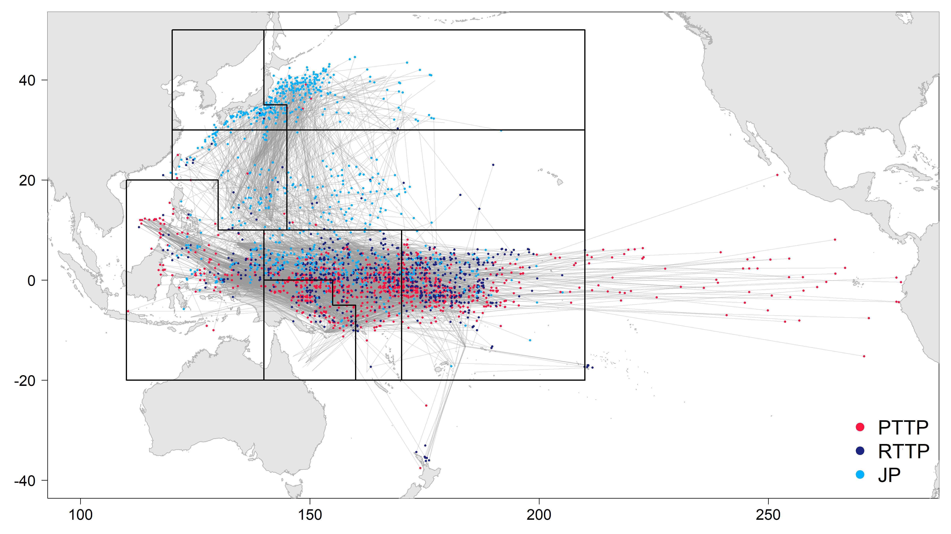
Tag movements - SKJ
269 release groups 329,811 releases 56,092 recaptures
Notes:
This illustrates the released and recaptured skipjack from the three tagging programs conducted. Only recaptures >1,000 nautical miles shown
These programs were conducted over a number of regions and model time periods, and therefore comprise 269 region-periods; i.e. there were 269 cohorts added to the tagged population partition.
This represents an enormous amount of data on movement input to the model; with over 56,000 recaptures.

