Slide 1
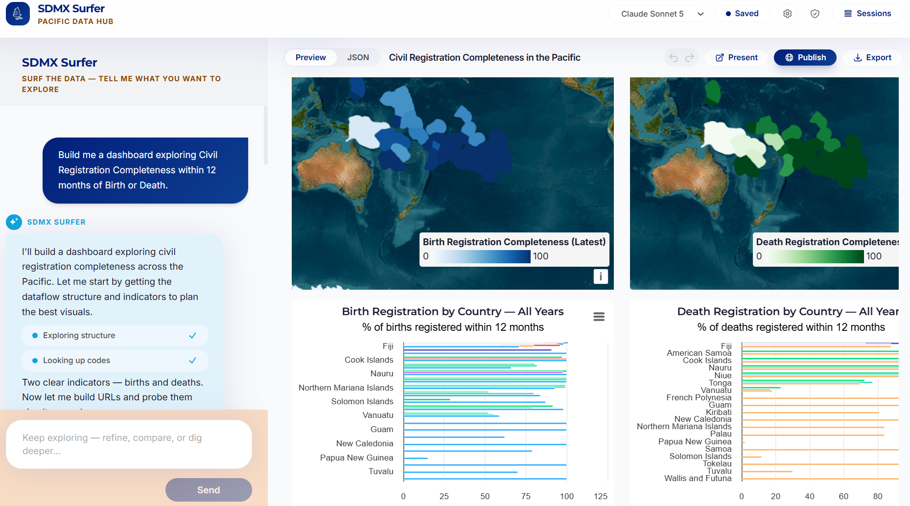
SDMX SURFER · COUNTRY SNAPSHOTS
Dashboards you ask for, numbers you can trust
– SDMX Surfer is a web app where you build dashboards on official statistics by describing them in plain language. An AI agent finds the right data in the SDMx catalogue and assembles the charts.
– Country Snapshots is the curated layer on top: ready-made statistical profiles for every Pacific country and territory, with comparison and regional views.
– Both run on the same pipeline: every number is fetched live from .Stat at the moment you look at it, and every chart links back to its official source.
Live data – no copies, no extracts
AI-assisted – conversation, not query languages
The AI cannot touch the data itself: it writes the query, and .Stat serves the values straight to the chart (next slide).
Human-verifiable – every chart cites its source

Slide 2
The AI writes the question, never the numbers
– Describe the dashboard in plain language. The agent explores the statistical catalogue step by step (dataflows, dimensions, availability) and writes a small, human-readable dashboard spec.
– Data never passes through the model. Charts fetch values directly from the .Stat SDMx API at view time. The AI cannot corrupt, invent, or round a number: it only chooses the query and the chart type.
– Always live, always checkable. No copies or extracts; reload and you see today's data. Every panel cites its exact source query, one click from the official .Stat page, and the spec stays human-editable.
AUTHORING
User
dashboard goal
LLM Agent
query + chart
MCP call
MCP Gateway
SDMX discovery
SDMX Endpoint
metadata
data values
CONFIGURATION
writes
JSON config
human-readable
Dashboard
components
RUNTIME
renders
Interactive dashboard
fetches data
SDMX query
values
The model acts only in the authoring phase. At runtime the dashboard talks to the SDMx endpoint directly.

Slide 3
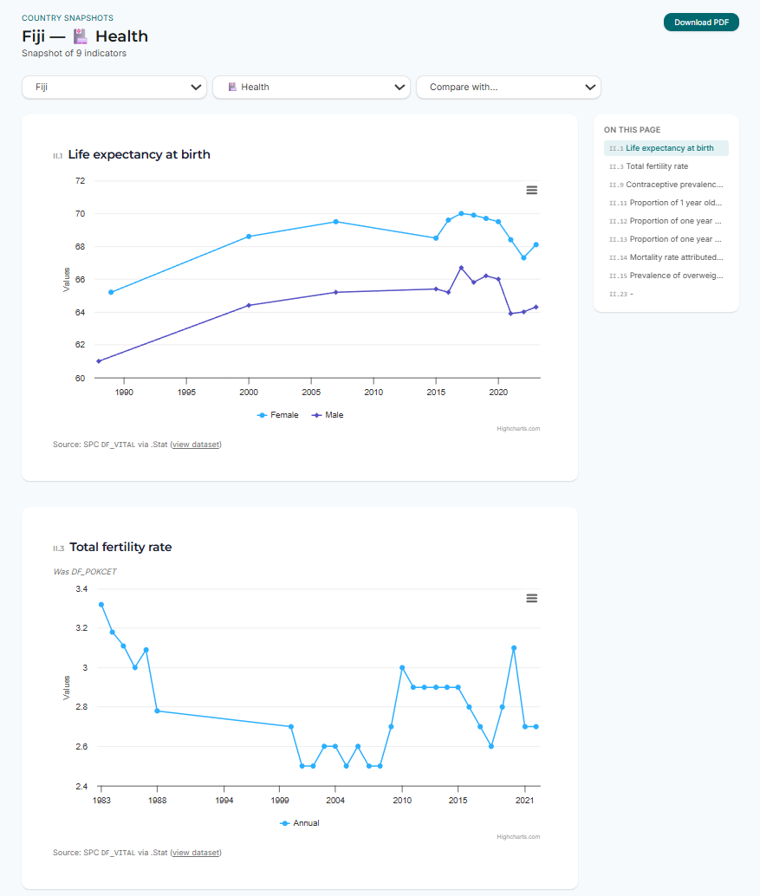
Country Snapshots: an indicator monitoring tool
– Built for MFAT. Developed for the New Zealand Ministry of Foreign Affairs and Trade: one-page statistical profiles ready to brief from, with a curated catalogue of ~100 indicators across 12 themes for each of 22 Pacific countries and territories, plus side-by-side comparison and region-wide views.
– Same trust pipeline. Every indicator on the page is a live .Stat query rendered on load, with its source cited. PDF export keeps the source links clickable.
– From reading to exploring in one click. “Explore in Surfer” turns any snapshot page into an editable AI session: change countries, time ranges, or chart types by asking.

Slide 4
Built for the Pacific, connected to the world
HOME
– Live today at sdmxsurfer.net (capped pilot), moving to surfer.pacificdata.org.
– Safe to open up: per-user daily limits and a hard budget cap on AI usage; the data itself is public official statistics.
– Owned by the Pacific: copyright The Pacific Community (SPC), source available under a noncommercial licence; built at the Statistics for Development Division.
SPC's Pacific Data Hub (.Stat), first-class support for all 22 Pacific countries and territories, treated with regional neutrality.
NATIONAL STATISTICS OFFICES
Stats NZ · Australian Bureau of Statistics · Fiji Bureau of Statistics · Samoa Bureau of Statistics
INTERNATIONAL ORGANISATIONS
OECD · Eurostat · UNICEF · ILO · IMF · ECB · BIS
One conversation can mix sources: Pacific data alongside the same indicator from any connected provider, every series still fetched live from its own endpoint.
Everything on screen is reproducible: open any chart's source link and you are on the official .Stat query that produced it.

