Slide 1
Module-II
Generating test cases-techniques and methods

Slide 2
Contents
Generalized pseudo code
Triangle Problem
Next Date function
Commission Problem
SATM Problem
Currency Converter
Saturn Windshield wiper

Slide 3
Example
class Roots {
// Solve ax2 + bx + c = 0
public roots(double a, double b, double c)
{ … }
// Result: values for x
double root_one, root_two;
}
Which values for a, b, c should we test? assuming a, b, c, were 32-bit integers, we’d have 1028 legal inputs with 1.000.000.000.000 tests/s, we would still require 2.5 billion years

Slide 4
1. HOW TO PROCEED ?
2. WITH WHAT VALUES OF A,B,C WE CAN PERFORM THE TEST?

Slide 5
Example
Consider an application named as “X”
I have 2 testers
T1 has written 100 test cases with 3 bugs
T2 has written 50 test cases with 3 bugs
Who is smarter?

Slide 6
User registration form
AGE:
18-80

Slide 7

WHY not Random?
To estimate the proportion of needles to hay
sample randomly – Reliability estimation requires unbiased samples for valid statistics.
But that’s not our goal! •
To find needles and remove them from hay, look systematically (non-uniformly) for needles – Unless there are a lot of needles in the haystack, a random sample will not be effective at finding them – We need to use everything we know about needles, e.g., are they heavier than hay? Do they sift to the bottom?

Slide 8
Testing methodologies
Exhaustive testing (Not realistic Impossible)
Optimal testing(Test with best possible values)

Slide 9

FUNCTIONAL TESTING-DESCRIPTIVE
Tester should use “Black Box” testing techniques to optimize testing
Developer should use “White Box” testing techniques to optimize testing.

Slide 10
Factors validated in functional Testing
Object Properties
Error Handling
Input Domain BVA/ECP
Calculation
Database
Links

Slide 11
What do you mean by object in an application?
Testing the properties of an object is an unavoidable part of functional testing.

Slide 12
What do you mean by Error Handling?
Application should identify incorrect transactions.
Any invalid operations, system should handle it

Slide 13
Black Box Testing Techniques
Boundary Value analysis (BVA):
What is it?
It is a black box testing technique used to derive the best possible input set to validate the functionality.
Where to use it?
Whenever input is in range/size.
What is the logic?
Possibility of errors in and out the boundaries.
Test the boundaries (in and around boundary)

Slide 14
Example
Age
Range : 18-80

Slide 15
Boundary Value Analysis
Popular and simpler test design technique.
Related to equivalence partitioning
Test both sides of each boundary (the assumption is that the system behaves differently on either side of the boundary)
Experience have shown that such test cases have a higher probability of detecting a fault in the software.

Slide 16
Boundary Value Analysis-What we check?
Minimum Value
Just above minimum value
Maximum value
Just below Maximum value
Nominal value
Number of inputs is 4n+1

Slide 17
Selected values for boundary analysis
100
101
200
299
300

Slide 18
Generalized pseudo code
Pseudo code provides a language-neutral way to express program source code.
No specific rule like programming languages
For traditional programming language the unit for testing is procedure.
For OO language its Class

Slide 19
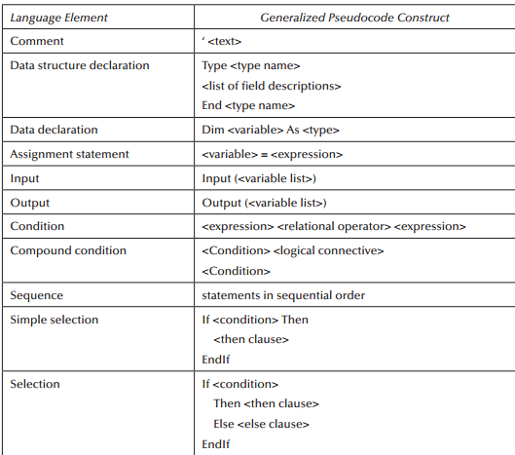
Language construct for pseudo code

Slide 20
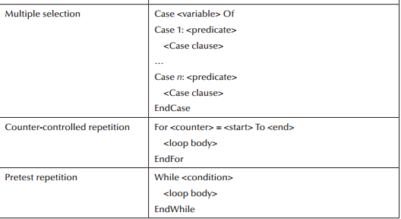
Language construct for pseudo code…

Slide 21
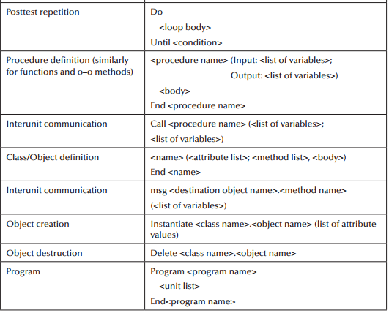
Language construct for pseudo code

Slide 22
Triangle Problem
Boundary value Analysis

Slide 23
The Triangle Problem
The triangle problem is the most widely used example in software testing literature.
The complexity in the triangle program is due to the relationships between inputs and correct outputs.
Problem statement
Simple version
Improved version
Implementation

Slide 24
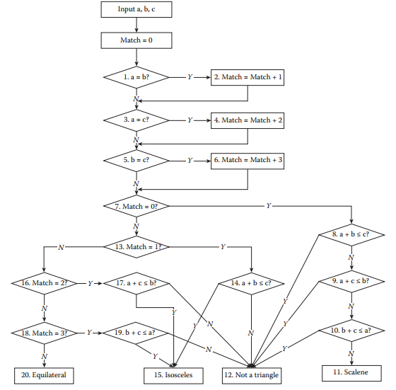
Traditional Implementation

Slide 25
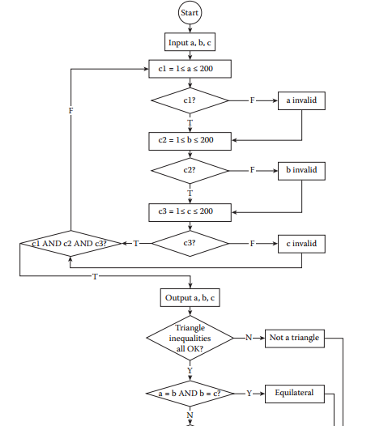
Improved version implementation

Slide 26
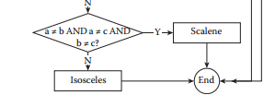
Improved version implementation…

Slide 27
Data flow diagram for structured implementation
Triangle sides
a,b,c
2.is_A_triangle
1.Get input
3.Triangle type
a,b,c
True / False
Triangle type o/p

Slide 28
Structured implementation
Dim a,b,c As Integer Dim IsATriangle As Boolean Step 1: Get Input Output(“Enter 3 integers which are sides of a triangle”) Input(a,b,c) Output(“Side A is”,a) Output(“Side B is”,b) Output(“Side C is”,c) ‘Step 2: Is A Triangle?’ If (a < b + c) AND (b < a + c) AND (c < a + b) Then IsATriangle = True Else IsATriangle = False EndIf Step 3: Determine Triangle Type If IsATriangle Then If (a = b) AND (b = c) Then Output (“Equilateral”) Else If (a ≠b) AND (a ≠c) AND (b ≠c) Then Output (“Scalene”) Else Output (“Isosceles”) EndIf EndIf Else Output(“Not a Triangle”) EndIf End triangle2
Program triangle2 ‘Structured programming version of simpler specification

Slide 29
Structured implementation
Dim a, b, c As Integer Dim c1, c2, c3, IsATriangle As Boolean ‘Step 1: Get Input Do Output(“Enter 3 integers which are sides of a triangle”) Input(a, b, c) c1 = (1 ≤ a) AND (a ≤ 200) c2 = (1 ≤ b) AND (b ≤ 200) c3 = (1 ≤ c) AND (c ≤ 200) If NOT(c1) Then Output(“Value of a is not in the range of permitted values”) EndIf If NOT(c2) Then Output(“Value of b is not in the range of permitted values”) EndIf If NOT(c3) ThenOutput(“Value of c is not in the range of permitted values”) EndIf
Until c1 AND c2 AND c3 Output(“Side A is”,a) Output(“Side B is”,b) Output(“Side C is”,c) ‘Step 2: Is A Triangle? If (a < b + c) AND (b < a + c) AND (c < a + b) Then IsATriangle = True Else IsATriangle = False EndIf ‘Step 3: Determine Triangle Type If IsATriangle Then If (a = b) AND (b = c) Then Output (“Equilateral”) Else If (a ≠b) AND (a ≠c) AND (b ≠c) Then Output (“Scalene”) Else Output (“Isosceles”) EndIf EndIf Else Output(“Not a Triangle”) EndIf

Slide 30
Consider a program addition
with two input values “x” and “y” and it
gives the addition of x and y as output
100≤x≤300
200≤y≤400

Slide 31
Selected values for boundary analysis
100
101
200
299
300

Slide 32
Test case | x | y | Expected Output
1 | 100 | 300 | 400
2 | 101 | 300 | 401
3 | 200 | 300 | 500
4 | 299 | 300 | 599
5 | 300 | 300 | 600
6 | 200 | 200 | 400
7 | 200 | 201 | 401
8 | 200 | 300 | 500
9 | 200 | 399 | 599
10 | 200 | 400 | 600

Slide 33
Generalizing BVA
Number of Variables
Kind of ranges

Slide 34
We just follow simple assumption theory
And identify the test cases mechanically
Does this have any impact ?

Slide 35
Limitations of Boundary value Analysis
When checking the value lower than minimum and a value greater than maximum is vital?

Slide 36
Robustness Testing
When do you say a program is robust?

Slide 37
Need for Robustness Testing
Exception Handling demands robustness testing
In robustness testing, we just add a value lower than minimum and one value higher than maximum to identify the exception handling capabilities.
So the total number of test cases in robustness testing is 6n+1

Slide 38
Consider a program addition
with two input values “x” and “y” and it
gives the addition of x and y as output
100≤x≤300
200≤y≤400

Slide 39
Test Case | x | y | Expected Output
1 | 99 | 300 | Invalid Input
2 | 100 | 300 | 400
3 | 101 | 300 | 401
4 | 200 | 300 | 500
5 | 299 | 300 | 599
6 | 300 | 300 | 600
7 | 301 | 300 | Invalid Input
8 | 200 | 199 | Invalid Input
9 | 200 | 200 | 400
10 | 200 | 201 | 401
11 | 200 | 399 | 599
12 | 200 | 400 | 600
13 | 200 | 401 | Invalid Input

Slide 40
When we need to go beyond Robustness Testing?
System failures can be costly or catastrophic

Slide 41
Worst Case Testing
One input value among
1. Minimum value
2.Just above minimum value
3.Just below maximum value
4.Maximum value
5.Nominal Value
Other input on nominal is not valid.
Cartesian product of the number of variables
If the mapping involves 2 variables its 5²

Slide 42
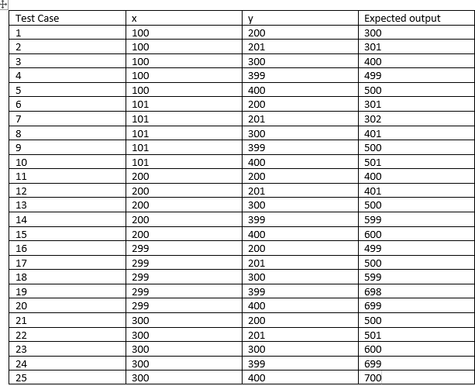

Slide 43
Identify the drawback with worst case testing
Invalid input entry is missing
Solution is robust worst case testing

Slide 44
With all this Can we say our product doesn’t go through failure?

Slide 45
Special Value Testing
Widely practised form of functional testing
Otherwise called as ad-hoc or seat-of-the-pants testing
Tester uses domain knowledge and experience with similar programs
No guidelines apart from “best engineering judgement”
Depends on the abilities of the tester

Slide 46
Consider a program for the determination of the largest among three numbers . Its input is triple of positive integers (say x,y and z) and values are from interval [1,300].

Slide 47
BVA test cases
Test case | x | y | z | Expected Output
1 | 1 | 150 | 150
2 | 2 | 150 | 150
3 | 150 | 150 | 150
4 | 299 | 150 | 150
5 | 300 | 150 | 150
6 | 150 | 150 | 1
7 | 150 | 150 | 2
8 | 150 | 150 | 299
9 | 150 | 150 | 300
10 | 150 | 1 | 150
11 | 150 | 2 | 150
12 | 150 | 299 | 150
13 | 150 | 300 | 150

Slide 48
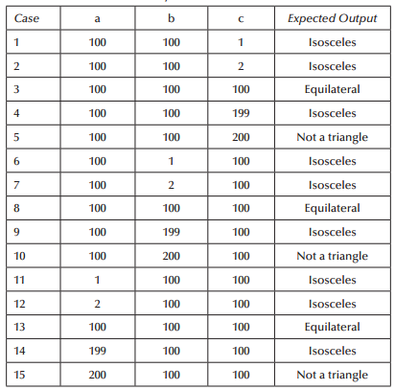
BVA for Triangle problem

Slide 49
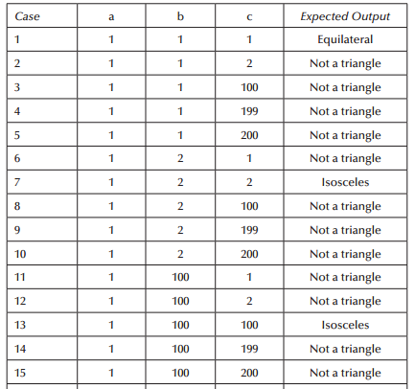
Worst test cases for triangle problem

Slide 50
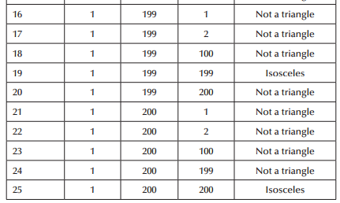

Slide 51
The Next date Function
NextDate function to illustrate a different kind of complexity—logical relationships among the input variables.
Problem Statement
NextDate is a function of three variables: month, date, and year. It returns the date of the day after the input date. The month, date, and year variables have integer values subject to these conditions
(the year range ending in 2012 is arbitrary, and is from the first edition):
c1. 1 ≤ month ≤ 12
c2. 1 ≤ day ≤ 31
c3. 1812 ≤ year ≤ 2012

Slide 52
Improved version
Dim tomorrowDay,tomorrowMonth,tomorrowYear As Integer
Dim day,month,year As Integer
Dim c1, c2, c3 As Boolean
Do
Output (“Enter today’s date in the form MM DD YYYY”)
Input (month, day, year)
c1 = (1 ≤ day) AND (day ≤ 31)
c2 = (1 ≤ month) AND (month ≤ 12)
c3 = (1812 ≤ year) AND (year ≤ 2012)
If NOT(c1)
Then Output(“Value of day not in the range 1..31”) EndIf
If NOT(c2)
Then Output(“Value of month not in the range 1..12”)EndIf
If NOT(c3)
Then Output(“Value of year not in the range 1812..2012”)EndIf
Until c1 AND c2 AND c2
Case month Of
Case 1: month Is 1,3,5,7,8, Or 10: ‘31 day months (except Dec.)
If day < 31
Then tomorrowDay = day + 1
Else
tomorrowDay = 1
tomorrowMonth = month + 1
EndIf
Case 2: month Is 4,6,9, Or 11 ‘30 day months
If day < 30
Then tomorrowDay = day + 1
Else
If day = 30
Then tomorrowDay = 1
tomorrowMonth = month + 1
Else Output(“Invalid Input Date”)
EndIf
EndIf
Case 3: month Is 12: ‘December

Slide 53
Else ‘not a leap year
tomorrowDay = 1
tomorrowMonth = 3
EndIf
Else
If day = 29
Then
If (year is a leap year)
Then tomorrowDay = 1
tomorrowMonth = 3
Else
If day > 29
Then Output(“Invalid Input Date”)
EndIf
EndIf
EndIf
EndIf
EndIf
EndCase
Output (“Tomorrow’s date is”, tomorrowMonth, tomorrowDay, tomorrowYear)
If day < 31
Then tomorrowDay = day + 1
Else
tomorrowDay = 1
tomorrowMonth = 1
If year = 2012
Then Output (“Invalid Input Date”)
Else tomorrow.year = year + 1
EndIf
EndIf
Case 4: month is 2: ‘February
If day < 28
Then tomorrowDay = day + 1
Else
If day = 28
Then
If (year is a leap year)
Then tomorrowDay = 29 ‘leap day

Slide 54
What are the difficulties of BVA?

Slide 55
Disadvantages
Redundancy is more
single-fault assumption.
With this underlying assumption, BVA testing is generally not effective in evaluating complex combinations of dependent or semicoupled parameters.

Slide 56
Motivation of equivalence testing
Members of the class should be treated the same
Resolve Awkward situations
- June 15 in five different years
Doesn’t make any sense

Slide 57
What equivalence class tries to remove?
Echoes the two deciding factors of BVA
- Robustness
-Single/multiple fault assumption

Slide 58
Basic Idea
Select few test cases and still achieve reasonable coverage
Split input domain into various categories with some relationship and expects every test case from a category exhibits the same behaviour.
If categories are well selected, we may assume that if one representative test case works perfectly ,others may give the same results.
Allows us to select exactly one test case from each category.

Slide 59
Example1(1-31)
Invalid Partition
0
-1
-2
-3
.
.
Valid Partition
1
2
3
.
Invalid Partition
32
33
.
.
.
.

Slide 60
Example 2 Username(6 to 10 characters)
Invalid Partition
0
1
2
3
4
5
Valid Partition
6
7
8
9
10
Invalid Partition
11
12
.
.
.

Slide 61
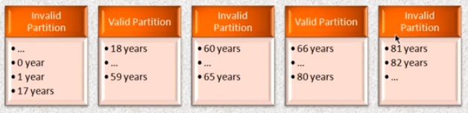
Example 3
Age 18-80 years except 60 to 65 years

Slide 62
Consider an application that takes x as input
And produces the square of x as output
1≤x≤100

Slide 63
Test Case | Input | Expected Output
1 | 0 | Invalid
2 | 50 | Valid
3 | 101 | Invalid
Test Case | Input | Expected Output
1 | 1 | 1
2 | 2 | 4
3 | 50 | 2500
4 | 99 | 9801
5 | 100 | 10000

Slide 64
Consider a program addition
with two input values “x” and “y” and it
gives the addition of x and y as output
100≤x≤300
200≤y≤400

Slide 65
Testcase | x | y | Expected output
1 | 99 | 300 | invalid
2 | 100 | 199 | Invalid
3 | 301 | 401 | invalid
4 | 200 | 300 | 500

Slide 66
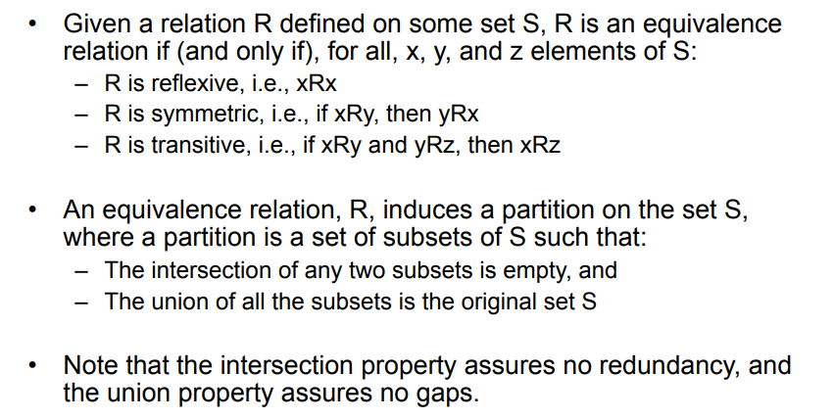

Slide 67
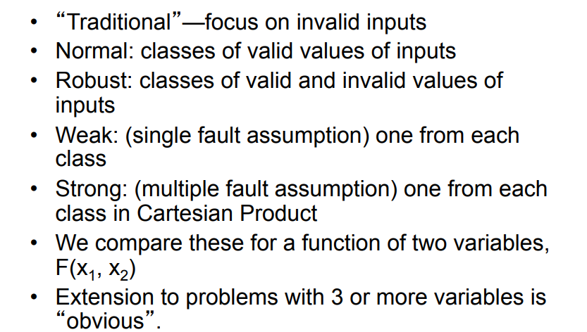
Forms of Equivalence Class Testing

Slide 68
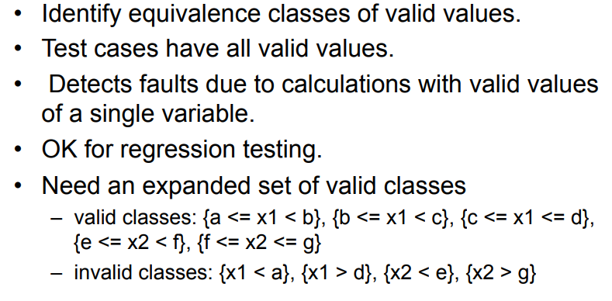
Weak Normal Equivalence Class

Slide 69
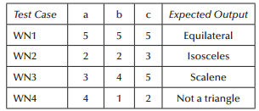
Equivalence Class test Cases for the triangle problem
Four weak normal equivalence class test cases, chosen arbitrarily from each class

Slide 70
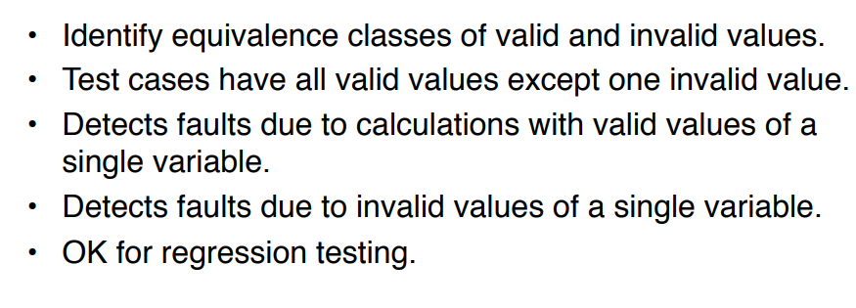
Weak Robust Equivalence classes

Slide 71
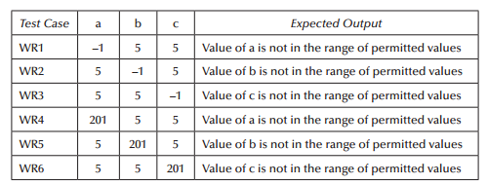
weak robust equivalence class testing
Considering the invalid values for a, b, and c yields the weak robust equivalence class test cases. (The invalid values could be zero, any negative number, or any number greater than 200.)

Slide 72
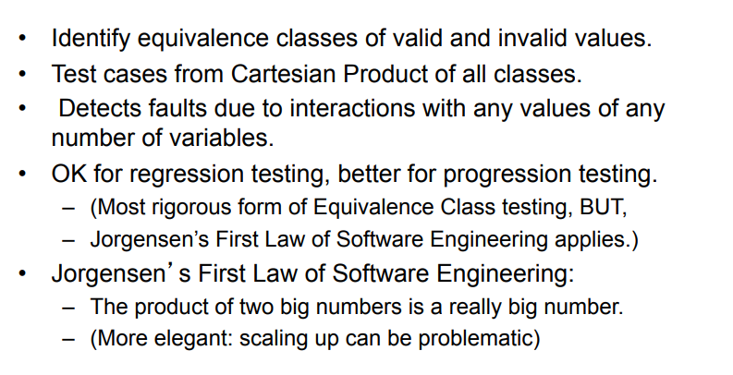
Strong Robust Equivalence Class

Slide 73
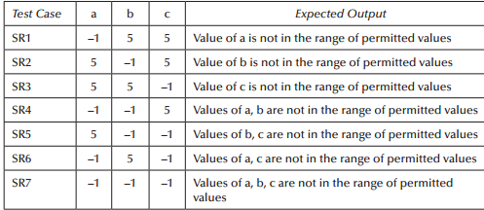
strong robust equivalence class test cases:
We get rich set of test cases if we design equivalence class based on output.

Slide 74
Applicability
Applicable at unit,integration,system and acceptance levels
We do not consider dependencies among different variables while designing equivalence classes
It is subjective in nature; two testing persons may design two different set of partitions of input and output domains.

Slide 75
Equivalence Class test Cases for the NextDate Function
Next Date is a function of three variables: month, day, and year, and these have intervals of valid values defined as follows:
M1 = {month: 1 ≤ month ≤ 12}
D1 = {day: 1 ≤ day ≤ 31}
Y1 = {year: 1812 ≤ year ≤ 2012}
The invalid equivalence classes are
M2 = {month: month < 1}
M3 = {month: month > 12}
D2 = {day: day < 1}
D3 = {day: day > 31}
Y2 = {year: year < 1812}
Y3 = {year: year > 2012}

Slide 76

weak normal equivalence class test case

Slide 77
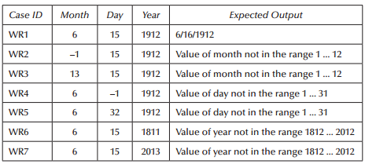
weak robust test cases:

Slide 78
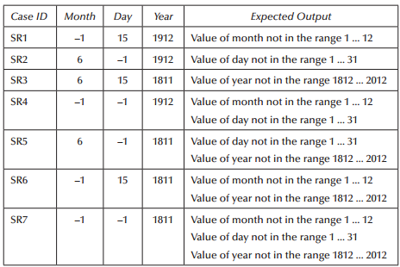
strong robust equivalence class test cases:

Slide 79
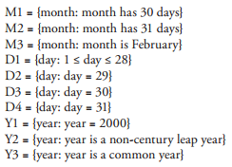
Equivalence classes for nextdate

Slide 80
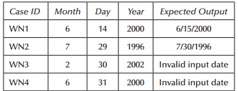
weak normal equivalence class test cases

Slide 81
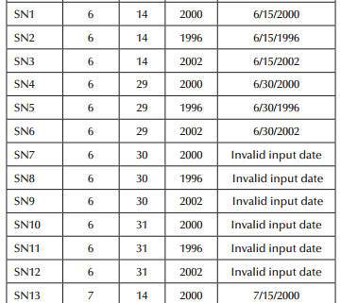
strong normal equivalence class test cases for the revised classes are as follows:

Slide 82

The Commission problem
Its typical commercial computing. It contains a mix of computation and decision making.

Slide 83
Problem statement:
A rifle salesperson in the some Territory sold rifle locks, stocks, and barrels made by a gunsmith in Missouri.
Locks cost $45, stocks cost $30, and barrels cost $25.
The salesperson had to sell at least one lock, one stock, and one barrel per month, and production limits were such that the most the salesperson could sell in a month was 70 locks, 80 stocks, and 90 barrels.

Slide 84
Problem statement:
After each town visit, the salesperson sent a telegram to the gunsmith with the number of locks, stocks, and barrels sold in that town.
At the end of a month, the salesperson sent a very short telegram showing –1 lock sold.
The gunsmith then knew the sales for the month were complete and computed the salesperson’s commission as follows: 10% on sales up to $1000, 15% on the next $800, and 20% on any sales in excess of $1800.

Slide 85
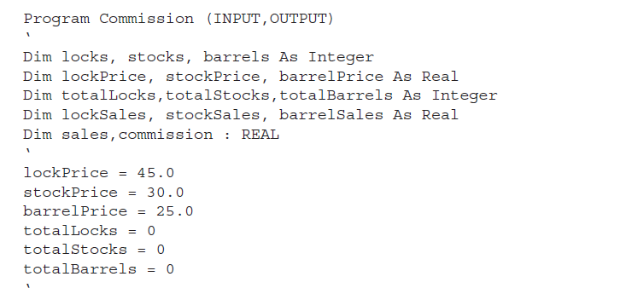
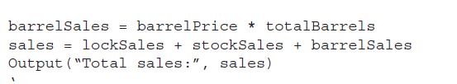
Pseudocode Notation
Step 1- Initialization

Slide 86
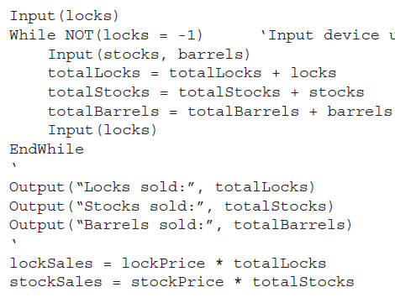
PseudoCode Notation
Step-2 Calculating The total sales

Slide 87
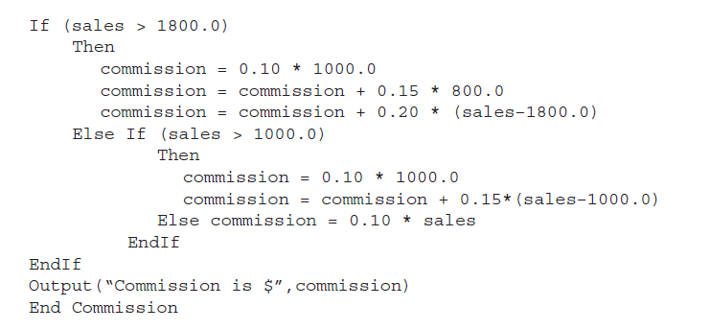
Pseudocode Notation
Step-3 Calculating Commission

Slide 88
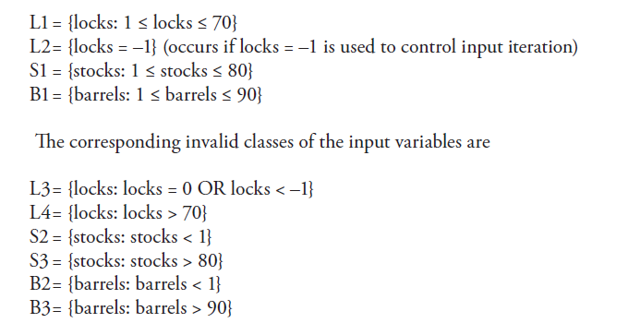
Valid and Invalid Classes

Slide 89
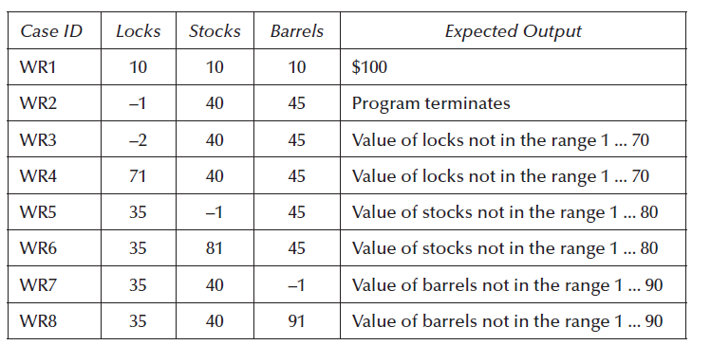
Weak Robust Test cases

Slide 90
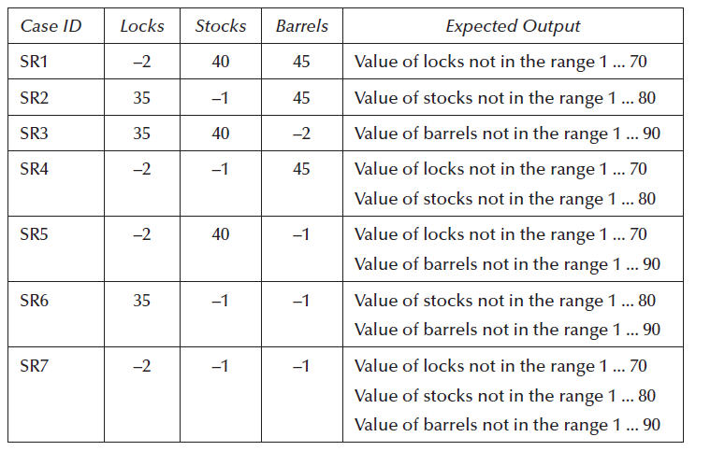
Strong Robust Equivalence Test cases

Slide 91
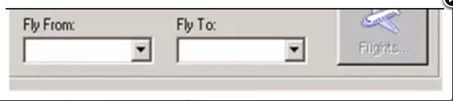
Example
Let's consider the behavior of Flight Button for different combinations of Fly From & Fly To.

Slide 92
Necessary conditions
When both the fields are blank , the flight button is disabled
When fly from is filled and fly to is blank, the flight button is disabled.
When fly to is filled and fly from is disabled, the flight button is disabled.
When both the fields are filled, the flight button is ON.
AND
X
Y
Z = X·Y
0
0
0
0
1
0
1
0
0
1
1
1

Slide 93
DECISION TABLE TESTING
More simply I can term this “as a method to document Logic”
It’s a way to deal with a combination of inputs, which produce different results.
It helps reduce test effort in verifying each combinations of test data, at the same time ensuring complete coverage

Slide 94
Parts of a decision table
CONDITION STUBS
Decision Table
ACTION STUBS
CONDITION ENTRIES
ACTION ENTRIES

Slide 95
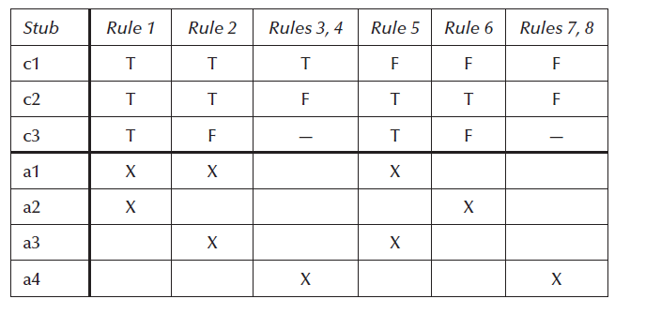
Parts of a Decision Table

Slide 96
DECISION TABLE FOR OUR EXAMPLE
Fly From | T | T | F | F
Fly To | T | F | T | F
Results | Success | Please enter the value | Please enter the value | Please enter the value
No.of Combinations=No.of condition1 values*No.of condition2 values.
No.of combinations =2^n

Slide 97
Exercise
A company wants to unify the way orders are handled:
All orders of non star-clients with bad credit should be rejected.
If there is enough product in stock, orders should be accepted; otherwise order is put in waiting list

Slide 98
Decision diagram example
(good, bad) (yes, no)
(sufficient,insufficient)
(accept, reject, waiting-list)
CREDIT
STAR-CLIENT
STOCK
HANDLE ORDER

Slide 99
DECISION TABLE
credit
Star client
Stock
Order Handling

Slide 100
Guidelines and observations
Apply decision table testing for following
If then else logic
Logical relationship among input variable
High Cyclomatic complexity
Limited entry decision table don’t scale up very well(a limited entry table with n conditions has 2n rules), so we use extended entry decision table- “factor” large tables into smaller ones, and look for repeating patterns of condition entries.
Use iteration technique for forming decision table as first set of conditions and actions we identify may be unsatisfactory. Use it as a stepping stone and gradually improve on it until you are satisfied with a decision table.

Slide 101
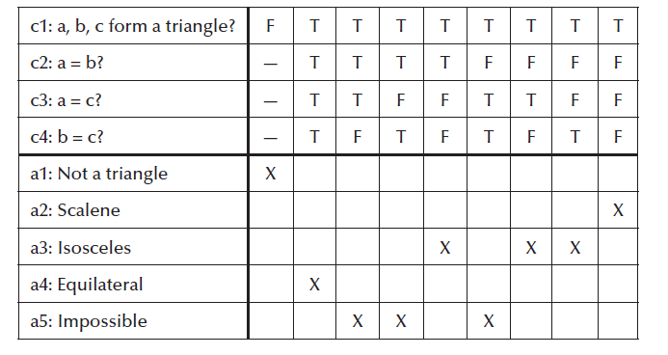
Decision Table for Triangle Problem

Slide 102
Observe rule 3,4 and 6

Slide 103
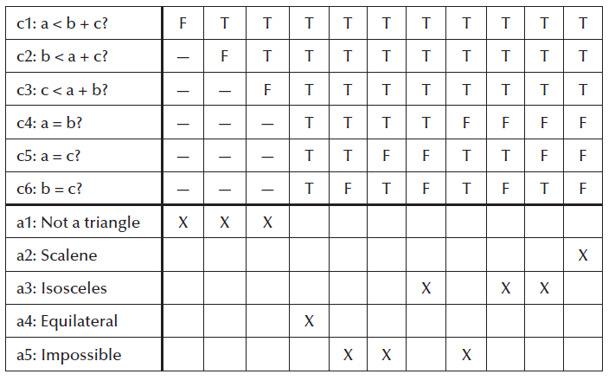
More refined Decision Table for Triangle Problem If any one condition fails it can’t be a triangle

Slide 104
How decision table is helpful to Testers?
Comprehensive set of test cases.
Avoid don’t care conditions and impossible rule usage.

Slide 105
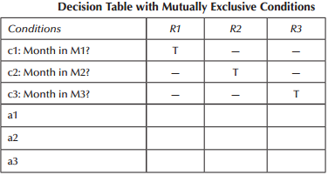
Decision Table with Mutually exclusive conditions
Notes:
NextDate problem; they refer to the mutually exclusive possibilities for the month variable.
Because a month is in exactly one equiva-lence class, we cannot ever have a rule in which two entries are true.
The don’t care entries (—) really mean “must be false.” Some decision table aficionados use the notation F! to make this point

Slide 106
Don’t Care conditions
If elements belong to one equivalence class then don’t care entries mean “must be false”
We can use the notation F! to make this point.
For a limited entry decision table with n conditions there must be 2^n independent rules.
The don’t care conditions might mean the conditions are irrelevant then we can develop the rule count as follows:
no don’t care condition in rule then rule count is 1
If don’t care condition exits then rule count doubles.

Slide 107
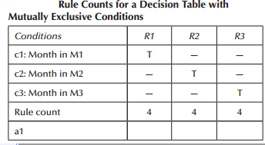
we get the rule counts shown in Table.
We should only have eight rules (2^3), so we clearly have a problem.
To see where the problem lies, we expand each of the three rules, replacing the “—” entries with the T and F possibilities,

Slide 108
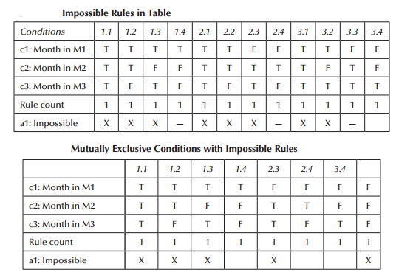
Where is the problem?
Notes:
Notice that we have three rules in which all entries are T: rules 1.1, 2.1, and 3.1. We also have
two rules with T, T, F entries: rules 1.2 and 2.2. Similarly, rules 1.3 and 3.2 are identical; so are
rules 2.3 and 3.3. If we delete the repetitions, we end up with seven rules; the missing rule is the
one in which all conditions are false.

Slide 109
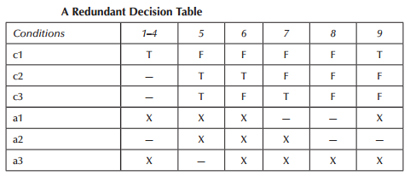
Care don’t care’s
If we are able to develop decision table then we need to identify inconsistency and redundancy.
Above table is redundant as we have 3 conditions but nine rules exists.
Notice that the action entries in rule 9 are identical to those in rules 1–4. As long as the actions in a redundant rule are identical to the corresponding part of the decision table, we do not have much of a problem. If the action entries are different then we have a bigger problem. As it results in inconsistence decision table.

Slide 110
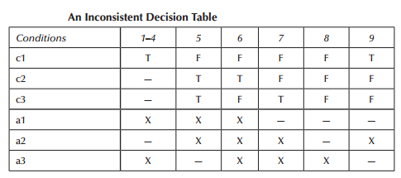
Non Determistic
If the above decision table were to process a transaction in which c1 is true and both c2 and c3 are false, both rules 4 and 9 apply.
We can make two observations:
1. Rules 4 and 9 are inconsistent.
2. The decision table is nondeterministic.
Rules 4 and 9 are inconsistent because the action sets are different. The whole table is nondeterministic because there is no way to decide whether to apply rule 4 or rule 9.
Lesson for testers is that care should be taken when don’t care entries are used in a decision table.

Slide 111
Applicability
Output is dependent on many conditions
Large number of decisions is required
Incorporate Complex business rules
Effective in unit testing

Slide 112
Student Average Problem
Marks Obtained | Division
75-100 | First Division with Distinction
60-74 | First division
50-59 | Second division
40-49 | Third division
0-39 | Fail
Consider the program for the determination of division of a student based on marks in three subjects. Its input is tripe of positive integers (say mark1,mark2,mark3) and values are from interval [0,100].
The division is calculated according to the following rules:

Slide 113
BVA
Test Case | Mark1 | Mark2 | Mark 3 | EO
1 | 0 | 50 | 50 | Fail
2 | 1 | 50 | 50 | Fail
3 | 50 | 50 | 50 | Second
4 | 99 | 50 | 50 | First
5 | 100 | 0 | 50 | First
6 | 50 | 1 | 50 | Fail
7 | 50 | 50 | 50 | Redundant
8 | 50 | 99 | 50 | Fail
9 | 50 | 100 | 50 | First
10 | 50 | 50 | 0 | First
11 | 50 | 50 | 1 | Fail
12 | 50 | 50 | 50 | Fail
13 | 50 | 50 | 99 | First
14 | 50 | 50 | 100 | First

Slide 114
Robust
Test Case | Mark1 | Mark2 | Mark3 | EO
1 | -1 | 50 | 50
2 | 0 | 50 | 50
3 | 1 | 50 | 50
4 | 50 | 50 | 50
5 | 99 | 50 | 50
6 | 100 | 50 | 50
7 | 101 | 50 | 50
8 | 50 | -1 | 50
9 | 50 | 0 | 50
10 | 50 | 1 | 50
11 | 50 | 99 | 50
12 | 50 | 100 | 50
13 | 50 | 101 | 50
14 | 50 | 50 | -1
15 | 50 | 50 | 0
16 | 50 | 50 | 1
17 | 50 | 50 | 99
18 | 50 | 50 | 100
19 | 50 | 50 | 101

Slide 115
Equivalence –output Domain Test cases
Test case | Mark1 | Mark2 | Mark3 | EO
O1 | 75 | 80 | 85 | FCD
2 | 68 | 68 | 68 | First
3 | 55 | 55 | 55 | Second
4 | 45 | 45 | 45 | Third
5 | 25 | 25 | 25 | Fail
6 | -1 | 50 | 50 | Inavlid

Slide 116
Equivalence-Input Domain
Test Case | Mark1 | Mark2 | Mark3 | EO
1 | 50 | 50 | 50 | Second
2 | -1 | 50 | 50 | Invalid
3 | 50 | -1 | 50 | Invalid
4 | 50 | 50 | -1 | Invalid
5 | 101 | 50 | 50 | Invalid
6 | 50 | 101 | 50 | Invalid
7 | 50 | 50 | 101
8 | -1 | -1 | 50
9
10
11
12
13
14
15
16
17
18
19
20
21
22
23
24
25
26
27

Slide 117
DECISION TABLE
Conditions
C1: Mark1>=0 | F
C2:mark1<=100 | -
C3:mark2>=0 | -
C4:mark2<=100 | -
C5:mark3>=0 | -
C6:mark3<=100 | -
C7:0 ≤ avg ≤39 | -
C8:40 ≤avg≤49 | -
C9: 50 ≤ avg≤59 | -
C10: 60 ≤ avg ≤74 | -
C11: avg≥75 | -
Actions | -
A1:Invalid Marks | -
A2:FCD
A3:First Division
A4:Second Division
A5:Third Division
A6:Fail
A7:Impossible

Slide 118
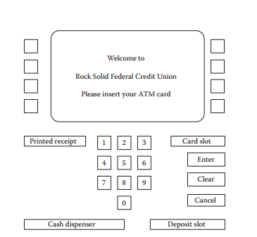
The SATM System
Used in discussion of integration and system testing

Slide 119
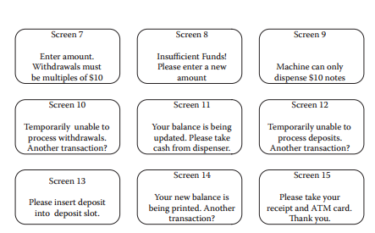
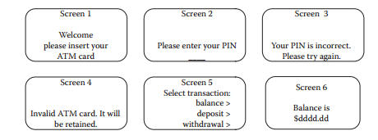
ATM Screens
Work Flow

Slide 120
SATM Flow

Slide 121
SATM Flow

Slide 122
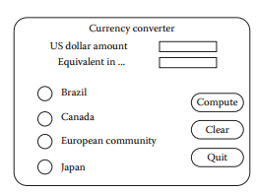
The Currency Converter

Slide 123
Windshield Wiper Controller
The windshield wiper on some automobiles is controlled by a lever with a dial.
The lever has four positions: OFF, INT (for intermittent), LOW, and HIGH.
the dial has three positions numbered simply 1, 2, and 3.
The dial positions indicate three intermittent speeds, and the dial position is relevant only when the lever is at the INT position.

Slide 124
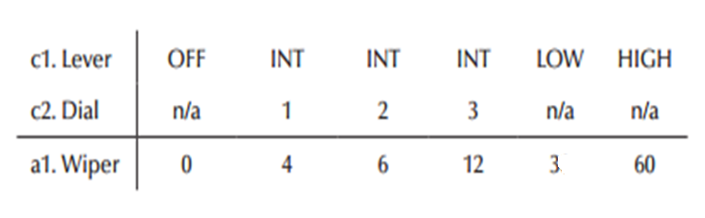
Windshield Wiper Controller…
The decision table below shows the windshield wiper speeds (in wipes per minute) for the lever and dial positions.

