Slide 1
Module-5
Integration and Component Based Software Testing

Slide 2
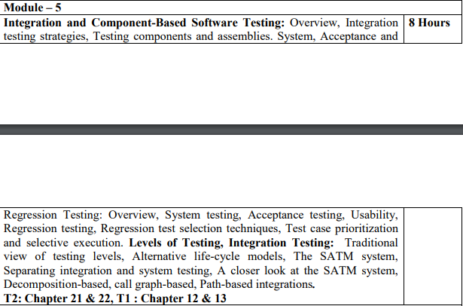
Syllabus

Slide 3
Regression Testing

Slide 4
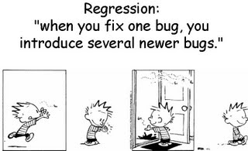
Why Regression Testing?
Project
1.admin
2.personal information
3.employment module

Slide 5
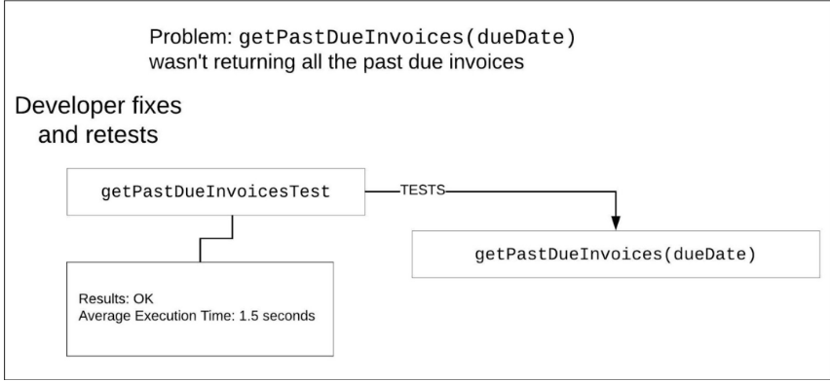

Slide 6
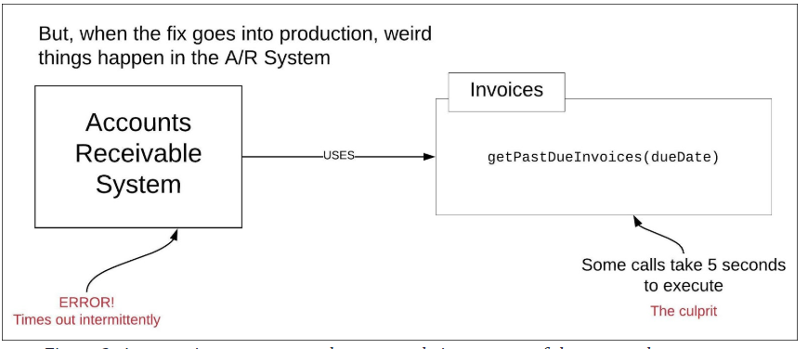

Slide 7

Why Regression Testing?
It turns out the developer indeed retested the code fix by way of a unit test.
And QA did a high-level inspection but no regression testing was performed.
The fix worked to expectation under unit testing and yet it broke the system when running in production.
Had the fix been incorporated into a system-wide regression test that used a copy of the data running in production, the chances are very good that the issue would have been discovered before the release to production.
Thus, the value and importance of regression testing.

Slide 8
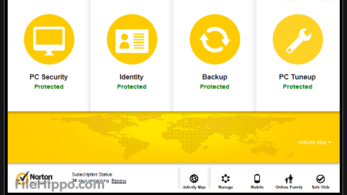
Regression Analysis
Earlier Version

Slide 9
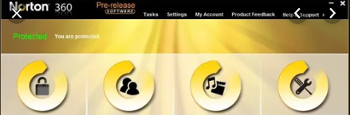
How to find which test cases to test?

Slide 10
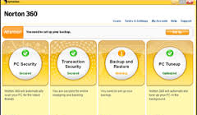
Why Regression Testing?
Software maintenance

Slide 11
Some reasons why software changes?
Errors
Additional Functionality
External policies and affairs
Restructuring
Change in existing technologies
Obsolete capabilities may have to be deleted.

Slide 12
What is Regression Testing?
“simply a process of re-testing”.
Modified Source Code
Parts of source code affected by the change

Slide 13
Comparison of Development and Regression Testing
Development Testing | Regression Testing
We write test cases | Use available test cases
Test all portions of source code | Test only modified portions and portions affected by modifications
Once in lifetime of the software | Many times
Correctness and confidence of the software | Correctness and confidence of the modified software
Performed under the pressure of release date | Performed in crisis situations
Separate allocation of time and budget | No time and budget
Time and effort consuming | Not much time and effort

Slide 14
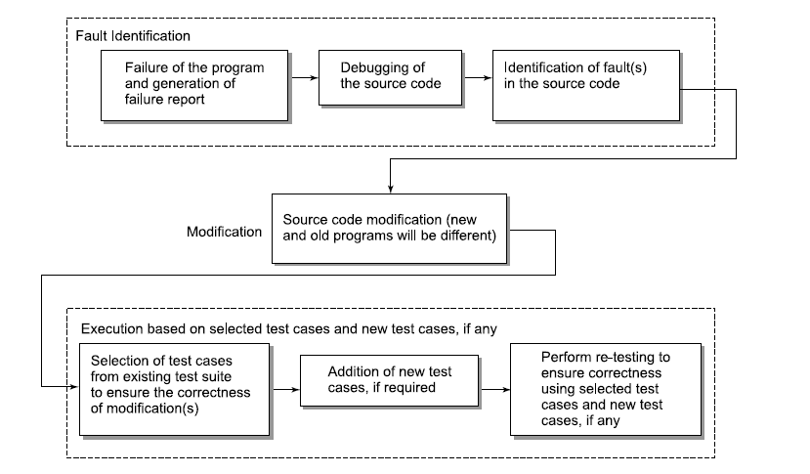
Regression Testing Process
Need test cases that target the modified and affected portions of the source code

Slide 15
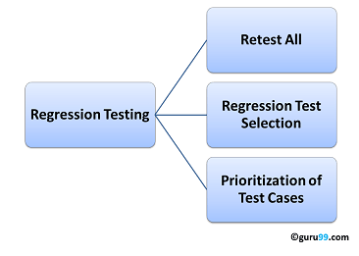
How to select regression test suite?

Slide 16
Regression Test Cases Selection
Select
Select all Test cases
Select
Select Test cases randomly
Select
Select modification traversing test cases

Slide 17
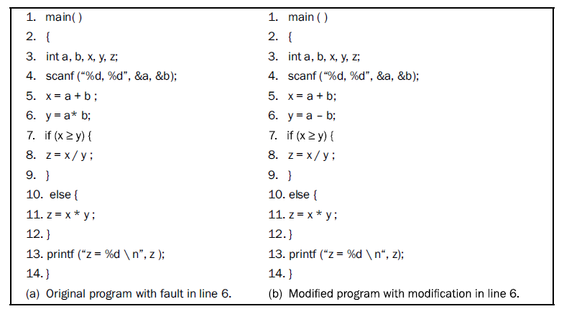
Selection of test cases

Slide 18
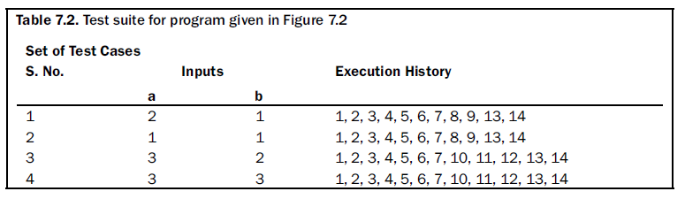
Test Suite for modified program

Slide 19
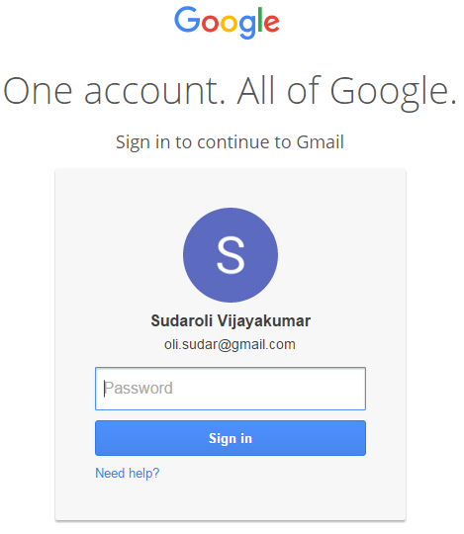
Select All Test Cases
Simplest and we don’t take any risk.
Practical only test suite is small.

Slide 20


Select Test Cases Randomly
Select test cases randomly to reduce the size.
Assumption is all test cases are equally good in finding the fault detection ability.
Disadvantage:
Most Randomly selected cases have no relation with the modified program.

Slide 21
Select Modification Traversing Test Cases
Only modified test cases and its impacted cases are tested.
Fault revealing Test cases.

Slide 22
Minimization Techniques
Avoiding redundant test cases.
Prioritization
General test case prioritization
Version specific test case prioritization

Slide 23
Prioritization Guidelines
What functions of the software must be tested?
What are the consequences if some functions are not tested?

Slide 24
Levels of Testing
Chapter 12

