Slide 1
A Humanoid Robot in HUST
Name：Shaojun Zhong
Huazhong University Of Science and Technology
School of Mechanical Science ＆ Engineering

Slide 2
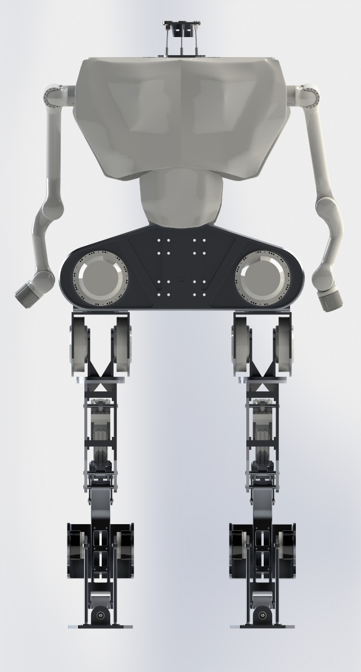
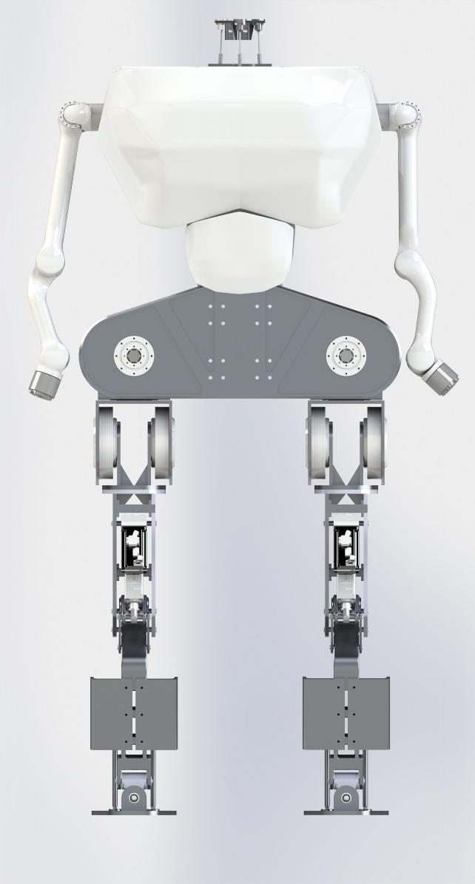
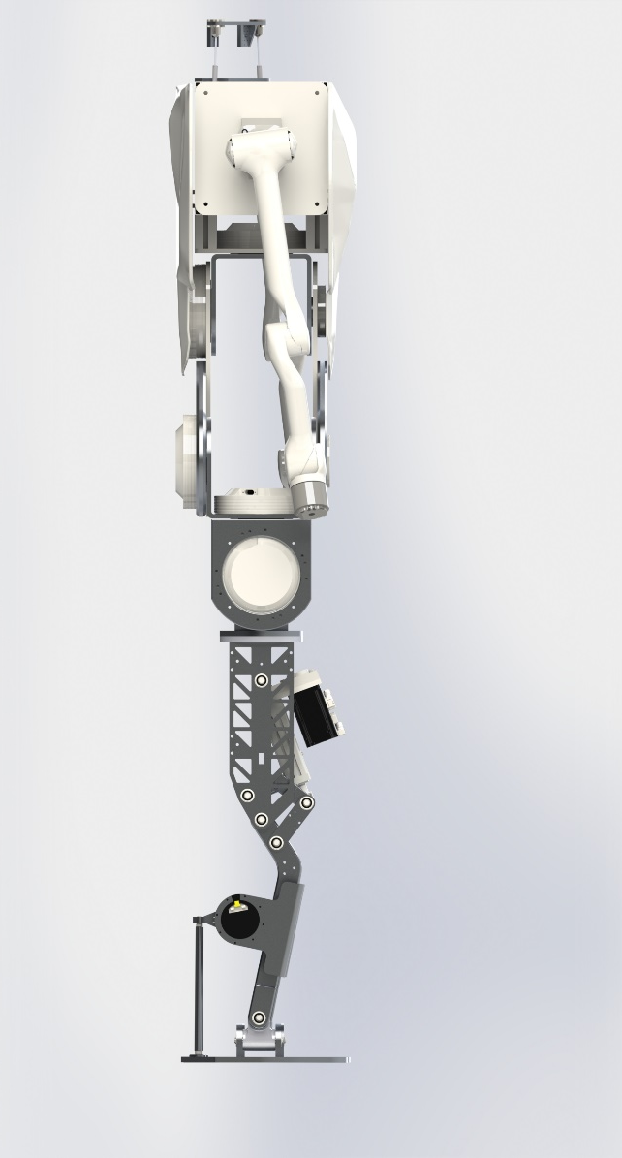
Overview
RearView
FrontView
SideView

Slide 3
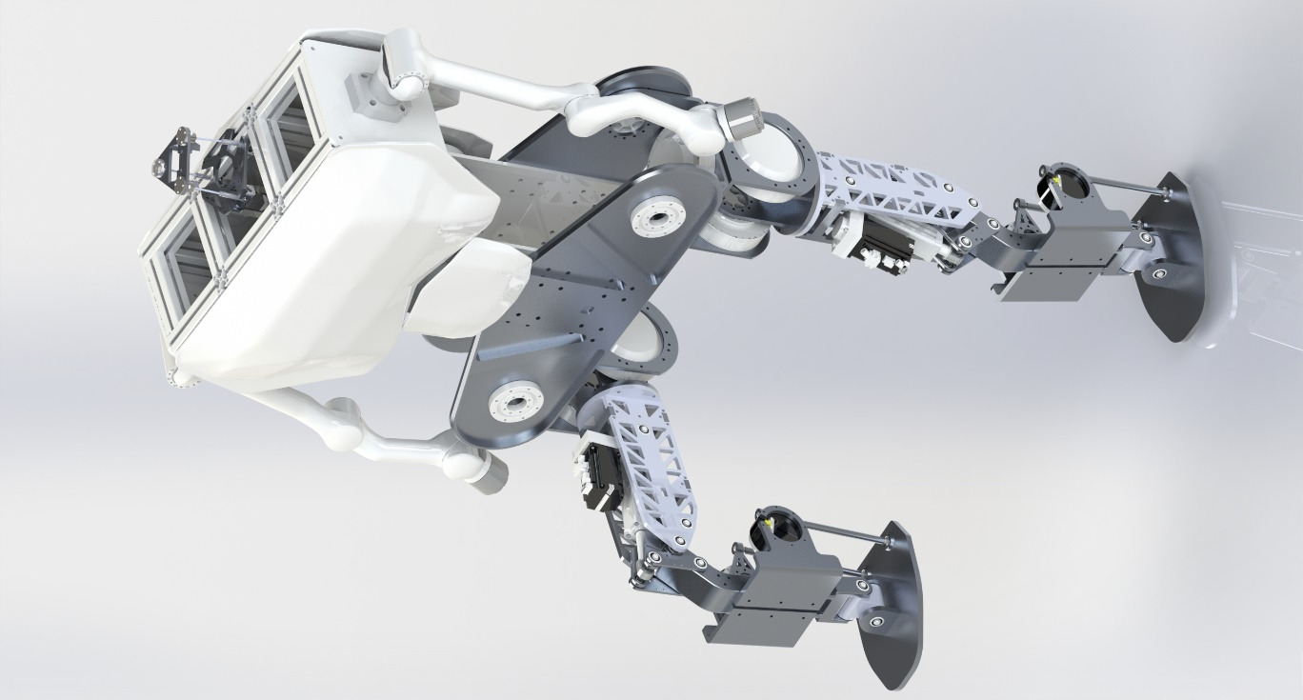
Overview
3-DOF neck
Central IMU
Total height:1.7m
Total weight:80kg
Max load(hands):8kg
Knee joint
2-DOF Ankle joint

Slide 4
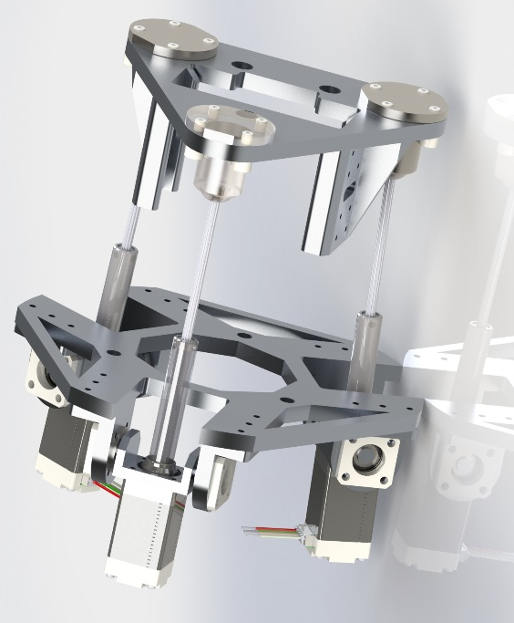
Neck-platform
3-DOF
Tare：2kg
Max load：3kg
Range of motion：40°per DOF
Universal platform for multi-sensor

Slide 5
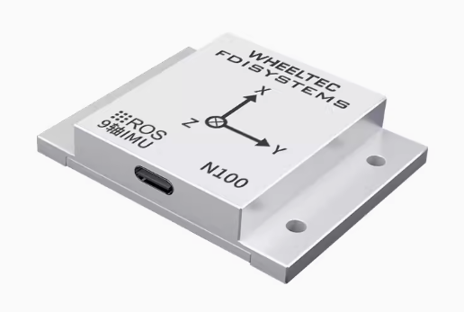
Central IMU
9-DOF
The only sensor for gait planning
（algorithm involved：MPC+WBC/ RL）

Slide 6
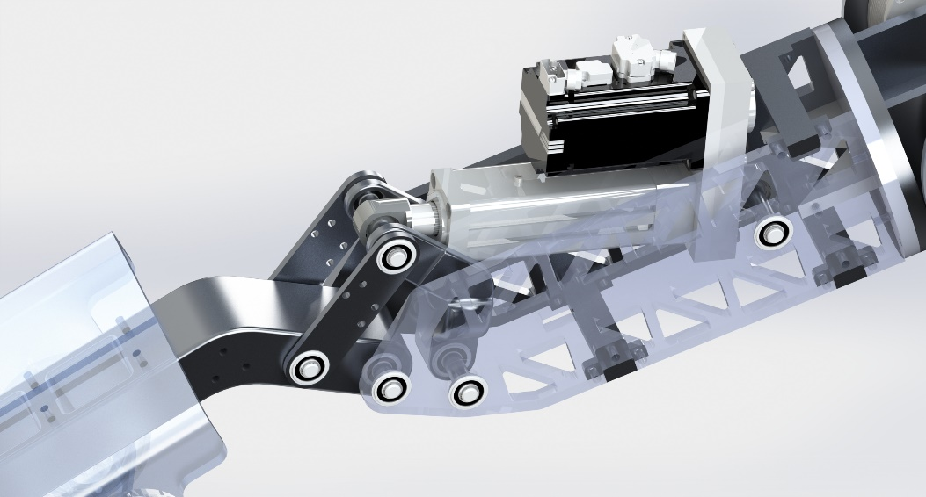
Knee joint
Four-bar linkage：Smooth the output curve
Actuator output force：8KN
Range of motion：100°

Slide 7
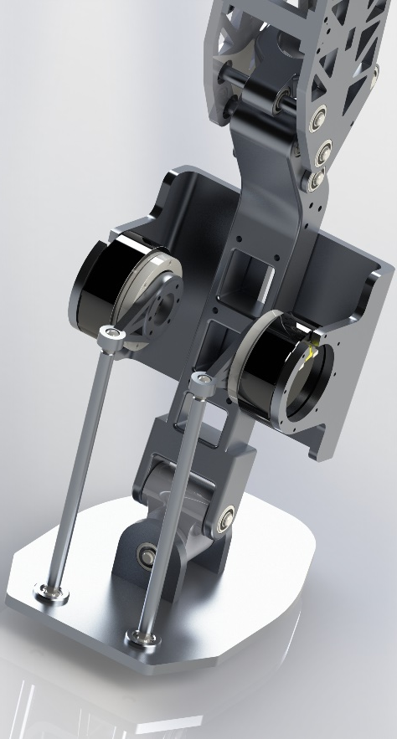
Ankle joint
2-DOF
Range of motion：
-15°~15°in pitch
-10°~10°in roll
Actuator output torque：35NM（each）

Slide 8
Control system

Slide 9
Thank you for listening

