Slide 1
WELCOME TO SUCCESS SELLING APPLICATION. ONLINE SHOPPING MALL

Slide 2
PURPOSE OF THIS APP.
SUCCESS APP is here to provide a user-friendly platform for individuals or businesses to showcase, market, and sell their products or services to a global or targeted audience, facilitating convenient transactions and enhancing the overall shopping experience.

Slide 3
PROBLEM TO BE SOLVED BY SUCCESS APP.
FOR THE BUSINESS
Save on operational costs
Potential to generate Revenue 24/7
Strategize for content marketing
Customer data insights
Reach new customers
FOR CUSTOMERS
No need to visit physical stores.
No need for cash
Provide buyers with access to more products.
Notes:
More explanation at: https://wareiq.com/resources/blogs/benefits-of-online-selling/

Slide 4
Contents
Log in form
Sign up form
Reset password
Tabs
Ordering system
Payment method

Slide 5



Log in Form
Success
Login
Phone number
Phone number starts with your country code
Password
Forget password?
Log in
Don’t have Success account
Sign up now

Slide 6

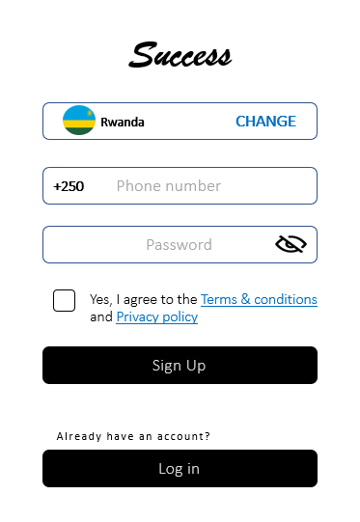






Sign up Form
Success
Rwanda CHANGE
+250 Phone number
Select country
Password
search
Yes, I agree to the Terms & conditions and Privacy policy
Rwanda +250
Burundi +257
Sign Up
DRC +243
Kenya +254
Tanzania +255
Already have an account?
Log in
Uganda +256

Slide 7


Reset Password
×
Verification
Please enter the code sent to
+250789534491
Edit Phone number
Didn’t receive the code?
Request new code
Verify & Proceed
Dear Pacifique your password reset code is 0123

Slide 8
IMPORTANT TABS
Home
Categories
Ordered
My profile

Slide 9





Home
Search
Home Categories Ordered My Profile

