Slide 1
Academic Performance in Online Learning
Big Data Analytics Capstone Project
Name: Pacifique HARERIMANA
ID: 26937

Slide 2



🎯 Problem Statement
Lack of Monitoring
Student Challenges
Project Goal
E-learning platforms often lack robust monitoring and prediction mechanisms.
Students face high dropout rates, low motivation, and poor performance.
Utilize data analytics to predict and improve academic outcomes for online learners.

Slide 3
📁 Dataset Overview
Our analysis leverages a comprehensive dataset from Figshare, comprising 7 CSV files.
1
2
3
Data Source
Key Target
Rich Records
7 CSV files from Figshare: assessments, student info, VLE activity.
The primary target variable is final_result: Pass, Fail, Withdrawn, Distinction.
Includes large-scale behavioral and demographic student records.

Slide 4




🛠 Tools Used
Python Ecosystem
Jupyter Notebook
Utilized pandas for data manipulation, seaborn and matplotlib for visualization, and scikit-learn for machine learning.
Interactive environment for iterative data analysis, modeling, and rapid prototyping.
Power BI
GitHub
Advanced tool for creating interactive dashboards and dynamic data visualizations.
Essential for version control, collaborative development, and secure code management.

Slide 5
🧼 Data Cleaning & Preprocessing
Rigorous steps were taken to ensure data quality and prepare the dataset for analysis.
Table Merging
Date Conversion
Consolidated disparate tables into a unified dataset for comprehensive analysis.
Missing Values
Transformed float-based date entries into consistent integer formats for easier processing.
Addressed missing values in critical fields like score, imd_band, and registration dates.

Slide 6
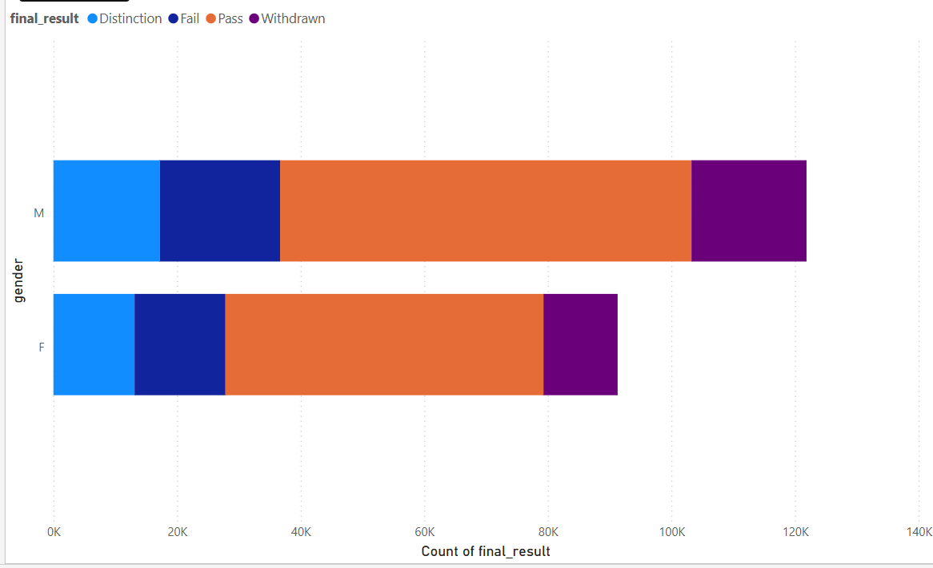
📊 Exploratory Data Analysis
Initial analysis revealed compelling trends in academic performance across demographic groups.
Gender vs. Result: Visualization highlighted differences in pass rates
between genders.
Age Band vs. Result: Students in the 26–35 age band consistently
demonstrated the best performance.
Region vs. Result: Geographical region also showed variations in academic
outcomes.
Disability Impact: A minor impact of disability status on final academic
outcomes was observed.

Slide 7




🧠 Feature Engineering
Advanced features were engineered to capture nuanced student interactions and improve model accuracy.
Merge Data
Create Dataset
Calculate Clicks

Slide 8
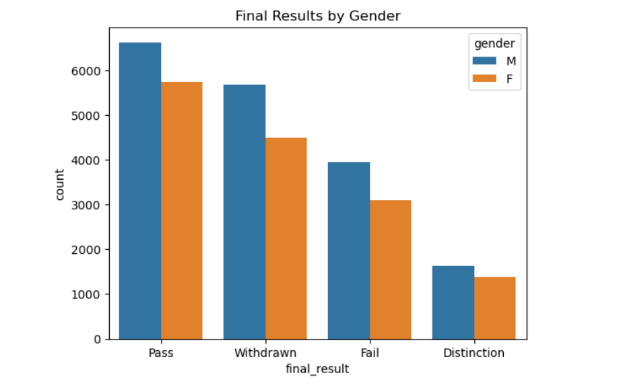
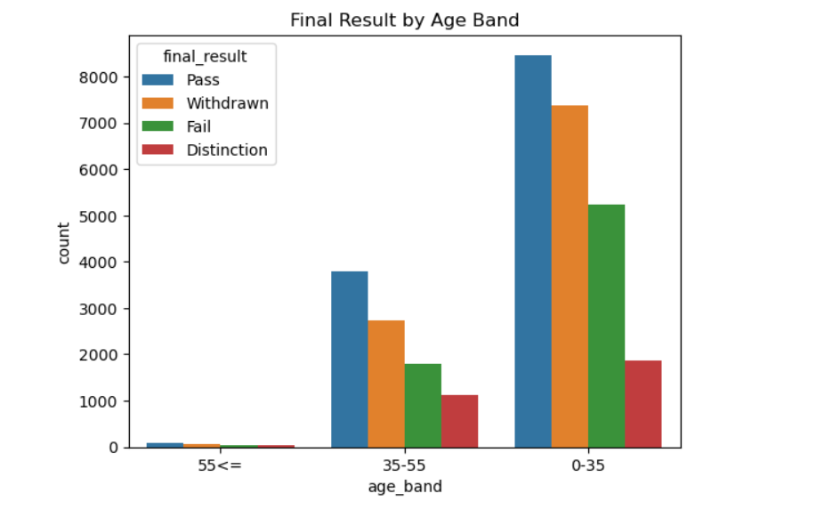
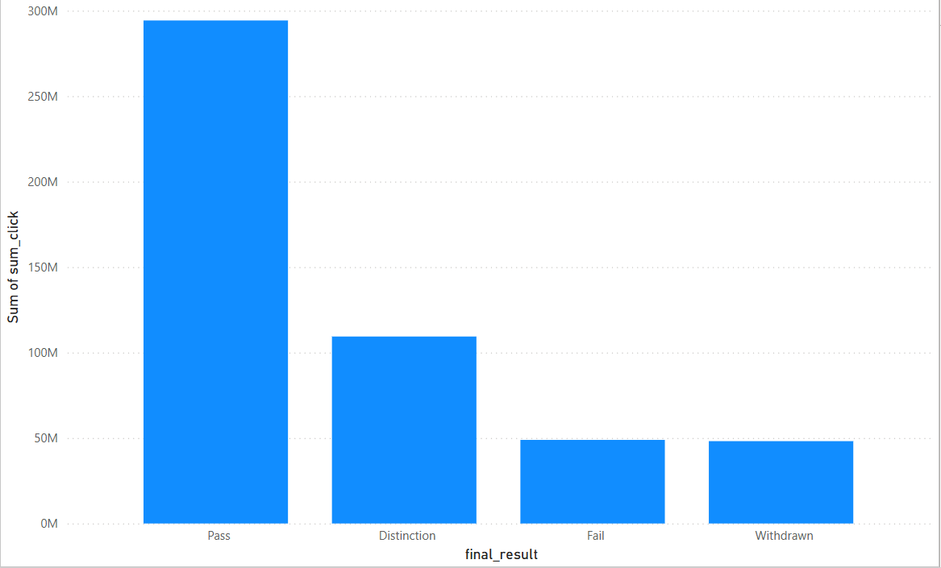
📊 Power BI Dashboard
Interactive dashboards were created using final_dataset.csv to visualize key insights.

Slide 9
✅ Reference & GitHub
Dataset: Academic Performance in Online Learning - Figshare
GitHub: Repository link
Pwer BI Visuals: Stored on Google Drive

