Slide 1
What Can Machine Learning Predict in NASDAQ Markets?
Price, Direction and Volatility Forecasting Across Models and Timeframes
Alessandro Pacifici
AI, Machine Learning and Big Data for Finance and Management · Waseda University
Final report · November 2026 · E-mini Nasdaq-100 futures (NQ), 2006–2025

Slide 2
Executive Summary
Exploratory results: next-candle volatility is clearly predictable; for returns and direction no useful improvement was shown
Problem
Market moves are hard to forecast, but not every characteristic of the market need be equally hard. Which one — the next return, the next candle's direction or the next candle's realized volatility — can machine learning actually predict?
Method
Nasdaq-100 futures (NQ), 1-minute data 2006–2025, rebuilt into 5 candle lengths (5 min to 1 day). 15 models, from naive benchmarks to deep networks and Mistral's Timestral, trained on 2006–2017, tuned and selected on 2017–2021, tested on 2021–2025 (a period already examined in earlier phases of the project).
Innovation
One pipeline, one data set and one test period for three different targets: the same models are compared across tasks and timeframes, so the answer to "what is predictable" does not depend on a different set-up per task.
Main findings (exploratory)
Volatility: ML removes +40% (5 min) and +52% (1 hour) of persistence's log-RV error and +6.8% / +26.1% of HAR-OLS's; RV UP/DOWN accuracy 72.2% vs 51.1% (5 min); 74.8% vs 47.7% (1 hour). Return: no improvement over forecasting zero demonstrated (R² −0.04%). Direction: 50.59% vs 49.90% majority (DNN 256-128-64-32, 5 min), but Long & Short −$515.9k after $2.50 costs. Timestral (Mistral): frozen weights beat no benchmark; with calibration, volatility beat persistence only at 5 min.
Usefulness
Volatility forecasts serve risk limits, position sizing, stop distances and volatility-sensitive decisions (e.g. whether to hold long or short straddles). Direction and return forecasts at this horizon are too weak to support trading after costs.
Conclusion
Realized volatility is the most predictable characteristic in this study. For returns and direction no useful improvement was demonstrated with the models, data and horizons tried. Exploratory: the test period had been examined before, and the volatility selection score was revised after first test results were seen.

Slide 3
Data & Methodology
One instrument, five candle lengths, three targets, one chronological split
NASDAQ historical data
NQ 1-min, 2006–2025
Feature engineering
lags, momentum, volatility, time of day
Models
benchmarks · ML · DNN · Timestral
Forecasts
for candle t+1
Out-of-sample evaluation
test from 2021-07 (exploratory)
Three targets, all for the next candle (t+1), decided at the close of t
Candles per timeframe (rows with a valid next candle)
Target | Definition | Evaluated with
1 Next return | r = log(C(t+1)/C(t)), regression | MAE, RMSE, out-of-sample R² vs zero forecast
2 Next-candle direction | UP if C(t+1) > O(t+1); doji kept, counts as a miss | accuracy, balanced accuracy, F1 vs majority class
3 Future realized volatility | RV = Σ (1-min log returns)² inside candle t+1 | log-RV error (R²) vs persistence; RV UP if RV(t+1) > RV(t)
Candle | Train: rows, sessions | Validation | Test
5 min | 769,058 2006-01-10 → 2017-08-24 | 269,167 2017-08-25 → 2021-07-14 | 273,340 2021-07-15 → 2025-05-30
15 min | 263,691 2006-01-10 → 2017-08-24 | 88,336 2017-08-25 → 2021-07-14 | 90,189 2021-07-15 → 2025-05-30
30 min | 132,606 2006-01-10 → 2017-08-24 | 44,513 2017-08-25 → 2021-07-14 | 44,395 2021-07-15 → 2025-05-30
1 hour | 64,813 2006-01-10 → 2017-08-24 | 21,642 2017-08-25 → 2021-07-14 | 21,507 2021-07-15 → 2025-05-30
1 day | 1,991 2006-03-13 → 2017-08-23 | 822 2017-08-25 → 2021-07-13 | 642 2021-07-15 → 2025-01-30
Instrument: E-mini Nasdaq-100 futures (NQ, CME), back-adjusted continuous series, $20 per point. No QQQ, MNQ, cash index or VIX.
Leakage control: features use candles ≤ t only; scaling fitted on training data; labels never cross a session or a split boundary (purged).
Selection: hyper-parameters, early stopping and the five configurations chosen with validation data. The volatility score was revised after first test numbers were seen, so the selection is not blind; the test period was also examined in earlier phases: results are exploratory.
Features (23): past returns and momentum, rolling volatility, range, body, wicks, RSI, moving-average gaps, relative volume, time of day, and log realized variance of the last 1, 5 and 22 candles plus the same time slot on the 5 previous sessions. Timestral sees only the last 512 closes. 1-minute candles excluded: their realized variance would be a single squared return.

Slide 4
All Models Tested
15 models on 5 timeframes: 150 model–timeframe–task configurations, all run on the same data
Family | Model | Method | Tasks
Baselines | Zero return / training mean | naive forecast | R
 | Majority class | always the most frequent training class | D
 | Persistence | RV(t+1) = RV(t) | V
 | Rolling mean (22 candles) | average past variance | V
Statistical | HAR-OLS | linear regression on past log RV (1, 5, 22 candles, same time slot) | V
 | Ridge regression | L2-penalised linear, α chosen on validation | R · V
 | Logistic regression | L2-penalised, C chosen on validation | D
Machine learning | Random forest | 200 trees, depth 8 | R · D · V
 | XGBoost | gradient boosting, depth 4, early stopping | R · D · V
Deep learning | DNN 64-32-16 (original) | feed-forward, ReLU, AdamW, early stopping | R · D · V
 | DNN 64-32 |  | R · D · V
 | DNN 128-64-32 |  | R · D · V
 | DNN 256-128-64-32 |  | R · D · V
Mistral AI | Timestral-5M, frozen weights | zero-shot quantiles of the next close from 512 past closes; median → return; direction = median vs last close (target: next candle's body) | R · D
 | Timestral-5M + supervised calibration | q10–q90 spread → log RV via a linear map fitted on validation targets (on validation: fitted on earlier sessions only) | V
Notes
R return · D direction · V volatility
Mistral's role: Timestral is a time-series foundation model (local weights, no API, no training here). It is not a language model and it does not read news. Scored on 20,000 random validation and 20,000 test origins per timeframe (all daily ones).
Timestral outcome: frozen weights beat no benchmark on any timeframe (return, direction); the calibrated volatility variant beat persistence only at 5 min. Neither is among the five; per-timeframe numbers in the report tables.
Considered, not run: LSTM (the feature networks reach their early-stopping optimum within a few epochs). Timestral 28M / 123M / 209M: weights available locally, not tested in this study.
Not used: Mistral chat / LLM API — no such integration exists in the repository.

Slide 5
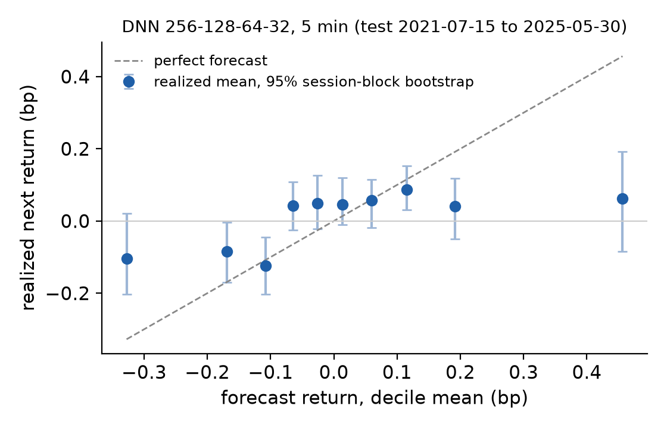
Price / Return Forecasting
No improvement over the zero-return forecast demonstrated with the models, data and horizons tried
# | Model, timeframe | MAE (bp) | RMSE (bp) | RMSE zero (bp) | R² vs zero | 95% interval | Sign right
1 | DNN 256-128-64-32, 5 min | 4.49 | 7.71 | 7.71 | −0.043% | [−0.103%, +0.016%] | 51.3%
Result: DNN 256-128-64-32, 5 min: R² −0.043%, interval not distinguishable from zero. A positive R² would mean a smaller squared error than always forecasting zero.
Predicted vs realized (right): realized returns per forecast decile. The forecasts span less than ±0.5 bp, while a typical candle moves about 7.7 bp (RMSE): the signal is buried in noise.
Economic reading: no usable return signal was found with the models, data and horizons tried. This is consistent with near-random-walk returns at these horizons, but does not prove it. All return models and Timestral were run on all five timeframes (inventory, slide 4).
bp = basis point = 0.01%. R² interval: model and zero-forecast errors resampled together in 20-session blocks, ratio recomputed per replicate. Decile bars: 20-session block bootstrap within each decile. Test 2021-07-15 → 2025-05-30 (exploratory: examined in earlier project phases).

Slide 6
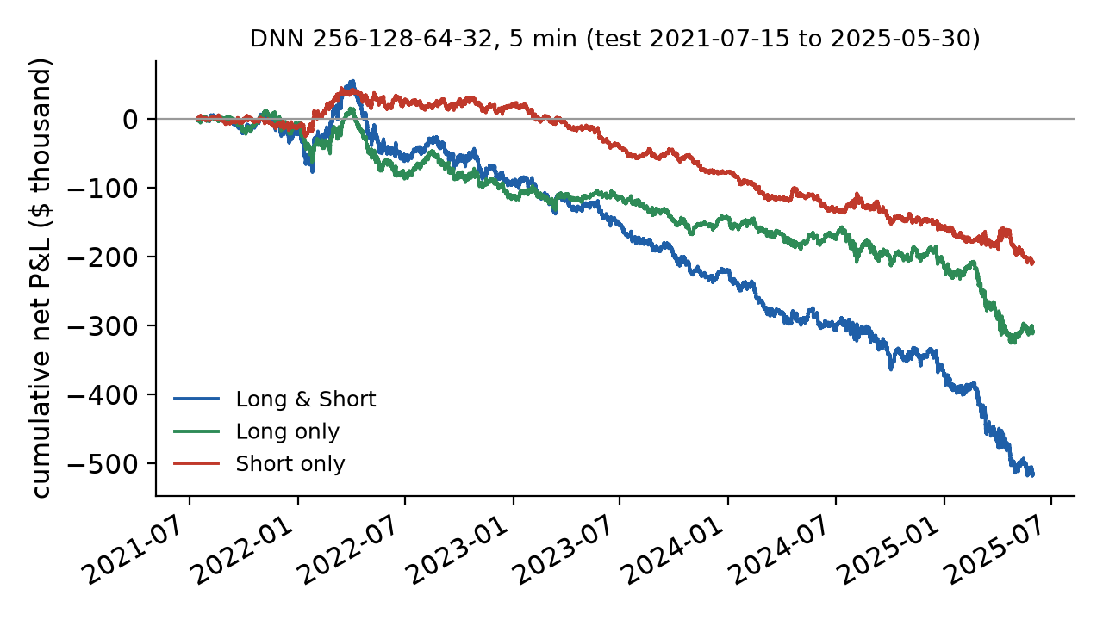
Direction Classification & Trading
Slightly better than the majority class, but the edge per trade is smaller than the commission
# | Model, timeframe | Accuracy | Balanced acc. | Majority | Gain | 95% interval | F1 up
2 | DNN 256-128-64-32, 5 min | 50.59% | 51.37% | 49.90% | +0.69 pp | [+0.40, +0.98] | 0.559
3 | DNN 64-32, 15 min | 50.99% | 50.83% | 50.74% | +0.25 pp | [−0.07, +0.57] | 0.622
Confusion matrix, DNN 256-128-64-32, 5 min (non-doji test candles): predicted UP & was UP 82,434 · UP but DOWN 76,180 · DOWN & DOWN 55,837 · DOWN but UP 53,956; dojis 4,933.
Trading rule, DNN 256-128-64-32, 5 min: UP → long, DOWN → short, next open → close
Strategy | Trades | Net P&L | Win rate | Profit factor | Max DD | Net / trade | Net at $5
Long & Short | 273,340 | −$515.9k | 50.6% | 0.98 | −$573.7k | −$1.89 | −$1.20M
Long only | 161,587 | −$307.7k | 51.0% | 0.98 | −$341.0k | −$1.90 | −$711.6k
Short only | 111,753 | −$208.3k | 50.0% | 0.98 | −$256.1k | −$1.86 | −$487.7k
Reading: accuracy gain +0.69 pp (interval above zero). Before costs Long & Short earns +$167.4k on 273,340 trades, $0.61 per trade; the $2.50 round trip turns it into −$515.9k.
Accuracy ≠ profit: with moves of size W, a hit rate p earns (2p − 1)·W − cost per trade; at p ≈ 51% and a 5-minute W of a few points the edge is cents, the cost is dollars. Fills are idealised.
Trading: idealised fills at the next open, zero latency, 100% fills, zero slippage, $2.50 per round trip, 1 NQ = $20/point

Slide 7
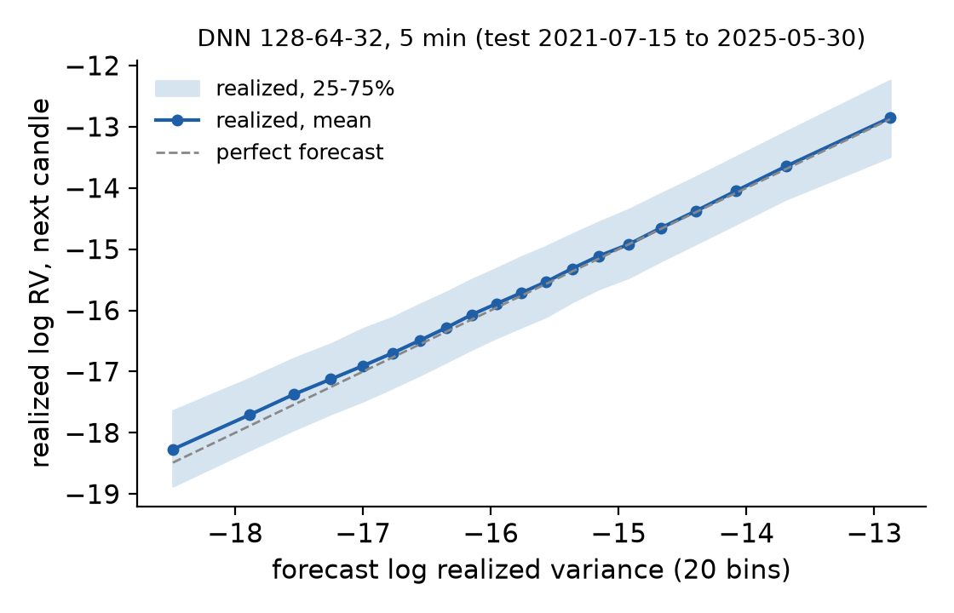
Volatility Forecasting
Large gain over persistence, smaller but positive gain over the HAR-OLS benchmark (exploratory)
# | Model, timeframe | RMSE log RV | Persist. | HAR-OLS | R² vs persistence | R² vs HAR-OLS | RV dir. acc. | Balanced | Majority | HAR dir. acc. | Dir. gain vs HAR
4 | DNN 128-64-32, 5 min | 0.901 | 1.163 | 0.933 | +40.0% [+39.5, +40.4] | +6.8% [+6.2, +7.3] | 72.2% | 72.0% | 51.1% | 71.0% | +1.13 pp [+0.95, +1.31]
5 | XGBoost, 1 hour | 0.572 | 0.825 | 0.666 | +52.0% [+50.0, +54.1] | +26.1% [+23.8, +28.5] | 74.8% | 75.1% | 47.7% | 70.5% | +4.28 pp [+3.53, +4.88]
Method: realized variance of the next candle from its 1-minute squared log returns (r² is a variance proxy; volatility = √variance). Models forecast log RV; R² = share of the benchmark's squared log-RV error removed. QLIKE check, model / HAR / persistence: 0.455 / 0.477 / 1.258; 0.264 / 0.275 / 0.559.
Two benchmarks: persistence is naive; HAR-OLS already captures clustering, mean reversion and the time-of-day pattern (RV direction 71.0% / 70.5%). The gain vs HAR, not vs persistence, is what ML adds.
Options (qualitative): rising realized volatility favours long straddles / strangles, falling favours short ones; but option prices embed IMPLIED volatility, so a correct realized-volatility forecast is not a profitable options trade. No option prices or P&L were computed.
Selection score: initially QLIKE vs persistence; revised to log-RV squared error after first test numbers were printed (QLIKE was dominated by a few limit-locked March 2020 candles): not blind. R² intervals: model and benchmark errors resampled together in 20-session blocks; direction gains: paired block bootstrap.

Slide 8
Which NASDAQ Market Characteristic Is Most Predictable?
Five configurations chosen with validation data (volatility score revised after a first look at test results), scored on the exploratory test
ID | Task | Model | Timeframe | Key metric (test) | Baseline | Improvement [95% interval]
1 | Return | DNN 256-128-64-32 | 5 min | RMSE 7.71 bp | Zero return: RMSE 7.71 bp | R² -0.04% [-0.10, +0.02]
2 | Direction | DNN 256-128-64-32 | 5 min | Accuracy 50.59% | Majority: 49.90% | +0.69 pp [+0.40, +0.98]
3 | Direction | DNN 64-32 | 15 min | Accuracy 50.99% | Majority: 50.74% | +0.25 pp [-0.07, +0.57]
4 | Volatility | DNN 128-64-32 | 5 min | log-RV RMSE 0.901; RV UP/DOWN 72.2% | Persistence 1.163; majority 51.1%; HAR 0.933, 71.0% | vs persistence R² +40.0% [+39.5, +40.4]; vs HAR R² +6.8% [+6.2, +7.3], RV dir. +1.13 pp
5 | Volatility | XGBoost | 1 hour | log-RV RMSE 0.572; RV UP/DOWN 74.8% | Persistence 0.825; majority 47.7%; HAR 0.666, 70.5% | vs persistence R² +52.0% [+50.0, +54.1]; vs HAR R² +26.1% [+23.8, +28.5], RV dir. +4.28 pp
Strongest return approach
DNN 256-128-64-32, 5 min: R² −0.043%, not distinguishable from zero: no improvement over zero demonstrated with the models, data and horizons tried.
Strongest direction approach
DNN 256-128-64-32, 5 min: +0.69 pp over the majority class, interval above zero; Long & Short −$515.9k after $2.50 per round trip.
Strongest volatility approach
log-RV R² vs persistence / vs HAR-OLS: DNN 128-64-32, 5 min +40% / +6.8%; XGBoost, 1 hour +52% / +26.1%. RV direction above HAR by +1.13 pp / +4.28 pp.
Exploratory verdict: realized volatility is the most predictable characteristic. Its gain is large over persistence and smaller but positive over HAR-OLS, with intervals above zero on both selected timeframes. For returns no improvement over zero was demonstrated; the direction gain is under one percentage point and loses money after costs. Metrics differ by task, so the ranking rests on benchmark-relative gains and their uncertainty. Exploratory: test period examined before, volatility score revised after a first look.
Originality one pipeline for three targets, five timeframes, classical, deep and foundation models. Usefulness volatility forecasts for risk and sizing; no trading edge claimed. Feasibility runs on a laptop CPU, free local models, reproducible from the repository.

