Slide 1
What Can Machine Learning Predict in NASDAQ Markets?
Price, Direction and Volatility Forecasting Across Models and Timeframes
Alessandro Pacifici
AI, Machine Learning and Big Data for Finance and Management · Waseda University
Final report · November 2026 · E-mini Nasdaq-100 futures (NQ), 2006–2025

Slide 2
Executive Summary
Volatility is predictable from 5 minutes to 1 hour (daily: filtered sample only); returns and direction show no useful improvement
Problem Markets are hard to forecast, but are all their characteristics equally hard? For the next NQ futures candle we ask what machine learning can predict: the return, the direction or the realized volatility.
Volatility
PREDICTABLE
Direction
MARGINAL
Return
NOT DEMONSTRATED
−40%
+0.69 pp
R² −0.04%
squared log-RV forecast error vs persistence (DNN 128-64-32, 5 min)
accuracy over the majority class: 50.59% vs 49.90% (5 min)
vs forecasting zero, 95% interval [−0.10%, +0.02%] (5 min)
vs the HAR-OLS benchmark: −6.8% at 5 min, −26% at 1 hour; rise or fall right 72% (majority 51%)
≈ 7 extra right calls per 1,000 candles; seen in 2021–2023, not in 2024–2025; smaller or nil on longer candles
No statistically supported improvement over the zero-return forecast was demonstrated on any candle length (5 min to 1 day)
Why: volatility clusters, returns do not
Data & method
NQ futures, 1-minute data 2006–2025, 5 candle lengths (5 min–1 day); 15 models, benchmarks to deep networks and Mistral's Timestral. Train 2006–17, choose 2017–21, test 2021–25.
Originality
Experimental: one pipeline and test period for three targets and five horizons, compared like for like. Applied: ML and a new foundation model against the classical HAR benchmark.
Usefulness
Volatility forecasts are inputs to risk limits and position sizing; the study shows on which horizons ML adds to HAR, and where it adds nothing.
Implication
Use ML for realized volatility, not for next-candle returns or direction, with the models, data and horizons tried.
Exploratory: the test period (2021-07 → 2025-05; daily: 642 of 1,002 sessions, turbulent periods under-represented) was examined in earlier phases and the volatility selection score was revised after a first look at test results. Statistical accuracy only: no trading, costs or profitability were evaluated. pp = percentage points, bp = 0.01%, RV = realized variance.

Slide 3
Data & Methodology
One instrument, five candle lengths, three targets, one chronological split
NASDAQ historical data
NQ 1-min, 2006–2025
Feature engineering
lags, volatility, time of day
Models
benchmarks · ML · DNN · Timestral
Forecasts
for candle t+1
Out-of-sample evaluation
test from 2021-07 (exploratory)
Three targets for the next candle (t+1), decided at the close of t
Data profile, test sample
Target | Definition | Main metric
1 Next return | r = log(C(t+1)/C(t)) | R² vs the zero forecast
2 Next-candle direction | UP if C(t+1) > O(t+1); doji = miss | accuracy vs the majority class
3 Realized volatility | RV = Σ (1-min log returns)² in t+1 | log-RV error vs persistence and HAR-OLS
Candle | Test rows | UP / DOWN | ACF return | ACF log RV
5 min | 273k | 50% / 48% | −0.005 | +0.75
15 min | 90k | 51% / 48% | +0.003 | +0.84
30 min | 44k | 51% / 48% | −0.002 | +0.84
1 hour | 22k | 52% / 48% | −0.000 | +0.83
1 day | 642 | 54% / 46% | −0.001 | +0.81
Data: E-mini Nasdaq-100 futures (NQ, CME), back-adjusted 1-minute series. No other market, no VIX.
Split: train → 2017-08-24, validation → 2021-07-14, test 2021-07-15 → 2025-05-30 (daily: 642 of 1,002 test sessions after the flagged-bar filter; appendix A3).
No look-ahead: features use candles ≤ t; scaling fitted on training data; intraday labels stay within a session; all labels respect split boundaries.
Uncertainty: 95% intervals from a moving-block bootstrap in 20-session blocks (Künsch, 1989).
Reading: candle direction is close to a coin flip; the lag-1 autocorrelation (ACF) of returns is about zero (−0.005 to +0.003), while log realized variance is strongly persistent (0.75 to 0.84).
23 features: past returns, momentum, rolling volatility, candle shape, RSI, moving-average gaps, volume, time of day, past log RV (1, 5, 22 candles). Timestral sees the last 512 closes.

Slide 4
What Is Predictable, and on Which Horizon?
Volatility beats persistence on every candle length (daily: filtered sample); its gain over HAR-OLS grows up to 1 hour
Task / metric (test) | 5 min 273k candles | 15 min 90k candles | 30 min 44k candles | 1 hour 22k candles | 1 day (filtered) 642 of 1,002 sessions
Return R² vs zero (%) | −0.04% [−0.10, +0.02] DNN 256-128-64-32 | −0.01% [−0.07, +0.04] XGBoost | +0.00% [−0.02, +0.02] XGBoost | −0.01% [−0.06, +0.04] DNN 128-64-32 | −1.95% [−6.11, +1.73] XGBoost
Direction accuracy gain vs majority (pp) | +0.69 pp [+0.40, +0.98] DNN 256-128-64-32 | +0.25 pp [−0.07, +0.57] DNN 64-32 | +0.16 pp [−0.12, +0.38] DNN 256-128-64-32 | +0.26 pp [−0.08, +0.55] XGBoost | −0.78 pp [−1.52, +0.00] DNN 128-64-32
Volatility squared log-RV error cut vs persistence (%) | +40.0% [+39.5, +40.4] DNN 128-64-32 | +36.5% [+35.1, +37.7] DNN 256-128-64-32 | +42.6% [+40.8, +44.3] DNN 256-128-64-32 | +52.0% [+50.0, +54.1] XGBoost | +18.7% [+9.7, +24.5] DNN 128-64-32
Volatility squared log-RV error cut vs HAR-OLS (%) | +6.8% [+6.2, +7.3] DNN 128-64-32 | +10.3% [+8.8, +11.6] DNN 256-128-64-32 | +16.7% [+14.5, +18.7] DNN 256-128-64-32 | +26.1% [+23.8, +28.5] XGBoost | +7.6% [−0.9, +14.6] DNN 128-64-32
95% interval above zero
interval includes zero
interval below zero
Each cell: the trained model with the highest validation z for that task and candle length, scored on the test.
Volatility: every candle length beats persistence (squared log-RV error 19% to 52% lower). The extra gain over HAR-OLS rises from 6.8% (5 min) to 26.1% (1 hour); daily: the interval includes zero.
Return and direction: no interval is above zero except 5-minute direction (+0.69 pp).
Daily caveat 1 day = filtered sample: 642 of 1,002 test sessions. The 304 sessions within 50 sessions after a session with a flagged 1-minute bar are excluded, so turbulent periods are under-represented; daily results are exploratory and hold for this filtered sample only (appendix A3).

Slide 5
All Models Tested
15 models on 5 timeframes: 150 model–timeframe–task configurations, all run on the same data
Family | Model | Method | Tasks
Baselines | Zero return / training mean | naive forecast | R
 | Majority class | most frequent training class | D
 | Persistence · rolling mean (22) | RV(t+1) = RV(t) · average past variance | V
Statistical | HAR-OLS | regression on past log RV (1, 5, 22 candles) — Corsi (2009) | V
 | Ridge / logistic regression | L2-penalised, strength chosen on validation | R · D · V
Machine learning | Random forest | 200 trees, depth 8 | R · D · V
 | XGBoost | gradient boosting, early stopping | R · D · V
Deep learning | DNN: 64-32-16 · 64-32 · 128-64-32 · 256-128-64-32 | feed-forward, ReLU, AdamW, early stopping | R · D · V
Mistral AI | Timestral-5M, frozen weights | pretrained forecaster of the next close (zero-shot) | R · D
 | Timestral-5M + calibration | forecast spread → log RV, linear map fitted on validation | V
Notes
R return · D direction · V volatility
Mistral's role: Timestral is a pretrained time-series model (local weights, no API); it is not a language model and reads no text.
Not run: LSTM; larger Timestral sizes (28M–209M).
Every fit and hyper-parameter: reports/multitarget_final/models.csv.

Slide 6
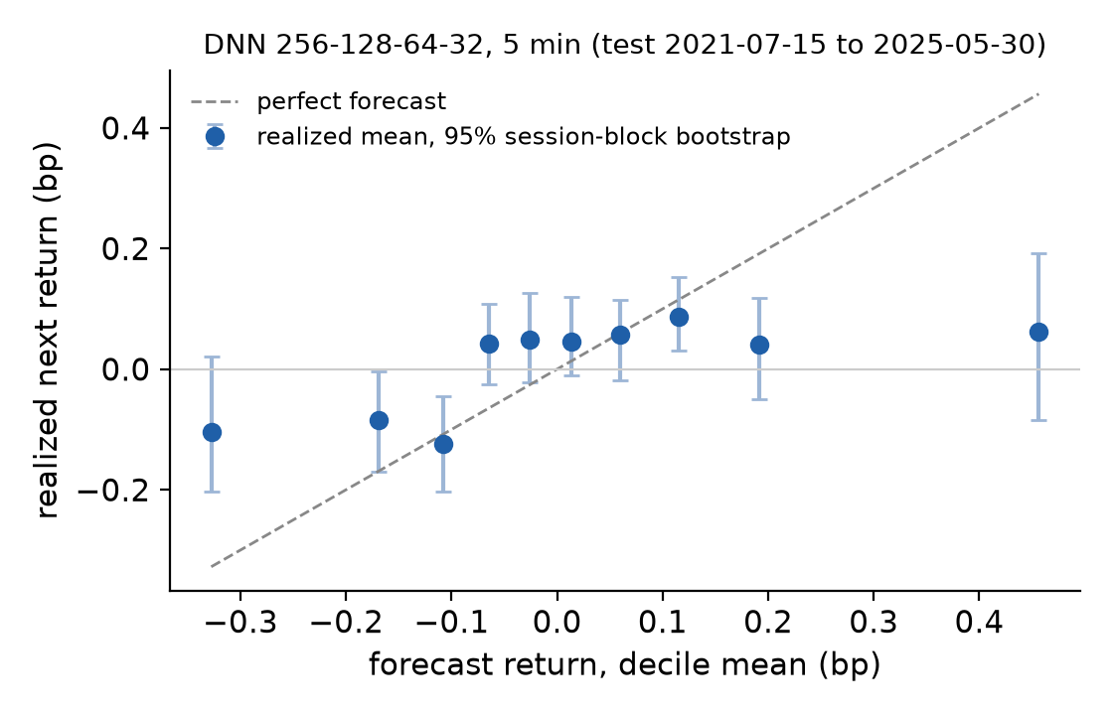
Price / Return Forecasting
Five models on 5 min candles: none improves on the zero-return forecast
# | Model | Val. z | RMSE bp | R² vs zero | 95% interval (%) | Sign right
1 | DNN 256-128-64-32 | 3.1 | 7.71 | −0.04% | [−0.10, +0.02] | 51.3%
2 | XGBoost | 2.5 | 7.71 | +0.00% | [−0.02, +0.02] | 51.2%
3 | Ridge | 0.8 | 7.71 | −0.03% | [−0.09, +0.03] | 51.2%
4 | Random forest | 0.1 | 7.71 | −0.05% | [−0.09, −0.02] | 51.2%
5 | Timestral-5M (frozen weights) * | -4.3 | 7.91 | −2.55% | [−3.43, −1.62] | 50.2%
Benchmark (zero-return forecast): RMSE 7.71 bp on all 5 min test candles. * Timestral: scored on its fixed random sample of 20,000 test candles (its benchmark on the same candles; appendix A4).
Result: the best R² is +0.00%; every interval includes or lies below zero, so no model beats "the next return is zero". The same holds on all five candle lengths (slide 4).
Predicted vs realized (right, #1): realized return per forecast decile: forecasts span less than ±0.5 bp while a typical candle moves about 7.7 bp.
Reading: linear, tree, deep and foundation models fail in the same way: no usable return signal with the models, data and horizons tried (consistent with, but not proof of, a random walk).
Rows ranked by validation evidence z (validation improvement over the task's naive benchmark ÷ its block-bootstrap standard error); all other columns are test results. R² interval: model and zero-forecast errors resampled together. Test 2021-07-15 → 2025-05-30.

Slide 7
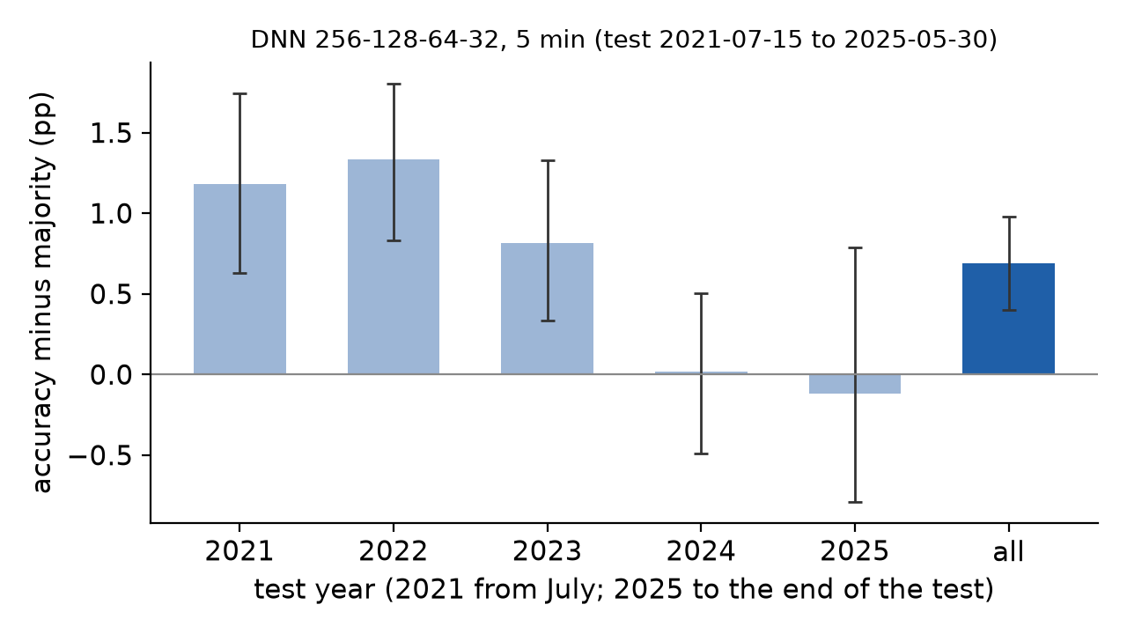
Next-Candle Direction Classification
Five models on 5 min candles: 4 of 5 beat the majority class, by less than one percentage point
# | Model | Val. z | Accuracy | Majority | Gain | 95% interval | Balanced acc. | F1 UP
1 | DNN 256-128-64-32 | 11.9 | 50.59% | 49.90% | +0.69 pp | [+0.40, +0.98] | 51.37% | 0.559
2 | Random forest | 11.0 | 50.52% | 49.90% | +0.62 pp | [+0.32, +0.91] | 51.36% | 0.541
3 | Logistic | 11.0 | 50.40% | 49.90% | +0.50 pp | [+0.24, +0.77] | 51.23% | 0.542
4 | XGBoost | 10.7 | 50.47% | 49.90% | +0.58 pp | [+0.27, +0.89] | 51.34% | 0.535
5 | Timestral-5M (frozen weights) * | -1.9 | 49.25% | 49.84% | −0.59 pp | [−1.65, +0.45] | 50.10% | 0.517
* Timestral: scored on its fixed random sample of 20,000 test candles (its benchmark on the same candles; appendix A4). Accuracy counts dojis (open = close) as misses.
#1 DNN 256-128-64-32: confusion matrix (test)
 | Actual UP | Actual DOWN
Predicted UP | 82,434 (30.7%) | 76,180 (28.4%)
Predicted DOWN | 53,956 (20.1%) | 55,837 (20.8%)
Size: +0.69 pp ≈ 7 more right calls per 1,000 candles. Tree, linear and deep models are within a few tenths of each other; Timestral does not beat the majority class.
Stability of #1 by test year: gain above zero in 2021, 2022, 2023; interval includes zero in 2024, 2025.

Slide 8
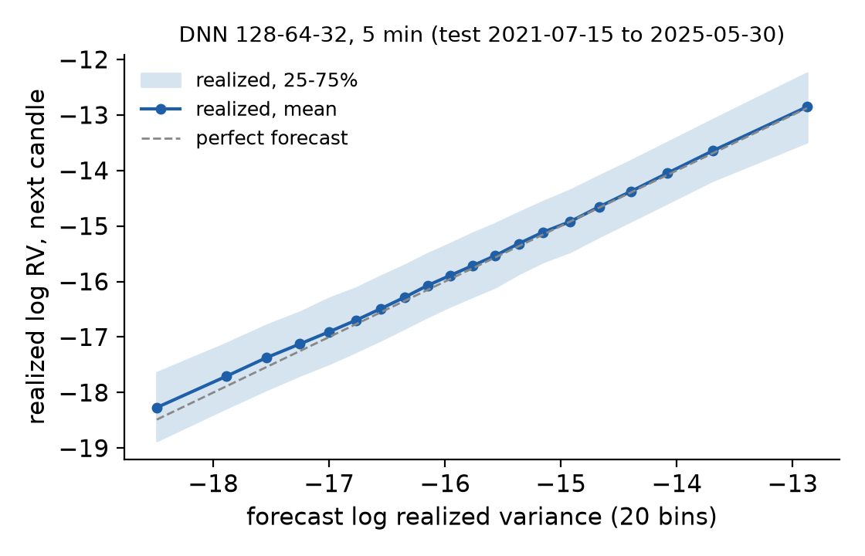
Volatility Forecasting
Five models on 5 min candles: all beat persistence; tree and deep models also beat the HAR-OLS benchmark
# | Model | Val. z | Error cut vs persistence [95%] | Error cut vs HAR-OLS [95%] | RMSE log RV | RV up/down right | Up/down vs HAR-OLS [95%]
1 | DNN 128-64-32 | 44.0 | +40.0% [+39.5, +40.4] | +6.8% [+6.2, +7.3] | 0.901 | 72.2% | +1.13 pp [+0.95, +1.31]
2 | XGBoost | 42.4 | +42.0% [+41.5, +42.4] | +9.9% [+9.4, +10.3] | 0.885 | 72.8% | +1.71 pp [+1.52, +1.88]
3 | Random forest | 27.4 | +37.1% [+36.5, +37.6] | +2.3% [+1.7, +2.8] | 0.922 | 71.4% | +0.37 pp [+0.25, +0.50]
4 | Ridge | 23.1 | +35.7% [+34.9, +36.3] | +0.1% [−0.9, +0.9] | 0.932 | 70.8% | −0.27 pp [−0.51, −0.05]
5 | Timestral-5M + calibration * | 6.4 | +12.2% [+9.7, +14.8] | −35.9% [−38.8, −33.2] | 1.087 | 67.7% | −3.36 pp [−4.02, −2.71]
Benchmarks on all 5 min test candles: persistence (next RV = current RV) RMSE 1.163, up/down majority 51.1%; HAR-OLS RMSE 0.933, up/down 71.0%. * Timestral: scored on its fixed random sample of 20,000 test candles (its benchmark on the same candles; appendix A4).
Metric: "error cut" = reduction of the squared log-RV forecast error vs a benchmark (an out-of-sample R²). For #1 it is 40.0% vs persistence; the RMSE itself falls by 22.5% (0.901 vs 1.163).
HAR-OLS is the bar to clear: it already captures clustering and the time-of-day pattern, so the cut vs HAR-OLS (6.8% for #1) is what ML adds. On the test XGBoost (#2 by validation z) is slightly ahead.
Scope: realized volatility from 1-minute returns (Andersen & Bollerslev, 1998), not implied volatility; no option prices or option strategies were studied.
Rows ranked by validation evidence z (validation improvement over the task's naive benchmark ÷ its block-bootstrap standard error); all other columns are test results. Volatility score revised from QLIKE (Patton, 2011) to log-RV error after a first look at test numbers: not blind.

Slide 9
Which NASDAQ Market Characteristic Is Most Predictable?
Strongest evidence of improvement: 5 min realized volatility, DNN 128-64-32
How the configurations were ranked
STRONGEST EVIDENCE OF IMPROVEMENT (HIGHEST VALIDATION z)
1
Each model × timeframe is scored on VALIDATION data (2017–2021) by its improvement over its task's naive benchmark.
DNN 128-64-32 · 5 min realized volatility
z = that improvement ÷ its bootstrap standard error: the strength of evidence against that benchmark, not a common scale of usefulness across tasks.
−40.0%
squared log-RV forecast error vs persistence on the test, 95% interval [−40.4%, −39.5%]; validation z 44.0
2
3
The highest z wins within each task (slides 6–8); across tasks z only says where the evidence of beating the naive benchmark is strongest.
−6.8%
−22.5%
72.2%
4
Winners are then scored on the TEST block. The volatility score was revised after a first look at test numbers: the ranking is exploratory.
squared error vs HAR-OLS [−7.3, −6.2]
RMSE of log RV vs persistence (0.901 vs 1.163)
RV up/down right (majority 51.1%, HAR-OLS 71.0%)
Task | Task winner (validation) | Val. z | Test vs naive benchmark
Volatility | DNN 128-64-32, 5 min | 44.0 | +40.0% error cut vs persistence [+39.5, +40.4]
Direction | DNN 256-128-64-32, 5 min | 11.9 | +0.69 pp vs majority [+0.40, +0.98]
Return | DNN 256-128-64-32, 5 min | 3.1 | R² −0.04% vs zero [−0.10, +0.02]
On the test XGBoost (#2 by validation z) cuts the error slightly more (−42.0%); the ranking is kept as computed on validation, not re-chosen on the test. Longer candles show larger gains over HAR-OLS (up to −26.1% at 1 hour, slide 4).
Implications: realized volatility is the most predictable characteristic here, useful as an input to risk limits and sizing; for returns no improvement was demonstrated, and the direction gain is small and fades after 2023. Limits: exploratory test; one market; daily results on a filtered sample (turbulent sessions under-represented); statistical accuracy only — commissions, spread and latency were not modelled, so economic value (e.g. of a +0.69 pp direction gain) is unknown.

Slide 10
Reproducibility & References
Every table, chart and slide is regenerated from code in the repository; the licensed NQ data are not published
Code, results and this deck
https://github.com/Paciooo/Project_ai_ML_bigdata · branch main
How to reproduce (details: appendix A1)
References
Environment | Python 3.12 + requirements-lock.txt, Node.js 18+
Data | NQ 1-minute bars 2006–2025 (licensed, not in Git): set FUTURES_DATA_DIR
Run | multitarget.py → multitarget_report.py → verify_multitarget.py
Deck | presentation: npm ci; node build_deck.js
Andersen, T. G., & Bollerslev, T. (1998). Answering the skeptics: Yes, standard volatility models do provide accurate forecasts. International Economic Review, 39(4), 885–905.
Corsi, F. (2009). A simple approximate long-memory model of realized volatility. Journal of Financial Econometrics, 7(2), 174–196.
Künsch, H. R. (1989). The jackknife and the bootstrap for general stationary observations. Annals of Statistics, 17(3), 1217–1241.
Patton, A. J. (2011). Volatility forecast comparison using imperfect volatility proxies. Journal of Econometrics, 160(1), 246–256.
Mistral AI (2026). Timestral: time series foundation models. Announcement mistral.ai/news/timestral; code github.com/mistralai/timestral (commit a534bdb); weights huggingface.co/mistralai/Timestral-5M.
Checked: verify_multitarget.py recomputes every reported point estimate, the rankings and the deck data from the saved forecasts (0 problems); unit tests cover targets, timing, bootstrap and the Timestral calibration.
Not re-checked: the raw data, the training (not re-run) and the bootstrap intervals (order only).

