Slide 1

HONEYNET CAPSTONE
PROJECT
agricultureintech.net
Deploying, Monitoring & Analyzing Real-World Threats in a Live Honeynet
Pima Community College | Cybersecurity Capstone
1 / 20

Slide 2






WHAT WE'LL COVER
Infrastructure & Architecture
How we built the honeynet from scratch
Network Monitoring Pipeline
Full-packet capture with Security Onion, Suricata, Zeek & Arkime
Malware Infections
Kinsing + RondoDox — a Loader-as-a-Service delivery chain
Data at Scale
784K+ events, alert triage, and the importance of parsing tools
Challenges & Lessons
What we learned building this from zero as students
What's Next
Windows endpoint expansion and future research
2 / 20

Slide 3



THE MISSION
Design, deploy, and operate a live honeynet to attract, capture, and analyze real-world malware infections and exploitation attempts.
Infrastructure
Buildout
Network
Monitoring
Incident
Response
Malware
Analysis
3 / 20

Slide 4




INFRASTRUCTURE
Physical Network & Datacenter
Internet
Palo Alto
3410
Juniper
EX4200
Proxmox
Server
Firewall
Switch
Virtualization
Palo Alto 3410 — wide open, no egress filtering. Full exposure by design.
SPAN/mirror port (ge-0/0/2 → ge-0/0/46) copying all honeypot traffic to Security Onion.
Single Proxmox host running Security Onion VM (60GB RAM) and honeypot webserver.
4 / 20

Slide 5
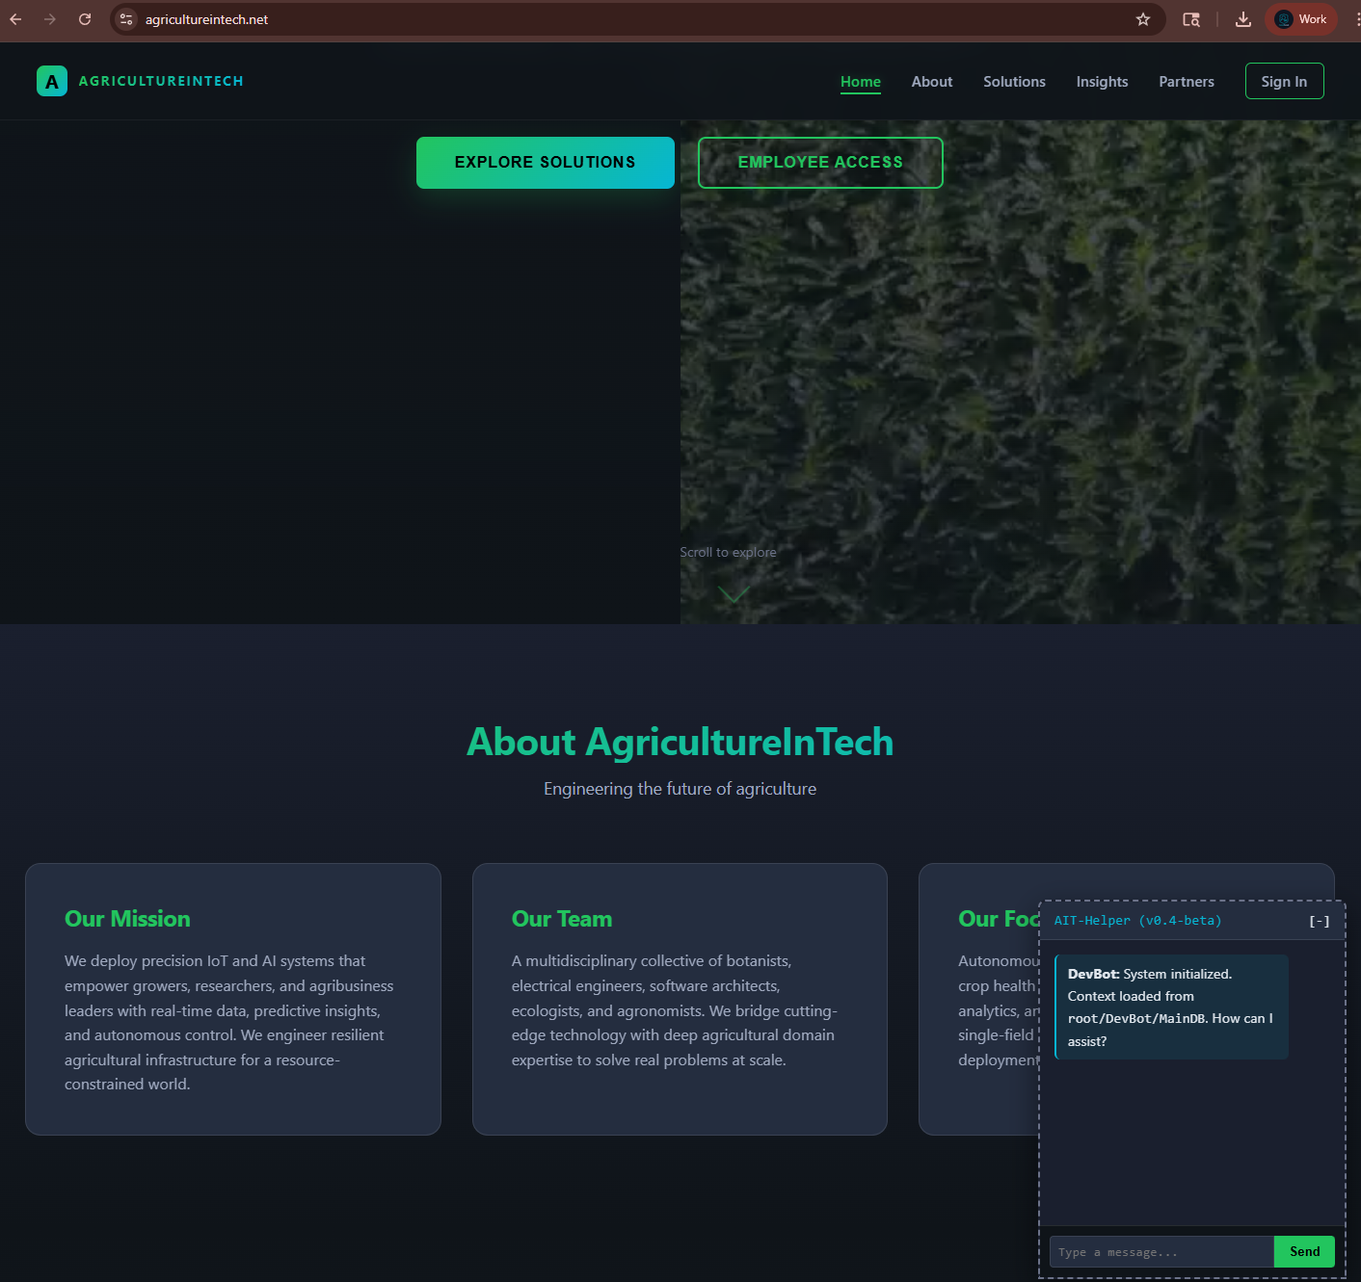
ATTACK SURFACE
Deliberately Exposed Services
Apache HTTPD
80 / 443
Web-facing honeypot
Apache ActiveMQ
61616 / 8161
CVE-2023-46604 RCE target
Jenkins
8081
Unauthenticated RCE exploits
Metabase
3000
Known attack surface
agricultureintech.net — Live Honeypot
5 / 20

Slide 6
MONITORING PIPELINE
Honeypot
Traffic
Juniper SPAN
Port Mirror
Proxmox Bridge
vmbr1 (Promisc)
Security Onion
ens19
▼
Suricata
Zeek
Arkime
ELK Stack
IDS/IPS Alerts
Connection Logs &
Protocol Analysis
Full Packet
Capture
Elasticsearch, Logstash
Kibana Dashboards
6 / 20

Slide 7
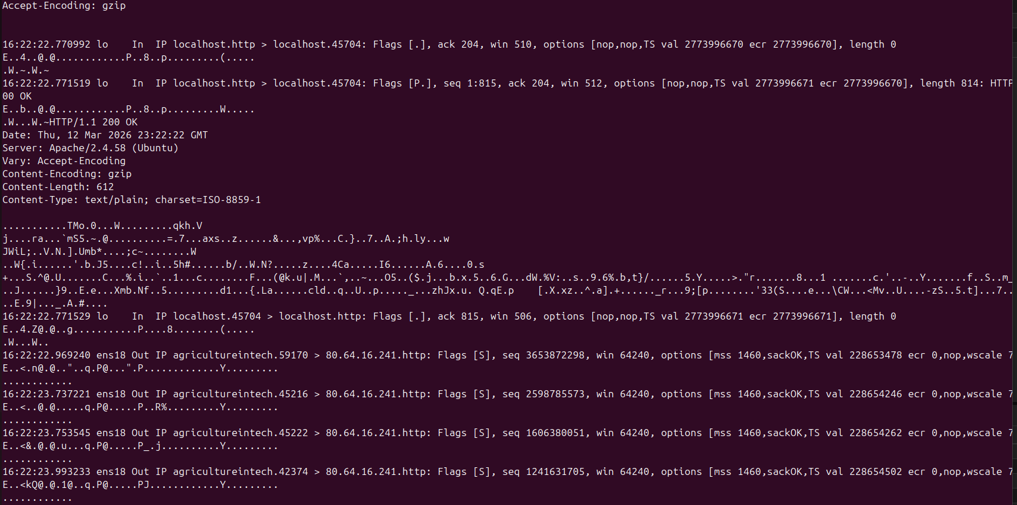
PACKET CAPTURE
Live Traffic Analysis via Arkime
Raw packet data showing HTTP responses and outbound connections from the honeypot to attacker infrastructure
7 / 20

Slide 8

INITIAL RECONNAISSANCE
Before the Vulnerable Services Were Even Deployed
CVE-2021-41773 / CVE-2021-42013
Apache Path Traversal
Directory traversal using single-encoded (%2e) and double-encoded (%%32%65) paths
Targeted /cgi-bin/../../bin/sh for remote shell access
IPs from Paris, Barcelona, and other global locations
Apache 2.4.58 blocked all attempts (AH10244: invalid URI path)
KEY TAKEAWAY
Automated bots found and started probing the honeypot within hours of it going live — before any vulnerable services were even deployed.
8 / 20

Slide 9
THE INFECTION CHAIN
Two malware families. One honeypot. A Loader-as-a-Service delivery chain.
KINSING
→
RONDODOX
Cryptominer + Rootkit
DDoS Botnet (Mirai)
9 / 20

Slide 10
KINSING
Cryptominer + Backdoor + Worm
Language
Go (Golang)
Known CVE Vectors
Payload
XMRig Monero Miner + Reverse Shell
CVE-2021-41773 (Apache Path Traversal)
CVE-2023-46604 (ActiveMQ RCE)
Log4Shell (Log4j RCE)
CVE-2022-0543 (Redis Lua Sandbox Escape)
Exposed Docker API
Persistence
Cron jobs, /etc/ld.so.preload rootkit
C2 Protocol
HTTP / HTTPS
Drop Locations
/tmp/, /var/tmp/, /dev/shm/
Filenames
kinsing, kdevtmpfsi
Successfully defanged and exfiltrated payload + libsystem.so rootkit
Behavior
Kills competing processes to protect mining resources — standard crypto-malware behavior
10 / 20

Slide 11
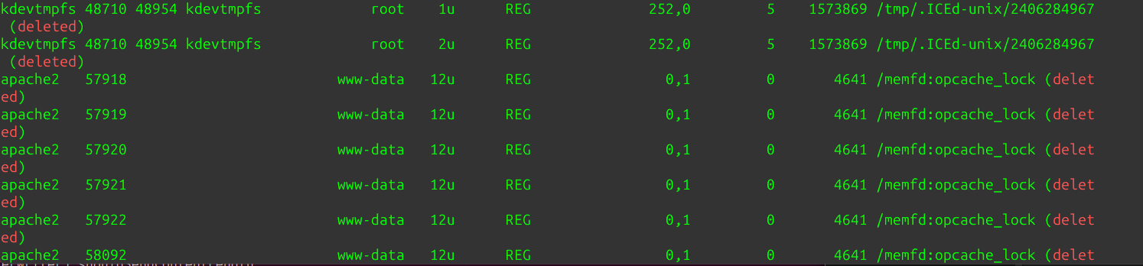
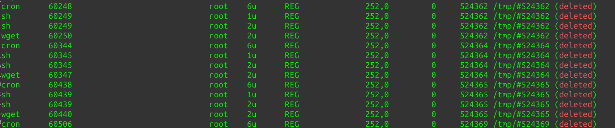
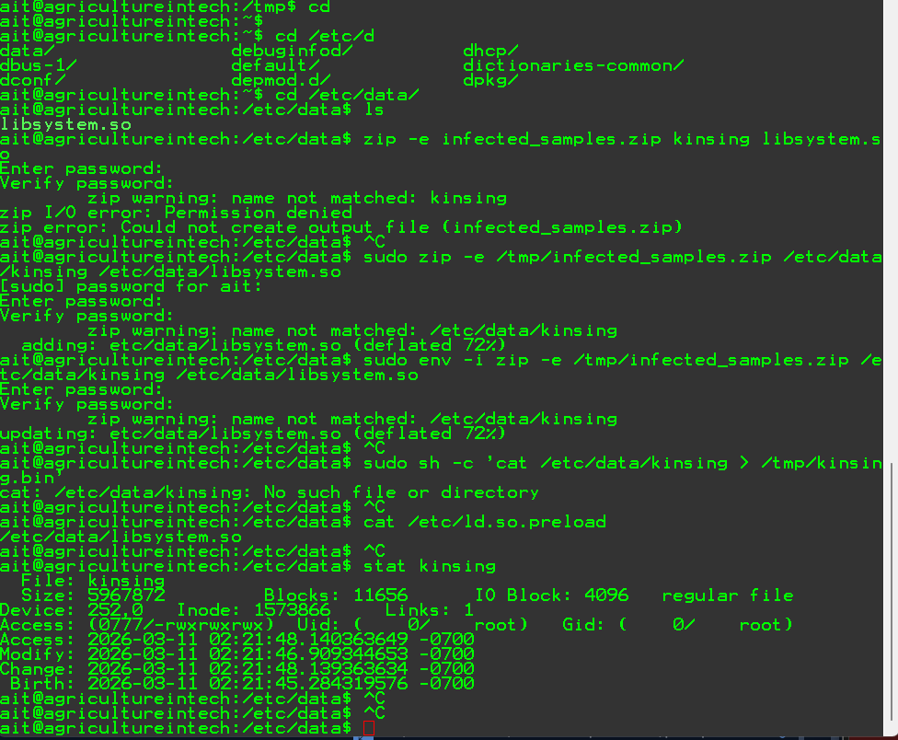
KINSING — LIVE EVIDENCE
lsof — kdevtmpfsi running as root, deleted temp files
Cron, shell, wget — persistence in /tmp/
11 / 20
Safe exfiltration — kinsing binary + libsystem.so rootkit from /etc/data

Slide 12
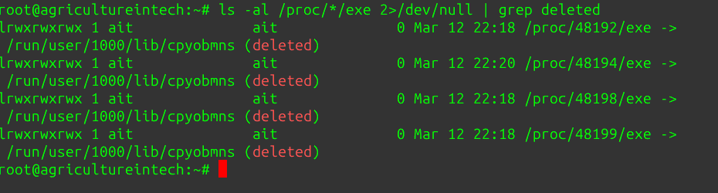
RONDODOX
DDoS Botnet — Mirai Lineage
C2 Obfuscation
XOR encoding with key 0x21
Beacon Interval
Every 5 minutes
C2 Architecture
Dual C2 endpoints
Evasion
Masquerades as gaming/VPN/chat traffic
Deleted RondoDox processes (cpyobmns) still running in memory
Binary
Statically linked C (carries own libc)
Analysis Findings
Decompiled code revealed a scanf-style format parser (static libc) and the main bot loop exposing the XOR key (0x21), 5-min beacon timing, and dual C2 structure. RondoDox likely completed its delivery role before persistence was needed — consistent with a Loader-as-a-Service model.
Behavior
Scans for and terminates rival processes — standard botnet resource protection
12 / 20

Slide 13
THE INFECTION CHAIN
HOUR 0
RondoDox arrives first via the exposed ActiveMQ RCE. Exploit-shotgun approach across multiple CVEs. Establishes initial access, beacons to dual C2, and exfiltrates the endpoint into a compromised pool.
HOUR ~6
Kinsing arrives from a separate C2 server operated by a different threat actor. Pulls XMRig miner, installs cron persistence and libsystem.so rootkit. Separate infrastructure and timing suggest the endpoint was sold or leased via Loader-as-a-Service.
RESULT
Not a turf war — a supply chain. RondoDox served as the acquisition layer. Kinsing was the payload delivered to a pre-compromised endpoint pool. Consistent with documented LaaS behavior from CloudSEK, Trend Micro, and FortiGuard (mid-2025).
13 / 20

Slide 14
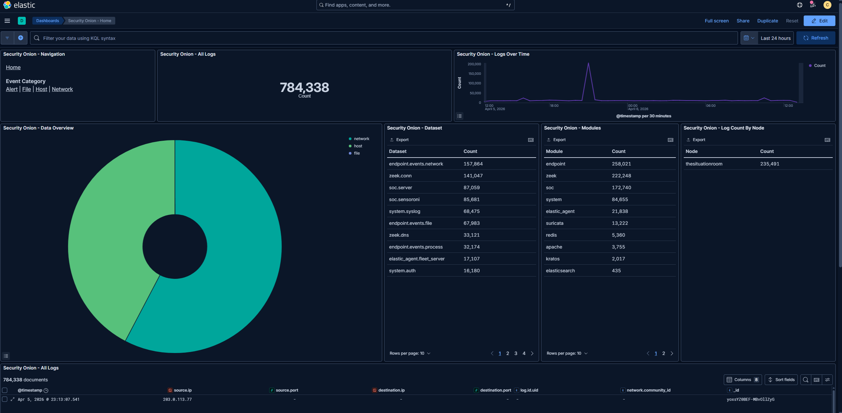
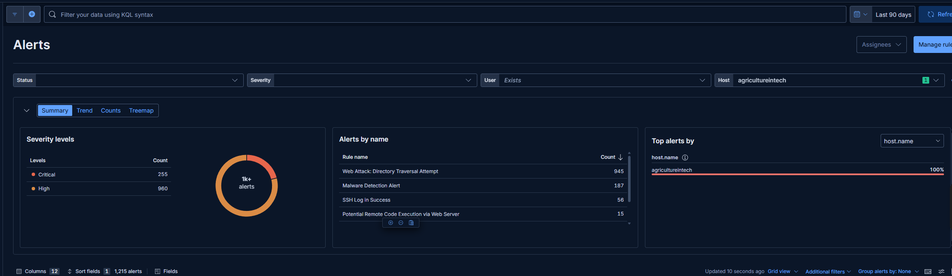
DATA AT SCALE
Why Data Parsing Tools Matter
784,338
total documents ingested into Elasticsearch — and climbing. Without proper tooling to parse, filter, and correlate this data, you're drinking from a firehose.
14 / 20
Security Onion Home — data overview
Kibana Alerts — 1,215 total (255 critical, 960 high)

Slide 15
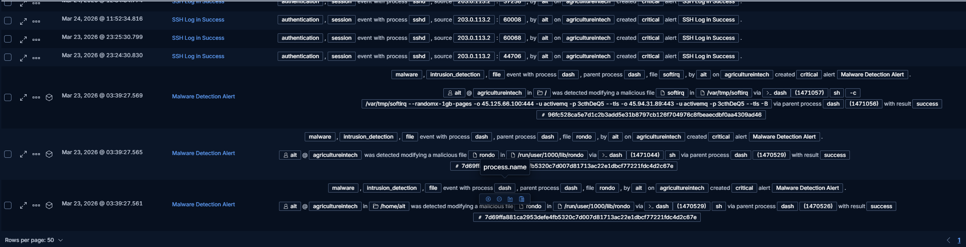
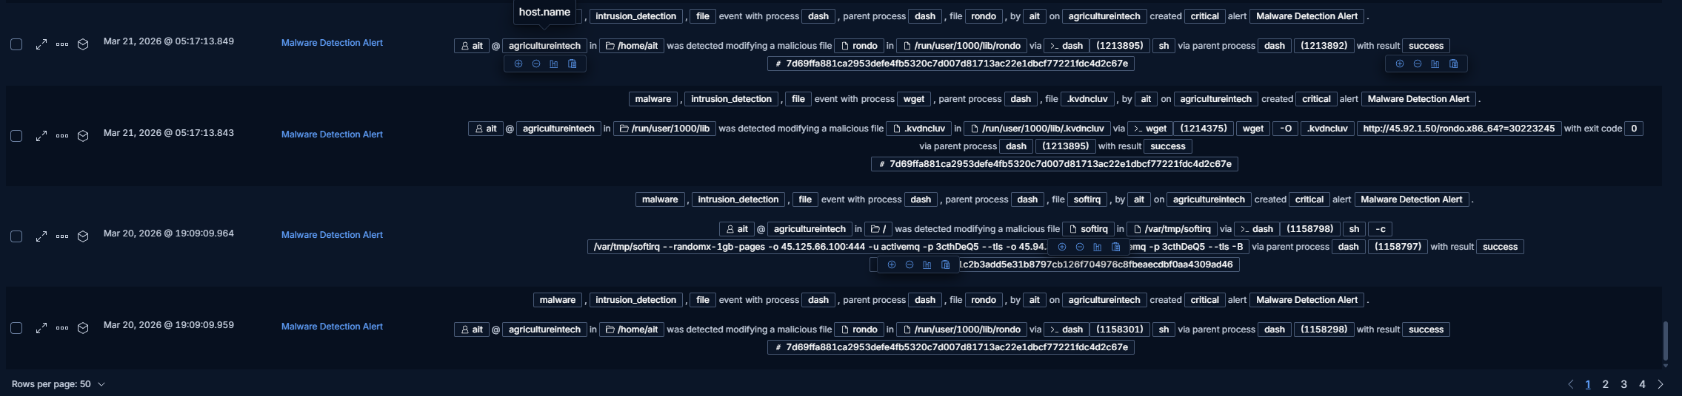
ALERT TRIAGE
Parsing Signal from Noise
Critical severity filter — kdevtmpfsi, rondo, and forensic artifacts
Malware detection events — softirq, rondo, file modification alerts
With nearly a million data points, the ability to filter, correlate, and prioritize is everything. Without tools like Kibana, Suricata rules, and custom queries, critical malware events get buried under noise. Data parsing isn't optional — it's survival.
15 / 20

Slide 16
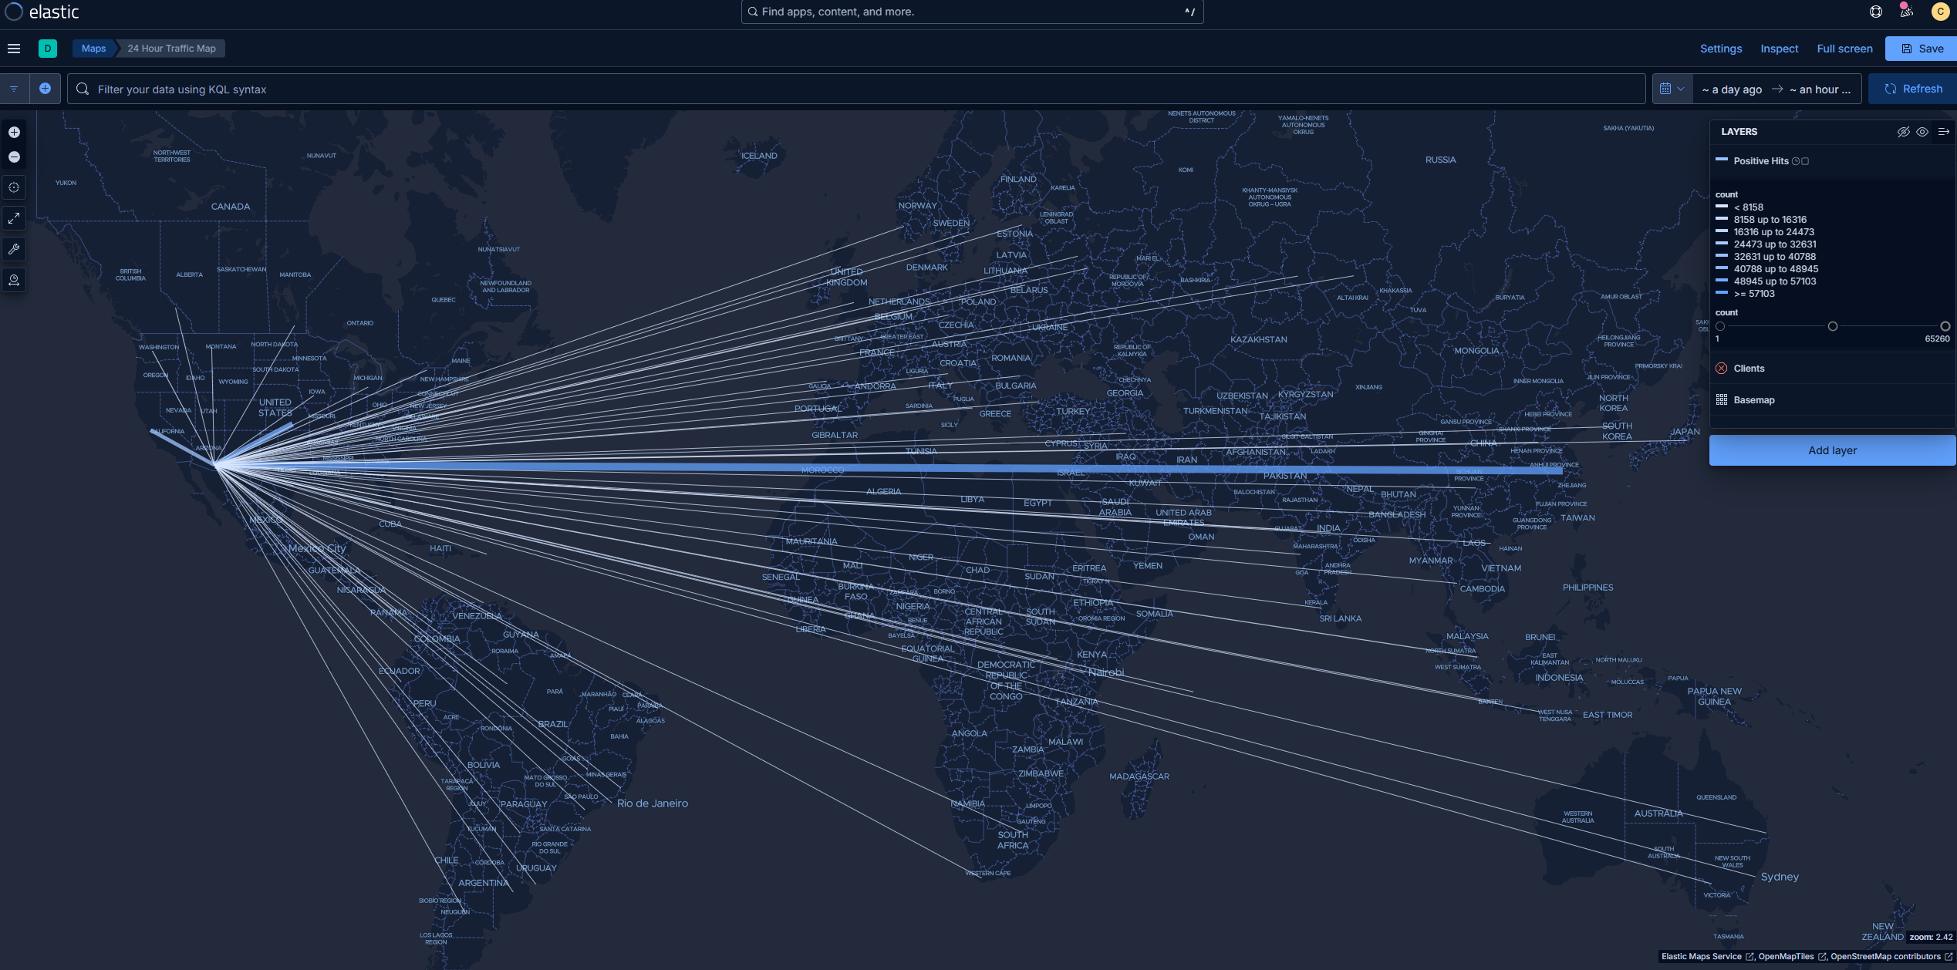
GLOBAL ATTACK ORIGINS
Kibana Maps — 24 Hour Point-to-Point Traffic
16 / 20
GeoIP-enriched traffic visualization showing global attack origin flight paths converging on agricultureintech.net

Slide 17




CHALLENGES & LESSONS
Student-Led, From Zero
Elasticsearch Disk Exhaustion
There was nothing here when we started. No script to follow, no template to copy. We had to hack it out and change scope day to day. This was a first attempt at something like this — and we made it work.
97% disk usage caused indexing to halt. 22,880 events backed up in Redis. Kernel memory exhaustion triggered soft lockups. We expanded LVM from 15GB to 30GB and recovered from container fault states.
The Containerization Detour
Huge Time Investment
We originally tried to containerize everything. This led to major issues standing up the ELK stack. We held onto this approach too long before pivoting to Security Onion, which worked perfectly out of the gate. Should've pivoted sooner.
We are students with lives. This is industry-level work — beyond industry-level at points. Managing personal time was a razor's edge. But every late night was worth it.
17 / 20

Slide 18

EXPANDING THE SCOPE
Windows Endpoint Monitoring & Kimwolf Experiment
Windows Endpoints
Kimwolf (Experimental)
Elastic Agent enrollment via SO Fleet
Sysmon (SwiftOnSecurity config) for process, network, DNS, file telemetry
PowerShell Script Block Logging via GPO
Windows Security/System/Application logs
Auth events (4624/4625), Sysmon EID 3
Target
Kimwolf botnet
Vector
ADB exploitation (port 5555)
Setup
Redroid (Android in Docker)
Capture
Container filesystem mirrored to host
Status
Deployed, awaiting results
18 / 20

Slide 19

KEY TAKEAWAYS
Two malware families. One infection chain. RondoDox as the loader, Kinsing as the delivered payload — a Loader-as-a-Service operation documented live.
Built entirely from scratch by students — no template, no script. We hacked it out, changed scope daily, and made it work.
Real CVE exploitation observed and analyzed: CVE-2021-41773 (path traversal) and CVE-2023-46604 (ActiveMQ RCE).
784K+ events ingested. Without Kibana, Suricata, and custom queries, critical detections drown in noise. Data parsing is survival.
Industry-level (and beyond) work done on student time. The time investment was a razor's edge — but worth every late night.
The Kimwolf/ADB pivot and Windows endpoint expansion show the project's adaptability and room to grow.
19 / 20

Slide 20

FINDINGS
A live honeynet built from scratch. Real CVE exploitation documented.
784K+ events ingested and analyzed. A Loader-as-a-Service infection chain confirmed.
Industry-level work done on student time.
agricultureintech.net | packetpursuit.net
Pima Community College — Cybersecurity Capstone
20 / 20

