Slide 1
Grism-F2T12
使用手冊

Slide 2
Revision History
No. | When | Who | What
0.1 | 2019/12/10 | Jay | 新增文件
0.2 | 2021/08/02 | Jay | 新增介接延伸用switch以及項目調整
0.3 | 2022/03/07 | Jay | 新增CECI進階案例探討
0.4 | 2022/03/17 | Jay | 新增GRISM XML範例

Slide 3
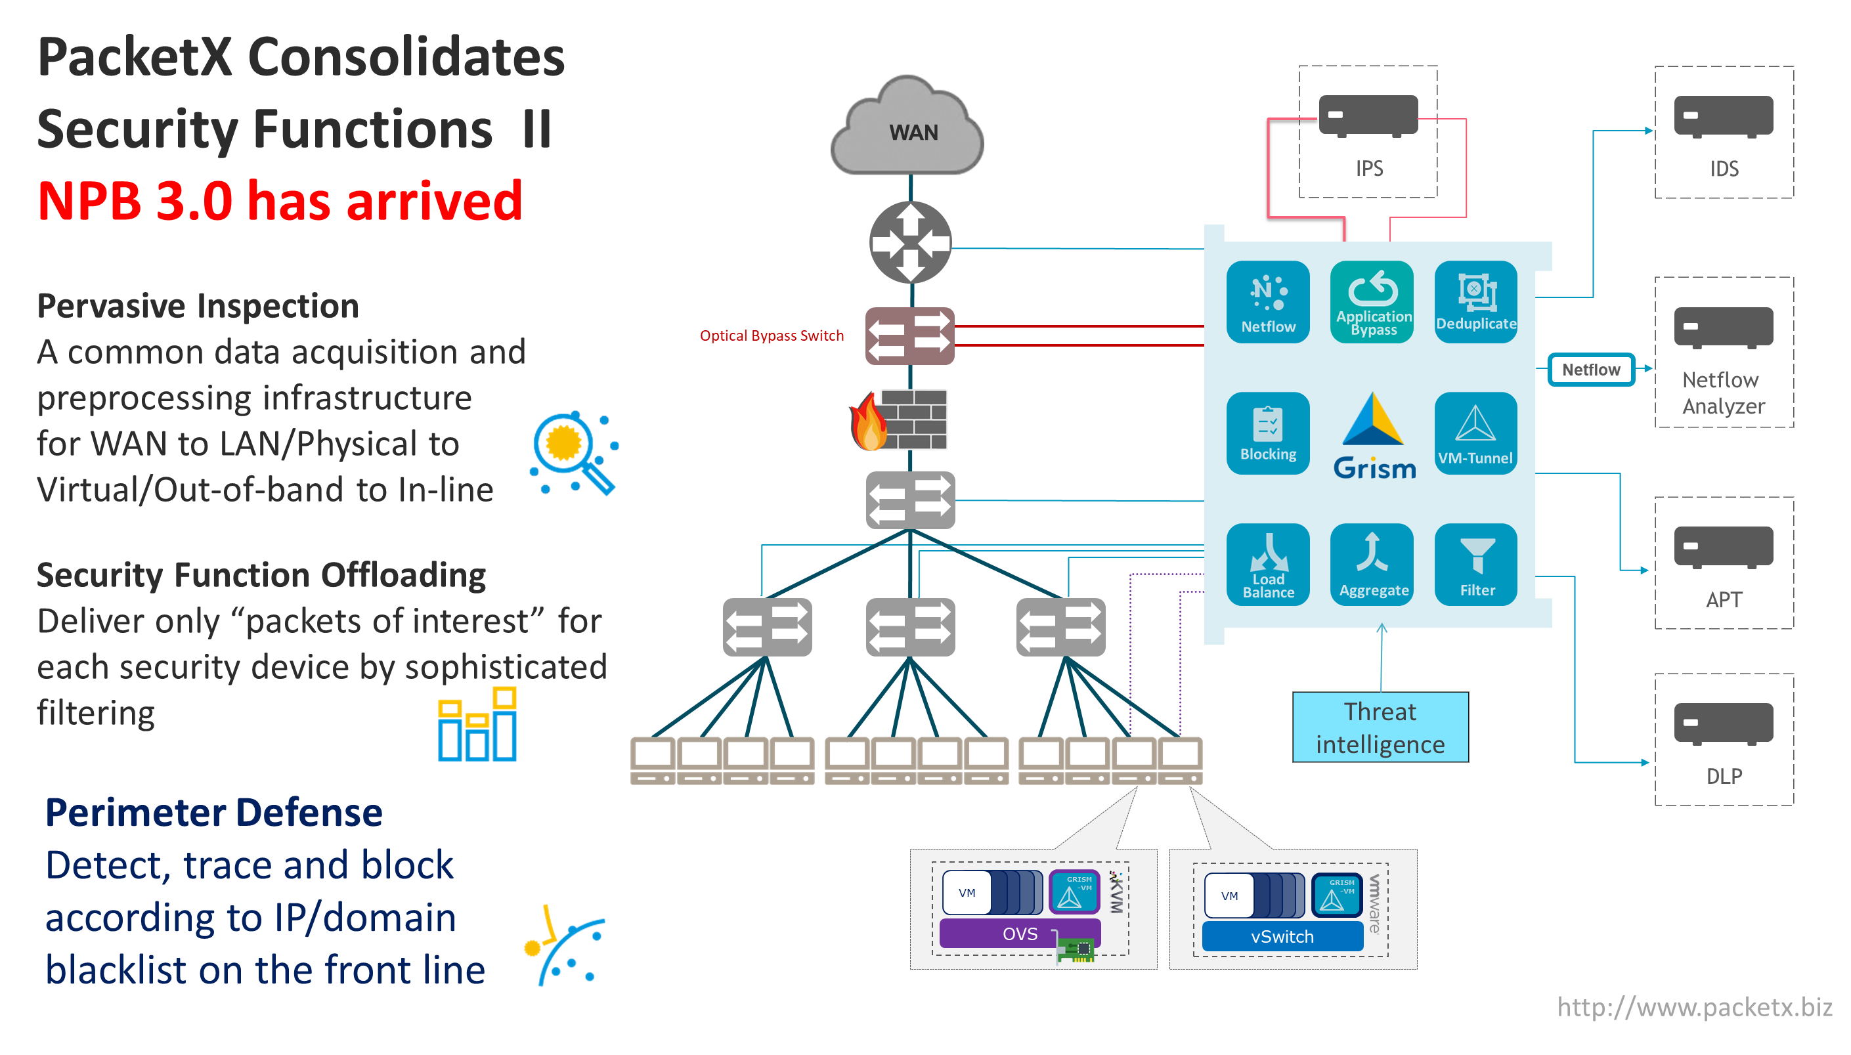

Slide 4
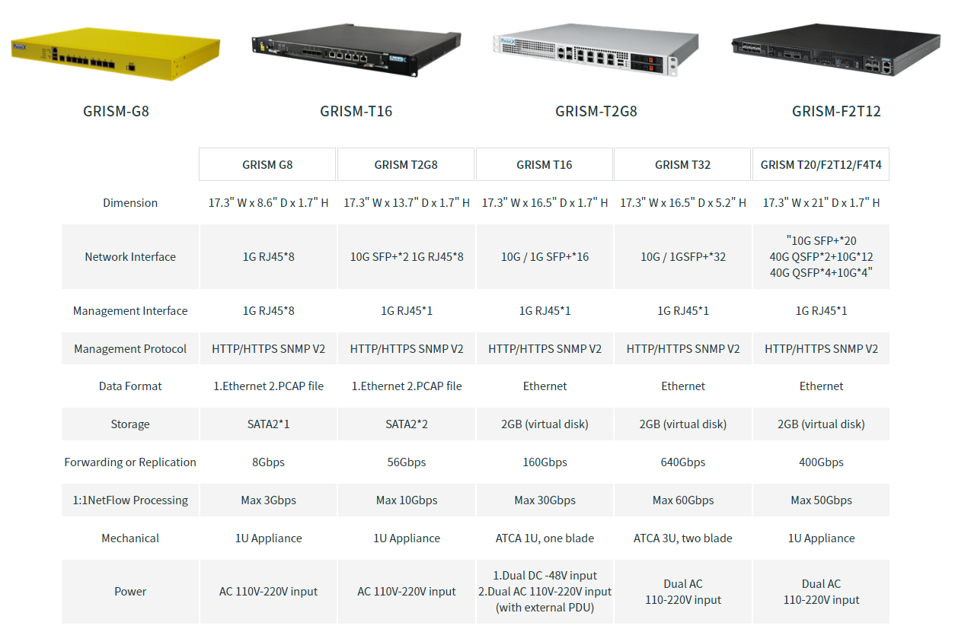

Slide 5
設備簡介: F2T12
40Gx2 (P0-P1)
10Gx12 (P2-P13)
1Gx1(Management)
P2
P4
P6
P8
P10
P12
P0
P1
P3
P5
P7
P9
M0
P11
P13

Slide 6
WEB操作畫面簡介
預設網址為 https://192.168.1.160
預設帳號密碼 packetx/packetx

Slide 7
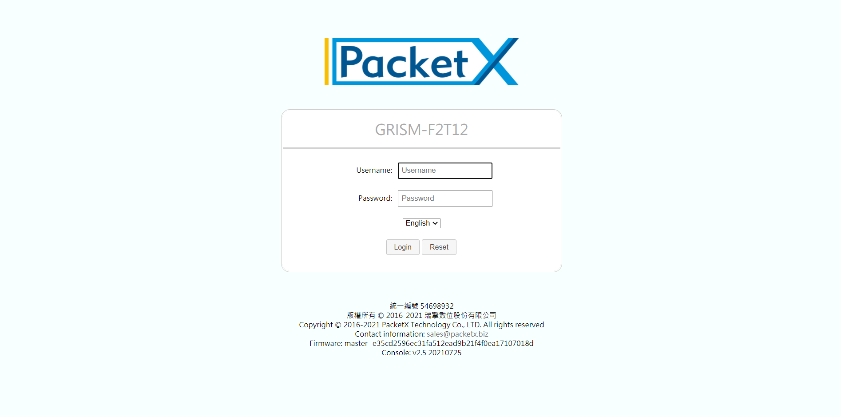
預設帳號密碼: packetx/packetx

Slide 8
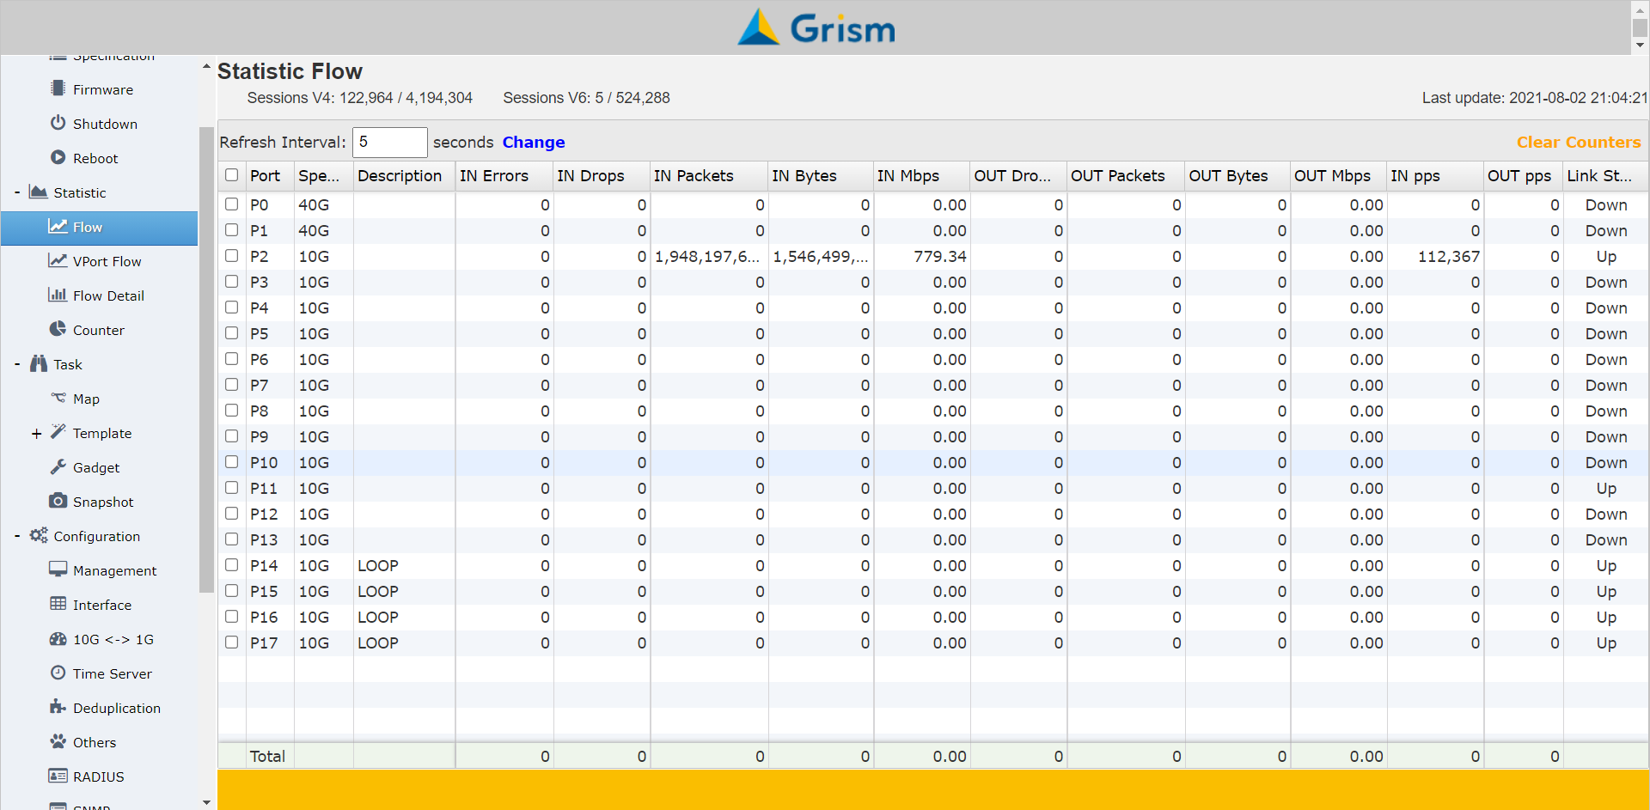
各介面的流量
實體介面流量

Slide 9
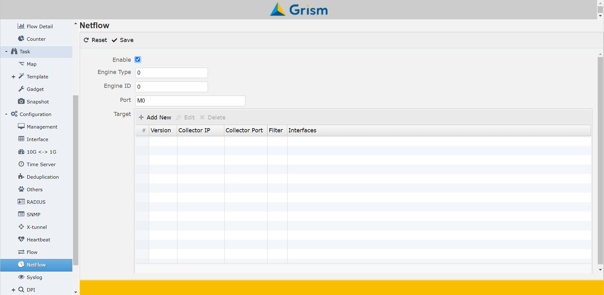
NetFlow萃取設定
Netflow 設定

Slide 10
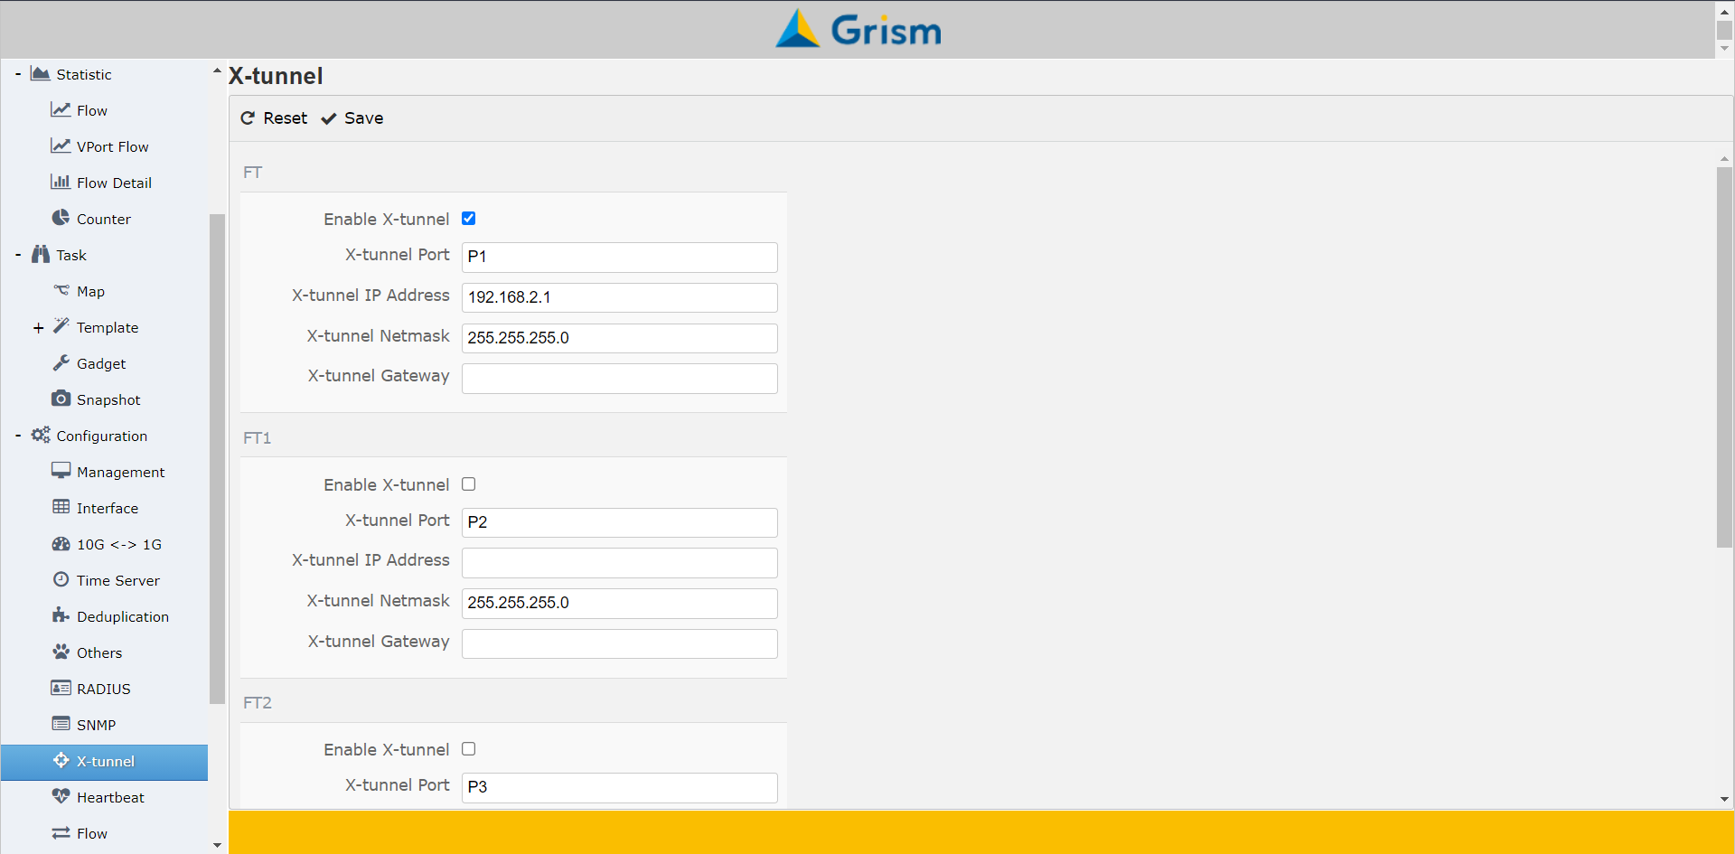
X-Tunnel 接收端設定
X-tunnel接收端設定

Slide 11
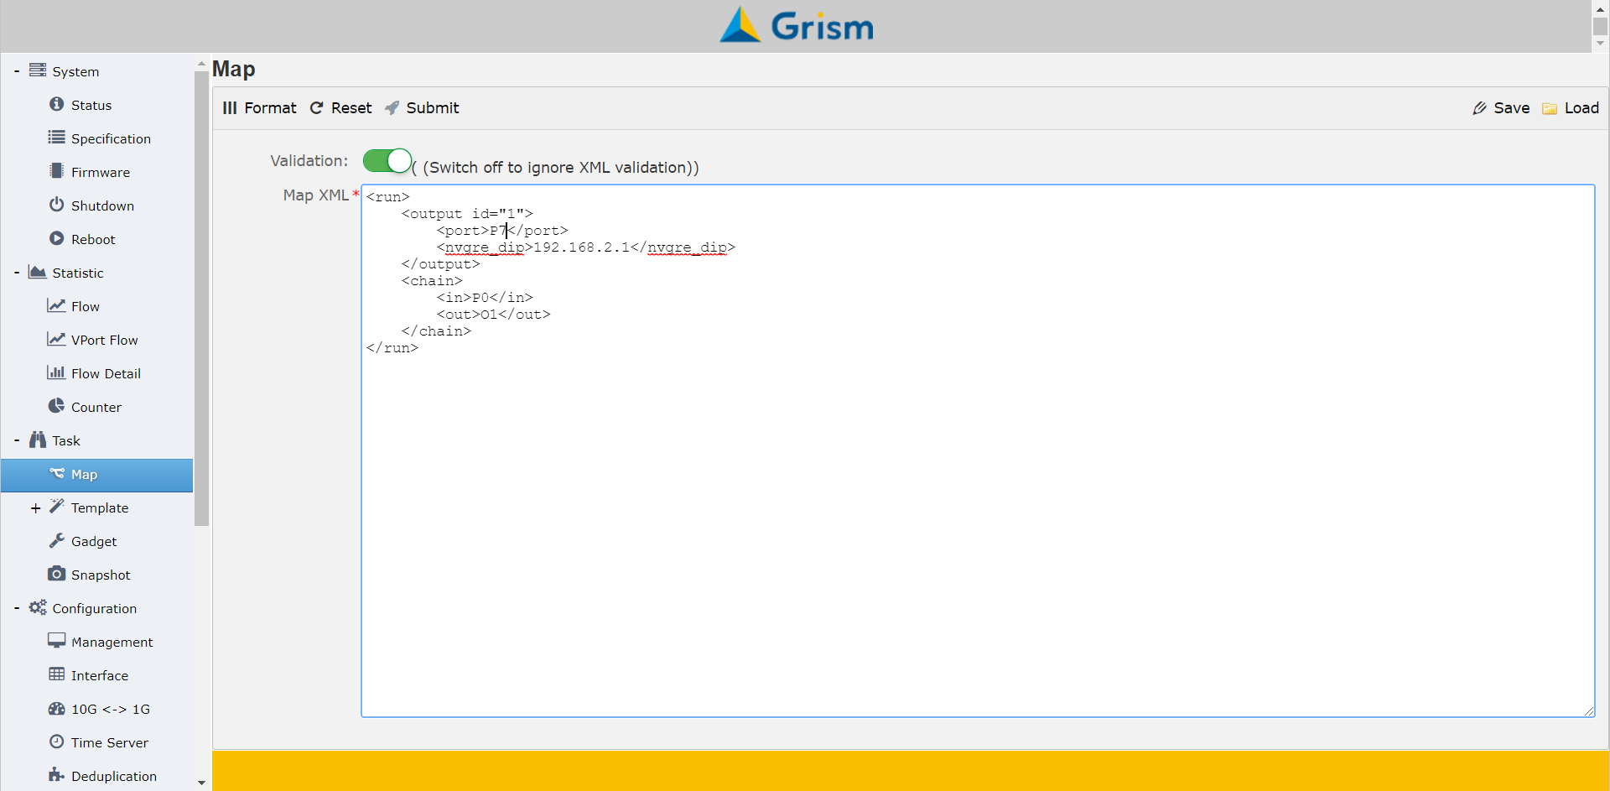
X-Tunnel 發送端設定
X-tunnel發送端設定

Slide 12
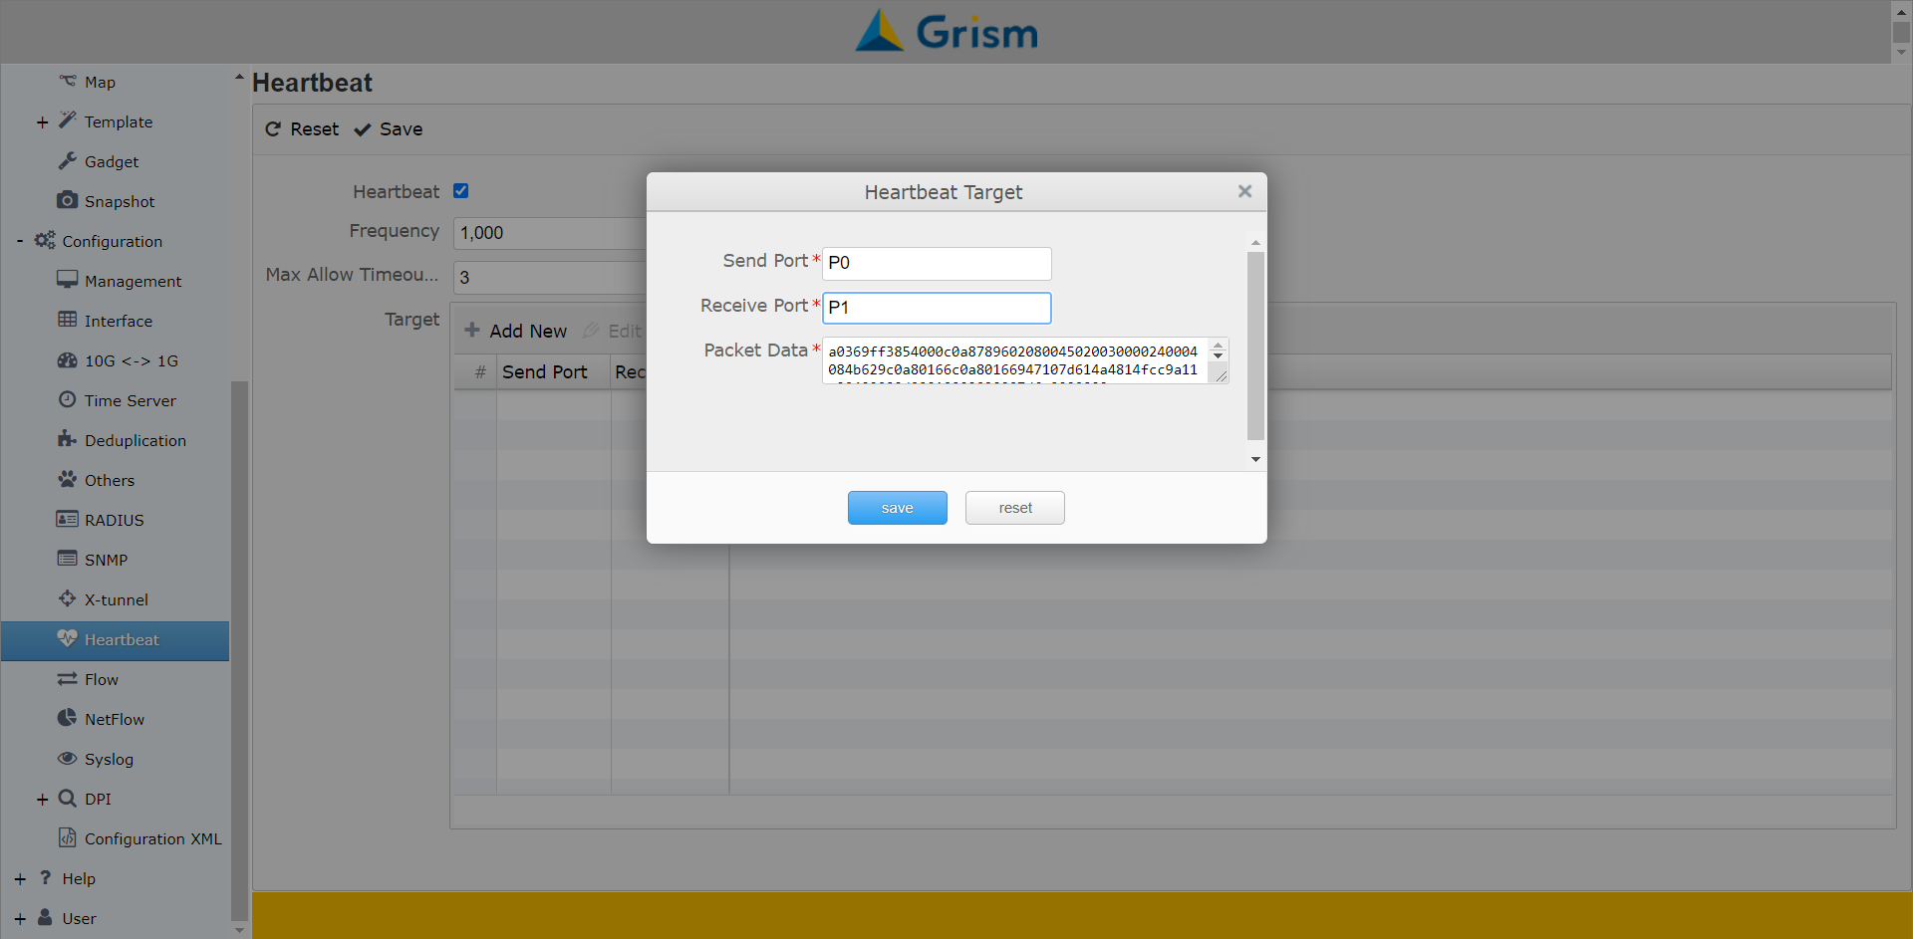
HeartBeat 設定

Slide 13
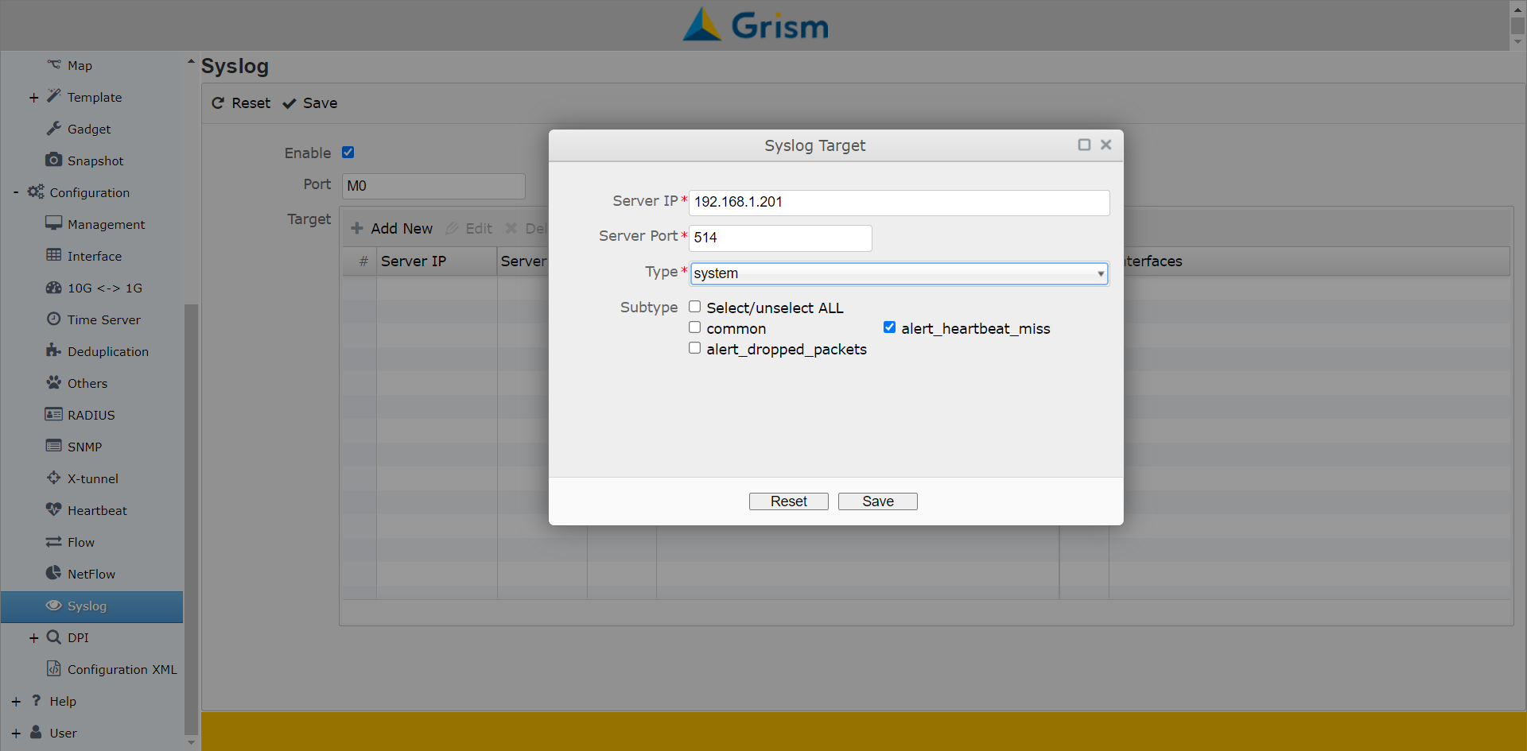
HeartBeat Syslog 設定

Slide 14
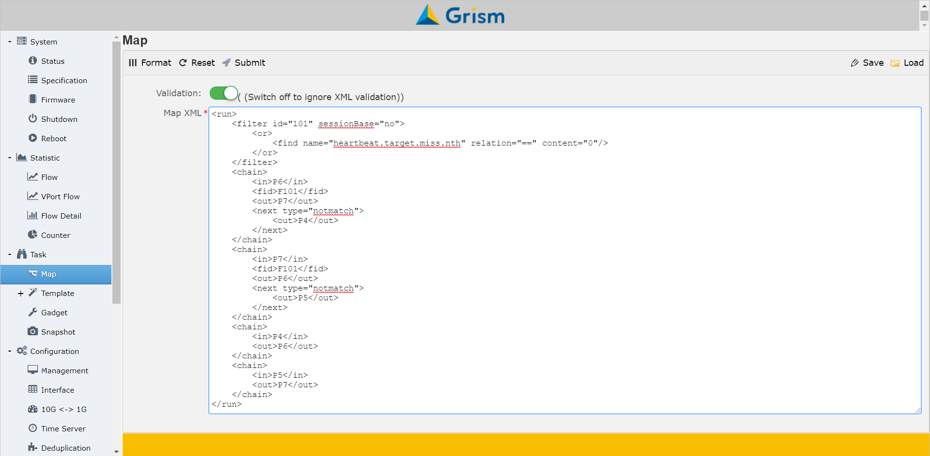
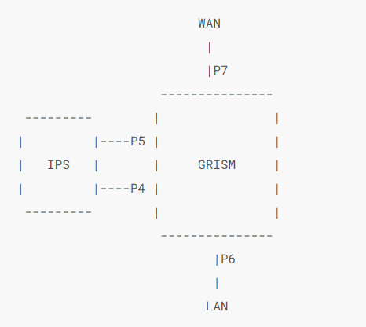
Service Chain with HeartBeat

Slide 15
介接延伸用switch
P2
P4
P6
P8
P10
P12
P0
P1
P3
P5
P7
P9
M0
P11
P13
Grism
LAG
40G
40G
10G
10G
10G
10G
10G
10G
10G
10G
100G
100G
10G
10G
10G
10G
10G
10G
10G
10G
Switch

Slide 16
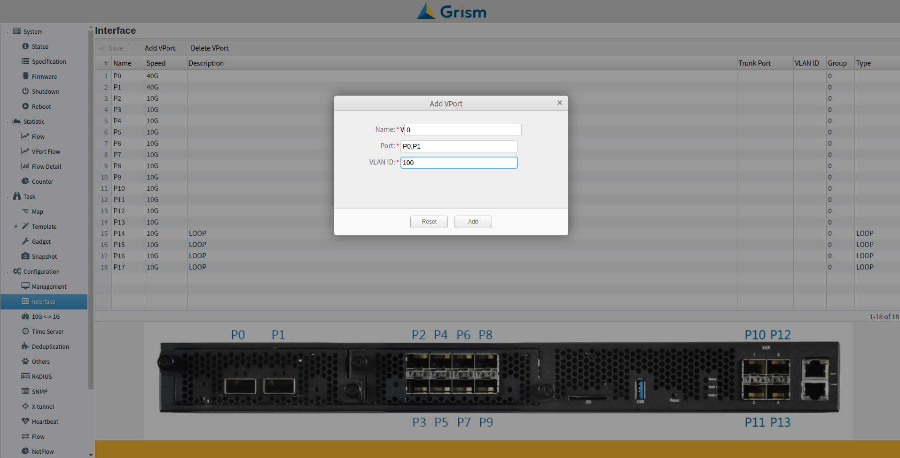

Slide 17
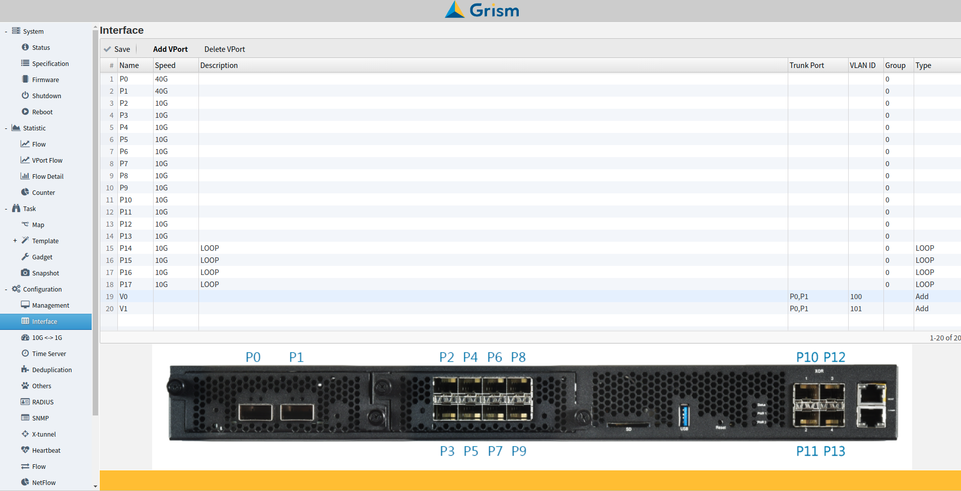

Slide 18
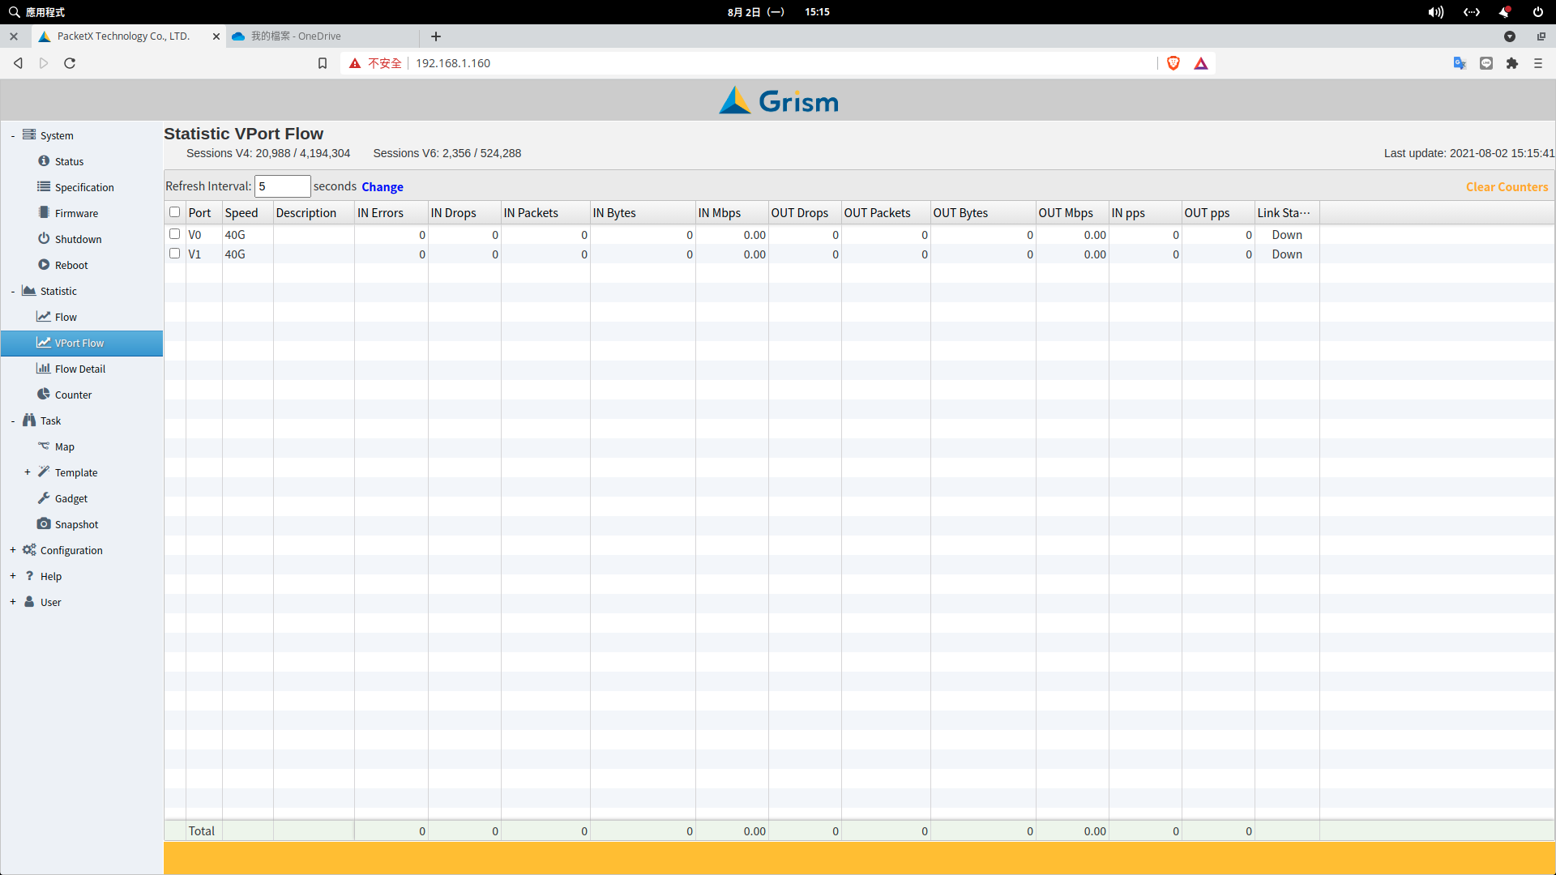

Slide 19
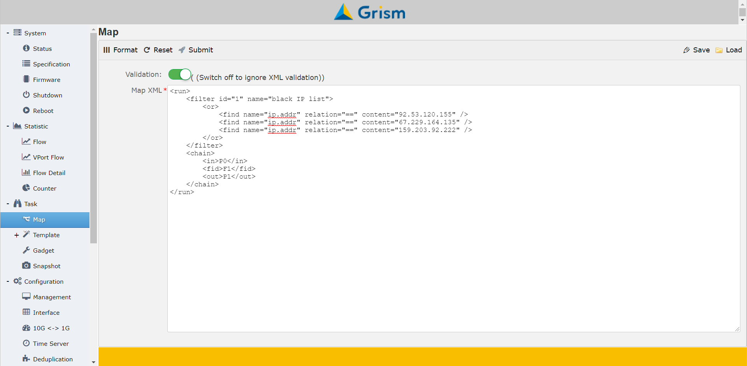
從web介面輸入XML script
GRISM XML 輸入頁面

Slide 20
GRISM XML
<run></run>
<filter id=“1”></filter>
  <and>,<or>
  <find />
<chain></chain>
  <in>P0</in>
  <fid>F1</fid>
  <out>P1</out>
  <next type=“notmatch”></next>
  <next type=“match”></next>
<output id=“1”></output>
  <port>P0<port>
  <stripping>vlan</stripping>
<action id=“1” type=“input-packet-process“></action>
  <port>P0<port>
  <Q>2000</Q>
https://packetx.github.io/gml

Slide 21
<filter>
L2-L4流量過濾
<filter id=“1” sessionBase=“no”>
<and>
<find name=“tcp.port” relation=“==” content=“443”>
<find name=“ip.dst” relation=“==” content=“122.116.229.84”>
</and>
</filter>

Slide 22
<filter>
L7流量過濾
<filter id=“2” sessionBase=“yes”>
<or>
<find name=“regex” relation=“==” content=“\x0bgooglevideo\x03com”>
<find name=“regex” relation=“==” content=“{s}\/.*Host: yahoo\.com”>
</or>
</filter>
ps1: \x0bgooglevideo\x03com 是要比對DNS訊息內的domain googlevideo.com
ps2: {s}\/.*Host: yahoo\.com 是要比對HTTP host yahoo.com
比對成功後接下來屬於相同session之封包會被濾出

Slide 23
<filter>
L7流量過濾
<filter id=“2” sessionBase=“yes”>
<or>
<find name=“dns.qry.name” relation=“==” content=“googlevideo.com”>
<find name=“ssl.server_name” relation=“==” content=“facebook.com”>
<find name=“http.request.url” relation=“==” content=“www.url.com.tw”>
</or>
</filter>

Slide 24
<chain>
In/out流量路徑規劃
<chain>
<in>P0</in>
<fid>F1</fid>
<next type="match">
<fid>F2</fid>
<out>P2</out>
</next>
<next type="notmatch">
<fid>F3</fid>
<out>P3</out>
</next>
</chain>
P0
F1
yes
F2
yes
P2
no
F3
yes
P3

Slide 25
範例:匯聚以及分流
分流
匯聚
P4
P0
P5
P1
P6
P7
複製一份流量送出

Slide 26
<chain>
<chain>
<in>P0,P1</in>
<out type="loadBalance“ lbtype=“5thash”>P4,P5,P6</out>
<next type="match">
<out>P7</out>
</next>
</chain>

Slide 27
範例:inline阻擋來源IP黑名單
Black IP list
yes
0(DROP)
inline
P6
F1
no
P7
P6
P7
P7
P6
P7
P6

Slide 28
<chain>
<filter id="1" name=“Black IP list" sessionBase="no">
<or>
<find name="ip.addr" relation="==" content="110.250.158.62" />
<find name="ip.addr" relation="==" content="113.128.212.234" />
<find name="ip.addr" relation="==" content="113.161.194.221" />
…. 千萬筆
</filter>
<chain>
<in>P6</in>
<fid>F1</fid>
<out>0</out>
<next type=“notmatch">
<out>P7</out>
</next>
</chain>
<chain>
<in>P7</in>
<out>P6</out>
</chain>

Slide 29
範例:inline阻擋HTTP url黑名單
HTTP url black list
P6
F0
yes
0(DROP)
no
P7
P7
P6

Slide 30
<chain>
<chain>
<in>P6</in>
<fid>F1</fid>
<out>0</out>
<next type=“notmatch">
<out>P7</out>
</next>
</chain>
<chain>
<in>P7</in>
<out>P6</out>
</chain>
<filter id=“1" sessionBase="no">
<or>
<find name=" http.request.url" relation="==" content=" www.whitehollowtransport.com/current-elliott-c-89.html " />
<find name=" http.request.url" relation="==" content=" www.cctv.com/index.html " />
<or>
… 百萬筆
</filter>

Slide 31
範例: inlne阻擋IP/dns domain黑名單
yes
Syslog Server
P6
F1: IP黑名單
0
(DROP)
no
F2: domain黑名單
yes
no
P7
P7
P6

Slide 32
<chain>
<in>P6</in>
<fid>F1</fid>
<out>0</out>
<next type=“notmatch">
<fid>F2</fid>
<out>0</out>
<next type=“notmatch">
<out>P7</out>
</next>
</next>
</chain>
<chain>
<in>P7</in>
<out>P6</out>
</chain>
<filter id="1" name="ip list" matchedlog=“yes”>
<or>
<find name="ip.addr" relation="==" content="110.250.158.62" />
<find name="ip.addr" relation="==" content="113.128.212.234" />
<find name="ip.addr" relation="==" content="113.161.194.221" />
…
<filter id=“2" name=“domain list" matchedlog=“yes”>
<or>
<find name=“dns.qry.name" relation="==" content=“google.com" />
<find name="dns.qry.name" relation="==" content=“facebook.com" />
<find name= dns.qry.name" relation="==" content=“twitter.com" />
…

Slide 33
<chain>
<in>P6</in>
<fid type=“or”>F1,F2</fid>
<out>0</out>
<next type=“notmatch">
<out>P7</out>
</next>
</chain>
<chain>
<in>P7</in>
<out>P6</out>
</chain>
<filter id="1" name="ip list" matchedlog=“yes”>
<or>
<find name="ip.addr" relation="==" content="110.250.158.62" />
<find name="ip.addr" relation="==" content="113.128.212.234" />
<find name="ip.addr" relation="==" content="113.161.194.221" />
…
<filter id=“2" name=“domain list" matchedlog=“yes”>
<or>
<find name=“dns.qry.name" relation="==" content=“google.com" />
<find name="dns.qry.name" relation="==" content=“facebook.com" />
<find name= dns.qry.name" relation="==" content=“twitter.com" />
…

Slide 34
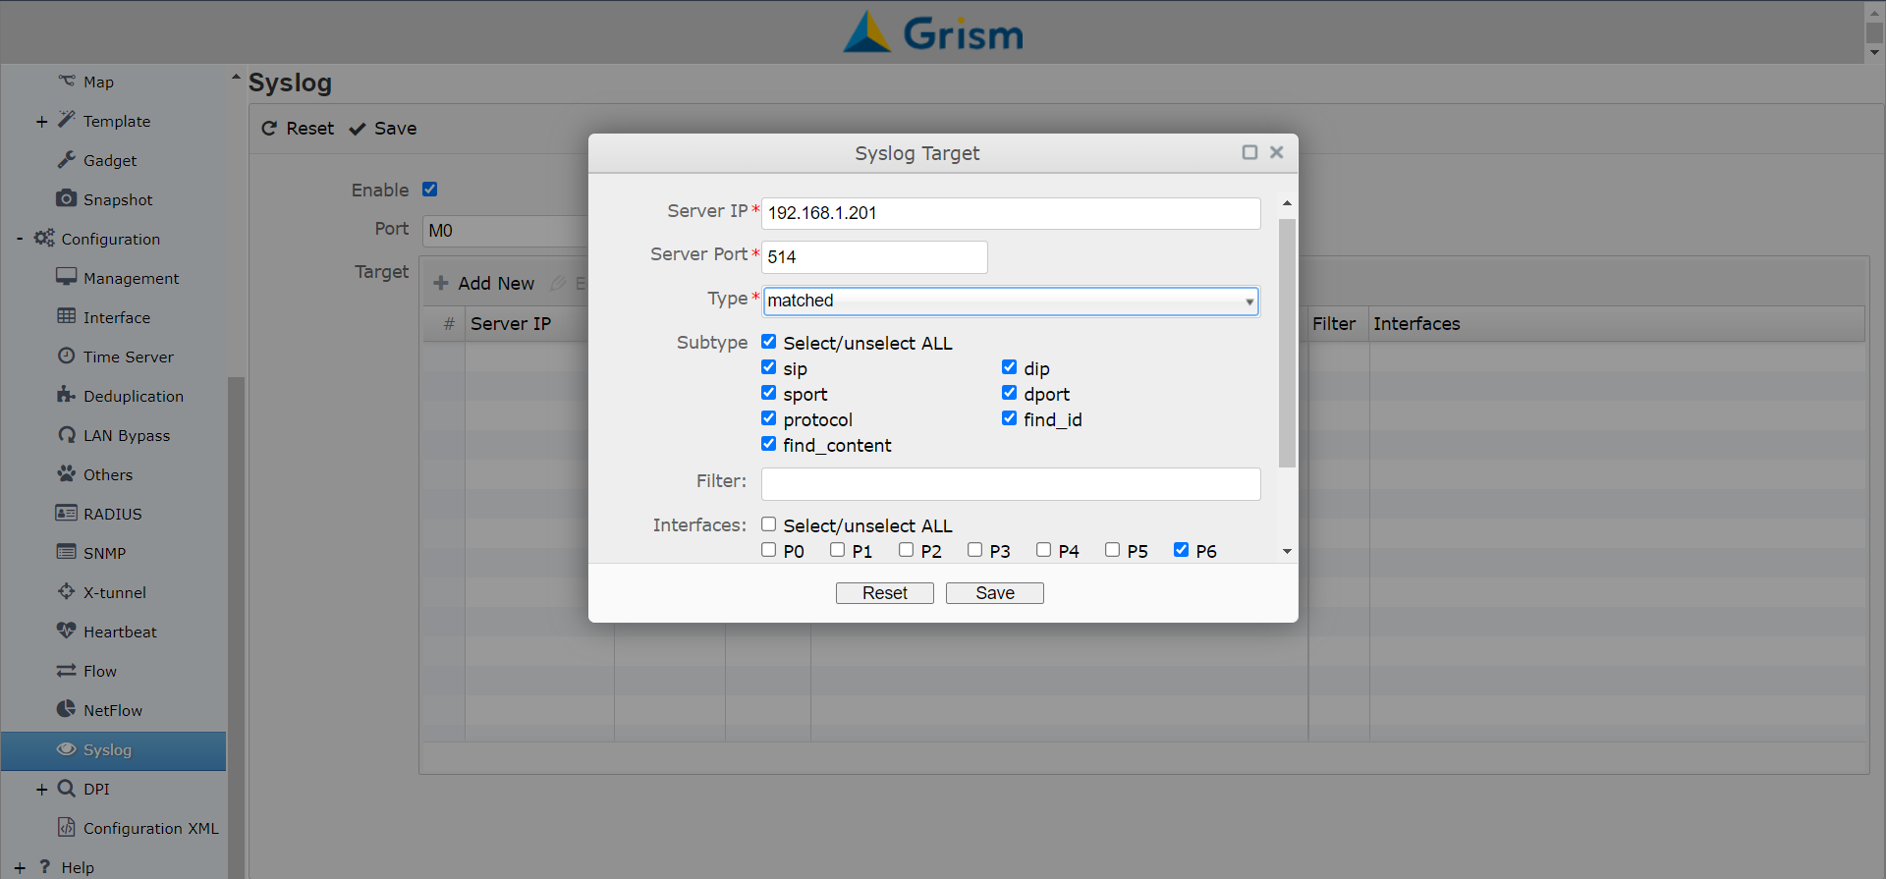
設定阻擋IP/domin黑名單送出syslog

Slide 35
進階案例探討

Slide 36
IPS/NGFW的使用情境
情境 A
採用100Gbp介面的IPS/NGFW
實際流量可能遠小於100Gbps
效益分析
100G介面IPS昂貴且甚多運算力閒置
考慮100G bypass的成本
Q: 能否不用100G IPS/NGFW
10G
Router
IPS/NGFW
10G
10G
100G
100G
10G
情境 B
用掉IPS/NGFW多個網路介面(8個)
四條10G鏈路的實際流量加總可能不大
效益分析
耗用太多介面但甚多運算力閒置
考慮10G bypass*4的成本
Q: 能否減少使用介面或採較小model
10G
IPS/NGFW
10G
10G
10G
10G
10G
10G
10G

Slide 37
效益優化方案:inline aggregation
100G
100G
Router
10G
10G
10G
10G
Router上做出多個10G迴圈，把IPS/NGFW建在10G上
把Case A轉化成Case B
說明:
這案例比較複雜，為了讓P0進來的封包，經過IPS後能從P1出去，P1進來的封包經過IPS後能從P0出去(P2,P3同樣意思)，要做三件事
從P4,P5出去的封包要打上標記
從P4,P5進來的封包要根據標記送到正確的地方
從P4,P5進來的封包要移除標記
Grism
P0
P1
P2
P3
P4
P5
IPS

Slide 38
CECI案例探討
Without IPS
CS
UG
LAN
WAN
CS
UG
Core Switch
LAG
UG: Uguard (Active-Standby)
切換規則: Link down/LAG fail

Slide 39
CECI案例探討
With IPS
CS
PA
UG
LAN
WAN
CS
UG
PA
問題
IPS設備inline串接
IPS設備當掉或效能變差
如何有效使用IPS設備
Link down/LAG
Core Switch

Slide 40
CECI案例探討
With IPS and SSLi
Array
CS
PA
UG
LAN
WAN
CS
UG
PA
問題
IPS/SSLi設備inline串接
IPS/SSLi設備當掉或效能變差
如何有效使用IPS/SSLi設備
Link down/LAG
SSLi只需要443流量
Core Switch
Array

Slide 41
CECI案例探討
Service Chain
CS
PacketX
UG
LAN
WAN
CS
UG
Core Switch
Array
Solution
IPS/SSLi設備inline串接 -> 都接到 PacketX
IPS/SSLi設備當掉或效能變差 -> Bypass
如何有效使用IPS/SSLi設備 -> LoadBalance
Link down/LAG -> Link down sync
SSLi只需要443流量 -> Filter 443
Array
PA
PA

Slide 42
CECI案例探討
More features
CS
PacketX
UG
LAN
WAN
CS
UG
Core Switch
黑白名單
More features
Bypass 白名單 IP/domain/url
Block 黑名單 IP/domain/url
IP: 千萬筆
domain/url: 百萬筆

