Slide 1
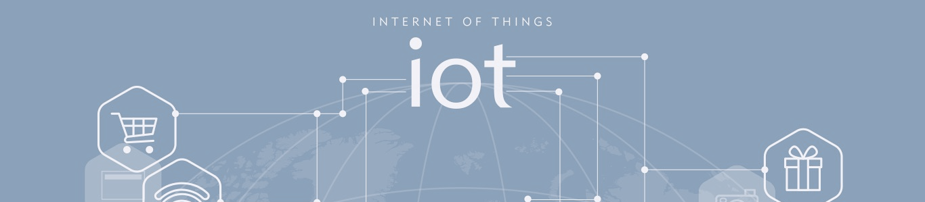

When Everything Meets at Mobile Edge
Notes:
0

Slide 2
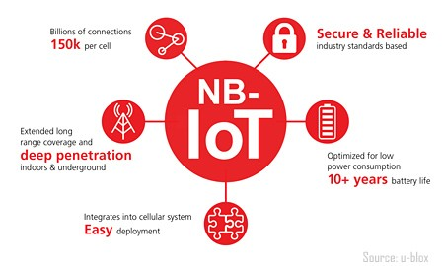

NB-IoT is one of the 5G wave of connectivity technologies and is what we call a LPWAN (Low-power, Wide-Area Network) radio technology.
Mobile operators can upgrade to support NB-IoT on top of the original 4G networks without having to pay a high price, which means that NB-IoT can provide excellent coverage with existing networks.
Many operators begin to progressively extend its NB-IoT coverage in order to catch up with the trend of IoT development.

Slide 3



Ideally, when all production machines are wired; not only should the machines quickly exchange information through the message-broker system, manufactures are able to immediately react accordingly, carry out big-data analysis and hence optimize efficiency.
Enterprise / Factory
MQ
Big Data Analysis
Company A
Notes:
X老闆的想法

Slide 4

Traditional Mode
High Latency
High Cost
- security overhead
- communication
cost
Internet
Enterprise / Factory
Telco
ISP
Mobile Operator
NB-IoT
CPE
NB-
IoT
NB-
IoT
NB-
IoT
NB-
IoT
NB-
IoT
NB-
IoT
NB-
IoT
NB-
IoT
Big Data Analysis
MQ
http://www.packetx.biz
Notes:
NB-IoT

Slide 5
Cloud Mode
Medium Latency
Medium Cost
Big Data Analysis
MQ
Enterprise / Factory
Telco
A at AWS
Mobile Operator
NB-IoT
NB-
IoT
NB-
IoT
NB-
IoT
NB-
IoT
http://www.packetx.biz
Notes:
NB-IoT

Slide 6
MEC Mode
Low Latency
Low Cost
ps: MEC=Mobile Edge Computing
Big Data Analysis
MQ
Enterprise / Factory
Telco
A at AWS
Mobile Operator
Big Data Analysis
MQ
MEC
GW
MECP
NB-IoT
NB-
IoT
NB-
IoT
NB-
IoT
NB-
IoT
NB-
IoT
NB-
IoT
NB-
IoT
NB-
IoT

Slide 7

MEC with Breakout Mode
Medium Latency
High Cost
- security overhead
- communication cost
Internet
Enterprise / Factory
Telco
ISP
Mobile Operator
Breakout
MEC
GW
CPE
NB-IoT
CPE
NB-
IoT
NB-
IoT
NB-
IoT
NB-
IoT
NB-
IoT
NB-
IoT
NB-
IoT
NB-
IoT
Big Data Analysis
MQ
http://www.packetx.biz
Notes:
NB-IoT

Slide 8






Internet
Big Data Analysis
MQ
A at AWS
Mobile Operator
Mobile Operator
ISP
NB-
IoT
NB-
IoT
NB-
IoT
NB-
IoT
CPE
NB-
IoT
NB-
IoT
NB-
IoT
NB-
IoT
Big Data Analysis
MQ
Internet
Mobile Operator
ISP
Mobile Operator
Big Data Analysis
MQ
MEC
GW
Breakout
CPE
MEC
GW
MECP
CPE
NB-
IoT
NB-
IoT
NB-
IoT
NB-
IoT
NB-
IoT
NB-
IoT
NB-
IoT
NBT
NB-
IoT
Big Data Analysis
MQ

Slide 9

MEC Security Issue
An IoT device can be hacked in the physical world hence attack or affect other devices.
Enterprise / Factory
Telco
Mobile Operator
Big Data Analysis
MQ
MEC
GW
MECP
NB-IoT
NB-
IoT
NB-
IoT
NB-
IoT
NB-
IoT
NB-
IoT
NB-
IoT
NB-
IoT
NB-
IoT

Slide 10

PacketX Mobile Edge Ecosystem
transparent GW & zero mobile network configuration
GRISM: GTP<->IP transition /Access control/ Breakout
EFP: A micro-cloud, virtualized Edge-function Container with traffic monitoring
Enterprise / Factory
Telco
Mobile Operator
APP
3
APP
4
APP
n
Big Data Analysis
MQ
MEC
GW
BDA
MQ
EF Platform
MECP
NB-IoT
NB-
IoT
NB-
IoT
NB-
IoT
NB-
IoT
NB-
IoT
NB-
IoT
NB-
IoT
NB-
IoT

Slide 11

MEC Security
An IoT device can be hacked in the physical world hence attack or affect other devices. For GRISM, the built-in security mechanism can filter and block out all the sessions which are not in “White list”: destination IP address, domain and protocol. The second layer security is “VM traffic monitoring as a service” and SNORT IPS on EF platform
Enterprise / Factory
Telco
Mobile Operator
Platform
Security
Gateway
BDA
MQ
APP
3
APP
4
APP
n
EF Platform
NB-IoT
NB-
IoT
NB-
IoT
NB-
IoT
NB-
IoT
NB-
IoT
NB-
IoT
NB-
IoT
NB-
IoT

Slide 12



PacketX Mobile Edge Ecosystem
Supports organizations with numerous devices and IT systems.
Support devices with LTE or NB-IoT capabilities.
Host “micro cloud” to provide IaaS or PaaS
Enterprise / Factory A
Home B
Telco
Mobile Operator
Platform
Security
Gateway
BDA
MQ
HC
FR
MQ
3rd
Party
EF Platform
LTE
NB-
IoT
NB-
IoT
NB-
IoT
NB-
IoT
NB-
IoT
NB-
IoT
NB-
IoT
LTE
NB-
IoT
NB-
IoT
NB-
IoT
NB-
IoT
Home B
＊HC = Home Controller
FR = Face Recognition
Company A

Slide 13


Deployment
Different size of Edge Function Platform ;
eNode←→EFP = N:1 or 1:1
eNodeB
MEC Platform
Mobile Core
BDA
MQ
APP
3
APP
4
APP
n
3:1
EFP
Mobile Operator
1:1
BDA
MQ
APP
3
APP
4
APP
n
EFP

Slide 14




MEC app via LTE/NB-IoT : Intelligent Home Lock System with Face Recognition
Cloud Computing
Edge Computing
INT
Internet
ERNET
Edge Advantage
1. Lower Latency
2. No internet access implies better security and lower cost
FR
MQ
AWS
Message “OK” over NB-IoT
FR
MQ
Message “OK” over NB-IoT
Low data rates
EFP
HD streaming over LTE
Very high data rates
High latency
High Internet access cost
Message “OK” over NB-IoT
HD streaming over LTE
Notes:
If any of you are currently wondering oh this MEC is only for NB-IoT. Uh-uh. It’s not that simple. BROAD BAND IOT is also able to be applied!
Lets take an example of John, john owns a house. Johns house has a facial recognition system that will only unlock the door when it recognizes johns face. Johns face is complicated like any other human face, high data rates will result in high latency if all that information has to travel to AWS. Since face is HD, we still have to use broad band for the recognition process. But for the transmission process of the message to the database for matches, we can sue MEC AND NB-IoT to minimize latency by reducing travel distance. So this is an example.

Slide 15
[New Biz Model]
Small Cell + MEC Leasing
Internet
Enterprise / Factory
Telco
An Operator can rent its NB-IoT small cell with MEC gateway to the enterprises! The company can preserve “virtual” intranet connectivity between NB-IoT devices and IT systems just like using a WiFi hot spot.
ISP
Mobile Operator
MEC
GW
NB-IoT
NB-
IoT
NB-
IoT
NB-
IoT
NB-
IoT
NB-
IoT
NB-
IoT
NB-
IoT
NB-
IoT
Big Data Analysis
MQ
http://www.packetx.biz
Notes:
NB-IoT

Slide 16
Conclusion
Telco have long wanted to provide customers with higher values and increase ARPU rather than being just a bearer. The opportunity has finally come in this era of IoT.
Not only can Mobile Edge Computing raise client acceptance towards the NB-IoT solution, and in some situations, it can provide better user experiences of PaaS/IaaS services for enterprise users than cloud-service providers. On top of it all, it can generate new sources of revenue which should be for cloud service provider.
Adopting the MECP solution by PacketX will create even more benefits. Due to its built-in security mechanisms, telecom operators can provide clients with more value-added services: monitoring as a service(ex. Data capturing) and security as a service(ex. SSL GW, IPS)…
At the same time, PacketX’s MECP is running in transparent mode: can be deployed without re-configuring the existing infrastructure. There is no worry about compatibility.
Notes:
If you go to MWC, Nokia and Huawei, they have placed Edge computing as the main character of this exhibition.
Our scale is not as big as them, but we are here to explain why choosing packet x is the right solution for you and your company. This is a great solution, and we add value by strengthening security and providing more than a platform.

Slide 17
Thank You.
It is Q&A time now.
tony.wang@packetx.biz
© 2016 PacketX Technology Inc. All Rights Reserved.

