Slide 1
Welcome to the course!
IT Science and multimedia 101

Slide 2



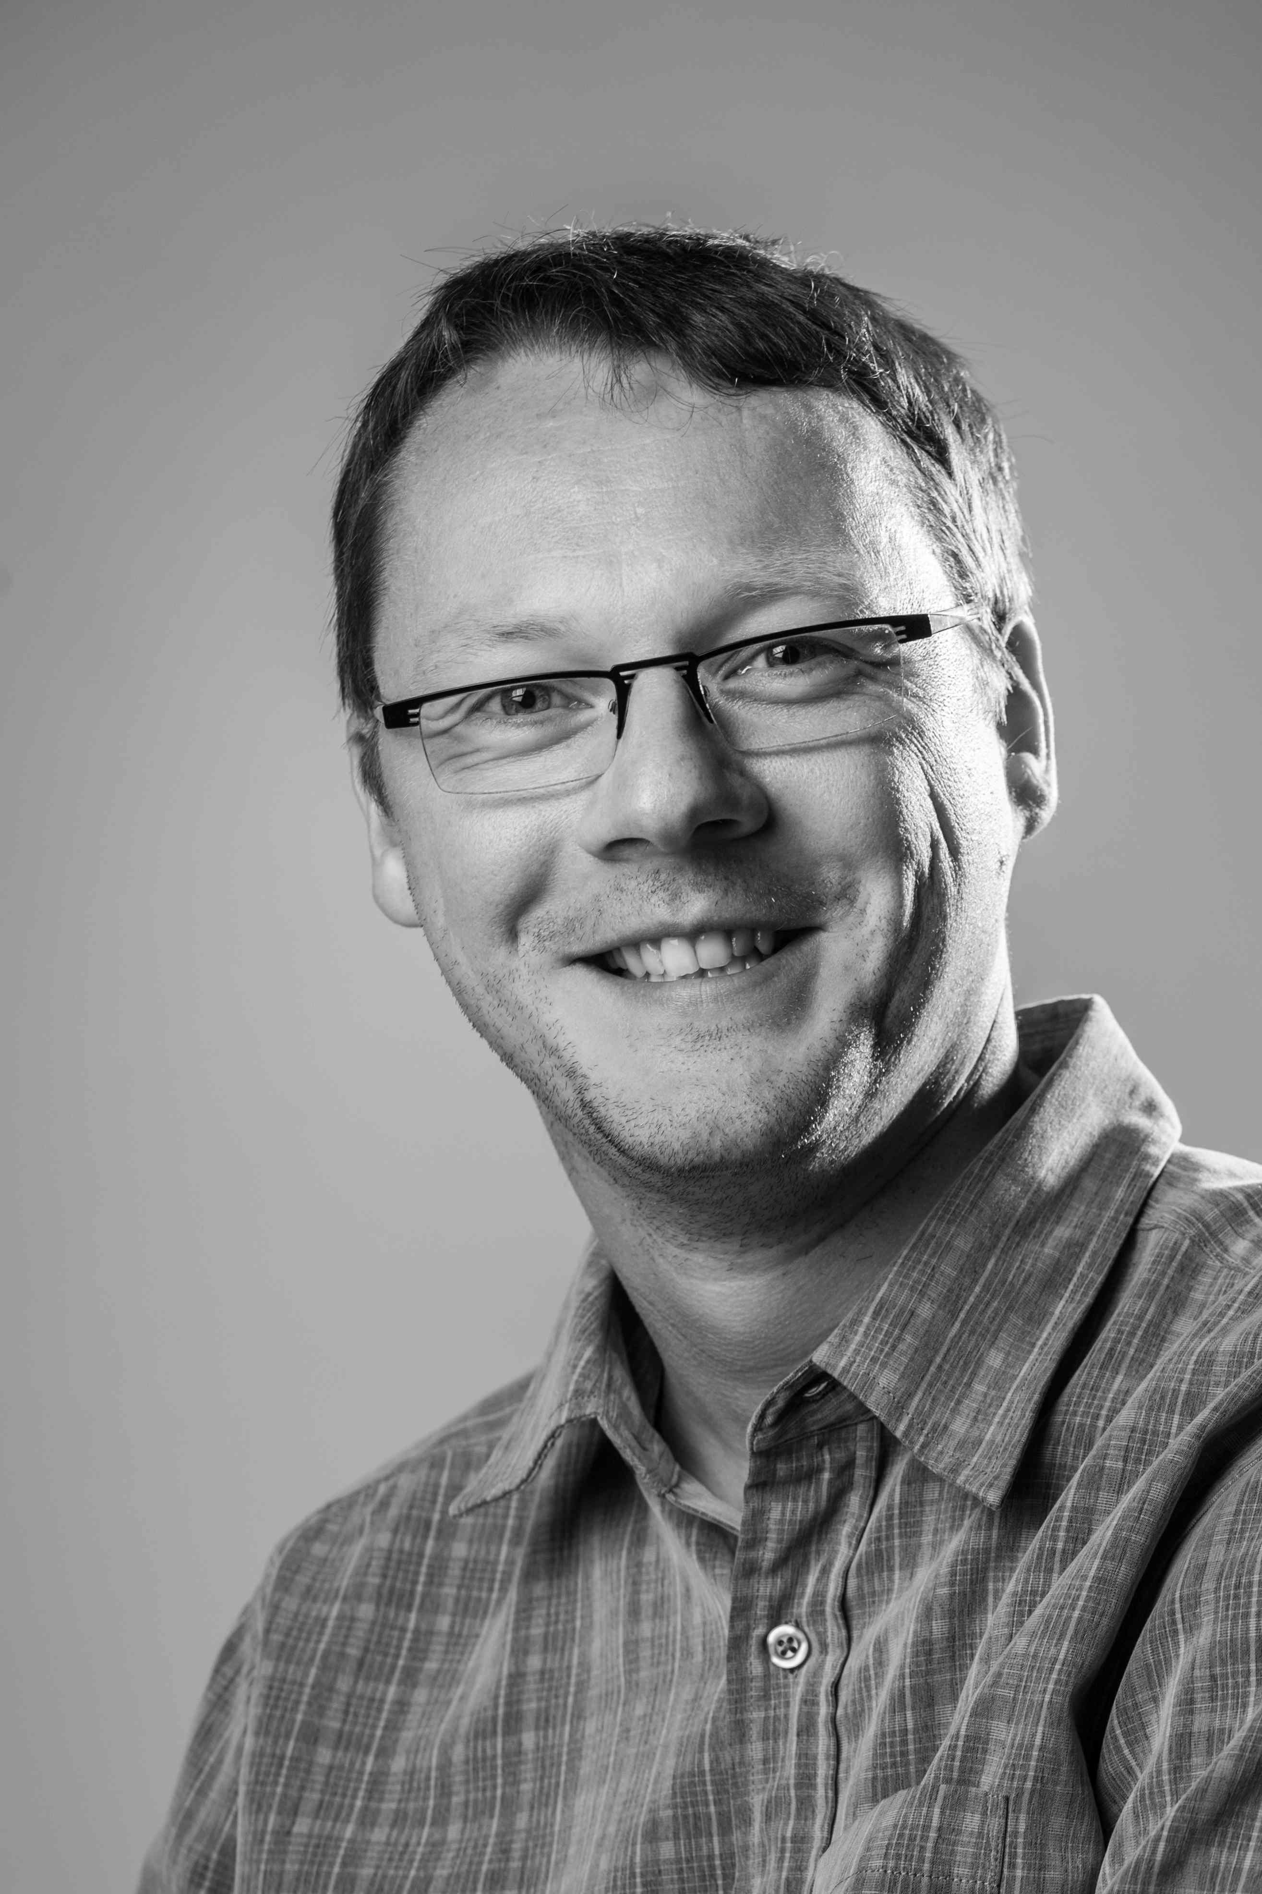
Damien Bruyndonckx
Your instructor

Slide 3
Who am I ?
I live in Thuin (Belgium)
In 1998, I started working as an elementary school teacher in Louisiana (USA).
I have been self-employed for about 5 years.
I specialize in IT training and eLearning.
I love music and from time to time I am a sound engineer in concerts.

Slide 4
Previous positions
Three years as a French teacher in Louisiana (USA).
Computer trainer in various training centers for adults.
Multimedia teacher in higher education.
Independent trainer specialized in eLearning.
Author for Packt Publishing since 2011.

Slide 5
Thank you !
I hope you'll find this course useful.
Don't hesitate to reach out if you need help.

