Slide 1



Salesforce Development in Cursor using MCP
From Zero to Hero
Mytutorialrack.com

Slide 2

What is Cursor?
Cursor is like Visual Studio Code with AI superpowers.
Think of VS Code, but instead of just editing text, it can:
Understand your code in context
Help you write, edit, debug, and refactor seamlessly
Act like an expert developer pairing with you
The interface still looks and feels like VS Code.
You can import all your old extensions and settings without hassle.
The key difference: an AI layer built directly into your coding flow.

Slide 3
Benefits of Cursor
Write Code Faster
As you type, Cursor predicts full lines or even whole blocks of code (like Gmail’s autocomplete, but for Apex, SOQL, LWC, JavaScript, etc.).
You hit Tab and it finishes your thought.
👉 Example: Start typing trigger AccountTrigger and Cursor will draft the whole trigger structure with before insert, before update methods, saving you setup time.

Slide 4
Benefits of Cursor
Fix & Refactor Instantly
Highlight some code → hit Inline Edit (Ctrl+K) → type what you want changed (“make this trigger bulk-safe”). Cursor rewrites it for you.
It doesn’t just suggest—it edits your file right there.
👉 Example: You paste messy SOQL inside a loop. Cursor can refactor it into a clean, bulkified handler class.

Slide 5
Benefits of Cursor
Agent for Bigger Tasks
Press Ctrl+I (Agent Mode) and describe what you want across the whole project:
“Add a new LWC that lets me search Contacts by Email and display them in a table with edit buttons.”
Cursor plans, creates files, updates tests, and even suggests terminal commands for you to approve.

Slide 6
Benefits of Cursor
Learn While You Code
You can literally ask Cursor:
“Explain what this Apex trigger is doing.”
“Show me why this validation rule is failing.”
Great for Salesforce Admins who are not deep developers but want to understand and learn.

Slide 7
Benefits of Cursor
Integrates with Salesforce DX (and MCP)
Cursor works with Salesforce CLI and MCP (Model Context Protocol), so you can run org commands right from chat.
Example prompts:
“Deploy everything in this project to my sandbox.”
“Run Apex tests and show me coverage %.”

Slide 8
Benefits of Cursor
Never Start From Scratch
Need a new formula field? Cursor writes the formula and explains it.
Need a Flow, an Apex invocable, or a Jest test for your LWC? Cursor scaffolds it.
It’s like having a coding coach that gives you both the “answer” and the “why.”

Slide 9


How Cursor Helps Day-to-Day
1
Salesforce Admins
Salesforce Developers
2
Generate formulas, validation rules, Flow actions, SOQL queries. Understand existing code without begging a developer.
Build Apex classes, LWCs, triggers, and tests in a fraction of the time. Stay focused on logic, let Cursor handle boilerplate.
3
Developers
Teams
Define coding rules once, and Cursor enforces them in every suggestion (naming conventions, bulkification, security best practices).

Slide 10
Power of Cursor
Cursor makes coding feel less like staring at a blank page and more like having a helpful senior dev sitting next to you—speeding up your work, reducing errors, and teaching you along the way.

Slide 11

What you will install
Cursor
Visual Studio Code
Salesforce CLI
Node.js
Java JDK
Git
VS code Extensions

Slide 12
How to Verify Installations
sf --version
node -v && npm -v
java -version
git --version
code –version

Slide 13
What is MCP Model Context Protocol?
Imagine you’re the boss of a big Lego city 🏙️
You (the boss) tell your assistant (Cursor) what you want: “Build me a hospital” or “Clean up the park.”
But Cursor can’t do everything by itself—it needs helpers who know how to use the right Lego sets.

Slide 14
What is MCP Model Context Protocol?
MCP is like a walkie-talkie system 📡
It lets Cursor talk to all these helpers in the city.
One helper knows how to use Salesforce tools (like Salesforce DX).
Another helper knows how to use GitHub (to fetch code).
Another helper knows Figma (to look at design files).
And more helpers can join in.

Slide 15
Why you need MCP ?
MCP is like giving Cursor a walkie-talkie so it can talk to different experts (GitHub, Salesforce, Figma, etc.) and help you get things done faster.

Slide 16
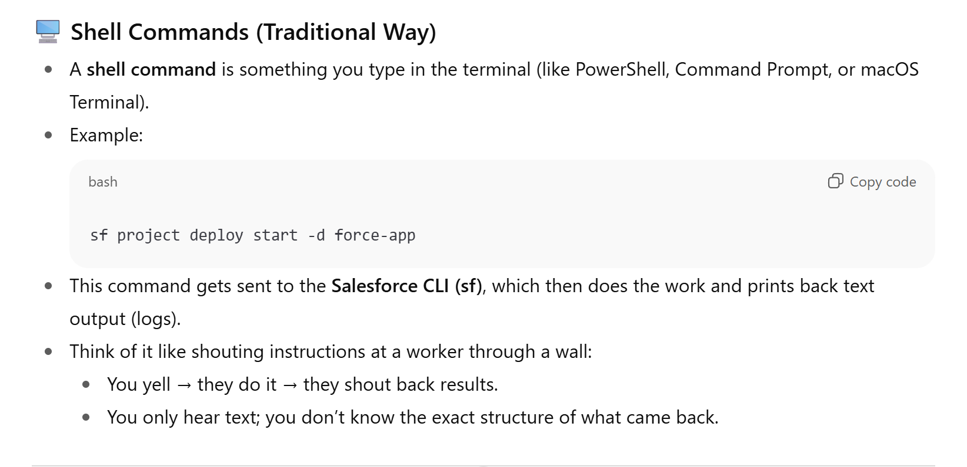
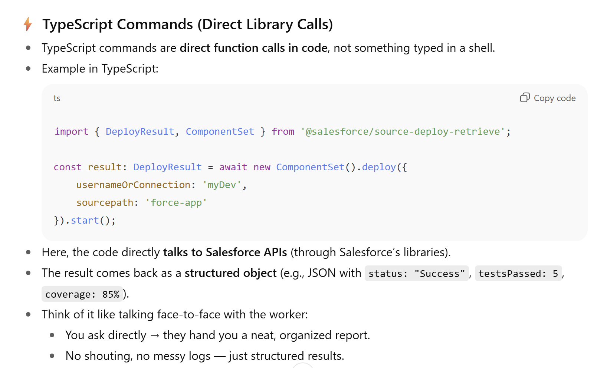
🖥️ Shell Commands (Traditional Way) vs TypeScript
Why you need MCP ?

Slide 17
Why do we need MCP in Cursor?
The Salesforce DX MCP Server is like a “bridge” that lets AI tools (like Cursor) safely talk to Salesforce orgs.
Normally, Cursor would just run Salesforce CLI (sf) commands in your terminal. But this MCP server is a special Salesforce-built version that:
Talks directly to Salesforce using TypeScript libraries (not shell commands).
Gives you safer, more controlled access to your orgs.

Slide 18
Key Features of MCP
Direct Interaction
→ The AI doesn’t just suggest code — it can actually run Salesforce actions like deploy, run tests, query records, etc.
Secure (No plain text secrets)
→ Instead of making you paste tokens into config files, it uses your already-authenticated Salesforce CLI login (encrypted).
Granular Access Control
→ You choose exactly which orgs the MCP server can touch (via allowlisting).
→ For example, you could allow DevSandbox but block Production.

Slide 19
Security Features
No Shell Commands
→ It doesn’t just run sf CLI commands in your terminal.
→ Instead, it calls Salesforce APIs directly using TypeScript libraries.
→ This makes it faster and much safer (less chance of hacking or running unwanted code).
No Secrets in Config Files
→ You don’t need to paste usernames, passwords, or tokens into mcp.json.
→ It reuses the encrypted login sessions you already have from Salesforce CLI.
Tokens Stay Hidden
→ MCP tools never pass around your real access tokens.
→ They just use usernames/aliases (like myDev) to know which org to talk to.
Org Allowlisting
→ You explicitly pick which orgs can be accessed by MCP.
→ Even if you’re logged into 5 orgs, MCP might only be allowed to touch 1 or 2.

Slide 20
Why do we need MCP in Cursor?
Safe & Controlled
The Salesforce DX MCP Server is a safer, smarter, and more controlled way for AI tools like Cursor to interact with Salesforce orgs.
Instead of running shell commands, it uses direct libraries.
Instead of exposing secrets, it uses your existing encrypted auth.
Instead of having unlimited access, it uses org allowlisting.

Slide 21
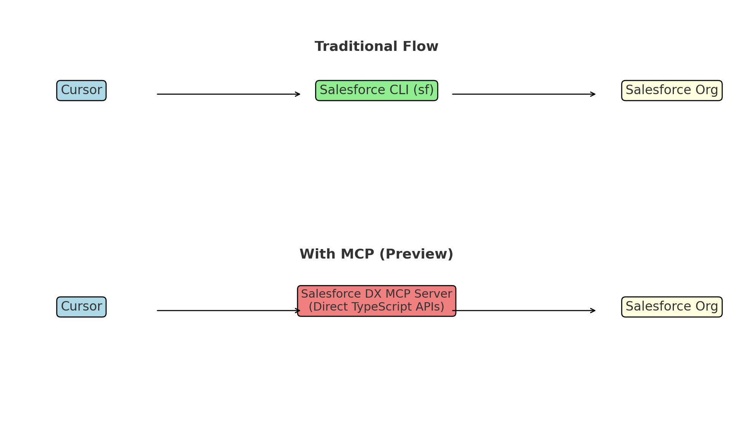
Why do we need MCP in Cursor?

Slide 22
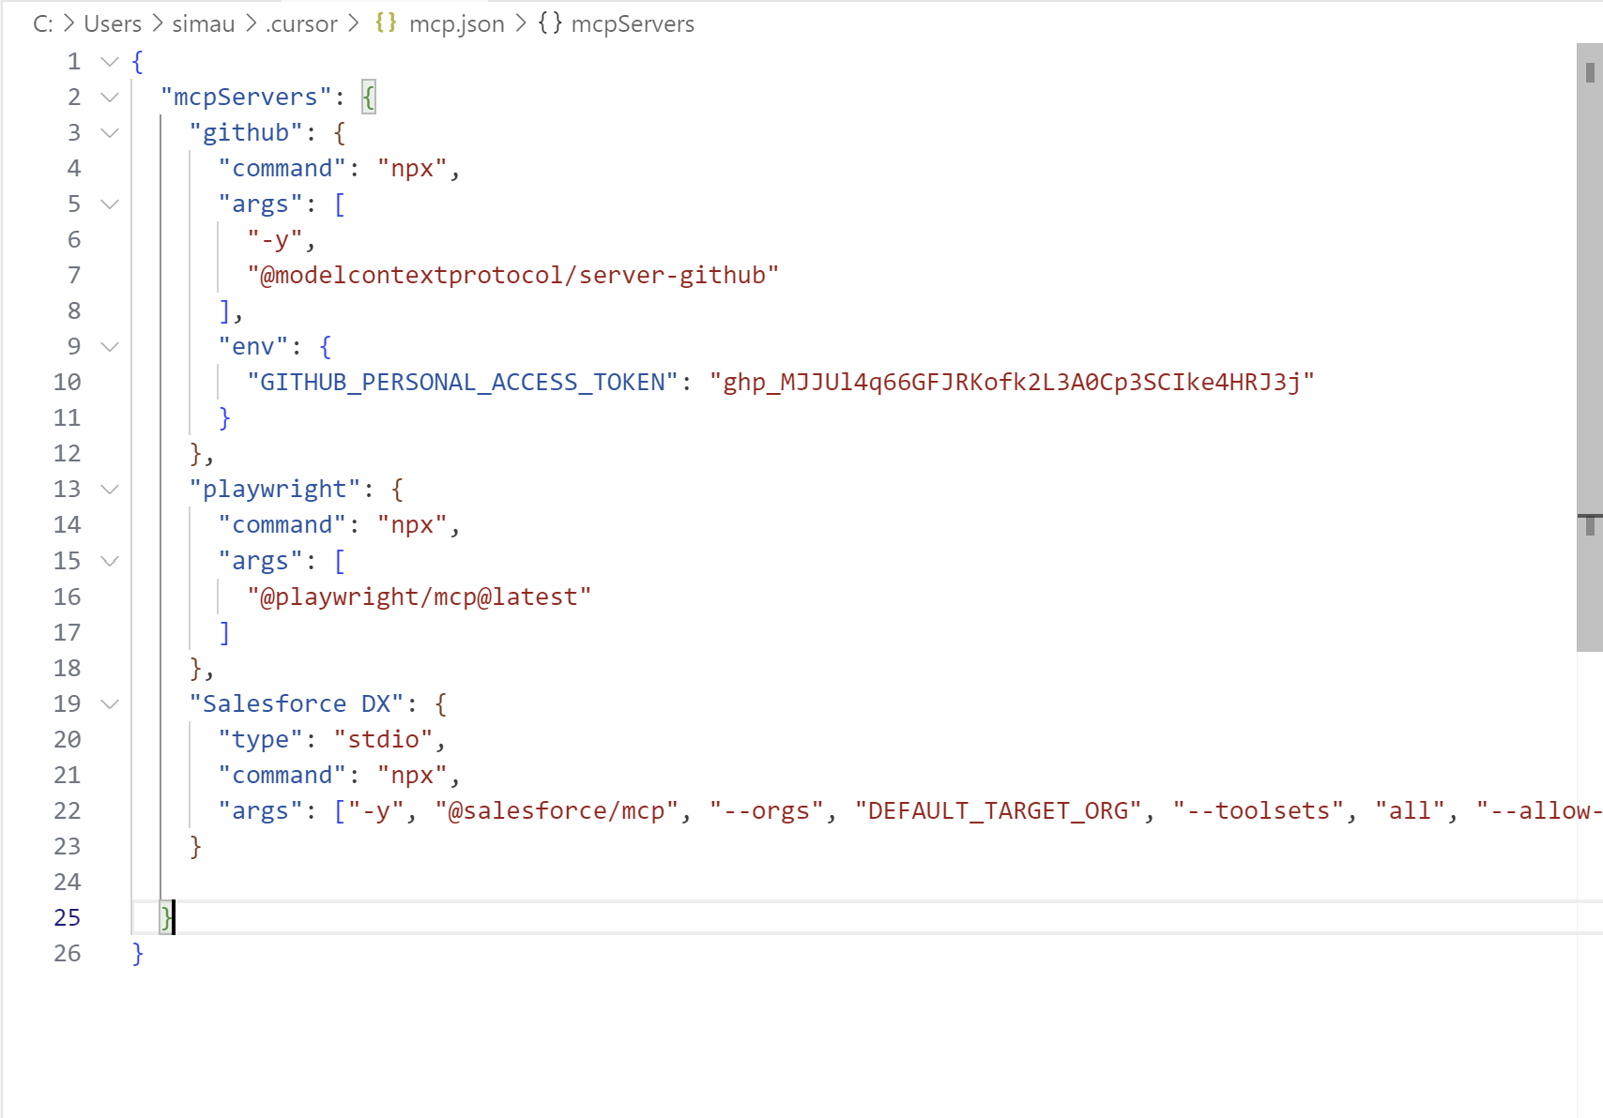
MCP.json FILE we need MCP in Cursor?

Slide 23
MCP.json FILE we need MCP in Cursor?
Flag Name | Description | Required
--orgs | One or more orgs that you've locally authorized. | Yes
--toolsets | Sets of tools, based on functionality, that you want to enable. | No
--tools | Individual tool names that you want to enable. | No. You can use this flag in combination with the --toolsets flag. For example, you can enable all tools in one toolset, and just one tool in a different toolset.
--no-telemetry | Boolean flag to disable telemetry, the automatic collection of data for monitoring and analysis. | No
--debug | Boolean flag that requests that the DX MCP Server print debug logs | No
--allow-non-ga-tools | Boolean flag to allow the DX MCP Server to use both the generally available (GA) and NON-GA tools that are in the toolsets or tools you specify. | No, By default, the DX MCP server uses only the tools marked GA.
--dynamic-tools | (experimental) Boolean flag that enables dynamic tool discovery and loading. When specified, the DX MCP server starts with a minimal set of core tools and loads new tools as needed. | No, This flag is useful for reducing the initial context size and improving LLM performance. Dynamic tool discovery is disabled by default.

Slide 24
With or without MCP
Feature / Behavior | Without MCP | With MCP
How deployment happens | Cursor runs Salesforce CLI (sf) commands directly in the terminal. | Cursor talks to the Salesforce DX MCP server, which exposes official “tools” like deploy, test, query.
Result format | Raw terminal text/logs (you read the output manually). | Structured results (organized tables/JSON) that Cursor can interpret and summarize for you.
Approval step | No explicit approval — command just runs in terminal. | Always shows proposed action → you must Approve / Deny.
Error handling | Errors show as plain text (you parse them yourself). | Errors are structured and easier for Cursor to explain or auto-fix.
Context awareness | Cursor doesn’t “know” what happened, it just sees logs. | Cursor understands the tool response (e.g., coverage %, failed tests) and can reason about next steps.
Security | Less control — commands execute directly. | Safer — Cursor only runs what you approve, nothing hidden.
Best for… | Quick solo dev work (small projects, personal sandboxes). | Team projects, teaching, or critical deployments where clarity & safety matter.

Slide 25
Demo Project using Salesforce DX MCP and Cursor
Learn about Creating New custom fields
Learn about Deploying Code through cursor.
Building Flows
Writing Trigger and test classes
Create a LWC component.

Slide 26
Demo Project
Insert three New Fields on Account Object.
Health_Score__c (Number, precision 3,scale 0, label Health Score)
Revenue_Tier__c (Formula, return type text, label Revenue Tier) with formula:
if(AnnualRevenue >=1000000, “Gold”,
If(AnnualRevenue>= 250000, “Silver”, “Bronze”))
Create Last_90_Day_Wins__c (Currency, precision 16, scale 2, label Last 90 Day Wins)

Slide 27
Demo Project
Create a new field on the Opportunity Object:
Discount__c (Percent, precision 3, scale 0, label Discount)
Create a new validation rule for this field:
Formula : Discount__c >.30
Error Message: Discount cannot exceed 30%
Error displayed on field: Discount__c

Slide 28
Demo Project
Create a record-triggered flow
Trigger: After Save on Account
Entry: Always
Logic: if Health_Score__c <40, create a task for Record.ownerId with Subject Proactive Check-in due in 2 days, Comment Health Score fell below 40. Please reach out.

Slide 29
Demo Project
Write an Apex Service Class that calculates and updates on Account Health Score
Class Name: AccountHealthService
Visibility and Secuirty: public with sharing
Method Signature:
public static void updateHealthScores (Set <Id> accountIds)

Slide 30
RevenueScore from AnnualRevenue
RecentWinsScore from Last_90_Day_Wins__c(currency)
Scoring rules (spell this out exactly):
RevenueScore (based on AnnualRevenue):
If AnnualRevenue is null or 0 → 0 points
If AnnualRevenue > 0 and < 250,000 → 10 points
If AnnualRevenue >= 250,000 and < 1,000,000 → 30 points
If AnnualRevenue >= 1,000,000 → 50 points
RecentWinsScore (based on Last_90_Day_Wins__c):
If Last_90_Day_Wins__c is null or 0 → 0 points
If Last_90_Day_Wins__c > 0 and < 25,000 → 10 points
If Last_90_Day_Wins__c >= 25,000 and < 100,000 → 30 points
If Last_90_Day_Wins__c >= 100,000 → 50 points
Final score: Health_Score__c = RevenueScore + RecentWinsScore

Slide 31
Demo Project
Now write a test class AccountHealthServiceTest that:
Inserts four Accounts covering each revenue bucket and each wins bucket
Calls AccountHealthService.updateHealthScores(new Set<Id>{…}).
Asserts the exact Health_Score__c for several representative accounts (e.g., 50+50=100, 30+10=40, 10+0=10, 0+0=0).
Uses no seeAllData=true.
Achieves ≥ 90% coverage for the service class.”

Slide 32
Demo Project
Implement a bulk-safe Opportunity trigger and trigger handler that rolls up Closed Won amounts from the last 90 days to the parent Account field Last_90_Day_Wins__c(Currency), then recalculates account health via AccountHealthService.updateHealthScores(…)

Slide 33
Demo Project
Create a test class for this OpportunityTriggerHandler.
Happy path:
Insert an Account (e.g., BigCo) with some AnnualRevenue.
Insert 3 Opportunities:
Closed Won, CloseDate = Date.today().addDays(-5), Amount = 80,000 → counts
Closed Won, CloseDate = Date.today().addDays(-100), Amount = 50,000 → does NOT count
Prospecting, CloseDate = Date.today().addDays(-3), Amount = 20,000 → does NOT count

Slide 34
Demo Project
Edge cases / bulk:
Insert another Account with no Closed Won in last 90 days; ensure it gets 0.
Insert multiple Opportunities across two Accounts to validate bulk aggregation works (sums per account).
Don’t use SeeAllData=true.
Aim for ≥ 85% coverage across the handler and trigger.

Slide 35
Demo Project
Create an LWC for Contact search.
HTML: input for last name + Search button + datatable (Name, Email)
JS: calls @salesforce/apex/ContactController.searchContacts(lastName) and sets data
Apex ContactController (with sharing), @AuraEnabled(cacheable=true), returns Id, Name, Email from Contact WHERE LastName LIKE ‘%key%’, LIMIT 50.

Slide 36
What is A Token ?
A token is like a little chunk of text.
Computers don’t read text letter by letter or word by word — they break it into tokens.
Example: "Salesforce is awesome!” → might become: Sales | force | is | awesome | !That’s 5 tokens, even though it’s 3 words.
So tokens are basically pieces of words the AI understands.

Slide 37
How tokens add up ?
Type a prompt → it gets split into tokens.
AI replies → its answer is also counted in tokens.
👉 You pay for prompt tokens + response tokens.

Slide 38
Pro Tips
Shorter, clearer prompts = fewer tokens + better results.
Use context sparingly (don’t paste huge logs unless needed).
Summarize responses if you only need the key points — saves tokens.

Slide 39
PROMPT 1
Use a Short Prompt Example
Write a simple Apex class that multiplies two numbers and returns the result.

Slide 40
PROMPT 2
Use a Long Prompt Example
Can you please, in the most detailed manner possible, create an Apex class that performs a mathematical operation specifically multiplication between two integers, ensuring you include all necessary Salesforce best practices such as proper class declaration with ‘public with sharing’, inline comments for every single line of code to make it extremely beginner friendly, a constructor even if it is empty, an example usage snippet inside a comment block, and proper exception handling even though multiplying two integers does not normally throw errors. Also explain the code afterward in plain English.”

Slide 41
Cursor Rules
Think of Rules in Cursor like the ground rules you give an assistant before they start working for you.
They tell Cursor how to behave when helping you.
They apply automatically in the background, so you don’t need to repeat instructions every time.
Without rules, Cursor just uses general AI knowledge. With rules, it tailors itself to your style, project, or company standards.

Slide 42
Key Points about Cursor Rules
Rules are persistent (they apply to all prompts until you change/remove them).
They act like “guardrails” for coding, style, or process.
They’re stored in a special place (cursor/rules) inside your project.

Slide 43
Example Cursor Rules
1. **NEVER put SOQL/DML inside loops** - Always bulkify your code
2. **Use selective SOQL queries** - Avoid non-selective patterns like !=, <>, or LIKE with leading wildcards
3. **Use collections for DML operations** - Process records in batches, not individually
4. **Implement proper exception handling** - Catch specific exception types
5. **Avoid hardcoded limits** - Use dynamic SOQL limits
6. **Enforce CRUD/FLS security** - Use WITH SECURITY_ENFORCED and Security.stripInaccessible()
7. **Avoid CPU-intensive operations** - Prevent infinite loops and complex operations
8. **Always perform null checks** - Prevent NullPointerExceptions
9. **Control trigger recursion** - Use static boolean flags or trigger frameworks
10. **🚨 MANDATORY: Follow DET_ naming conventions** - ALL Apex classes and files MUST use DET_ prefix

Slide 44
Best Practices for Cursor Rules
Keep rules under 500 lines
Split large rules into multiple, composable rules
Provide concrete examples or referenced files
Avoid vague guidance. Write rules like clear internal docs
Reuse rules when repeating prompts in chat

Slide 45
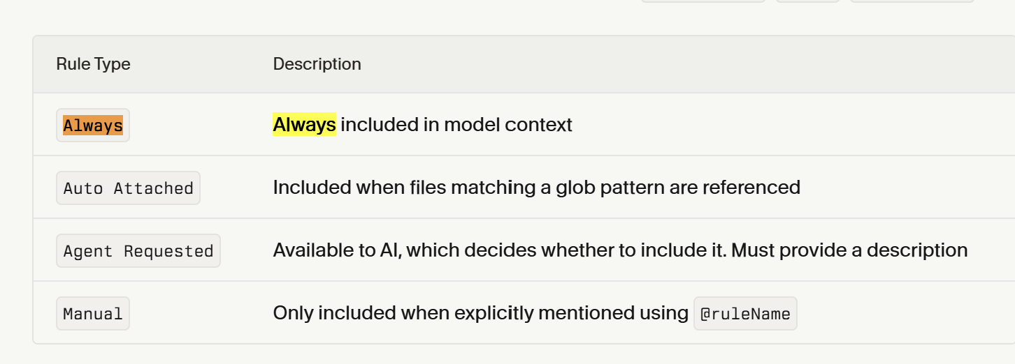
Different Rule Types

Slide 46
GitHub MCP Server
Connect to GitHub MCP server through mcp.json
Update the token in the mcp file.

Slide 47
Prompts to Try
List down all the repositories I have.
Create a new repository.
Commit AccountHealthService and its corresponding test class to the CursorProject3 repository.
List open pull requests in <owner>/<repo>.

Slide 48
Prompts to Try
Show me the most recent commits on the main branch in <owner>/<repo>.
Open and display the contents of README.md from the main branch in <owner>/<repo>.
Create a new issue in CursorProject3 titled “Add AccountHealthService Apex class” with body “We need a service to calculate Account health based on revenue and last 90-day wins.

Slide 49
Prompts to Try
List all open issues in CursorProject3
Add a comment to issue #1 in CursorProject3 that says “I’ll start working on this now.
Close issue #1 in CursorProject3 with comment “Feature implemented and merged.

Slide 50
Cursor Commands
Create a new folder name commands inside of .cursor
Instead of typing long prompts every time, you can set up simple commands that start with a / (like /review or /deploy) to make Cursor do specific tasks automatically.
These commands help you and your team save time, stay consistent, and run the same workflows (like code reviews, deployments, or documentation checks) with just one quick command.

Slide 51
Cursor Commands
# Code Review Checklist
## Overview
Comprehensive checklist for conducting thorough code reviews to ensure quality, security, and maintainability.
## Review Categories
### Functionality
- [ ] Code does what it's supposed to do
- [ ] Edge cases are handled
- [ ] Error handling is appropriate
- [ ] No obvious bugs or logic errors
### Code Quality
- [ ] Code is readable and well-structured
- [ ] Functions are small and focused
- [ ] Variable names are descriptive
- [ ] No code duplication
- [ ] Follows project conventions
### Security
- [ ] No obvious security vulnerabilities
- [ ] Input validation is present
- [ ] Sensitive data is handled properly
- [ ] No hardcoded secrets

Slide 52
Agentforce for Developers
Agentforce for Developers, an AI-powered tool available as a Visual Studio Code extension, provides a range of benefits designed to boost productivity and streamline the Salesforce development workflow.
Developers can leverage its AI capabilities to focus on complex problem-solving rather than repetitive tasks.

Slide 53
Enhanced productivity and efficiency
Generate code and tests: Developers can use natural language prompts to generate Apex code, test cases for Apex methods, and Lightning Web Component (LWC) components.
Inline code completion: The tool offers AI-powered, inline code completion suggestions as you type for Apex and LWC files, reducing the need for manual typing and minimizing errors.
Automated tasks: Agentforce's "Dev Agent" can execute multi-step development tasks, such as analyzing unfamiliar code, improving documentation, and managing complex workflows through natural language commands.
Reduced context switching: By integrating AI assistance directly into the VS Code environment, developers can execute complex commands without switching between different tools and interfaces.

Slide 54
Improved code quality and consistency
Enforce best practices: The tool helps enforce development standards by generating boilerplate code and supporting static analysis and security scanning tools.
Standardized development: Developers can create and enforce consistent coding standards and project-specific preferences across their teams using "Dev Agent Rules".
Enhanced understanding: Dev Agent can help developers quickly understand existing or unfamiliar code by providing explanations and concise summaries.

Slide 55
Secure and integrated development
Built on a trusted platform: Agentforce is built on the secure Salesforce Platform, respecting your existing security policies and using a Trust Layer to protect sensitive data.
Seamless integration: It connects directly with your existing Salesforce org, Salesforce DX CLI, and DevOps workflows, allowing for seamless deployment and metadata operations.
External system connectivity: Through the Model Content Protocol (MCP), Agentforce can securely connect to external systems and data sources, extending its capabilities.

Slide 56
⚙️ Business Scenario
Your fictional company, BoostForce, wants to help their sales teams focus on deals that are most likely to close. You’ll build an AI-assisted “Sales Productivity Booster” feature with these components:
An Apex service that calculates a Priority Score for each Opportunity
An Apex trigger that updates the score automatically when key fields change
A LWC dashboard to display high-priority deals
SOQL queries, unit tests, and documentation — all generated and refined using Agentforce.

Slide 57
⚙️ Create Custom Fields
Object | Field | Type | Description
Opportunity | Priority_Score__c | Number(3,0) | AI-calculated score (0–100)
Opportunity | Confidence__c | Percent(3,1) | Rep’s confidence in close
Opportunity | Days_To_Close__c | Formula | CloseDate - TODAY()

Slide 58
⚙️ Build the Apex Service — OpportunityScoringService
Create an Apex class called OpportunityScoringService with a method updateScores(Set<Id> oppIds) that calculates Opportunity.Priority_Score__c as: (0.5 × Confidence__c) + (0.3 × Stage Weight. Use SOQL to fetch data efficiently.

Slide 59
⚙️ Create a Trigger Handler
Write a trigger handler that calls OpportunityScoringService.updateScores() whenever Opportunity stage, amount, or confidence changes.

Slide 60
⚙️ Create a Lightning Web Component
Create an LWC called opportunityPriorityBoard that displays a table of top 10 Opportunities with columns: Name, Stage, Priority Score, Amount, and Close Date. Include a refresh button.

