Slide 1
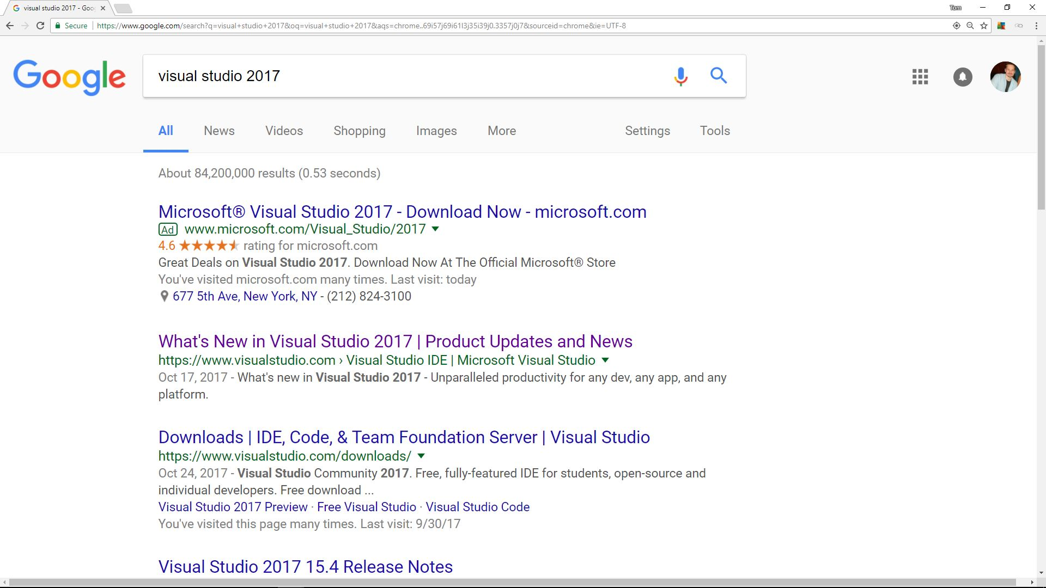
1. Do a search as shown below.

Slide 2
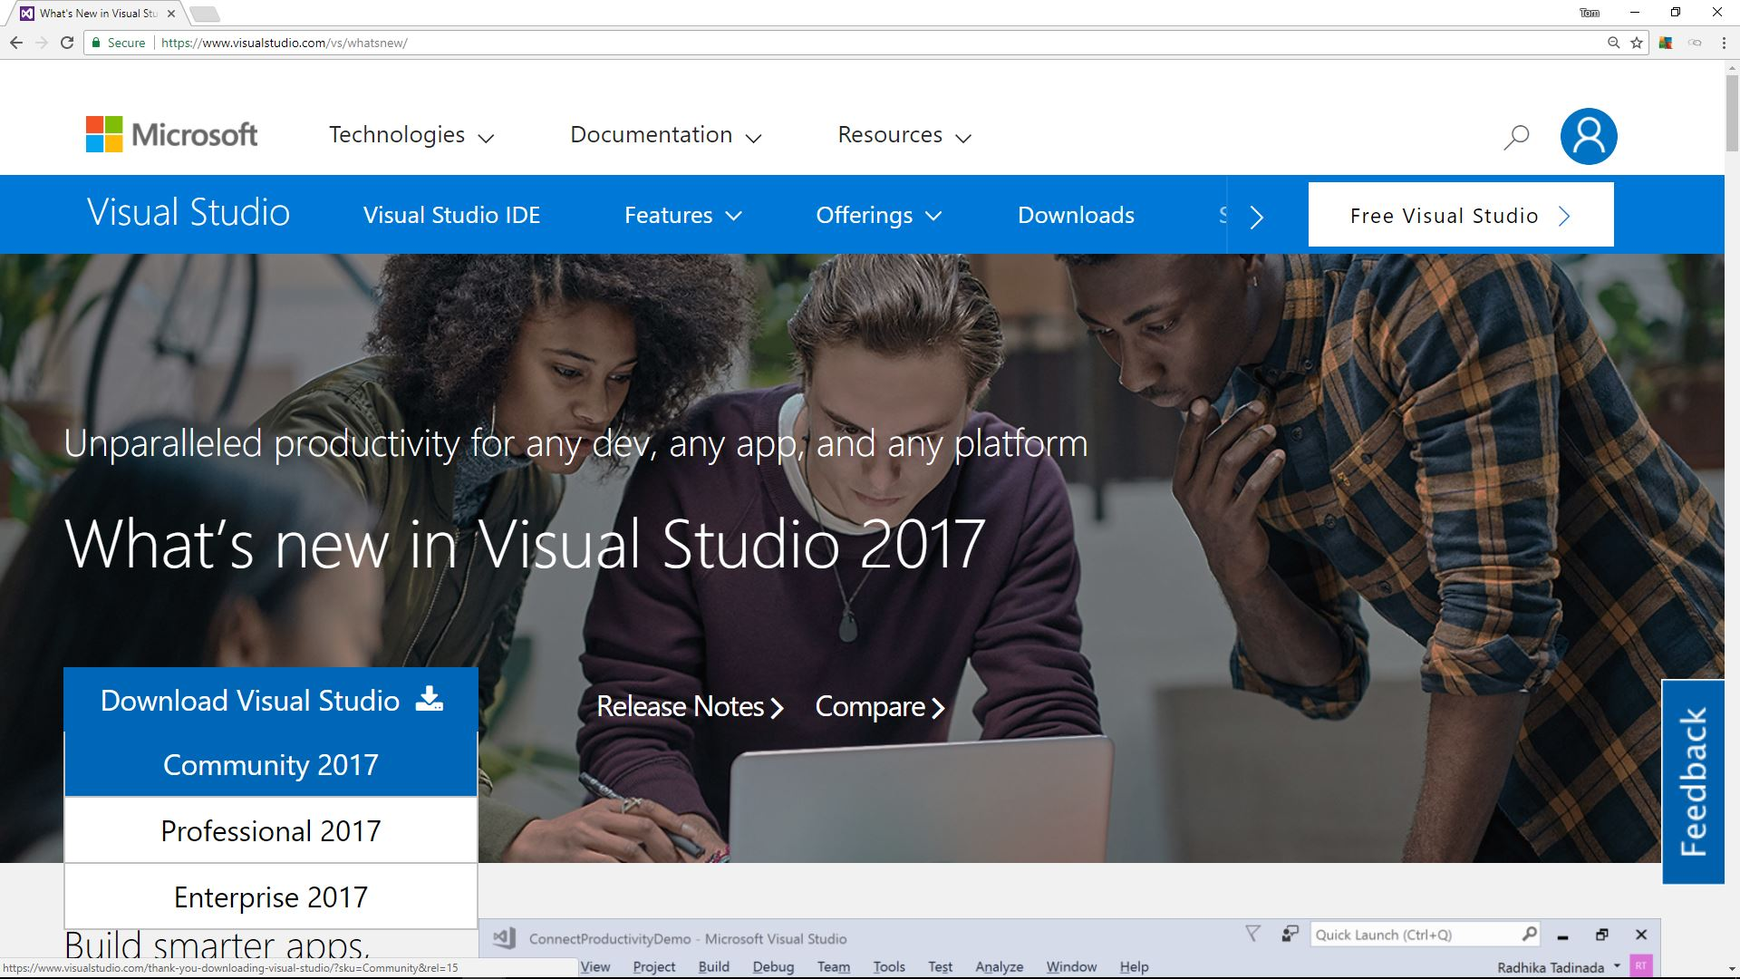
2. Click Download Visual Studio Community 2017.

Slide 3
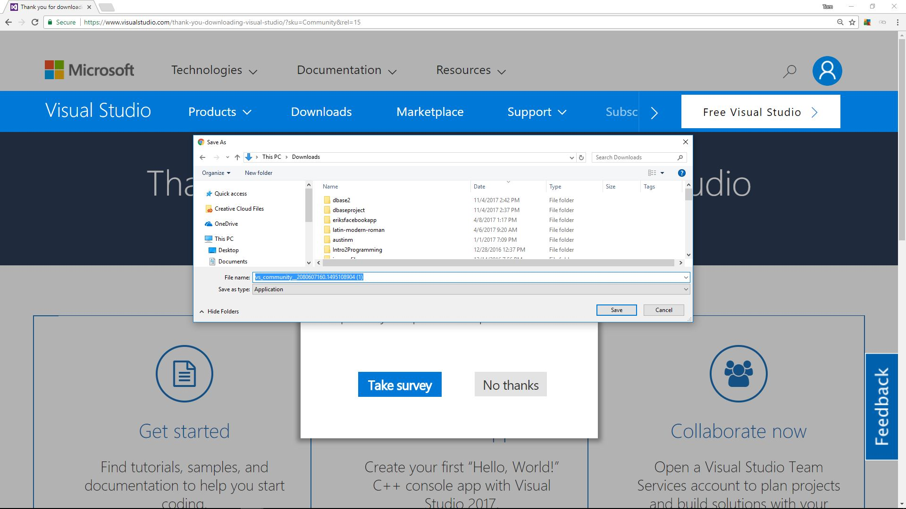
3. Save the installer.

Slide 4
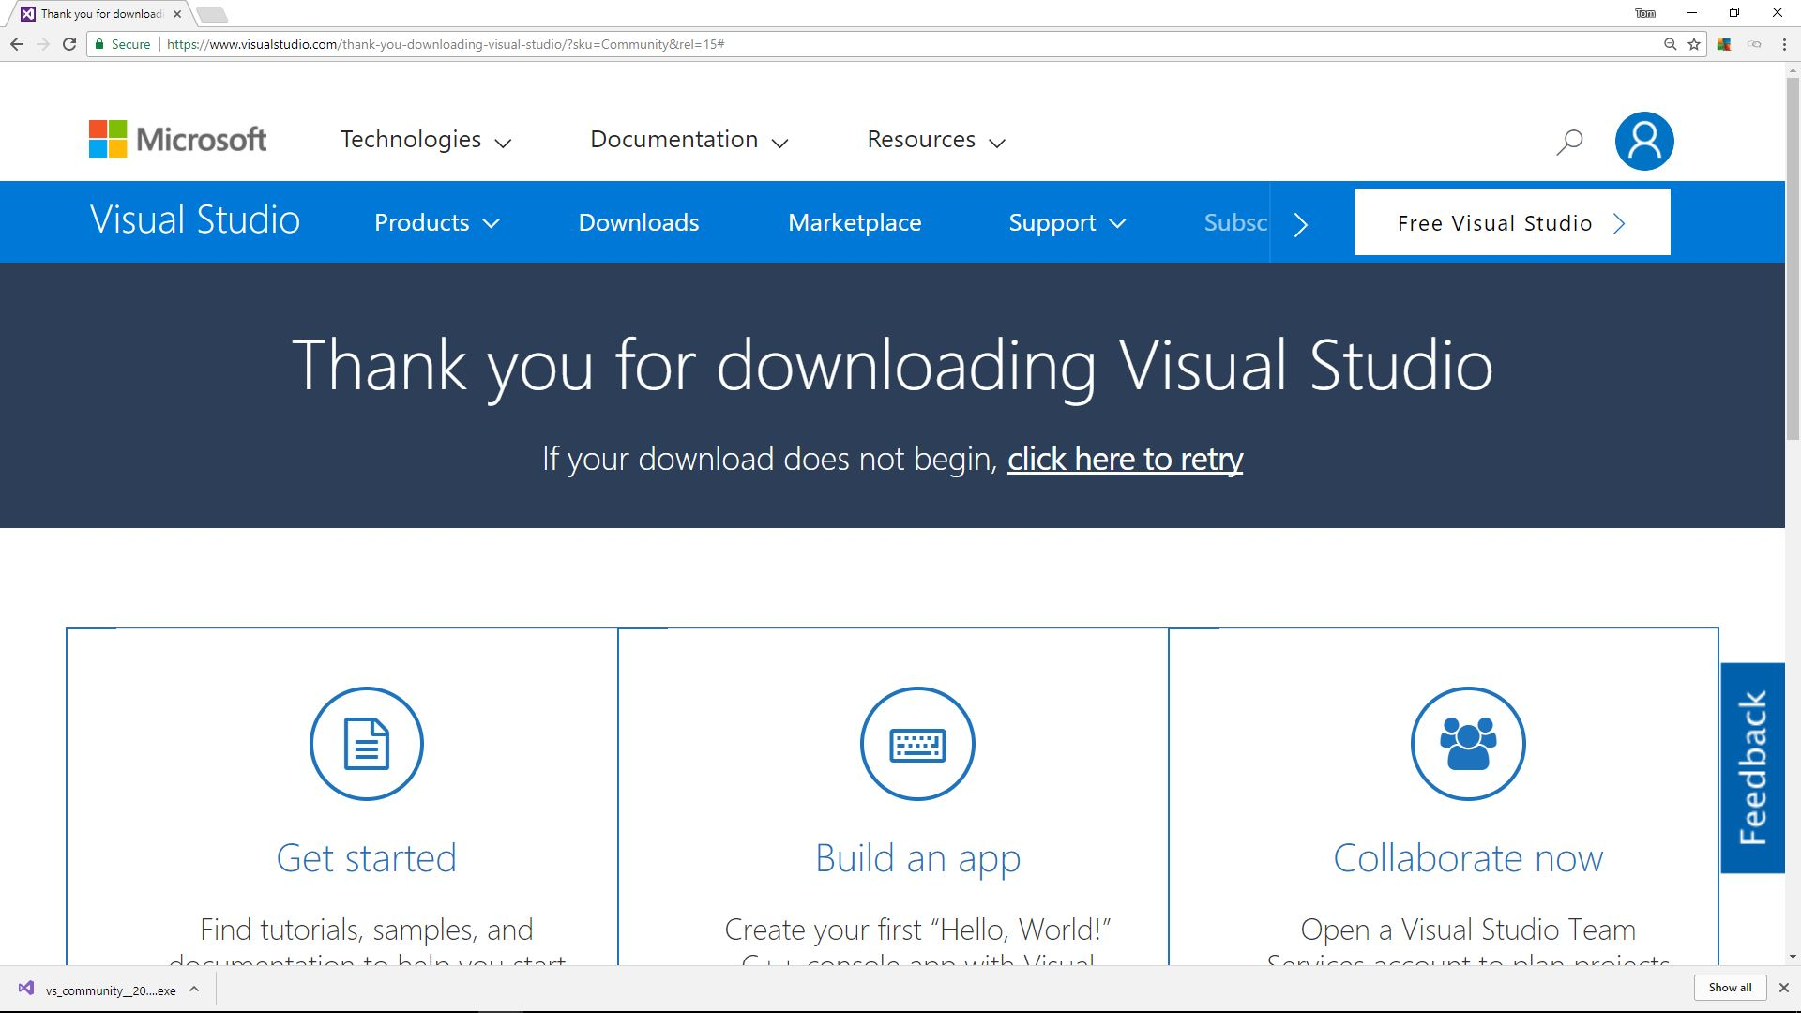
4. Save the installer.
Click on the installer to start the installation process.

Slide 5
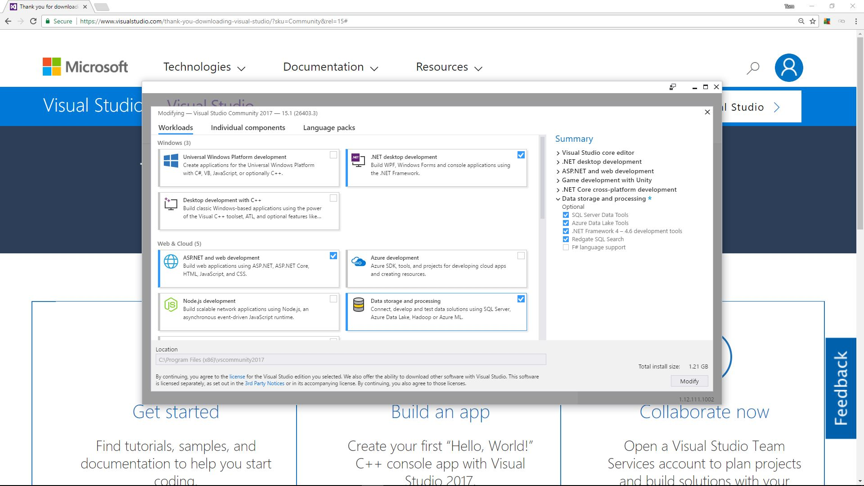
5. Choose the options shown below.

Slide 6
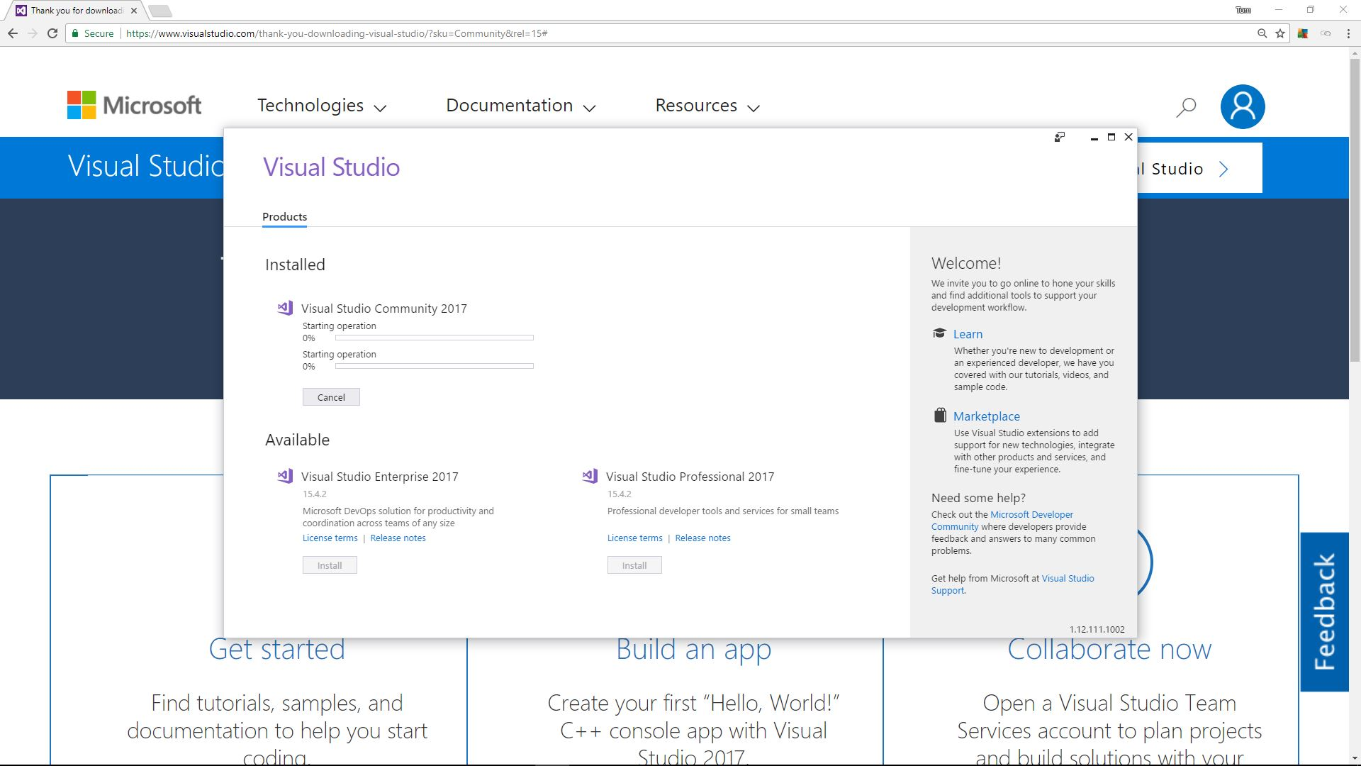
6. Wait for installation process to complete.

Slide 7
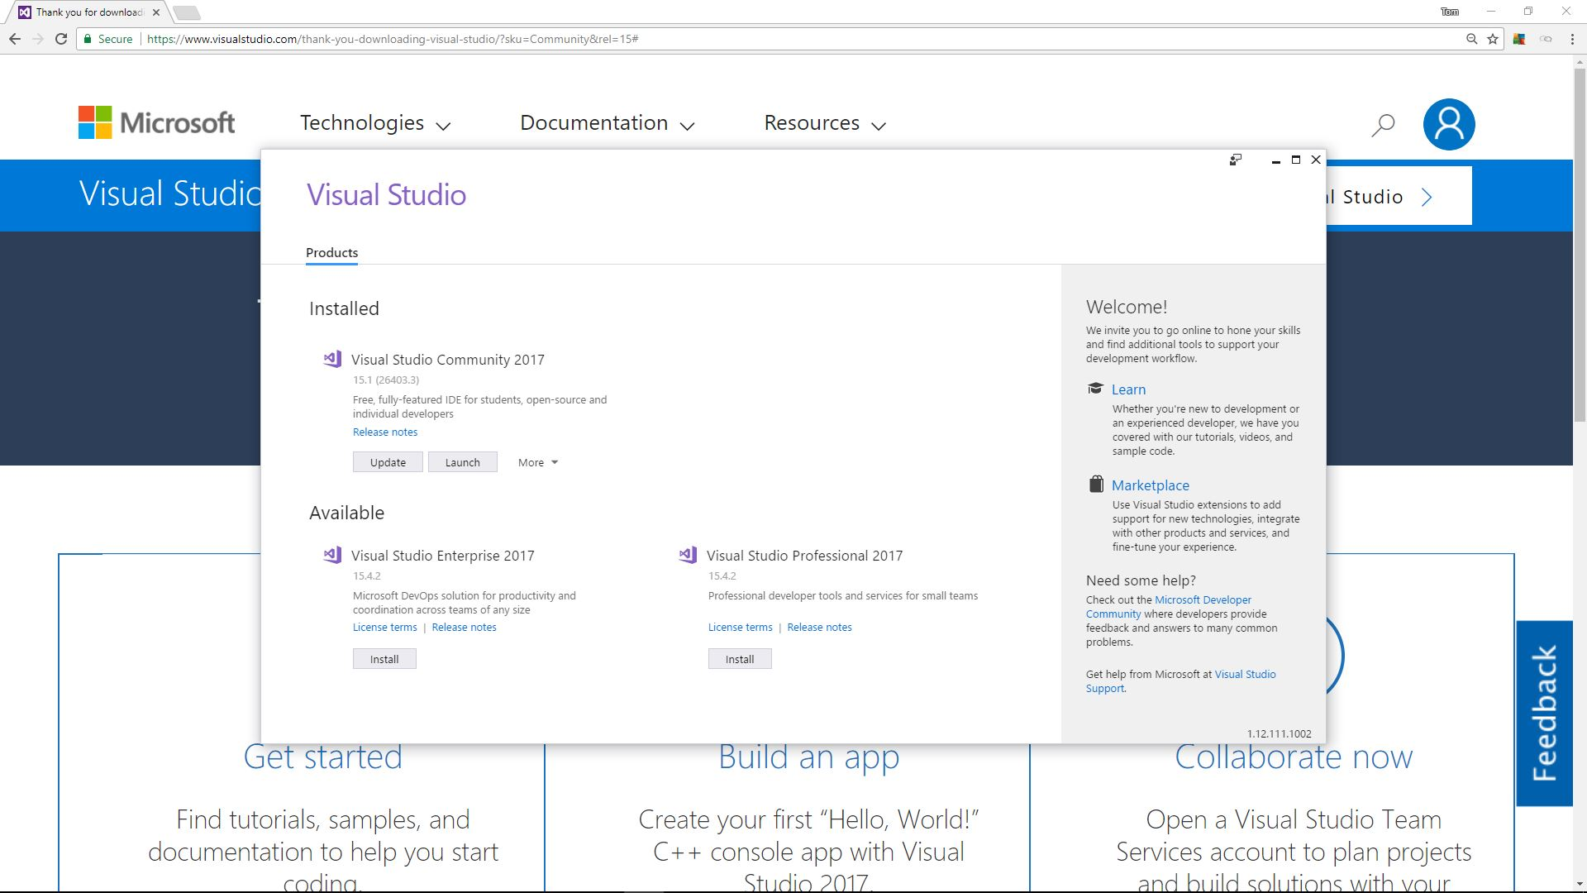
7. Click to launch Visual Studio.

Slide 8
8. Click to launch Visual Studio.

Slide 9
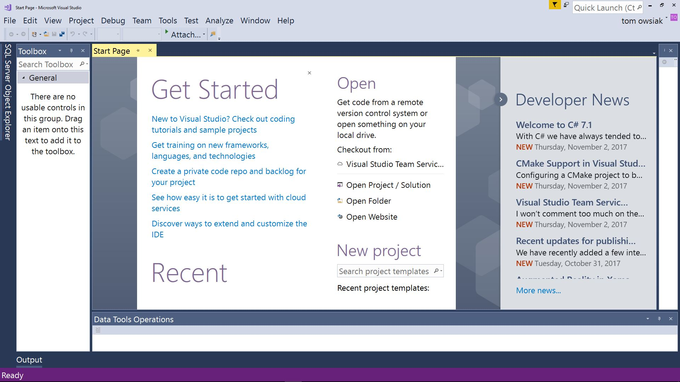
9. This is Visual Studio opened up.

