Slide 1
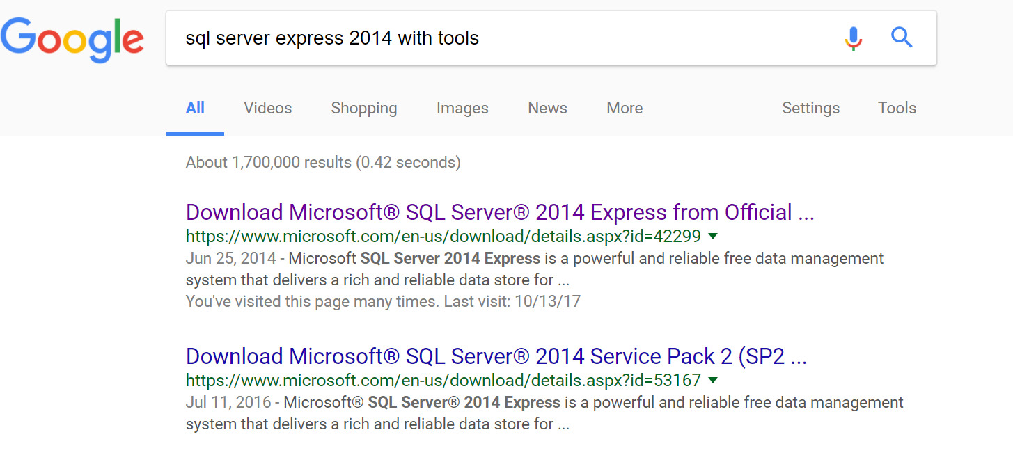
1. Do a search as shown below.

Slide 2
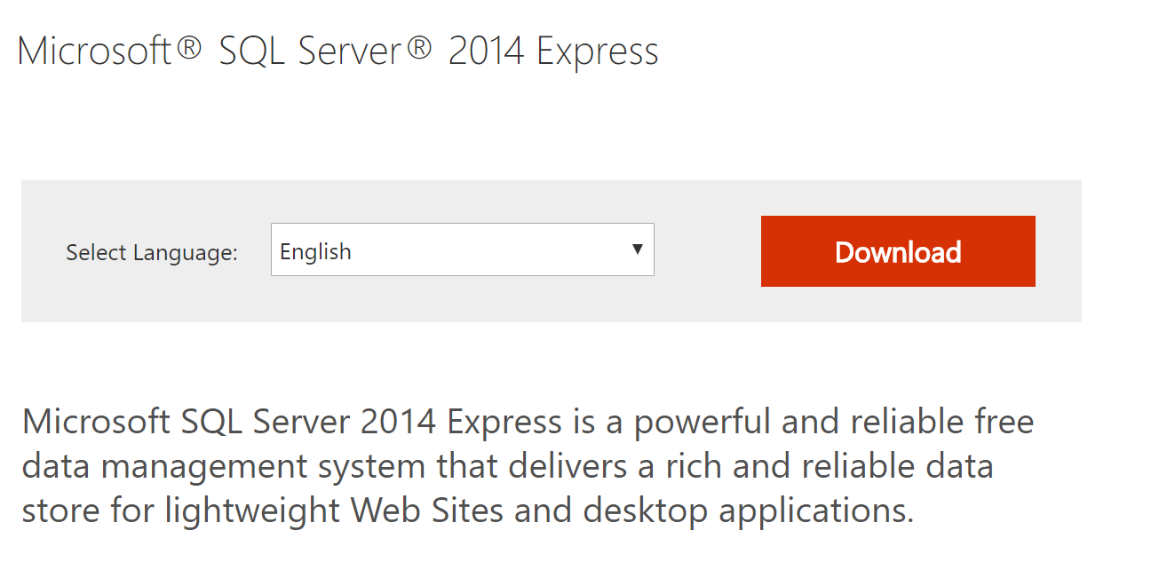
2. From the next page click download.

Slide 3
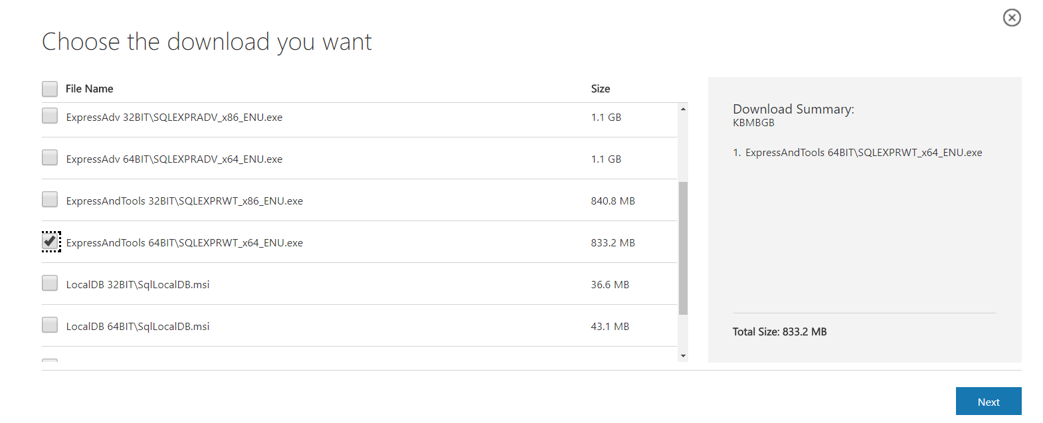
3. Choose the package shown below. It contains both
the server and the management studio.

Slide 4
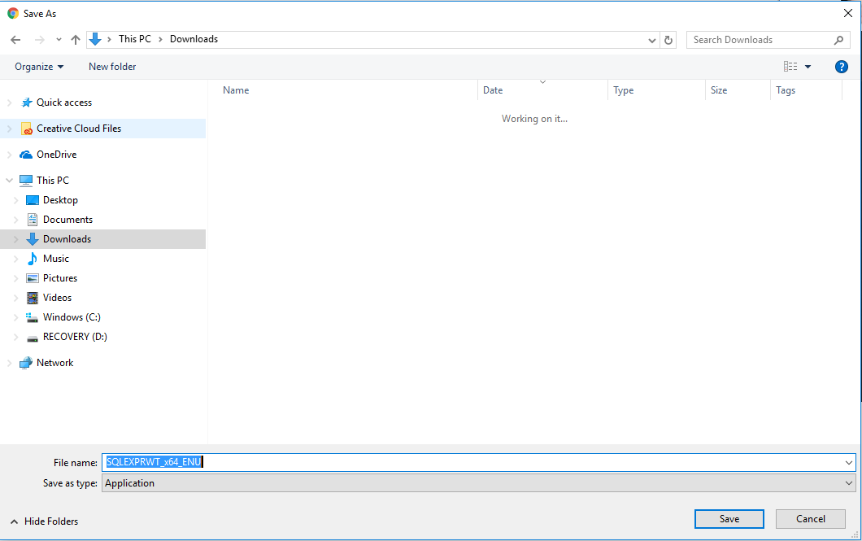
4. Save the installer.

Slide 5
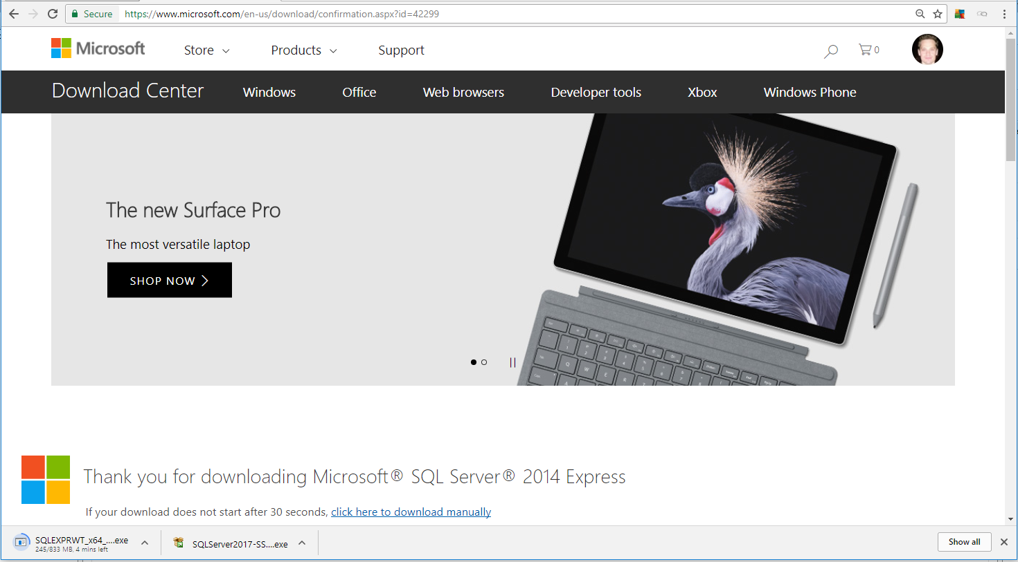
5. Click on the installer after it downloads.
Click the installer after it downloads.

Slide 6
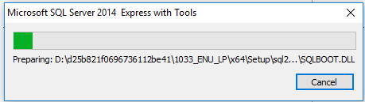
6. Wait for the process of extraction to complete.

Slide 7
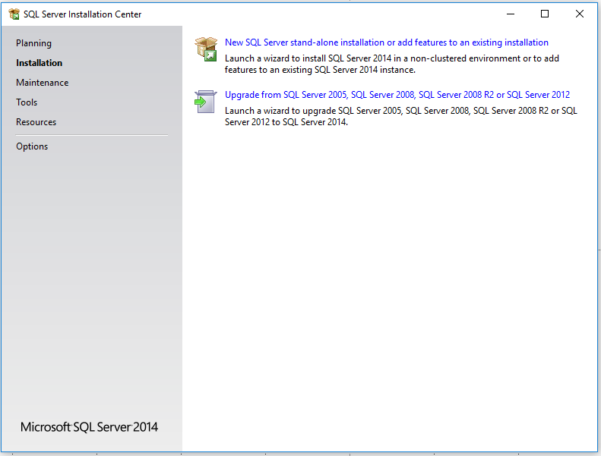
7. Choose a new installation.

Slide 8
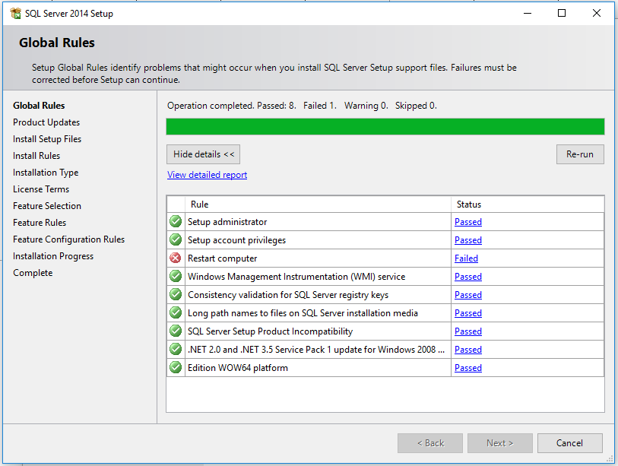
8. Go through the rules check.

Slide 9
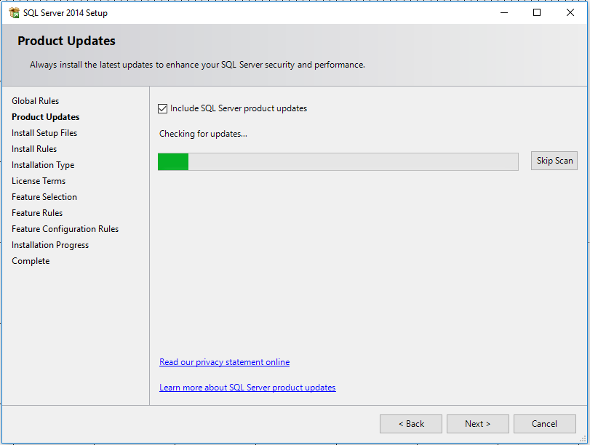
9. Go through the installation process.

Slide 10
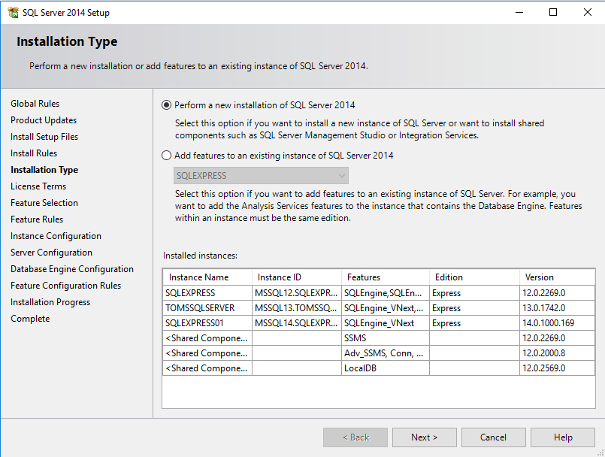
10. Choose new installation.

Slide 11
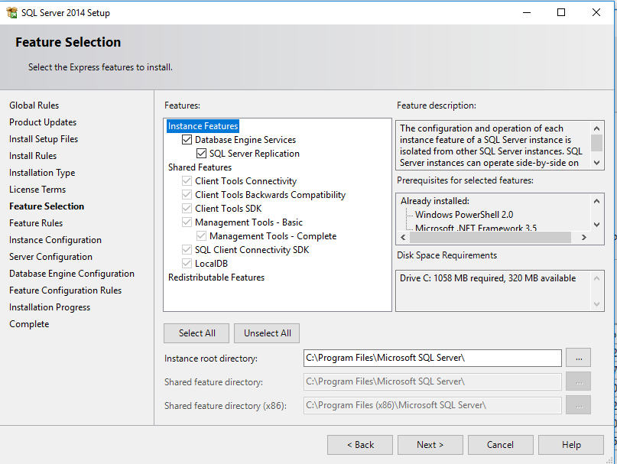
11. Choose the settings shown below.

Slide 12
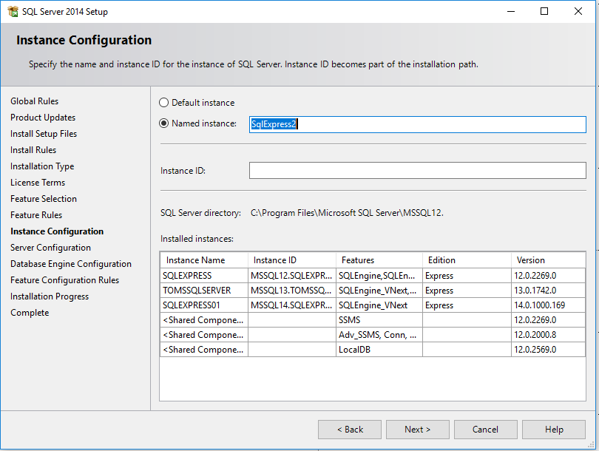
12. Name your installation.

Slide 13
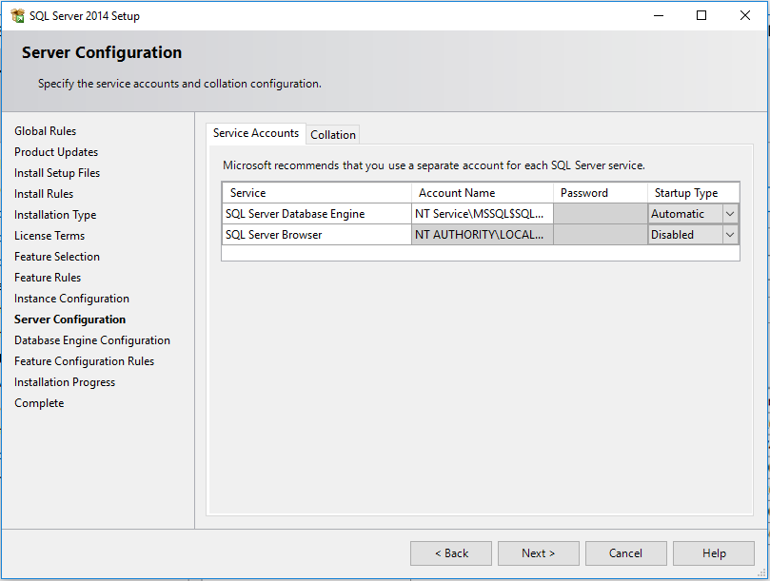
13. Leave the server configuration as shown below.

Slide 14
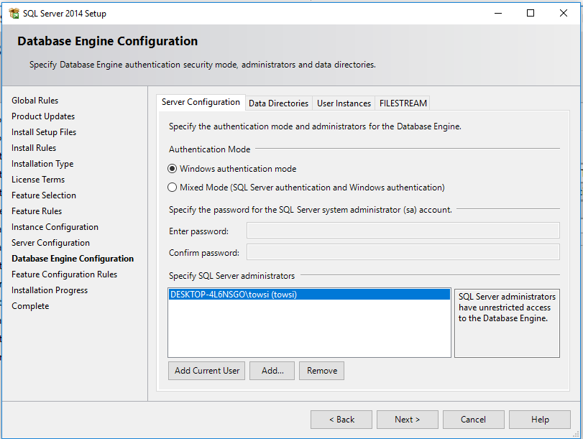
14. Leave it on Windows Authentication Mode.

Slide 15
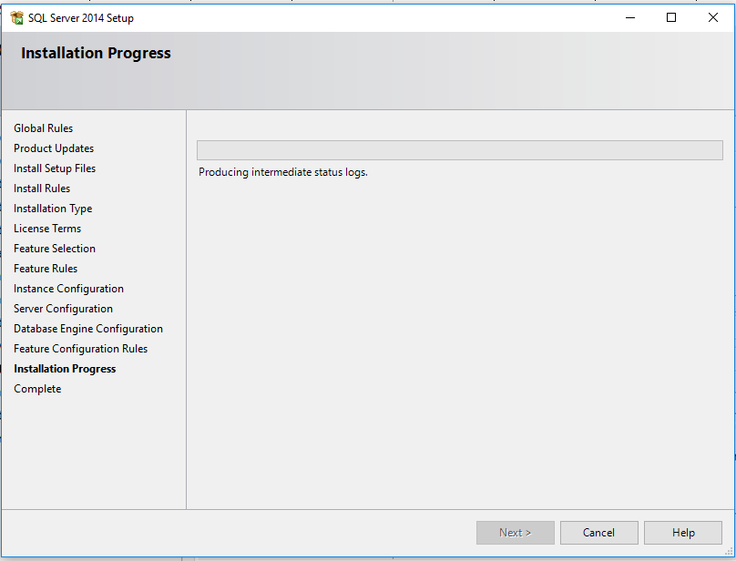
15. Wait for the process of installation to complete.

Slide 16
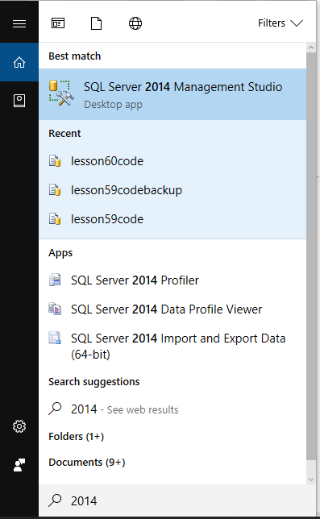
16. Search for 2014 in Windows 10.
Might be a little different for your version of windows.

Slide 17
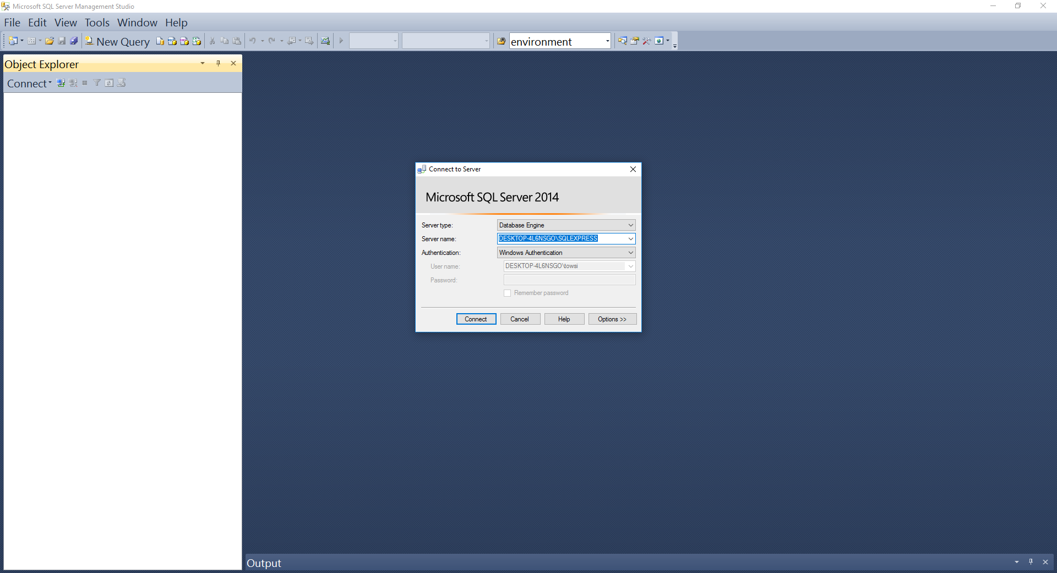
17. Log in using the windows account you’re logged in under.

Slide 18
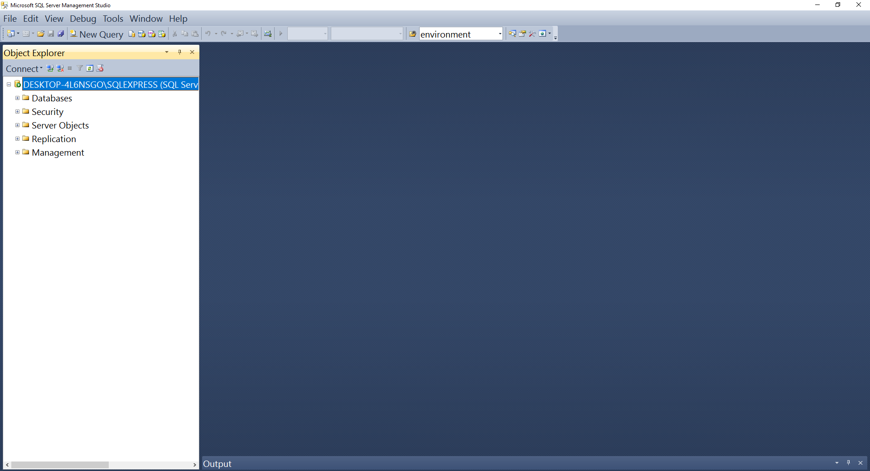
18. Should look as shown below at the end.

