Slide 1
use AdventureWorks2014
go
--select * from Production.Product
--where UPPER(name) in ('BLADE', 'BB BALL BEARING','LL CRANKARM')
--select color, count(color) as Colors from Production.Product
--where upper(color) not in ('BLACK','WHITE')
--group by color

Slide 2
select * from Person.Person
where lower(FirstName) like '__a'
--'%sar'
--'sar%'
--'%pe%'
--'_a%'
--'__a'

Slide 3
--1. In English: for each order id,
-- get max, get the min order qty and show the average
-- price per unit and show that sorted from highest to lowest
select * from Sales.SalesOrderDetail
where SalesOrderID=43659
use AdventureWorks2014
go
select SalesOrderID,
max(OrderQty) as MaxQty,
min(OrderQty) as MinQty,
Format(avg(UnitPrice),'C','en-gb') as AverageUnitPrice
from Sales.SalesOrderDetail
group by SalesOrderID
order by avg(UnitPrice) desc

Slide 4
--1. show the percent each individual order qty. is of the total
-- order quantity, for each order id
use AdventureWorks2014
go
select SalesOrderID,
orderqty,
sum(orderqty) over(partition by salesorderid) as Sum,
Format(cast(orderqty as float)/sum(orderqty)
over(partition by salesorderid),'P') as PercentOfWhole
from sales.SalesOrderDetail

Slide 5
--lesson 39
use AdventureWorks2014
go
select SalesOrderID, productid,
(select color from production.Product as proddetails
where ordetails.productid=proddetails.ProductID) as Color
from Sales.SalesOrderDetail as ordetails

Slide 6
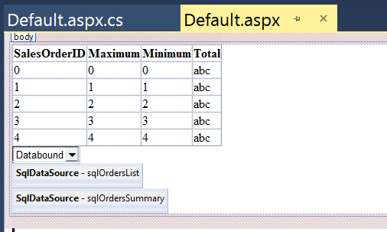
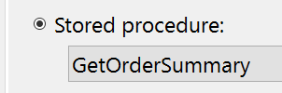
select distinct salesorderid from sales.salesorderdetail
protected void DropDownList1_SelectedIndexChanged(object sender, EventArgs e)
{
sqlOrdersSummary.SelectParameters["SalesOrderID"].DefaultValue =
DropDownList1.SelectedValue;
}

Slide 7
use AdventureWorks2014
go
sp_columns 'Product'
go
create procedure GetByWeight @Weight decimal
as
if @Weight>=0
select * from Production.Product
where Weight>=@Weight
order by weight desc
else
Print 'Must Enter Postive Value For Product ID'
go
GetByWeight @Weight=50
drop procedure GetByWeight
select ProductID from Production.Product

Slide 8
drop procedure SetWeight
go
create procedure SetWeight
@ProductID int,
@Weight decimal
as
if @Weight>=0
update Production.Product
set weight=@weight
where ProductID=@ProductID
else
Print 'No Negative Weights Allowed'

Slide 9
use AdventureWorks2014
go
ALter Procedure Commissions
as
select Format(SalesYTD,'C') as SalesYTD,
"CommisionEarned"=
Case
When SalesYTD<200000
Then Format(SalesYTD*0.1,'C')
When SalesYTD between 200000 and 1000000
Then Format(SalesYTD*0.2,'C')
When SalesYTD>1000000
Then Format(SalesYTD*0.2,'C')
end
from Sales.SalesPerson
go
Commissions

Slide 10
use AdventureWorks2014
go
--1. case/when/then
--2. when SalesYTD<200000, then commission=SalesYTD*.1
--3. when SalesYTD between 200,000 and 1,000,000, then commission=SalesYTD*.2
--4. when SalesYTD >1,000,000, then commission=SalesYTD*.3
select * from Sales.SalesPerson
go
alter procedure Commissions
as
select Format(SalesYTD,'C') as SalesYTD,
"Commission Earned"=
Case
When SalesYTD<200000
Then Format(SalesYTD*0.1,'C’)
When SalesYTD between 200000 and 1000000
Then Format(SalesYTD*0.2,'C’)
When SalesYTD>1000000
Then Format(SalesYTD*0.3,'C')
end
from sales.SalesPerson
Commissions

Slide 11
use mydbase
go
drop table RandomValues
go
create Table RandomValues
(
ID int not null primary key identity(1,1),
Random float
)
DECLARE @counter int
SET @counter = 1;
WHILE @counter <= 25
Begin
insert into RandomValues
values(10*Rand())
set @counter = @counter + 1
End
GO
select * from RandomValues

Slide 12
use AdventureWorks2014
go
drop procedure GetSum
go
create procedure GetSum @total money output
as
set @total=(select sum(LineTotal) from Sales.SalesOrderDetail)
return @total
go
declare @Money money
execute GetSum @total=@Money output
Print 'The amount sold is '+Format(@Money,'C')

Slide 13
--1. local variables
--2. generating random values
--3. begin/end and while
use mydbase
go
drop table RandomValues
create Table RandomValues
(
ID int not null primary key identity(1,1),
Random float
)
declare @loopCounter int
set @loopCounter=1 --4. this condition shoudl reflect your specific need
while @loopCounter<=250 --5. @counter<=250 is a logical condition we have chosen
Begin
insert into RandomValues values(Rand()) --6. generate and save 250 random values
set @loopCounter=@loopCounter+1 --7. needed to grow loop counter value
End
select * from RandomValues
--8. if loopCounter is not incremented, you get an infinite while loop
--9. if begin/end are missing, you get an infinite loop

Slide 14
--1. we had procedures that accepted values through input parameters
--2. we are going instead to return a single value using an output parameter
use AdventureWorks2014
go
drop procedure GetSum
go
create procedure GetSum @total money output
as
--3. find total of linetotal in the table and set it to the @total parameter
--4. after that, return that value to the calling code
set @total=(select sum(LineTotal) from Sales.SalesOrderDetail)
return @total
go
declare @total money
execute GetSum @total output
Print 'Sum of line total '+Format(@total,'C')

Slide 15
--1. using try/catch to create more stable code
--2. never divide by zero because division by zero is not defined
declare @counter decimal=-10
while @counter<=1
begin try
select 1.00/@counter
set @counter=@counter+1
end try
begin catch
select ERROR_MESSAGE() as 'Error Message'
Break--3. helps to pop out of the loop after an error is handled
end catch

Slide 16
use mydbase
go
select SalesAmount, date ,
lag(salesamount,1) over(order by date) as PreviousDaySales,
(SalesAmount-(lag(salesamount) over (order by date))) as Difference,
(SalesAmount-(lag(salesamount) over (order by date)))/(lag(SalesAmount) over(order by date))*100 as PercentChange
from Sheet1$

Slide 17
--1. Please pause the video and import the excel file under
-- lesson resources
--2. import the SalesAmount field as a money
--3. Date import as date data type
--4. percent change: (current amount - previous amount )/previous amount
select SalesAmount,
lag(SalesAmount) over(order by date) As PreviousDaylSales,
(SalesAmount-(lag(SalesAmount) over(order by date))) as Difference,
(SalesAmount-(lag(SalesAmount) over(order by date)))/(lag(SalesAmount) over(order by date))*100
as PercentChange
from Sheet1$

Slide 18
use AdventureWorks2014
go
With SalesOrderSummary (SalesOrderID, TotalQuantity, TotalSales)
as
(
select SalesOrderID,
Sum(OrderQty) as TotalQuantity,
Sum(LineTotal) as TotalSales
from Sales.SalesOrderDetail
group by SalesOrderID
)
select SalesOrderID,
TotalQuantity,
TotalSales
from SalesOrderSummary
where TotalSales>=50000

Slide 19
--1. common table expressions
use AdventureWorks2014
go
--2. define the common table expression
--3. this table expression can be queried like a regular table
--3. be sure to highlight everything, including the query down below the CTE
--4. when running this code
With SalesOrderSummary (SalesOrderID, TotalQuantity, TotalSales)
as
(
Select SalesOrderID,
Sum(OrderQty) as TotalQuantity,
Sum(LineTotal) as TotalSales
from Sales.SalesOrderDetail
group by SalesOrderID
)
Select SalesOrderID,
TotalQuantity,
Format(TotalSales,'C')
from SalesOrderSummary
where SalesOrderID=43659

Slide 20
use AdventureWorks2014
go
With SalesSummary (SalesOrderID, TotalSales)
As
(
select SalesOrderID,
Sum(LineTotal) as TotalSales
from Sales.SalesOrderDetail
group by SalesOrderID
)
select SalesOrderID,
Format(TotalSales, 'C') as CurrentAmount,
Format(lead(TotalSales) over (order by SalesOrderID), 'C') as NextAmount,
TotalSales-(lead(TotalSales) over (order by SalesOrderID)) as Difference
from SalesSummary

Slide 21
use AdventureWorks2014
go
--1. comparing sales from order to order
With SalesSummary (SalesOrderID, TotalSales)
As
(
--2. sum the line total by the order id
select SalesOrderID, Sum(LineTotal) as TotalSales
from Sales.SalesOrderDetail
group by SalesOrderID
)
--3. without formatting of NextAmount and Difference
select SalesOrderID ,
Format(TotalSales,'C') as CurrentAmount,
(lead(TotalSales) over(order by SalesOrderID)) as NextAmount,
TotalSales-(lead(TotalSales) over(order by SalesOrderID)) as Difference
from SalesSummary

Slide 22
use AdventureWorks2014
go
--1. comparing sales from order to order
With SalesSummary (SalesOrderID, TotalSales)
As
(
--2. sum the line total by the order id
select SalesOrderID, Sum(LineTotal) as TotalSales
from Sales.SalesOrderDetail
group by SalesOrderID
)
--3. without formatting of NextAmount and Difference
select SalesOrderID ,
Format(TotalSales,'C') as CurrentAmount,
(lead(TotalSales) over(order by SalesOrderID)) as NextAmount,
TotalSales-(lead(TotalSales) over(order by SalesOrderID)) as Difference
from SalesSummary

Slide 23
use AdventureWorks2014
go
--1. comparing sales from order to order
With SalesSummary (SalesOrderID, TotalSales)
As
(
--2. sum the line total by the order id
select SalesOrderID, Sum(LineTotal) as TotalSales
from Sales.SalesOrderDetail
group by SalesOrderID
)
--3. With formatting of NextAmount and Difference
select
SalesOrderID ,
Format(TotalSales,'C') as CurrentAmount,
Format((lead(TotalSales) over(order by SalesOrderID)),'C') as NextAmount,
Format(TotalSales-(lead(TotalSales) over(order by SalesOrderID)),'C') as Difference
from SalesSummary

Slide 24
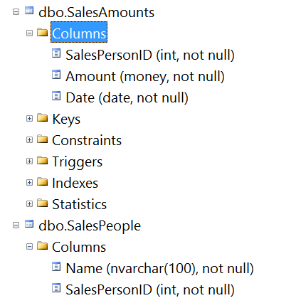
use mydbase
go
BULK INSERT SalesPeople
FROM 'C:\Data\SalesPeople.csv'
WITH
(
FIRSTROW=2,
FIELDTERMINATOR =',',
ROWTERMINATOR ='\n'
)
BULK INSERT SalesAmounts
FROM 'C:\Data\SalesAmounts.csv'
WITH
(
FIRSTROW=2,
FIELDTERMINATOR =',',
ROWTERMINATOR ='\n'
)
With JoinCTE(Name, SalesAmount)
As
(
Select Name,
Sum(Amount) as TotalSales
from
SalesPeople as s inner join SalesAmounts as a on s.SalesPersonID=a.SalesPersonID
group by Name
)
select * from JoinCTE

Slide 25
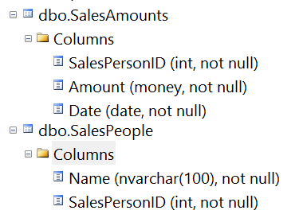
--1. importing CSV (comma separated files)
--2. joining them in a common table expression
--3. selecting records from the common table expression
--4. drop table SalesAmounts, SalesPeople
bulk insert SalesPeople
from 'C:\Data\SalesPeople.csv'
with
(
FIRSTROW=2,
FIELDTERMINATOR=',',
ROWTERMINATOR='\n'
)
select * from SalesPeople
bulk insert SalesAmounts
from 'C:\Data\SalesAmounts.csv'
with
(
FIRSTROW=2,
FIELDTERMINATOR=',',
ROWTERMINATOR='\n’
)
select * from SalesAmounts;
With JoinCTE (Name,SalesAmount)
As
(
Select Name, Sum(Amount) as TotalSales
from
SalesPeople as s inner join SalesAmounts as a on s.SalesPersonID=a.SalesPersonID
group by Name
)
select * from JoinCTE

Slide 26
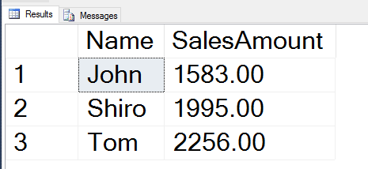
--1. importing CSV (comma separated files)
--2. joining them in a common table expression
--3. selecting records from the common table expression
--4. drop table SalesAmounts, SalesPeople
bulk insert SalesPeople
from 'C:\Data\SalesPeople.csv'
with
(
FIRSTROW=2,
FIELDTERMINATOR=',',
ROWTERMINATOR='\n'
)
select * from SalesPeople
bulk insert SalesAmounts
from 'C:\Data\SalesAmounts.csv'
with
(
FIRSTROW=2,
FIELDTERMINATOR=',',
ROWTERMINATOR='\n’
)
select * from SalesAmounts;
With JoinCTE (Name,SalesAmount)
As
(
Select Name, Sum(Amount) as TotalSales
from
SalesPeople as s inner join SalesAmounts as a on s.SalesPersonID=a.SalesPersonID
group by Name
)
select * from JoinCTE
These are the values after the first bulk insert. if you do bulk insert without clearing the tables, the values will be bigger.

Slide 27
--1. pivoting tables
--2. taking a column and turning it into a row
--3. 1
--4. 2
--5. 3
--6. 1 2 3
use AdventureWorks2014
go
select 'TitleCount' as 'Title Count', [Mr.],[Ms.]
from
(select Title from Person.Person) as SourceTable
Pivot
(
Count(Title) for Title in ([Mr.],[Ms.])
) As PivotTable

Slide 28
use AdventureWorks2014
go
create function ufnTotalAmount(@OrderID int) returns money
as
begin
declare @TotalMoney money
select @TotalMoney=sum(LineTotal)
from Sales.SalesOrderDetail
where SalesOrderID=@OrderID
return @TotalMoney
end
go
Print 'Order Total '+Format(dbo.ufnTotalAmount(43659),'C')
drop function dbo.ufnTotalAmount

Slide 29
--1. user defined functions allow us to create reusuable blocks
--of code
--2. scalar valued functions return one quantity as a result of
-- of their operations
use AdventureWorks2014
go
--3. create a function that returns the line total for an order id
--4. call function with order id, order id value goes into the body
--5. of the function, which uses it and then returns the sum
--6. for that order id back to the calling line
create function ufnTotalOrderAmount(@OrderID int) returns money
as
begin
declare @TotalOrderAmount money
select @TotalOrderAmount=sum(LineTotal)
from Sales.SalesOrderDetail
where SalesOrderID=@OrderID
return @TotalOrderAmount
end
go
Print 'Total Order Amount '+Format(dbo.ufnTotalOrderAmount(43659),'C')

Slide 30
use AdventureWorks2014
go
create function GetProductDetails(@ProductID int)
returns @ProductDetails table (Name name, Color nvarchar, ListPrice money)
as
begin
declare @Name name, @Color nvarchar, @ListPrice money
select @Name=name, @Color=color, @ListPrice=ListPrice
from Production.Product
where ProductID=@ProductID
begin
insert @ProductDetails
select @Name, @Color, @ListPrice
end
return
end
go
select ProductID, Name,Color from dbo.GetProductDetails(2)
drop function dbo.GetProductDetails

Slide 31
--1. returning entire tables from calling functions
--2. table-valued function
use AdventureWorks2014
go
create function GetProductDetails(@ProductID int)
returns @ProductDetails table (Name Name,Color nvarchar,ListPrice money)
as
begin
declare @Name name, @Color nvarchar, @ListPrice money
select @Name=name, @Color=color, @ListPrice=ListPrice
from Production.Product
where ProductID=@ProductID
insert @ProductDetails select @Name, @Color, @ListPrice
return
end
go
select name,Color from GetProductDetails(2)
drop function GetProductDetails

Slide 32
use mydbase
go
declare @TableVar table(id int, Date date)
declare @ID int =1
while @ID<=1000
begin
insert into @TableVar values (@ID, Convert(datetime, RAND()*50000))
set @ID=@ID+1
end
select * into TomasTable from @TableVar
where (Year(Date) between 1950 and 2017)
drop table TomasTable
select * from TomasTable

Slide 33
use mydbase
go
--1. table variables
declare @TableVar table(ID int, Date date)
declare @ID int=1
while @ID<=1000
begin
insert into @TableVar values(@ID,Convert(datetime,Rand()*50000))
set @ID=@ID+1
end
select * into PermaTable from @TableVar
where (Year(Date) between 1950 and 2017)
--drop table PermaTable
select * from PermaTable

Slide 34
using System;
using System.Data;
using System.Data.SqlClient;
using System.Linq;
public partial class _Default : System.Web.UI.Page
{
string connString = @"Data Source=DESKTOP-4L6NSGO\SQLEXPRESS;
Initial Catalog=AdventureWorks2014;Integrated Security=True;
Connect Timeout=15;Encrypt=False;TrustServerCertificate=True;
ApplicationIntent=ReadWrite;MultiSubnetFailover=False";
protected void Button1_Click(object sender, EventArgs e)
{
using (SqlConnection conn = new SqlConnection(connString))
{
SqlCommand comm = new SqlCommand("Select SalesYTD From Sales.SalesPerson", conn);
SqlDataAdapter adapter = new SqlDataAdapter(comm);
DataTable dt = new DataTable();
adapter.Fill(dt);
var totalYTDSales = dt.AsEnumerable().Sum(row => row.Field<decimal>("SalesYTD"));
lblTotalYTDSales.Text = string.Format("Total Year To Date Sales: {0:C}", totalYTDSales);
}
}
}

Slide 35
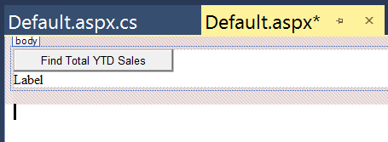
<%@ Page Language="C#" AutoEventWireup="true" CodeFile="Default.aspx.cs" Inherits="_Default" %>
<!DOCTYPE html>
<html xmlns="http://www.w3.org/1999/xhtml">
<head runat="server">
<title></title>
</head>
<body>
<form id="form1" runat="server">
<div>
<asp:Button ID="Button1" runat="server" Text="Find Total YTD Sales" OnClick="Button1_Click" /><br />
<asp:Label ID="lblTotalYTDSales" runat="server" Text="Label"></asp:Label>
</div>
</form>
</body>
</html>

Slide 36
use AdventureWorks2014
go
if OBJECT_ID('EmployeeDetails') is not null
drop view EmployeeDetails
go
create view EmployeeDetails
as
select HireDate,
"Bonus"=(case when DATEDIFF(YEAR, HireDate,GETDATE())>=8 then 'Yes' else 'No' end)
from HumanResources.Employee
go
select * from EmployeeDetails

Slide 37
--1. creating views with scripts
use AdventureWorks2014
go
if OBJECT_ID("EmployeeDetails") is not null
drop view EmployeeDetails
go
create view EmployeeDetails
as
select HireDate,
"Bonus"=(case
when DATEDIFF(YEAR, HireDate,GETDATE())>=8
then 'Yes’
else 'No’
)
from HumanResources.Employee
go
select * from EmployeeDetails

Slide 38
--1. triggers allow taking actions after an update, delete
--or an insert
use mydbase
go
sp_columns 'SalesAmounts'
alter table SalesAmounts
add ID int primary key identity(1,1)
select * from SalesAmounts
go
if OBJECT_ID('OnDeleteUpdateInsert') is not null
drop trigger OnDeleteUpdateInsert
go
create trigger OnDeleteUpdateInsert on SalesAmounts
after update, delete, insert
as
if OBJECT_ID('SalesAmountsTemp') is not null
drop table SalesAmountsTemp
select * into SalesAmountsTemp from SalesAmounts
update SalesAmounts
set Amount=6787
where id=5

Slide 39
--1. a transaction is a unit of work
--2. transactions help to ensure database consistency
--3. prevent existence of partial/inconsistent data
use mydbase
go
drop table temp
create table temp (id int, value float)
declare @InsertTransact varchar='Insert Transaction'
declare @counter int=1
while @counter<=100
begin
begin transaction @InsertTransact
insert into temp values (@counter, Rand()*1000)
select @@TRANCOUNT as 'Transaction Count'
commit transaction
set @counter=@counter+1
end
go
select * from temp
select @@TRANCOUNT as transactioncount

Slide 40
use mydbase
go
--1. save points and rolling back transactions
drop table temp
create table temp (id int, value float)
begin transaction
insert into temp values(1,'')
select * from temp
save transaction SavePoint
update temp
set value=Rand()
where id=1
select * from temp
rollback transaction SavePoint
select * from temp

Slide 41
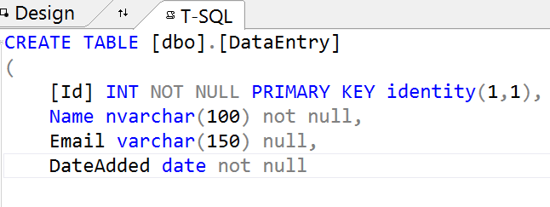
CREATE PROCEDURE [dbo].[InsertProc]
@Name nvarchar(100),
@Email varchar(320),
@DateSaved date
AS
begin
begin transaction
begin try
insert into DataEntry (Name, Email, DateAdded) values ( @Name, @Email, @DateSaved)
end try
begin catch
select ERROR_MESSAGE()
if @@TRANCOUNT>0
rollback transaction
end catch
if @@TRANCOUNT>0
commit transaction
end
InsertProc @Name='John Smith', @Email='johnsmith@gmail.com', @DateSaved='10/31/2017'
select * from DataEntry

Slide 42
--drop procedure InsertProc
--go
CREATE PROCEDURE [dbo].[InsertProc]
@Name nvarchar(100),
@Email varchar(150),
@DateSaved date
AS
begin
begin transaction
begin try
insert into PersonTable (Name, Email, DateAdded) values (@Name, @Email, @DateSaved)
end try
begin catch
select ERROR_MESSAGE()
rollback transaction
end catch
if @@TRANCOUNT>0
commit transaction
end
go
InsertProc @Name='John', @Email='john@gmail.com', @DateSaved='10/31/2017'
select * from PersonTable

Slide 43
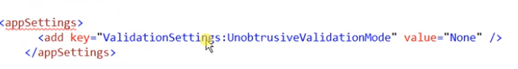
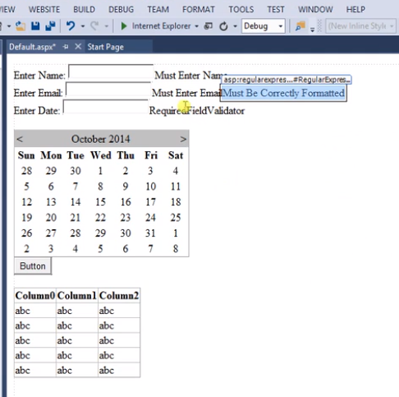


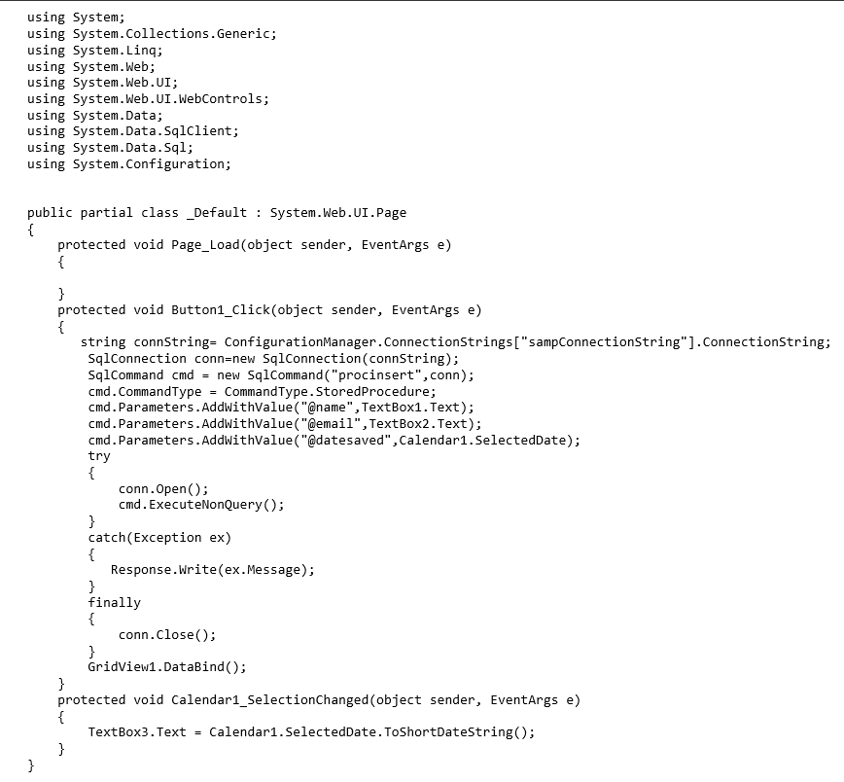


Slide 45
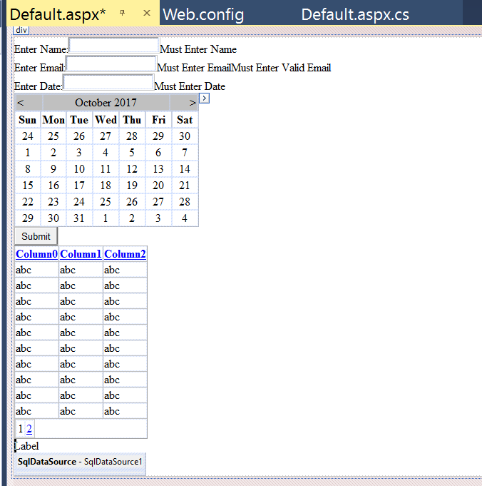
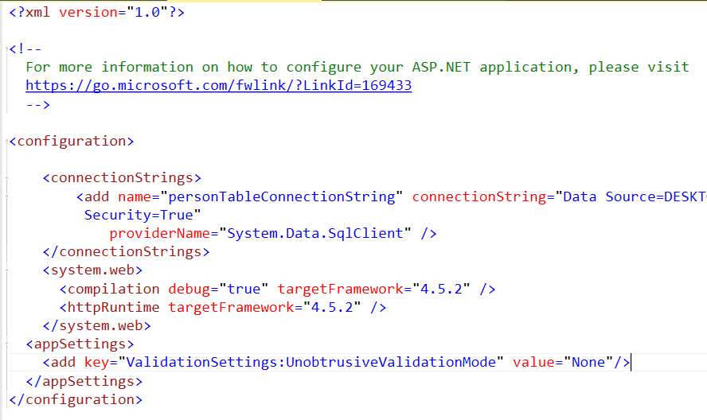

Slide 46
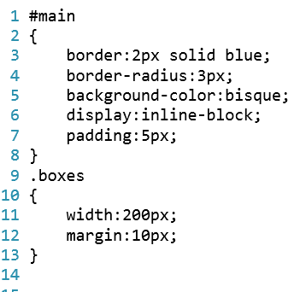
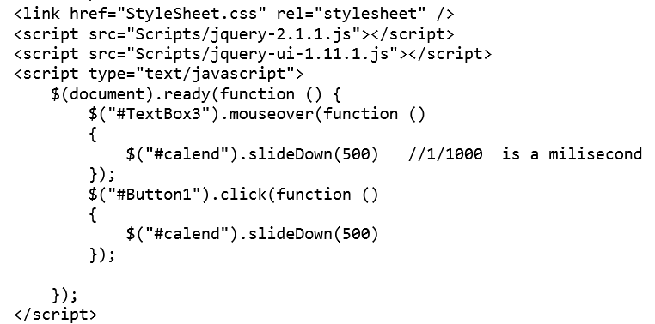
txtDate.Text = txtEmail.Text = txtName.Text = "";

Slide 47
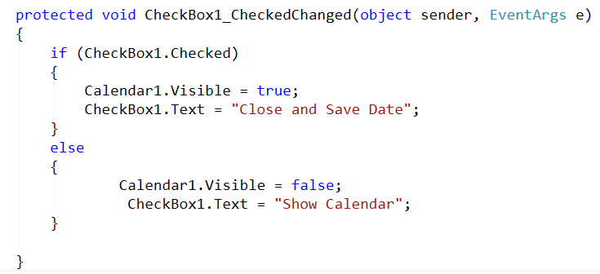

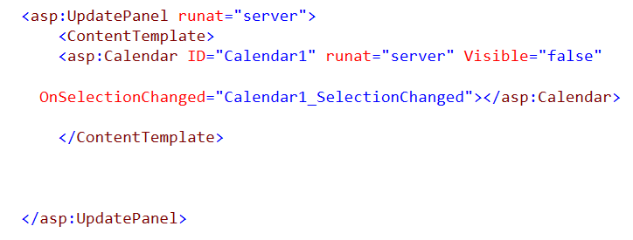
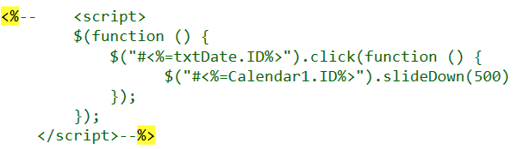

Slide 48
Turn windows features on/off
Add IIS
Make sure all the important parts are selected
Create a new website
Copy the existing site to an easy to use folder on c drive
Add a log in to SQL Server
7. Open hosts file in notepad in administrator mode and add
127.0.0.1 mapped to dataentry.home
8. Set permissions on the stored procedure to be sure it can be executed by the site under IIS APPPOOL\dataentry

Slide 49
add database role under admin account
call it: InsertCustomersSelectEmployees
Add two now log ins
Map logins to users and to database role
log in under one login
open new editor window
show which table can be inserted into
show which table can be selected from but not inserted into

Slide 50
Backup
Database->Tasks->Backup
Database->Tasks->Restore
Take Offline/Put online
Database-> Tasks->Take Offline
Database->Tasks->Bring Online
3. Query SQL Server from Excel
1. Get connection string from Server
2. In Excel, go to Data and choose SQL Server as data source

Slide 51
Server Objects-> Backup Devices
Show how to use new backup device
Show different restore from name of mydbase directly
Show how to open the SQL Server log
Show how information is updated in the log when an event occurs

Slide 52
Stage 1:
1. Make folder for site on c drive c:\dashboard
2. Make a site using it on IIS
3. Add entry to hosts file: 127.0.0.1 dashboard (launch note pad in admin mode)
4. Launch VS in admin mode and make HTTP site on IIS Server
5. Add basic ASP.NET web page
Stage 2:
5. Add table to sql server named Employees in MyDbase
6. Add details view to plain ASP.NET web page, clear the settings on it for width/height
7. Add connection to sql server to EmployeesTable
8. Add login to SQL Server for APPPOOL\dashboard
Stage 3:
Add style sheet
Add jquery with drag, drop, save to local storage
.DashboardElement
{
border:1px solid red;
border-radius:5px;
background-color:bisque;
padding:5px;
font-family:Arial;
}
<script>
$("#main").draggable()
var topLeft = JSON.parse(localStorage.getItem('div'))
$("#main").css(topLeft)
$(window).on('beforeunload', function () {
var pos = $("#main").position()
localStorage.setItem('div', JSON.stringify(pos))
});
</script>

Slide 53
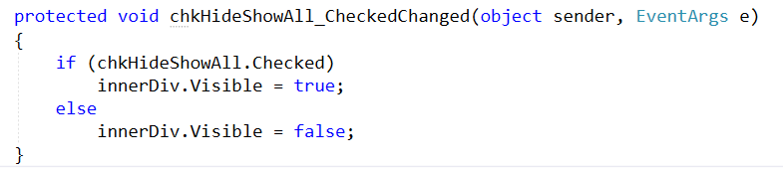
Stage 4:
1. Add header div with checkbox to element
2. Add C# code to operate the checkbox
3.

Slide 54
<%@ Page Language="C#" AutoEventWireup="true" CodeFile="Default.aspx.cs" Inherits="_Default" %>
<!DOCTYPE html>
<html xmlns="http://www.w3.org/1999/xhtml">
<head runat="server">
<title></title>
<script src="Scripts/jquery-1.12.4.js"></script>
<script src="Scripts/jquery-ui-1.12.1.min.js"></script>
</head>
<body>
<form id="form1" runat="server">
<div class="Element" style="border:1px solid red;
background-color:bisque;
display:inline-block;
padding:1px;
border-radius:5px;
position:absolute;">
hello world
</div>
<asp:Button runat="server" Text="Save" ID="btnSave" />
<script>
$(function () {
$(".Element").draggable();
$("#<%=btnSave.ID%>").click(
function () {
var pos = $("#Element").position()
localStorage.setItem('div', JSON.stringify(pos))
});
var xy = JSON.parse(localStorage.getItem('div'));
$(".Element").css(xy);
//$(window).unload(function ()
//{
// var pos = $(".Element").position()
// localStorage.setItem('div', JSON.stringify(pos))
//});
});
</script>
</form>
</body>
</html>
website 12

Slide 55
Add jQuery UI referenece to top of file
add position: style="position:absolute">
Add jQuery code to bottom of page
<script>
$(function () {
$("#main").draggable()
var topLeft = JSON.parse(localStorage.getItem('div'))
$("#main").css(topLeft)
$(window).on('beforeunload', function ()
{
var pos = $("#main").position()
localStorage.setItem('div', JSON.stringify(pos))
});
});
</script>
4. Talk about fixing up the email field in the grid view
5. Copy site to dataentry.home

Slide 56
Name: ____________
Date:______________
Find the domain of f(x)=ln(4-x).
Show the domain on a number line.
Express the domain using interval notation.

Slide 57
create table SalesTable
(
ID int identity(1,1) primary key,
EmpID int,
DateSold date,
MonthOnly varchar(20),
Amount money
)
declare EmpIDCursor cursor for (select EmpID from EmployeesTable)
declare @InnerCounter int=1
declare @EmpID int
open EmpIDCursor
fetch next from EmpIDCursor into @EmpID
while @@FETCH_STATUS=0
begin
while @InnerCounter<=30
begin
insert into SalesTable(EmpID, DateSold, MonthOnly, Amount)
Values(@EmpID,
GetDate()+@InnerCounter,
DateName(Month,GetDate()+@InnerCounter),
Rand()*10000)
set @InnerCounter=@InnerCounter+1
end
set @InnerCounter=1
fetch next from EmpIDCursor into @EmpID
end
close EmpIDCursor
deallocate EmpIDCursor
select * from SalesTable

Slide 58
1. add trigger to run after insert into EmployeesTable
USE [mydbase]
GO
/****** Object: Trigger [dbo].[UpdateSalesTable] Script Date: 11/13/2017 10:30:40 PM ******/
SET ANSI_NULLS ON
GO
SET QUOTED_IDENTIFIER ON
GO
ALTER Trigger [dbo].[UpdateSalesTable]
on [dbo].[EmployeesTable] after insert
as
declare @EmpID int=(select max(EmpID) from EmployeesTable)
declare @Counter int=0
while @Counter<=10
begin
insert into SalesTable(EmpID,DateSold,MonthOnly, Amount)
values(@EmpID,
GetDate()+@Counter,
Datename(Month,GetDate()+@Counter),
Rand()*10000)
set @Counter=@Counter+1
end

Slide 59
Add a foreign key constraint to SalesTable
Runs when EmployeesTable has records deleted
ALTER TABLE SalesTable
ADD CONSTRAINT FK_EMPID FOREIGN KEY (EMPID)
REFERENCES EmployeesTable (EMPID)
ON DELETE CASCADE
GO

Slide 60
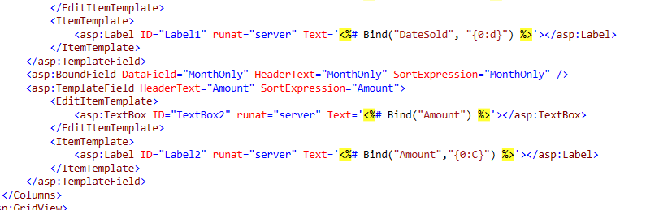
Add gridview within panel
Add new data source
Configure data source to use details view so it’s synchronized
make sure gridview data source has all features enabled
convert data and money into template fields
add formatting to the source code this time

Slide 61
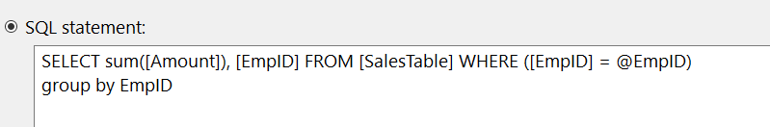
Make Dataview update the gridview under it on deletion
protected void dvEmployees_ItemDeleted(object sender, DetailsViewDeletedEventArgs e)
{
GridView1.DataBind();
}
2. add a new grid view
3. make summary grid view connect using the code below
4. click on grid view and add code as shown to make sure gridview 2 is data bound
protected void GridView1_DataBound(object sender, EventArgs e)
{
GridView2.DataBind();
}

Slide 62
Add an asp dropdown list above div with content
<asp:DropDownList ID="ThemeList" runat="server" AutoPostBack="True">
<asp:ListItem>Azure</asp:ListItem>
<asp:ListItem>Bisque</asp:ListItem>
</asp:DropDownList>
$("#dvDiv").draggable()
$(window).on('beforeunload', function () {
var pos = $("#dvDiv").position()
var color=$("#ThemeList Option:Selected").text()
localStorage.setItem('dvDiv', JSON.stringify(pos))
localStorage.setItem('dvDivColor', color)
});
var topLeft = JSON.parse(localStorage.getItem('dvDiv'))
var backColor = localStorage.getItem('dvDivColor')
$("#ThemeList").val(backColor)
$("#dvDiv").css(topLeft)
$("#dvDiv").css("background-color", backColor)

Slide 63
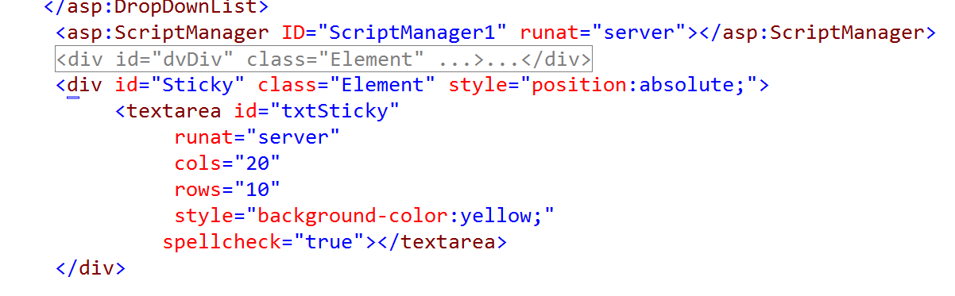
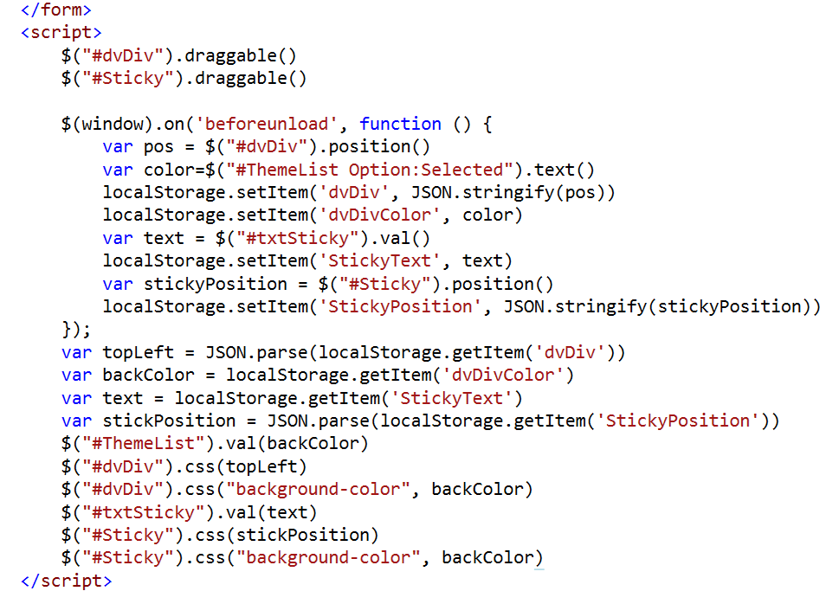

Slide 64
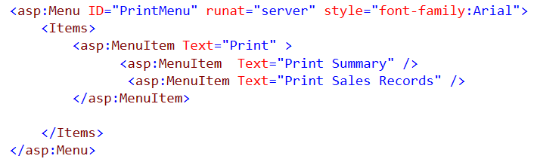
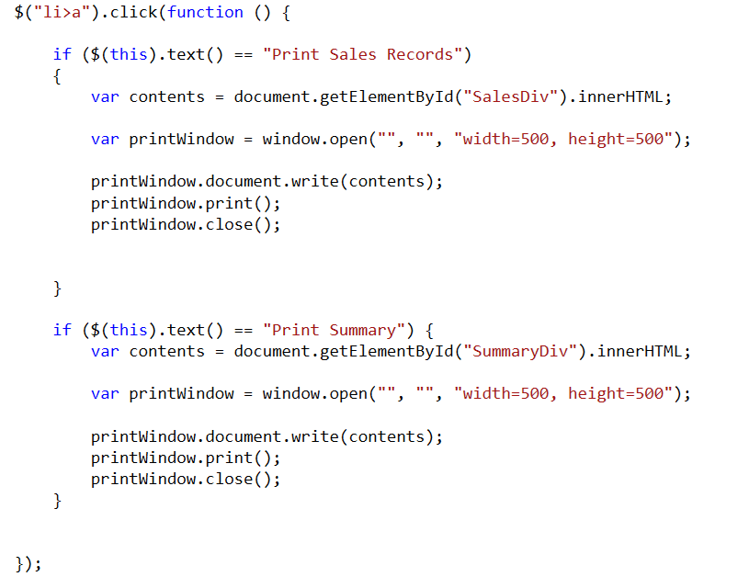
1. Add menu items
2. Wrap grid vies in divs with ID’s: SummaryDiv, SalesDiv
3. Add print code

Slide 65
Add new page named Login.aspx
Add Login control to Login.aspx
Add a group summary validator under login control
Add jQuery validation to web.config
Add folder named MemberPages
pug mainspx in this folder
wrap content of main aspx in a loginview
make sure the content is under logged in template
add a loginname and login status to loginview also

