Slide 1
Weekly Sales Report 09/05/16
Author: Alex, alex@innova8

Slide 2
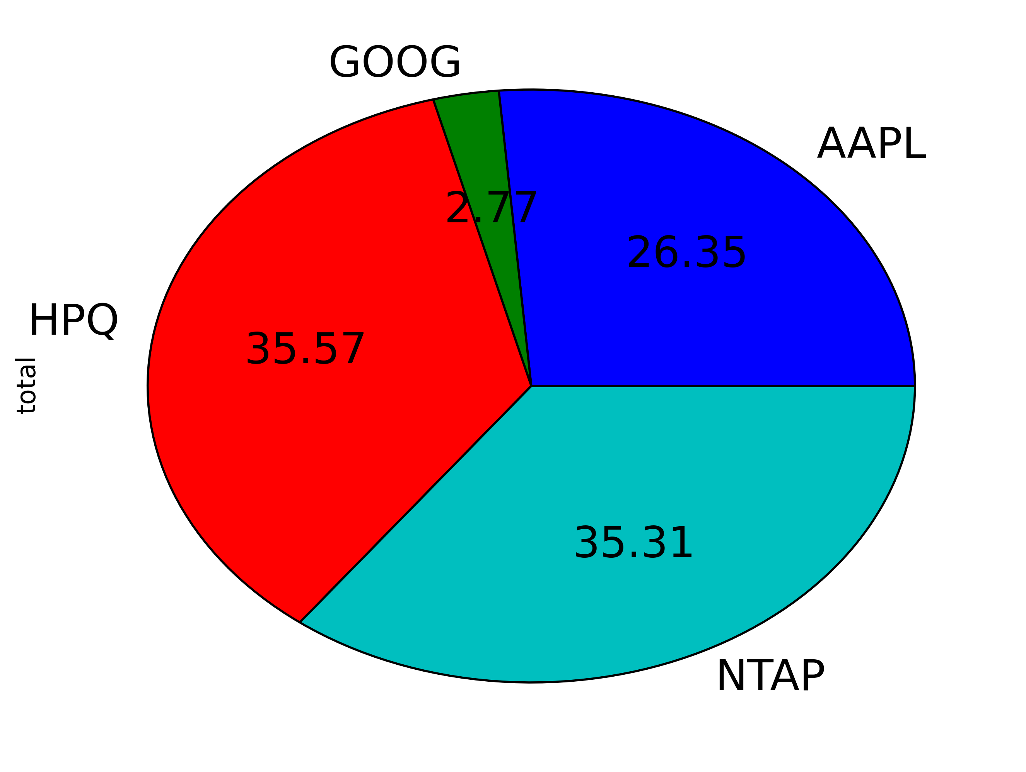
% Revenue for Accounts

Slide 3
Sales Manager Performance

