Slide 2






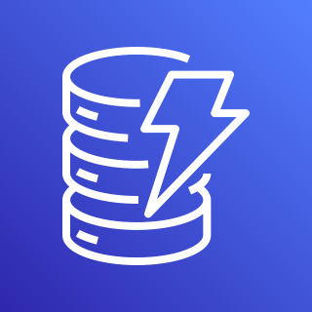
AWS Cloud
Region
VPC
Amazon Simple Storage Service (Amazon S3)
Instance
Endpoints
Amazon DynamoDB

