Slide 2



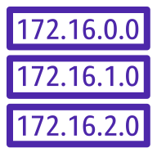
AWS Region us-east-1
VPC
/16 - CIDR
Availability Zone 1
Availability Zone 2
Public subnet
Public subnet
Application Load Balancer
/24
172.16.3.0/24
/24
172.16.4.0/24
Private subnet
Private subnet

