Slide 1
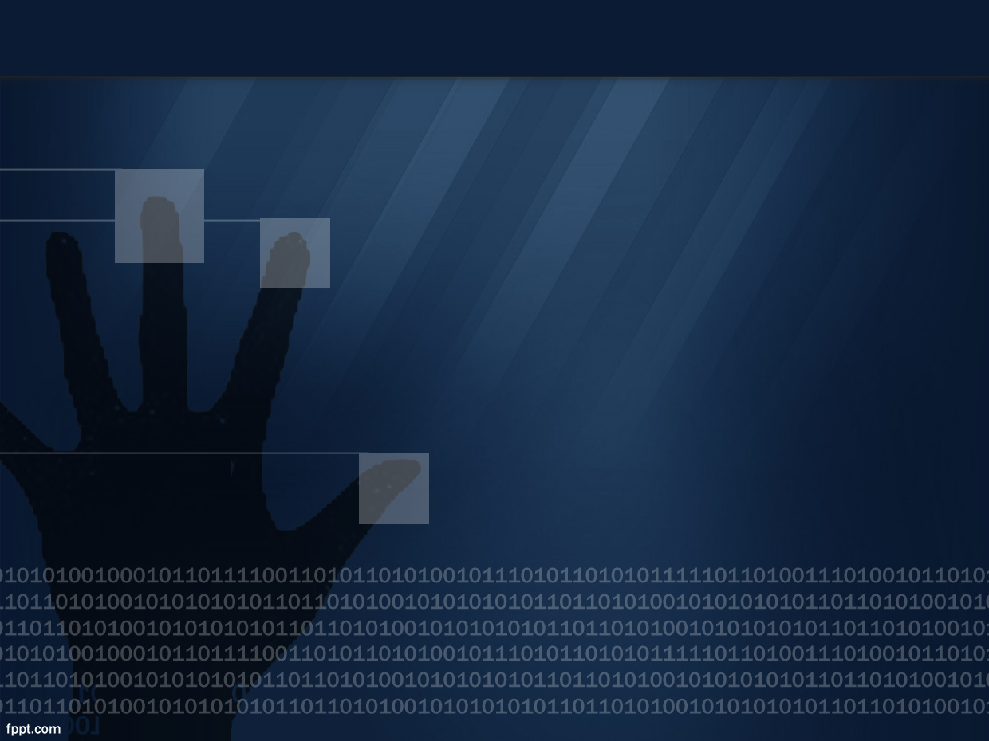
BIOMETRICS

Slide 2

What is Biometrics?
A security mechanism used to authenticate and provide access based on the verification of physical characteristics.
‘Everyone is unique’

Slide 3
Biometric Identifiers
Physiological Characteristics - The shape or composition of the body.
Behavioral Characteristics - The behavior of a person.

Slide 4
Physiological Characteristics
Fingerprints
DNA
Retina
Face
Hand

Slide 5
Behavioral Characteristics
Voice
Gestures
Gait

Slide 6
Biometrics
A database that stores the biometric data for comparison.
Accuracy has improved and cost reduced over time
Becoming increasingly common

