Slide 1
Data Scraping from
Beginner to Professional
Hands on data scraping course including in demand industry skills
Muhammad Ahmad

Slide 2
Website: www.aisciences.io

Slide 3

Your Instructor
MUHAMMAD AHMAD
(Cloud and Big Data Engineer)

Slide 4
Data Scraping Applications

Slide 5
Data Scraping Application
For Marketing: Lead Generation
For Businesses / eCommerce
Gathering data from multiple sources for analysis
For Research
Collecting data set for Machine Learning
For building your own website
For providing data to real estate agents
Get user profiles
Build health applications
Build review applications
Translation of documents

Slide 6

Data Scraping Application
For Marketing: Lead Generation
For Businesses / eCommerce
Gathering data from multiple sources for analysis
For Research
Collecting data set for Machine Learning
For building your own website
For providing data to real estate agents
Get user profiles
Build health applications
Build review applications
Translation of documents

Slide 7
Data Scraping Application
For Marketing: Lead Generation
For Businesses / eCommerce
Gathering data from multiple sources for analysis
For Research
Collecting data set for Machine Learning
For building your own website
For providing data to real estate agents
Get user profiles
Build health applications
Build review applications
Translation of documents

Slide 8
Data Scraping Application
For Marketing: Lead Generation
For Businesses / eCommerce
Gathering data from multiple sources for analysis
For Research
Collecting data set for Machine Learning
For building your own website
For providing data to real estate agents
Get user profiles
Build health applications
Build review applications
Translation of documents

Slide 9
Data Scraping Application
For Marketing: Lead Generation
For Businesses / eCommerce
Gathering data from multiple sources for analysis
For Research
Collecting data set for Machine Learning
For building your own website
For providing data to real estate agents
Get user profiles
Build health applications
Build review applications
Translation of documents

Slide 10
Data Scraping Application
For Marketing: Lead Generation
For Businesses / eCommerce
Gathering data from multiple sources for analysis
For Research
Collecting data set for Machine Learning
For building your own website
For providing data to real estate agents
Get user profiles
Build health applications
Build review applications
Translation of documents

Slide 11
Data Scraping Application
For Marketing: Lead Generation
For Businesses / eCommerce
Gathering data from multiple sources for analysis
For Research
Collecting data set for Machine Learning
For building your own website
For providing data to real estate agents
Get user profiles
Build health applications
Build review applications
Translation of documents

Slide 12
Data Scraping Application
For Marketing: Lead Generation
For Businesses / eCommerce
Gathering data from multiple sources for analysis
For Research
Collecting data set for Machine Learning
For building your own website
For providing data to real estate agents
Get user profiles
Build health applications
Build review applications
Translation of documents

Slide 13
Data Scraping Application
For Marketing: Lead Generation
For Businesses / eCommerce
Gathering data from multiple sources for analysis
For Research
Collecting data set for Machine Learning
For building your own website
For providing data to real estate agents
Get user profiles
Build health applications
Build review applications
Translation of documents

Slide 14
Data Scraping Application
For Marketing: Lead Generation
For Businesses / eCommerce
Gathering data from multiple sources for analysis
For Research
Collecting data set for Machine Learning
For building your own website
For providing data to real estate agents
Get user profiles
Build health applications
Build review applications
Translation of documents

Slide 15
Data Scraping Application
For Marketing: Lead Generation
For Businesses / eCommerce
Gathering data from multiple sources for analysis
For Research
Collecting data set for Machine Learning
For building your own website
For providing data to real estate agents
Get user profiles
Build health applications
Build review applications
Translation of documents

Slide 16
Data Scraping Application
For Marketing: Lead Generation
For Businesses / eCommerce
Gathering data from multiple sources for analysis
For Research
Collecting data set for Machine Learning
For building your own website
For providing data to real estate agents
Get user profiles
Build health applications
Build review applications
Translation of documents

Slide 17
Projects

Slide 18
Methodology

Slide 19
Prerequisites

Slide 20
Prerequisites
Must have basic understanding of HTML.
Must have basic understanding of Programming and Python language.
Also check out other courses on our websites

Slide 21
Website: www.aisciences.io

Slide 22
Data Scraping

Slide 23
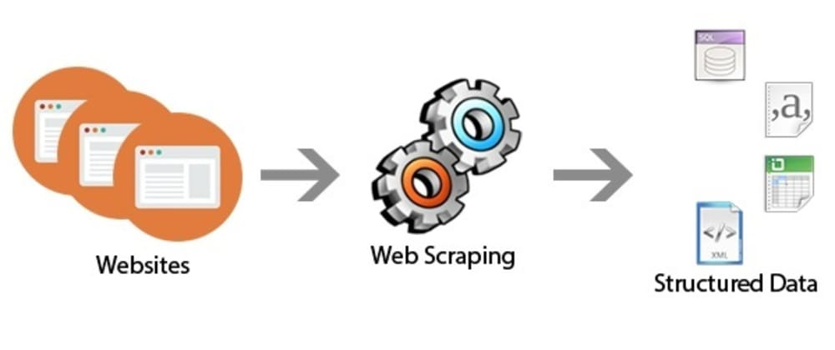
Data scraping Basic understanding
Importing information from a website

Slide 24
Tools

Slide 25
Tools for data scraping
Python Requests Module
Beautiful Soup
Scrapy
Selenium

Slide 26
Python Requests Module

Slide 27
Python Requests Module
Requests is an elegant and simple HTTP library for Python, built for human beings.
Some useful features
Keep-Alive & Connection Pooling
International Domains and URLs
Sessions with Cookie Persistence
Browser-style SSL Verification
Streaming Downloads
Connection Timeouts

Slide 28
Requests Module (Hands on)

Slide 29
Python Requests Module
Getting Started
r = requests.get('https://quotes.toscrape.com/')
r.status_code
r.encoding
r.text

Slide 30
Requests Module (QUIZ)

Slide 31
Python Requests Module
Extract author names of the quotes and save them in a file “Authors.txt”
https://quotes.toscrape.com/

Slide 32
Requests Module (Quiz Solution)

Slide 33
Requests Module (QUIZ)

Slide 34
Python Requests Module
Extract quotes and author names from the website and save them in a csv file named “quotes.csv”
https://quotes.toscrape.com/
e.g:
Albert Einstein, Try not to become a man of success. Rather become a man of value.
André Gide , It is better to be hated for what you are than to be loved for what you are not.

Slide 35
Requests Module (Quiz Solution)

Slide 36
Requests Module (QUIZ)

Slide 37
Python Requests Module
Extract the top 20 super stats from espncricinfo.com
https://www.espncricinfo.com/ci/content/story/genre.html?genre=706

Slide 38
Requests Module (Quiz Solution)

Slide 39
Beautiful Soup

Slide 40
Beautiful Soup Introduction
Beautiful Soup is a Python library for pulling data out of HTML.
Beautiful Soup is a library that makes it easy to scrape information from web pages. It sits atop an HTML or XML parser, providing Pythonic idioms for iterating, searching, and modifying the parse tree.

Slide 41
Beautiful Soup (QUIZ)

Slide 42
Beautiful Soup
What is the major difference between Requests and Beautiful Soup?

Slide 43
Beautiful Soup (Quiz Solution)

Slide 44
Beautiful Soup
Requests is responsible for fetching the data from the internet. BS4 is responsible for parsing and extracting data from the HTML

Slide 45
Beautiful Soup (Hands on)

Slide 46
Beautiful Soup (QUIZ)

Slide 47
Beautiful Soup
Extract the author names of the quotes from the website
https://quotes.toscrape.com/

Slide 48
Beautiful Soup (Quiz Solution)

Slide 49
Beautiful Soup (QUIZ)

Slide 50
Beautiful Soup
Extract the ratting along the name and year of the imdb top 250 movies.
https://www.imdb.com/chart/top/

Slide 51
Beautiful Soup (Quiz Solution)

Slide 52
CSS Selectors

Slide 53
CSS Selectors (Hands on)

Slide 54
CSS Selectors (Quiz)

Slide 55
CSS Selectors (Quiz Solution)

Slide 56
Scrapy

Slide 57
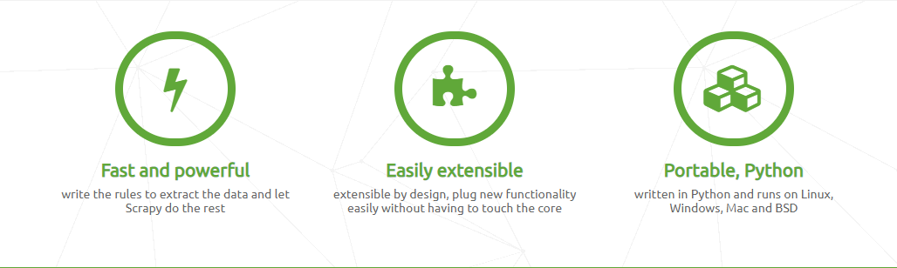
Scrapy
Scrapy is an application framework for crawling web sites and extracting structured data
Why Scrapy

Slide 58
Comparison
Requests VS Scrapy
Requests | Scrapy
Sequential / Synchronous | Parallel / Asynchronous
No parser | Built-in Parser
Suitable for small projects and API | Suitable for small and large projects

Slide 59
Scrapy Documentation

Slide 60
Scrapy Getting Started

Slide 61
Scrapy Hands on

Slide 62
Scrapy (Quiz)

Slide 63
Scrapy
Extract the tags along with the Quotes and Author name

Slide 64
Scrapy (Quiz Solution)

Slide 65
Scrapy (Quiz)

Slide 66
Scrapy
Extract the year from the first page as well and pass it to the next callback

Slide 67
Scrapy (Quiz Solution)

Slide 68
Selenium

Slide 69
Selenium
Selenium is not a data scraping tool.
Selenium is used for automation generally
Selenium is slow as compared to Scrapy

Slide 70
Selenium Getting Started

Slide 71
Selenium Hands on

Slide 72
Selenium (Quiz)

Slide 73
Selenium
Extract the tags besides the author name and quote.

Slide 74
Selenium (Quiz Solution)

Slide 75
Selenium (Quiz)

Slide 76
Selenium
Login the website and extract the quotes from the first page

Slide 77
Selenium (Quiz Solution)

Slide 78
Average Salary 200,000 – 400,000

