Slide 1
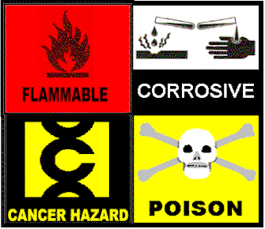
Hazard Communication
Notes:
Hello, welcome to the Hazard Communication training program. This is an OSHA-required training and incorporates the existing Hazard Communication Standard (HCS), 1910.120 as well as information on the new labeling and Safety Data Sheet (SDS) requirements associated with OSHA’s adoption in 2012 of the Globally Harmonized System of Classification and Labeling of Chemicals (GHS).

Slide 2

PROGRAM OVERVIEW
Hazard Communication Standard
Employer Responsibilities
Labels, including new GHS requirements
Safety Data Sheets (MSDS/SDS)
Hazards: non-routine tasks
Contractor Procedures
Notes:
This training on OSHA’s Hazard Communication Standard is intended to provide employees who may be exposed to hazardous chemicals with information on their safe handling, use, storage and disposal. This information is conveyed to employees through container labeling and material safety data sheets.

Slide 3

OSHA
1983 – OSHA established Hazard
Communication Standard (HCS), 1910.1200 (“RIGHT TO KNOW”)
1988 – All employers,
regardless of size, required
to comply
2012 – Globally Harmonized
System (GHS) adopted by OSHA
and incorporated into 1910.1200
Notes:
In 1983, OSHA established the Hazard Communication Standard, requiring employers to provide information to their employees on the safe handling and use of hazardous chemicals to which they may be exposed. It gave employees the “right to know” about the chemicals they were working with and required employers to grant employees access to labeling information and Material Safety Data Sheets (MSDS). Effective in 2012, new changes to the Occupational Safety and Health Administration’s (OSHA) Hazard Communication Standard (1910.1200), are bringing the United States into alignment with the Globally Harmonized System of Classification and Labeling of Chemicals (GHS), further improving safety and health protections for America’s workers.

Slide 4
You are Covered by the Standard
and required to be trained:
OSHA
(Additional information on the OSHA HCS Standard and the GHS can be found at the following links:
http://www.osha.gov/dsg/hazcom/index.html
http://www.orosha.org/pdf/rules/division_2/2Z_1200_haz_com.pdf
Notes:
To facilitate understanding of the new system, the new standard requires that workers be trained by December1, 2013 on the new label elements and safety data sheet format, in addition to the current training requirements. By June 1, 2016, employers must comply with all modified provisions of this final rule including updating workplace labeling and hazard communication programs and provide additional employee training for newly identified physical or health hazards. During the transition period between now and June 1, 2016, the City will comply with both the current standard and the modified/final standard, 29 CFR 1910.1200. After June 1, 2016 the City will comply with the modified/final standard.

Slide 5
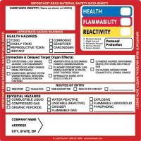
UNDER THE CURRENT HCS, WHAT’S ON A LABEL?
A container label will tell you:
  The identity of the substance
  Any hazard warnings
Many labels also include:
  The manufacturer's or importer’s name,
  address, & emergency phone number
  Storage & handling instructions
  Required PPE
Notes:
Narrate slide.

Slide 6
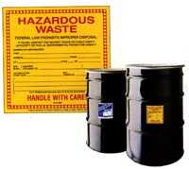
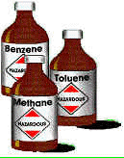
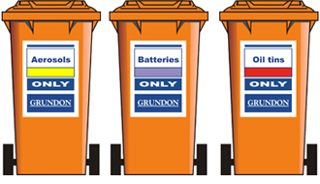
LABEL ISSUES
Labels that are torn, worn,
or damaged may cause harm;
report/replace right away
Is the label missing? Don’t assume
you know what’s inside the container
You must label secondary containers:
  Transfers from original containers
  Label with contents and hazards
  Exception
Don’t cover up any other labels
when adding in-house labels
Notes:
All container labels that are torn, worn, or illegible must be replaced immediately. Vendors or manufacturers can supply replacement labels. Containers of chemicals must be labeled, including secondary containers which contain chemicals transferred from larger containers. There is an exception for portable containers. A portable container is one intended for immediate use, and the hazardous chemical must be under the control of and used only by the person who transfers it from a labeled container and only within the work shift in which it is transferred.

Slide 7
STANDARD LABELS
There are currently many types and styles. Standard labels are usually diamond or rectangular shaped. They have four areas of information:
  Health (blue),
  Flammability (red),
  Reactivity (yellow)
  Special Notice (white)
Hazard Ratings range from 0 – 4,
four being the most hazardous
Notes:
It is important to be aware of the colored hazard identifiers and numerical (0-4) hazard ratings on labels. The higher the number, the greater the hazard.

Slide 8
Health Hazard
Flammability Hazard
3
0
1
Reactivity
Hazard
NFPA Diamond
OX
Hazard Rating
Severe
Serious
Dangerous
Minor
0 Slight
Special Hazard
Notes:
This is an example of one of the most common National Fire Protection Association (NFPA) labels currently found on chemical containers. When fully implemented, these labels will be superseded by the GHS labeling requirements.

